Slide 1


A software module for investigating nonlinear heat transfer processes in rectification columns of packed type
Department of Automation and Control Processes
Speaker: graduate student Serditov Juriy

Slide 2
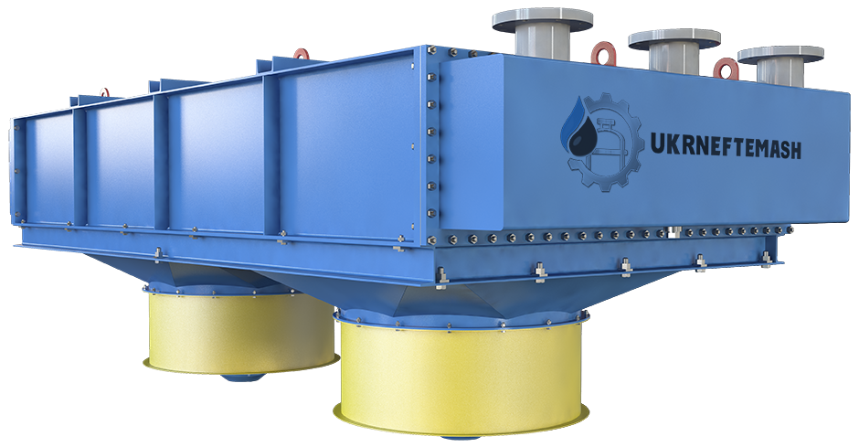
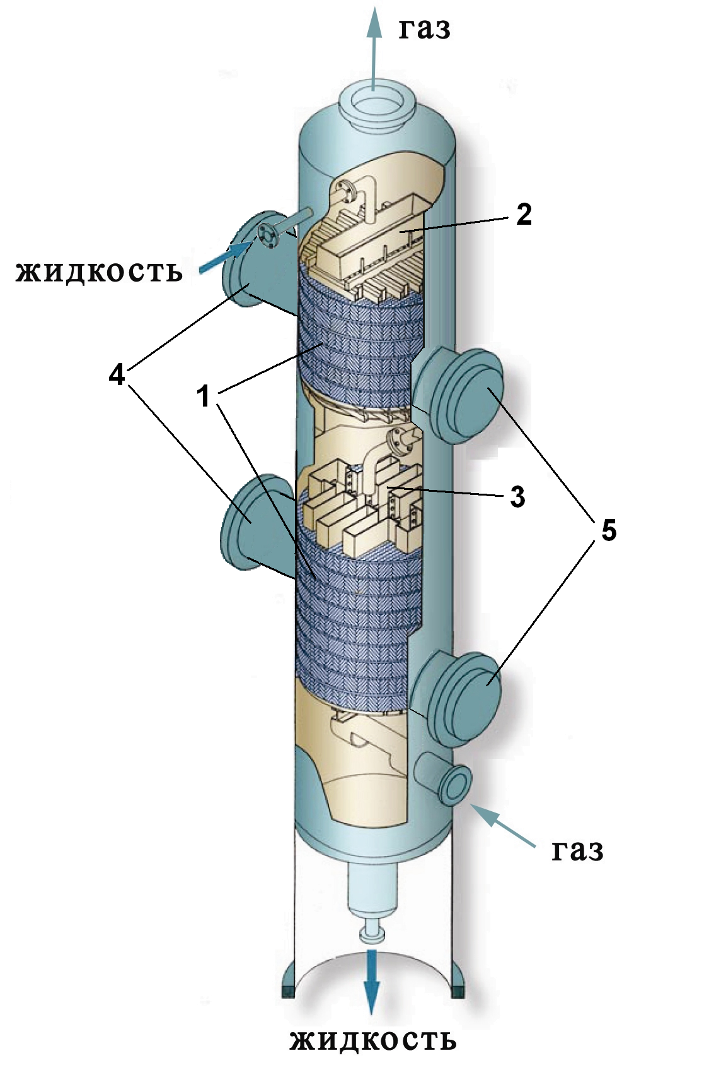
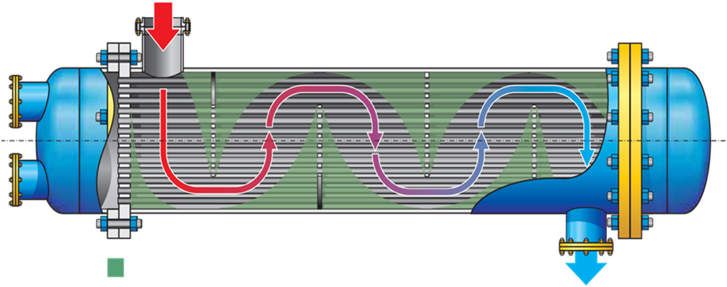
Scope of this study
Gas production and natural gas preparation for transportation
Recovery of the absorbent to the initial conditions
Heat and mass transfer processes interact in antiphase in mass transfer nozzles(1) in the RC
Transformation of the existing mathematical model into a differential view to accelerate the modeling of technological processes

Slide 3
Thanks for attention!

