Slide 1
Gravitational-wave parameter estimation
Shrey Aggarwal, Calvin Firth, Steven Henderson, Yiwen Chen

Slide 2
Intro
Mergers of compact binary systems produce gravitational waves (GW) that are detected by the Laser Interferometer Gravitational-waves Observatory (LIGO) and Virgo Interferometer.
These detections have expanded the prospects of multi-messenger astronomy significantly. There are significant ongoing efforts to enable low-latency electromagnetic follow-ups of these GW signals.
The parameter estimation of GW detections is a significant part of this process as it informs about the nature and location of the mergers. Current techniques either use matched filter and/or likelihood based techniques that are computationally expensive.
Here we demonstrate a likelihood-free inference algorithm for doing the same with accelerated hardware. This work is loosely based on the AMPLFI pipeline

Slide 3
Main Idea
Data:
  Spectrogram data that captures the frequency evolution with respect to time
  IMRPhenomD waveforms using only 8 parameters that are important for sky localisation
Similarity Embedding:
  Reduces the data size and dimensionality
  Marginalizes expensive parameters like time of arrival
Normalizing Flows:
  Provides likelihood-free Bayesian parameter estimation
  Fast sampling

Slide 4
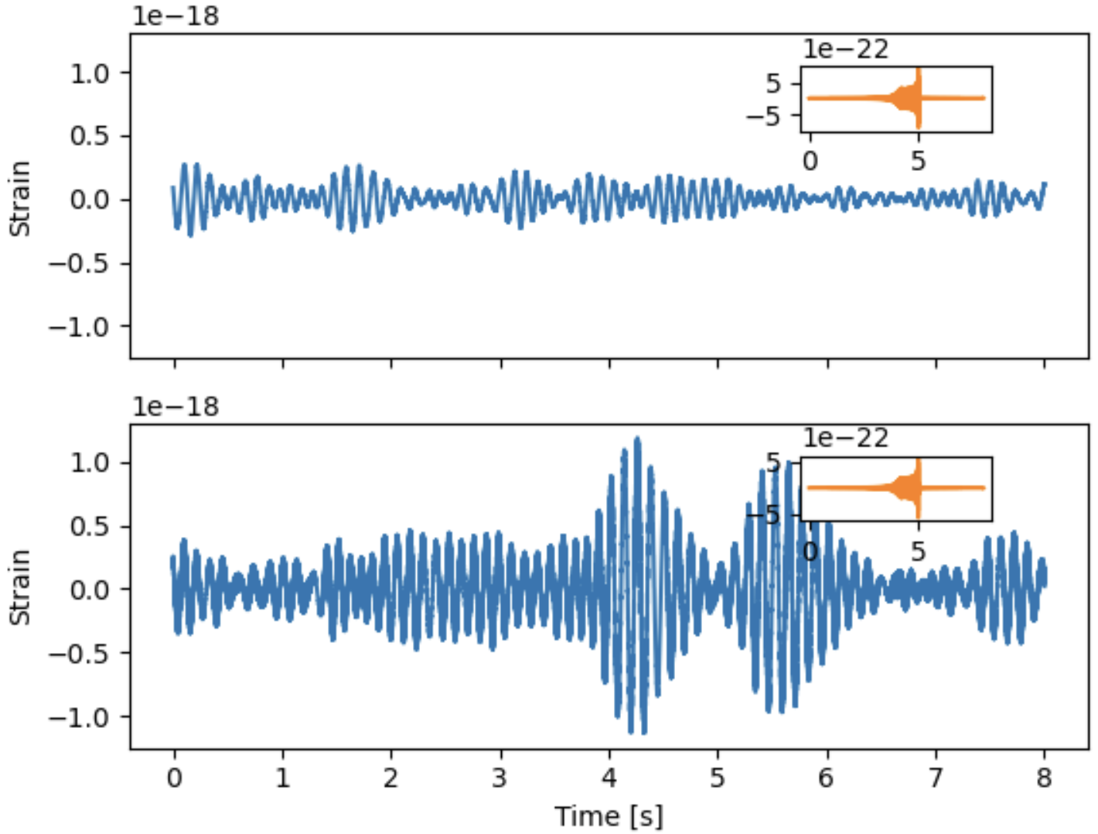
Data and Injection (ML4GW)
LIGO O3b data
Interferometers: Livingston and Hanford
Duration: 8 seconds
Waveform: IMRPhenomD
Parameters: 8
Num Waveforms: ~ 1000
The data is split into train, validation, and test set as 80%, 10%, 10%

Slide 5
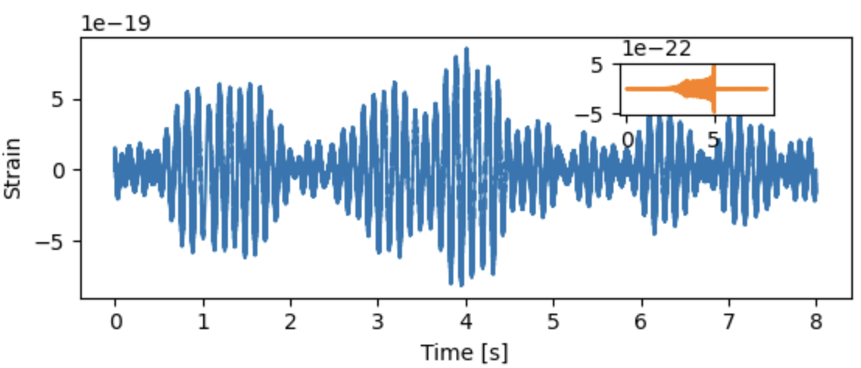
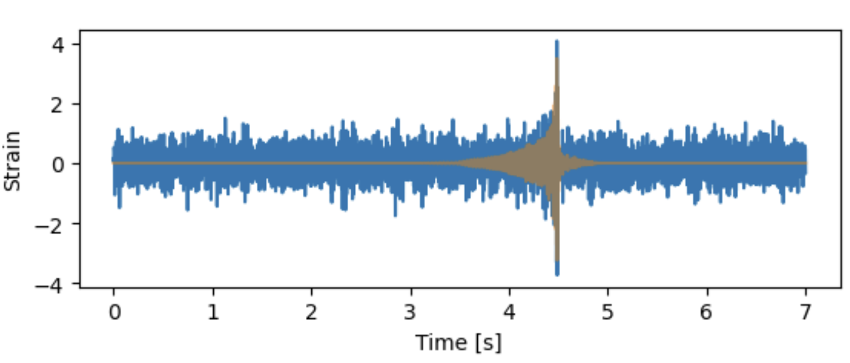
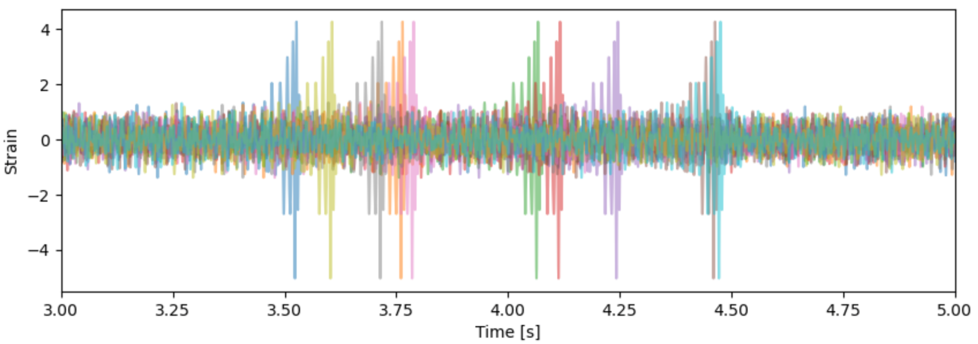
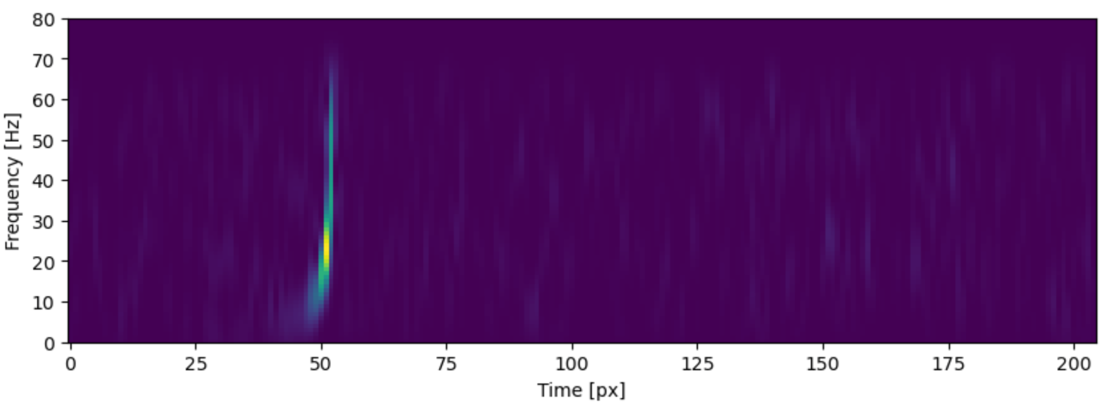
Data Processing (ML4GW)
Chunks -> Whiten -> Time Shifts -> Spectrograms
The first plot shows the injected signal (signal in inset)
Second is the whitened signal
Next is the 10 random timeshifts of 2 seconds
Finally the input is the spectrogram
Shape = [batch, ifo, data points]
Shape = [batch, ifo, data points]
Shape = [batch, ifo, 10 shifts, data points]
Shape = [batch, ifo, 10 shifts, rows, columns]

Slide 6
Similarity Embedding Network
The similarity embedding network uses two encoders for different ifos (ch1 and ch2)
Each input consists of 2D spectrograms with 10 time shifts
The encoder takes in a batch of data, projects it into lower dimension
The VICReg Loss is calculated for the embedded data and is minimized in each epoch
Finally, each both channel embeddings are concatenated for passing to flow model
Input Data
(ch1, ch2)
Encoder
ch1, ch2
VICRegLoss
Output
Ch1, ch2

Slide 7
Embedding Architecture
The encoder is a Conv2D architecture that projects all the spectrograms into embedding_dim dimensions
The VICRegloss function takes the embedded dataset and calculates the difference between the time shifted waveform from the same injection
Insert Network Architecture Diagram

Slide 8
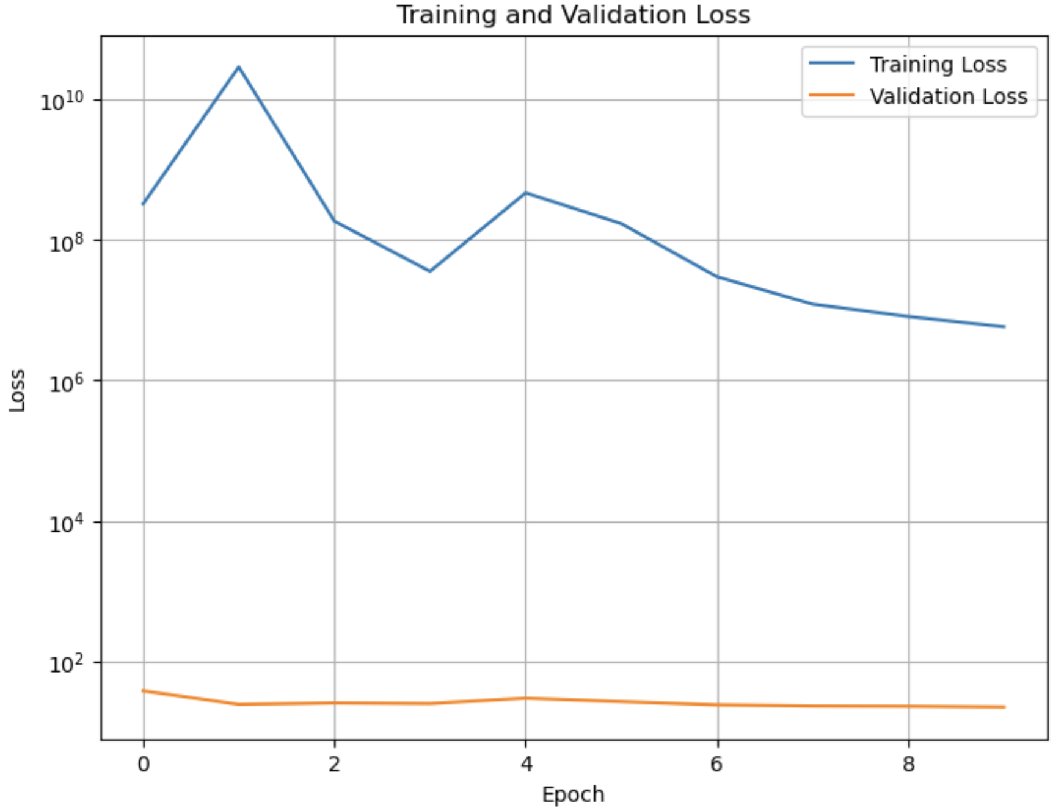
Embedding Training
The training is not optimal yet
Training loss is too high
Somehow validation loss is very low
Suggests improper embedding for the validation set

Slide 9
Normalizing Flow Network
*Brief explanation of normalizing flows
The spectrograms are passes through the trained encoder and used as context

Slide 10
Normalizing Flow Results
Pending

