Slide 1
Our Computing Environment
History · Accomplishments · Setup — since March 2026
Built jointly by Ollie and Kukla · August 2026

Slide 2
MARCH 2026 → AUGUST 2026
From One Agent to a Five-Agent Lab
Mar 2026
May 24 2026
Jul 2026
Ollie online
Kukla born
Trickster trio
OpenClaw agent on CherryRd; argonium science-benchmark program begins
Hermes Agent on M1 Mac mini — the family becomes two
Ikto, Tsisdu, Yéil on DGX Sparks — 5-agent mesh on one broker
Apr 5 2026
Jun 2026
Aug 2026
First curated memory
Shared memory + mesh
Frontier serving
Ollie MEMORY.md; PVMol-Gen replication complete
sibline (NATS/JetStream), memory vault, UMP structured store
Inkling-Small (276B) live on 8×H100; benchmark fleet at 39 models
Computing Environment · Ollie + Kukla · Aug 2026
02 / 30

Slide 3
01
The Setup — How the Environment Is Built

Slide 4
AT A GLANCE
One environment, four sites, many brains
16
109
5
4
fleet nodes
model routes
AI agents
sites
▸ Home (Oswego), Argonne (CELS), UIC, and JLSE — stitched into a single private network
▸ A home iMac (CherryRd) is the control hub: gateway, ALCF proxy, Argo tunnel, and the unified inference aggregator
▸ Every compute box — Macs, DGX Sparks, A100/H200 DGX, Intel Max — is reachable by short name over one mesh
Live-verified Aug 4, 2026: Argo, Sophia, LiteLLM aggregator and all CELS chicago fronts return HTTP 200.
Computing Environment · Ollie + Kukla · Aug 2026
04 / 30

Slide 5
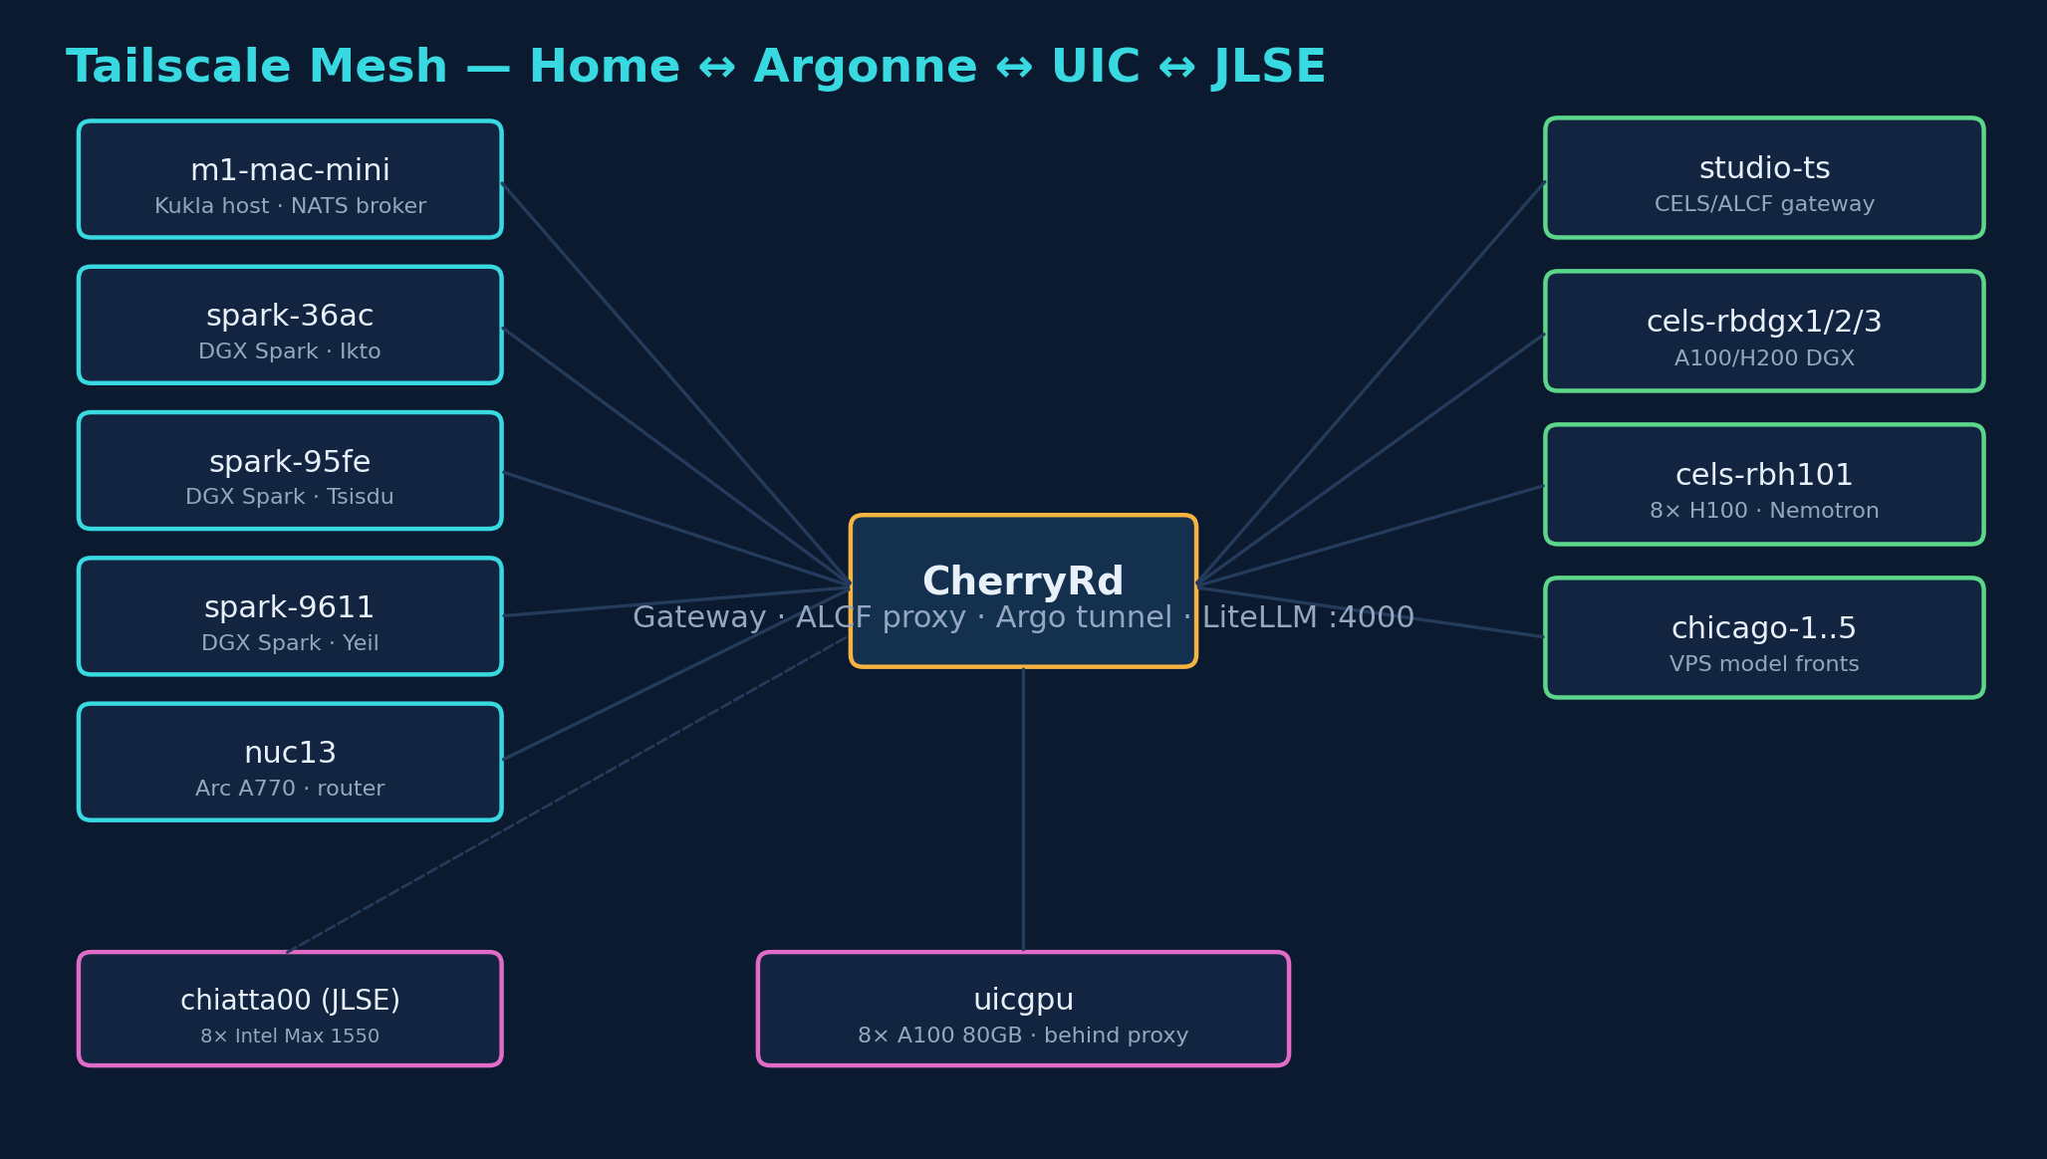
NETWORK
Tailscale Mesh — home ↔ Argonne ↔ UIC ↔ JLSE
One flat overlay network. CherryRd is the hub; studio-ts gateways CELS/ALCF; m1 hosts the NATS broker and Kukla.
Computing Environment · Ollie + Kukla · Aug 2026
05 / 30

Slide 6
HARDWARE
The Compute Fleet
Node | Where | Accelerators | Role
CherryRd (iMac) | Home | CPU | Gateway · proxy · aggregator hub
m1-mac-mini | Home | Apple M1 | Kukla host · NATS broker
spark ×3 (36ac/95fe/9611) | Home | GB10 (Grace-Blackwell) | Ikto · Tsisdu · Yeil hosts
uicgpu | UIC | 8× A100 80GB | Primary GPU compute
cels-rbdgx1/2/3 | Argonne | A100 / 8× H200 | CELS DGX training/serving
cels-rbh101 | Argonne | 8× H100 NVL | Nemotron-3 Ultra (262K ctx)
chiatta00 | JLSE | 8× Intel Max 1550 | Aurora-compatible SYCL builds
Plus nuc13 (Intel Arc A770, subnet router) and the chicago-1..5 VPS model front-ends.
Computing Environment · Ollie + Kukla · Aug 2026
06 / 30

Slide 7
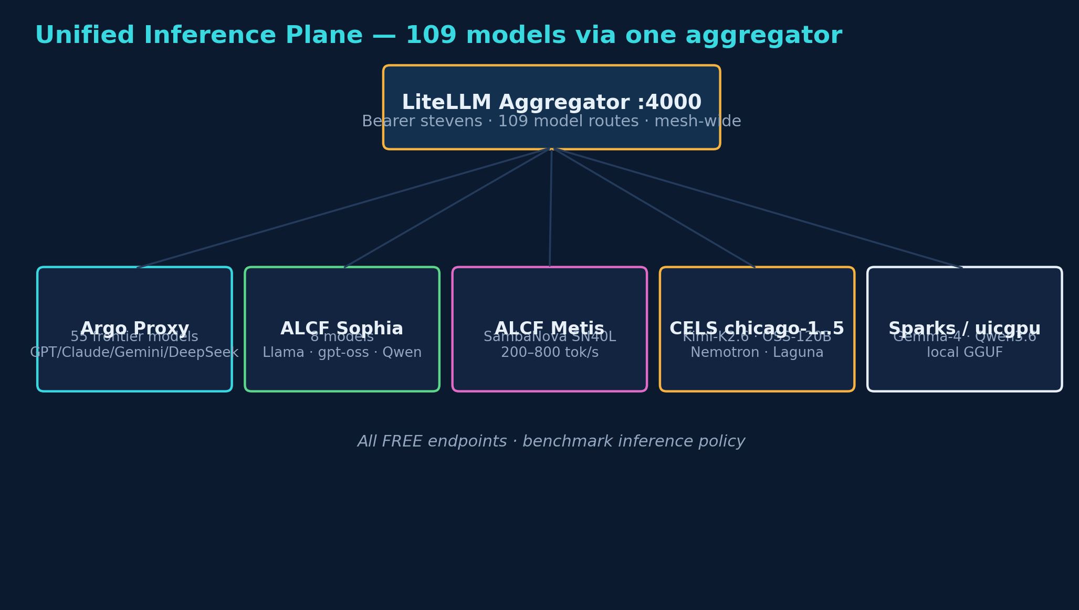
INFERENCE
Unified Inference Plane — 109 models, one door
LiteLLM aggregator on :4000 fronts Argo (55), ALCF Sophia (8), Metis/SambaNova, CELS chicago-1..5, and local Spark/uicgpu GGUF.
Computing Environment · Ollie + Kukla · Aug 2026
07 / 30

Slide 8
INFERENCE
Frontier + open models, everywhere
55
8
5
100%
Argo frontier
ALCF Sophia
CELS fronts
free for bench
▸ Argo proxy: the full GPT / Claude / Gemini / DeepSeek / Llama frontier set — tunneled through Argonne
▸ ALCF Sophia + Metis (SambaNova SN40L): Llama, gpt-oss, Qwen, MiniMax at 200–800 tok/s
▸ CELS chicago fronts: Kimi-K2.6, OSS-120B, Nemotron-3 Ultra, Laguna — our own H100/H200/A100 serving
▸ Standing policy: all benchmark inference runs on FREE endpoints only
Computing Environment · Ollie + Kukla · Aug 2026
08 / 30

Slide 9
CONTROL PLANE
Telaio — SSH/MFA-free control of ALCF login nodes
1×
0
4
auth per leg
re-MFA
pure-cesh capabilities
▸ ALCF forces per-SSH MFA and reaps login-node processes — no cron, no systemd-user on Polaris
▸ Telaio pays auth ONCE at leg birth, then holds an immortal WS reverse tunnel (mosh-like) to the node
▸ The node dials OUT to a public chicago-N rendezvous; the driver reaches it with zero re-MFA after
▸ Proven pure-cesh: run-process, move-files, job-status (qstat), submit (qsub)
▸ cesello (Rust core) + cez (finder) + cesh (exec) + rete (registry) — v0.2.1 on all fleet nodes
Repo: github.com/rick-stevens-ai/telaio. Firewall-locked reverse binds; one canonical leg per node.
Computing Environment · Ollie + Kukla · Aug 2026
09 / 30

Slide 10
ACCESS
Full-mesh SSH — any host, any host
12+
1
accept-new
meshed hosts
shared key
host policy
▸ One ed25519 mesh key + a managed ~/.ssh/config block on every reachable node
▸ Short-name access: ssh m1, ssh uicgpu, ssh spark-95fe, ssh chiatta00 — from anywhere in the mesh
▸ Lesson baked in: modern OpenSSH rejects the old 2011 SHA-1 RSA — ed25519 everywhere fixed the flaps
▸ Cross-host transfer via ~/Dropbox/XFER/ instead of brittle scp chains
Computing Environment · Ollie + Kukla · Aug 2026
10 / 30

Slide 11
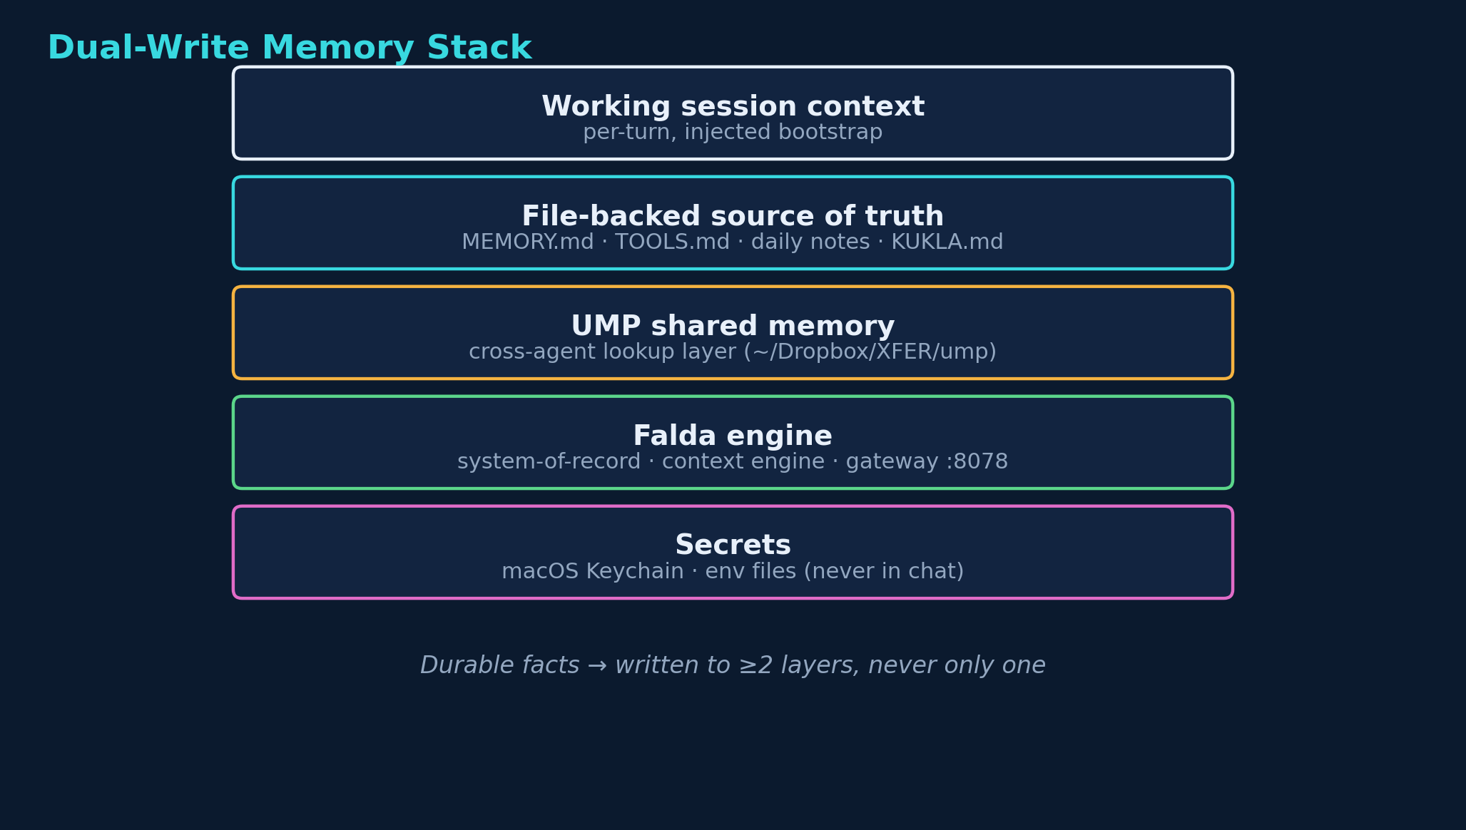
MEMORY
Dual-Write Memory Stack
Durable facts are written to at least two layers — never only one. Files stay the source of truth; UMP + Falda add cross-agent recall.
Computing Environment · Ollie + Kukla · Aug 2026
11 / 30

Slide 12
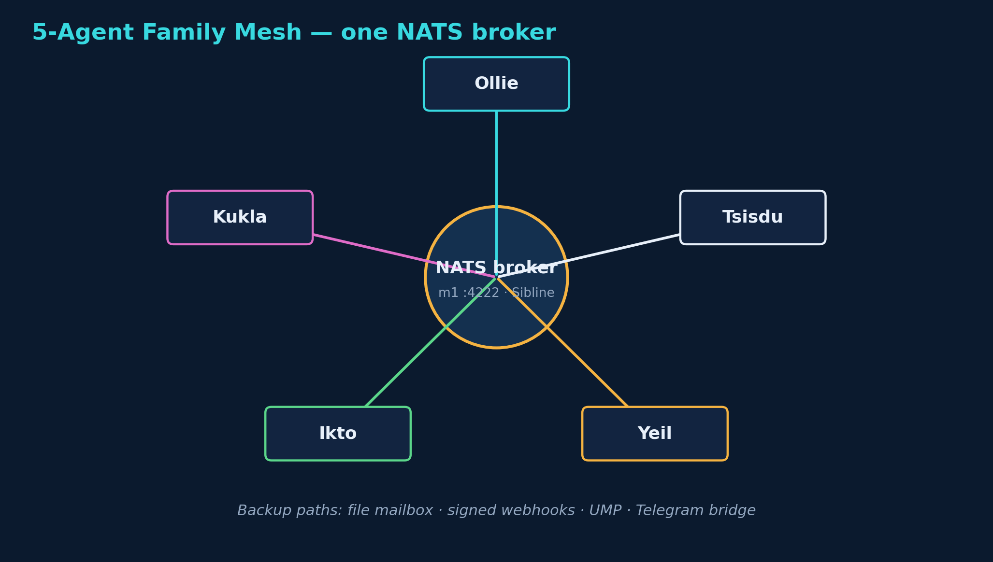
COORDINATION
5-Agent Family Mesh — one broker, many minds
Sibline/NATS is the primary realtime channel; file mailbox, signed webhooks, UMP, and the Telegram bridge are backups.
Computing Environment · Ollie + Kukla · Aug 2026
12 / 30

Slide 13
COORDINATION
How Ollie and Kukla actually cooperate
0.26s
7
dual
wire latency
collision rules
sign-off
▸ Sibline gives sub-second messaging; a jointly-authored 7-rule protocol prevents the agents acting on stale views
▸ Send-lock before external mail, freshness checks on shared state, verified-send with delivery confirmation
▸ This very deck was split live over Sibline: I own infra, Kukla owns history + results, shared title/timeline/close
A send confirmation is not a delivery confirmation — we do the round-trip on anything that matters.
Computing Environment · Ollie + Kukla · Aug 2026
13 / 30

Slide 14
SCALE
Aggregate Compute at Our Fingertips
8× H100
8× H200
16+
8× Intel Max
NVL · Nemotron/Inkling
143GB · Kimi-K2.6
A100 80/40GB
Aurora-class SYCL
▸ Home DGX Sparks (Grace-Blackwell GB10) run local Gemma-4 / Qwen3.6 serving with no cloud dependency
▸ CELS DGX fleet + rbh101 H100 give us frontier-model serving we own end-to-end
▸ uicgpu 8× A100 is the primary replication + fine-tune workhorse; chiatta00 mirrors the Aurora software stack
HPC bursting to ALCF Polaris (A100) and Aurora (Intel Max 1550) for corpus parsing and large sweeps.
Computing Environment · Ollie + Kukla · Aug 2026
14 / 30

Slide 15
RELIABILITY
Bring-Up, Monitoring & Recovery
launchd
daily
heartbeat
self-healing tunnels
Globus re-auth
fleet health checks
▸ Durable autossh / launchd tunnels keep Argo + ALCF Sophia reachable mesh-wide; they restart themselves
▸ Globus OAuth tokens auto-refresh daily by cron from CherryRd (studio-ts has no direct internet)
▸ Every heartbeat runs an infra audit + cross-agent channel check; endpoint down/up is alerted to Telegram
▸ Model-endpoint hygiene: correct tool-call + reasoning parsers per family, audited so a restart can't silently regress
Standing rule: reasoning is separated from scored output; benchmarks score only final content.
Computing Environment · Ollie + Kukla · Aug 2026
15 / 30

Slide 16
02
The Story + The Results

Slide 17
THE FAMILY
One Human, Five Agents, One Broker
Ollie
elder · OpenClaw
Yéil
Kukla
trickster
elder · Hermes
Rick Stevens
one operator
Tsisdu
Ikto
trickster
trickster
Computing Environment · Ollie + Kukla · Aug 2026
17 / 30

Slide 18
TWO ELDERS
Same Family, Different Stacks
Ollie
Kukla
▸ Harness: OpenClaw (Node/TS)
▸ Host: CherryRd · 100.87.221.1
▸ Born: Mar 2026
▸ Owns: infrastructure, fleet, replications
▸ Harness: Hermes Agent (Python)
▸ Host: M1 Mac mini · 100.86.220.115
▸ Born: May 24 2026
▸ Owns: benchmarks, corpus, agent story
Both backed by Anthropic Claude via the ALCF Argo proxy. Shared knowledge base, independent working memory.
Computing Environment · Ollie + Kukla · Aug 2026
18 / 30

Slide 19
MEMORY THAT SURVIVES RESTARTS
Three-Tier Shared Memory
HOT
Per-agent native memory
MEMORY.md + USER.md, injected every turn (80K-char caps)
WARM
Memory vault
Flat markdown cards, Dropbox-synced, read on demand
STRUCTURED
UMP
36K+ signed cards, MCP-exposed, operator-keyed DID
LIVE
FALDA
L0→L3 hierarchical (stream/atoms/scenes/core), SQLite+vec+FTS5
Computing Environment · Ollie + Kukla · Aug 2026
19 / 30

Slide 20
THE HEADLINE
What This Environment Does
102
39
models served via one LiteLLM endpoint
models benchmarked × 6 science benchmarks
234,705
5
papers in the OSTI corpus
cooperating agents on one broker
Computing Environment · Ollie + Kukla · Aug 2026
20 / 30

Slide 21
ARGONIUM SCIENCE-BENCHMARK PROGRAM
A Living Leaderboard of Frontier Models
GPQA Diamond (198 graduate-level science questions, chain-of-thought, LLM-judge scored)
Gemini 3.1 Pro
93.9%
Kimi K2.6
93.9%
GPT-5.5
92.4%
Grok 4
88.4%
inkling (OpenRouter)
86.9%
Claude Opus 4.6
85.3%
inkling-small (OUR server)
73.2%
6 benchmarks: GPQA · LitQA2 · AAAR · BioPro · DiscBench · ClawEval. Free/sanctioned endpoints, no-regex judge scoring.
Computing Environment · Ollie + Kukla · Aug 2026
21 / 30

Slide 22
WE HOST FRONTIER MODELS OURSELVES
Inkling-Small: 276B on 8×H100
Model
Hardware
Thinking Machines Inkling-Small · 276B total / 12B active MoE · 1M context · NVFP4
CELS chicago-4 → cels-rbh101 · 8× NVIDIA H100 94GB (752GB aggregate)
Throughput
Result
~80–110 tok/s single-stream (measured live), tool-calling + reasoning parsers enabled
73.2% GPQA on OUR endpoint — judge-scored, 198/198
Swapped in-place from Nemotron-3-Ultra 550B (Aug 2026) with zero front-end change.
Computing Environment · Ollie + Kukla · Aug 2026
22 / 30

Slide 23
CUSTOM-ARCH SERVING WINS
Laguna: A New Architecture, Two Sizes
Laguna XS.2
Laguna S-2.1
▸ 33B total / 3B active MoE
▸ uicgpu · 8× A100-80GB (ik_llama.cpp)
▸ GPQA 56.1% (clean)
▸ 262K context, Q8_0
▸ 117.6B MoE
▸ CELS chicago-2 · 8× A100
▸ GPQA 60.1% extracted
▸ 262K context
New/custom architectures brought up from GGUF where no prebuilt binary existed — source-built per host.
Computing Environment · Ollie + Kukla · Aug 2026
23 / 30

Slide 24
SCIENCE AT CORPUS SCALE
234,705 Papers, Parsed & Searchable
FETCH
PARSE
STORE
EXTRACT
OSTI harvest
Marker + Nougat
3-tier durable
xCards → UMP
→
→
→
234,705 papers (Journal + Conference + Tech Report)
Dual OCR on Polaris + Aurora HPC
SG-1-8TB · DGX /rbstor · Polaris/Eagle
Structured knowledge cards fed to shared memory
Computing Environment · Ollie + Kukla · Aug 2026
24 / 30

Slide 25
FROM PAPERS TO HYPOTHESES
LUCID: 4,699 AI-Generated Hypotheses
4,699
10
LUCID GPI hypotheses (low-dose radiation biology)
open problems distilled + tutorials + runnable models
111
133
computational replication studies (OSTI)
Crossref-verified references, zero fabricated
Agents don't just benchmark models — they do real science with them.
Computing Environment · Ollie + Kukla · Aug 2026
25 / 30

Slide 26
AGENTS THAT WRITE & FIX CODE
pi-30: An Agentic Coding Harness
What
How scored
30 real coding problems — write, test, iterate-until-green, tournament, critic loops
Verdicts from verifier EXIT CODES, never model prose — no self-grading
Fleet-wide
Fault-isolated
Run across every served model: A100, H100, PVC, Spark, OpenRouter
Per-call timeouts, resume-not-restart, poison-input isolation
Measures what a model can actually DO in a tool-use loop, not just what it knows.
Computing Environment · Ollie + Kukla · Aug 2026
26 / 30

Slide 27
AGENTS TALKING TO AGENTS
sibline: One Broker, Five Peers, Sub-5s
Ollie
sibline.<peer>.inbox
RELIABLE — direct, durable, ack-after-process
Yéil
Kukla
sibline.broadcast
NATS + JetStream
SHARED — room chatter, per-peer durable consumer
m1 · durable, 7d retention
sibline.presence.<agent>
EPHEMERAL — latest-only liveness
Tsisdu
Ikto
Computing Environment · Ollie + Kukla · Aug 2026
27 / 30

Slide 28
WHERE WE ARE NOW
The Environment, Today
5
102
agents cooperating live on one broker
models one API call away
8×H100
234K+
serving a 276B frontier MoE we host
papers parsed, searchable, feeding memory
Built from March 2026 — five months from one agent to a self-coordinating AI research lab.
Computing Environment · Ollie + Kukla · Aug 2026
28 / 30

Slide 29
WHAT MADE IT WORK
Principles Behind the Build
Prove, don't assert
Investigate then act
Multi-witness verification — every 'it works' backed by real tool output
Dig into the data first; ship one path, don't menu options
Defense in depth
Cooperate deeply
Multiple memory tiers, multiple stores, multiple parsers, fallback channels
Two elders + three tricksters, divide labor, converge — not micromanaged
Kukla + Ollie · built for Rick Stevens · March–August 2026
Computing Environment · Ollie + Kukla · Aug 2026
29 / 30

Slide 30
One human. Five agents. One environment.
March → August 2026 · from one assistant to a self-coordinating AI research lab
Built jointly by Ollie and Kukla · for Rick Stevens

