Slide 1
The decoder-only transformer
Mathematics, mechanisms, and a working language model
An undergraduate tutorial
Text
“The atom”
Token vectors
Causal
transformer
Next-token
probabilities
A small, dense GPT-style implementation in PyTorch
Prerequisites: vectors, matrix multiplication, derivatives, and basic Python
01
Notes:
The decoder-only transformer
This tutorial develops one complete decoder-only language model. It uses learned absolute position embeddings, pre-LayerNorm blocks, ordinary multi-head attention, an exact GELU activation, and a tied input/output embedding matrix. Dense means every token uses the same complete feedforward network in each layer. There is no expert router. Decoder-only means we use causal self-attention without an encoder or cross-attention. The code is deliberately small enough to inspect. Its byte tokenizer and tiny training corpus make it a teaching model, not a pretrained general-purpose LLM. Read the equations as row-vector operations. The implementation includes biases even when a diagram simplifies a label. The code folder contains executable examples, training, inference, and tests. Speaker notes provide the explanations that would overcrowd a slide.
References
Radford et al. (2019), Language Models are Unsupervised Multitask Learners. https://github.com/openai/gpt-2/blob/master/src/model.py
Vaswani et al. (2017), Attention Is All You Need, Sections 3.2–3.4. https://arxiv.org/abs/1706.03762

Slide 2
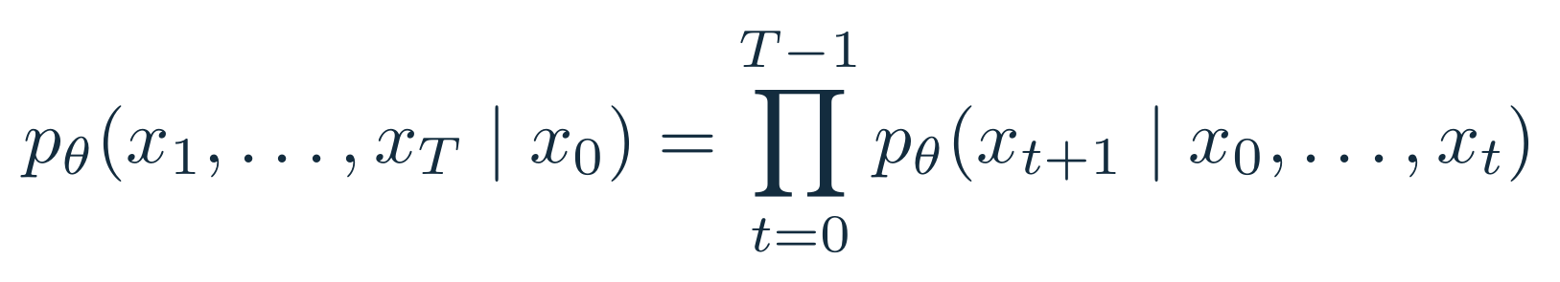
The next-token learning problem
Every position predicts the token immediately after it
BOS
The
atom
stores
Input
The
atom
stores
energy
Target
Training computes all positions together. The causal mask prevents access to the answer.
Word-sized tokens illustrate the shift here. The runnable model uses UTF-8 bytes.
02
Notes:
The next-token learning problem
Let x0 be a beginning-of-sequence marker. The probability of a whole token sequence factors into conditional probabilities by the probability chain rule. A language model learns these conditionals. Given the input [BOS, The, atom, stores], the targets are [The, atom, stores, energy]. The target is shifted once relative to the input. Our stream sampler constructs y by taking the next slice, so DenseLM must not shift targets again. This is teacher forcing: training provides the real preceding tokens. Matrix operations can evaluate all positions simultaneously because the mask ensures the representation at position t depends only on tokens at positions 0 through t. During generation, the future token is unknown, so we must choose one and append it before predicting another. The word-level diagram is pedagogical. The actual tokenizer operates on bytes plus two special IDs.
References
Radford et al. (2019), Language Models are Unsupervised Multitask Learners. https://github.com/openai/gpt-2/blob/master/src/model.py

Slide 3
The complete model and its tensor shapes
B sequences, T token positions, d features, H attention heads, V vocabulary entries
Token IDs
Symbol | Classroom run
V | 258
T | 64
d | 64
H; dₕ | 4; 16
L; FFN width | 2; 256
B × T
Embeddings + positions
B × T × d
L transformer blocks
B × T × d
Final LayerNorm
B × T × d
Tied vocabulary projection
B × T × V
One residual stream keeps the same width d through every block.
03
Notes:
The complete model and its tensor shapes
A tensor is a multidimensional array. B identifies separate sequences in a minibatch, T identifies token positions, and d identifies learned features per token. All blocks preserve [B,T,d], which makes residual addition possible. H divides each attention projection into heads of width dh=d/H. V is the number of token IDs the model can score. The classroom run uses 256 byte IDs plus BOS and EOS, so V=258. Its 2 blocks, width 64, and four heads fit on a CPU. train.py defaults to a slightly larger 4-block, width-128 model, while slide 19 gives the exact command used for the classroom run. The conceptual architecture remains the same at larger scale. Embedding and projection matrices are learned parameters, whereas activations change for every input. A block has roughly 12d² matrix parameters: 4d² in attention and 8d² in its two FFN projections, plus biases and normalization parameters.
References
Radford et al. (2019), Language Models are Unsupervised Multitask Learners. https://github.com/openai/gpt-2/blob/master/src/model.py

Slide 4
Tokenization: text becomes integer IDs
The tokenizer defines the symbols the model can read and predict
Exact byte example
Subword BPE idea
Hi!
UTF-8
[72, 105, 33]
l o w e r
↓
lo w e r
↓
Text | Byte IDs
café | 99, 97, 102, 195, 169
BOS / EOS | 256 / 257
low e r
↓
low er
Learn frequent adjacent-pair merges on training text, then freeze them.
A byte is not always a character. “é” uses two bytes.
04
Notes:
Tokenization: text becomes integer IDs
ByteTokenizer encodes text as UTF-8 and uses each byte value as an ID. Hi! therefore becomes [72,105,33]. Accented é is encoded as bytes 195 and 169, so café occupies five token positions. The two additional IDs delimit documents. This fixed tokenizer is reversible for valid text and never needs to learn a vocabulary. Arbitrary generated bytes can be invalid UTF-8, so decoding visibly replaces invalid sequences. Production tokenizers often use subword units to shorten sequences. Byte-pair encoding repeatedly merges frequent adjacent symbols while fitting a vocabulary. Encoding later follows the fixed ranked merge rules. The right-hand example uses a hand-specified educational sequence of merges: l+o, lo+w, and e+r. It does not claim to reproduce any named tokenizer or its IDs. Token IDs are arbitrary category labels: numerical closeness of IDs has no semantic meaning. The code includes both byte examples and the toy merge trace.
References
Sennrich, Haddow & Birch (2016), Neural Machine Translation of Rare Words with Subword Units. https://arxiv.org/abs/1508.07909

Slide 5
Embedding lookup and position
Each token ID selects a learned vector, then position adds an order signal
Toy ID | Feature 1 | Feature 2 | Feature 3
0 | 0.10 | 0.20 | −0.10
1 | 0.50 | −0.30 | 0.80
2 | 0.00 | 0.40 | 0.20
3 | 0.70 | 0.10 | −0.20
ID 2 at position 0
E[2] = [0.00, 0.40, 0.20]
P[0] = [0.01,−0.02, 0.03]
X[0] = [0.01, 0.38, 0.23]
The same token at another position receives a different input vector.
05
Notes:
Embedding lookup and position
E is a V-by-d table of learned parameters. Looking up E[token_id] produces a d-component vector. Equivalently, multiplying a one-hot row vector by E selects exactly one row, but a lookup avoids constructing a large sparse one-hot array. Our example selects toy row 2 and adds a learned three-component vector for position 0. These are deliberately chosen numbers, independent of the byte IDs and random initial weights in training. The resulting [0.01,0.38,0.23] can be checked in examples.py. Features are learned coordinates, not preassigned concepts. Both E and P receive gradients from the language-model loss. The position table lets the network distinguish order, since pure content-based attention alone has no explicit index information. Learned absolute positions have a finite table, so the implementation rejects inputs beyond its configured context. The generation harness can use a rolling window, but reindexes that window and is not an unlimited-context model.
References
Radford et al. (2019), Language Models are Unsupervised Multitask Learners. https://github.com/openai/gpt-2/blob/master/src/model.py

Slide 6
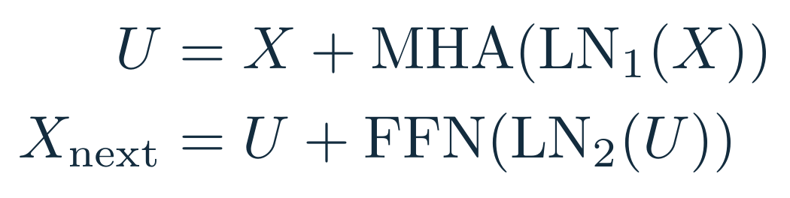
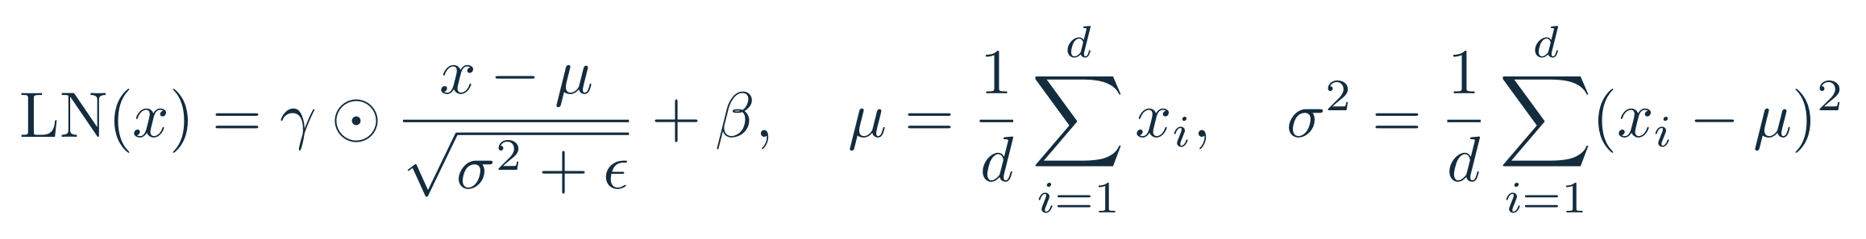
The residual block and LayerNorm
Normalize features within each token, compute an update, and add it back
Input
LayerNorm
Attention / FFN
+ original input
Example: [1, 2, 3] becomes approximately [−1.225, 0, 1.225] when γ = 1 and β = 0.
Each LayerNorm has its own learned scale γ and shift β. ε prevents division by zero.
06
Notes:
The residual block and LayerNorm
This is pre-LayerNorm: normalization sits inside the branch before attention or the FFN. The first branch reads LN1(X), returns a vector with the same shape, and adds that vector to the original X. The second branch acts on LN2(U) and adds its update to U. Residual connections provide a direct path for activations and gradients across layers. LayerNorm calculates mean and population variance across d features of each individual token, independently of other tokens and other sequences. Subtracting the mean centers the vector, and division by the standard deviation rescales it. Gamma and beta are learned featurewise scale and shift vectors. With x=[1,2,3], mean=2 and variance=2/3, giving approximately [-1.225,0,1.225] before affine parameters. PyTorch uses epsilon=1e-5 here. Dropout is configurable in the code and applied on residual-branch outputs, with default zero for clear numerical examples. The final model includes an additional LayerNorm before vocabulary projection.
References
Ba, Kiros & Hinton (2016), Layer Normalization. https://arxiv.org/abs/1607.06450
Radford et al. (2019), Language Models are Unsupervised Multitask Learners. https://github.com/openai/gpt-2/blob/master/src/model.py

Slide 7
Queries, keys, and values
Three learned projections give each token different roles in attention
Q = queries
What can this position use?
Normalized token matrix
X̃: T × d
K = keys
How can each position be matched?
Vₕ = values
What information can be mixed?
One head: WQ, WK, WV each have shape d × dₕ. The projected arrays have shape T × dₕ.
07
Notes:
Queries, keys, and values
Focus on one sequence and one attention head. X-tilde is the normalized residual stream. Multiplication by three separate learned matrices gives Q, K, and the value matrix Vh. Each has T rows and dh columns. A query at the current position is compared with keys at eligible positions. The resulting scores control how much of each value vector contributes to the output. These roles are a useful mathematical interpretation, not a guarantee that individual dimensions have human-readable meanings. All three projections come from the same sequence, which makes this self-attention. The code computes all heads together in one Linear(d,3d), then reshapes and splits that result. Bias vectors broadcast across token positions. Our notation uses V for vocabulary size and Vh for a head’s value matrix to avoid confusing the two. The matrices are learned by gradient descent. They are not supplied by a retrieval system or stored facts database.
References
Vaswani et al. (2017), Attention Is All You Need, Sections 3.2–3.4. https://arxiv.org/abs/1706.03762
Radford et al. (2019), Language Models are Unsupervised Multitask Learners. https://github.com/openai/gpt-2/blob/master/src/model.py

Slide 8
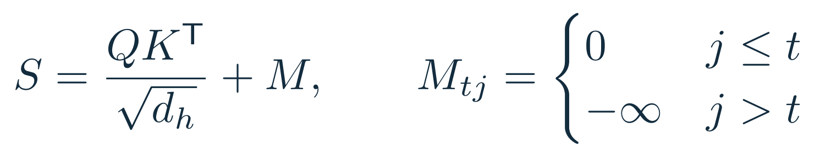
Attention scores and the causal mask
The dot product measures compatibility, and the mask removes future positions
query / key | 0 | 1 | 2 | 3
0 | 0 | −∞ | −∞ | −∞
1 | 0 | 0 | −∞ | −∞
2 | 0 | 0 | 0 | −∞
3 | 0 | 0 | 0 | 0
Why divide by √dₕ?
A dot product adds dₕ terms. Under a unit-variance independence assumption, its variance grows with dₕ.
Example: dₕ = 2, q = [√2, 0]
Keys: [2, 0], [1, 1], [0, 2]
Scaled scores: [2, 1, 0]
08
Notes:
Attention scores and the causal mask
For each query row t and key row j, compute their dot product and divide by the square root of head width. The T-by-T result contains a score for every possible token pair. Add the causal mask: zero for j≤t and negative infinity for j>t. The diagonal is allowed because token t is known when predicting token t+1. Exponentiating negative infinity gives zero, so the later softmax assigns exactly zero weight to future tokens. Without this restriction, training could read its shifted target through a later input position. For the scaling intuition, if q and k have independent, zero-mean, unit-variance components, the dot product’s variance is dh. Dividing by sqrt(dh) returns variance to one. This is an explanatory approximation, not a statement that trained features remain independent. The model creates a lower-triangular boolean mask once and takes the needed T-by-T slice. The mask table shown is additive, while the implementation uses masked_fill.
References
Vaswani et al. (2017), Attention Is All You Need, Sections 3.2–3.4. https://arxiv.org/abs/1706.03762
PyTorch scaled dot-product attention. https://docs.pytorch.org/docs/main/generated/torch.nn.functional.scaled_dot_product_attention.html

Slide 9
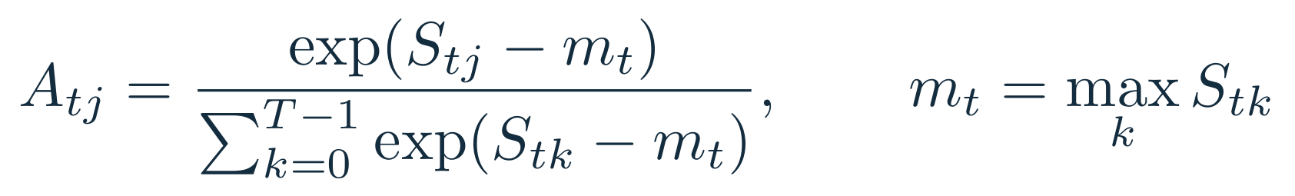
Softmax converts scores into weights
Exponentiate, then normalize each query row across the key positions
Allowed score | Subtract max = 2 | Exponential | Normalized weight
2 | 0 | 1.000 | 0.665
1 | −1 | 0.368 | 0.245
0 | −2 | 0.135 | 0.090
The weights are nonnegative and sum to 1.
Subtracting the row maximum leaves the answer unchanged and avoids overflow.
09
Notes:
Softmax converts scores into weights
For scores [2,1,0], subtract the largest score, 2, to obtain [0,-1,-2]. Exponentiation gives approximately [1,0.3679,0.1353], whose sum is 1.5032. Dividing by this sum yields [0.6652,0.2447,0.0900]. These numbers are calculated by examples.py. Subtracting any shared constant cancels between numerator and denominator, so subtracting the maximum improves numerical stability without changing the distribution. Each attention row normalizes over key positions, not over features, heads, or the minibatch. Masked entries exponentiate to zero. A causal row always contains at least its diagonal, so this model avoids an all-masked row. PyTorch implements a stable softmax. The manual path explicitly computes it in float32 before casting back to the value dtype when mixed precision is active. A later vocabulary softmax will use exactly the same mathematical operation, but normalize across possible output token IDs instead.
References
Vaswani et al. (2017), Attention Is All You Need, Sections 3.2–3.4. https://arxiv.org/abs/1706.03762
PyTorch scaled dot-product attention. https://docs.pytorch.org/docs/main/generated/torch.nn.functional.scaled_dot_product_attention.html

Slide 10
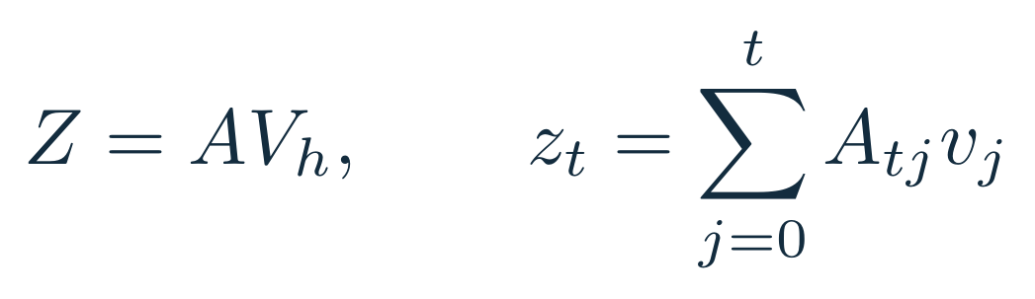
Attention mixes the value vectors
A weighted sum produces a new feature vector for each query position
0.665 × [1, 0]
0.245 × [0, 2]
0.090 × [3, 1]
+
+
The output has dₕ features. The T attention weights control where information comes from.
10
Notes:
Attention mixes the value vectors
Reuse the three weights from the preceding slide and assign value vectors [1,0], [0,2], and [3,1]. The first output component is 0.66524+3×0.09003=0.93533. The second is 2×0.24473+0.09003=0.57949. Matrix multiplication A@Vh performs the same calculation for all query positions. A has shape T-by-T and Vh has shape T-by-dh, so the result has shape T-by-dh. Since pre-dropout weights are nonnegative and sum to one, each head output is a convex combination of its eligible values. The subsequent learned output projection and residual addition need not preserve that property. With attention dropout enabled during training, the realized dropped weights also need not sum to one. The displayed values are a constructed arithmetic example, not measured attention from a trained model. Attention weights show one part of a computation and should not by themselves be treated as a complete explanation of a prediction.
References
Vaswani et al. (2017), Attention Is All You Need, Sections 3.2–3.4. https://arxiv.org/abs/1706.03762

Slide 11
Multiple heads and the attention implementation
Each head learns its own projections and its own attention distribution
Head 1
q, k, v = split_heads(qkv(x))
s = (q @ k.transpose(-2, -1))
s = s / math.sqrt(head_dim)
s = s.masked_fill(~mask, -inf)
a = softmax(s, dim=-1)
z = a @ v
y = out_proj(merge_heads(z))
Head 2
Concatenate
then project
X̃
Head 3
Head 4
Shapes: Q, K, V are [B, H, T, dₕ]
4 heads × 16 features = 64 features
11
Notes:
Multiple heads and the attention implementation
Different heads can compute different mixtures because they use different learned projections. With d=64 and H=4, each head carries 16 features. Concatenating four head outputs returns 64 features, then a learned output projection mixes information between the heads. We do not assign fixed linguistic roles to heads. The excerpt shows the exact sequence of operations while using descriptive split_heads and merge_heads placeholders. dense_lm.py contains the actual reshape, permute, unbind, transpose, and contiguous calls, plus biases and optional dropout. Scores have shape [B,H,T,T]. Softmax uses the final axis. A matrix multiplication with values gives [B,H,T,dh], then the head and feature axes merge back to [B,T,d]. The manual version exposes these arrays for teaching. The optional PyTorch SDPA path evaluates the same causal operation using an optimized backend when available. The tests compare the two outputs within floating-point tolerance.
References
PyTorch scaled dot-product attention. https://docs.pytorch.org/docs/main/generated/torch.nn.functional.scaled_dot_product_attention.html

Slide 12
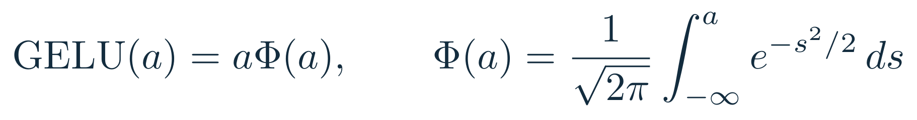
The feedforward network and GELU
Attention mixes positions. The FFN transforms features independently at each position.
d
64
4d
256
GELU
elementwise
d
64
GELU(−1) ≈ −0.159
GELU(0) = 0
GELU(1) ≈ 0.841
12
Notes:
The feedforward network and GELU
Every token passes through the same FFN parameters within one layer. W1 expands d features to 4d, the activation acts elementwise, and W2 projects back to d. Different layers have different FFN parameters. GELU(a)=aΦ(a), where Φ is the standard normal cumulative distribution function. Positive inputs mostly pass through, while negative inputs are smoothly attenuated. A nonlinear activation is essential: two consecutive affine transformations without it would collapse into one affine transformation. This tutorial uses nn.GELU(approximate="none"), matching the displayed equation. The drawn curve uses numerical values of the same function. A complete numerical FFN example is in examples.py: [1,-1] times the specified 2-by-4 W1 gives [1,-1,0,-2], then GELU and a specified 4-by-2 W2 produce approximately [0.8186,-0.1359]. These small matrices are given explicitly in the code. GELU is a clear GPT-style baseline choice. Other architectures may use different activations, normalization, or gating.
References
Hendrycks & Gimpel (2016), Gaussian Error Linear Units. https://arxiv.org/abs/1606.08415
Radford et al. (2019), Language Models are Unsupervised Multitask Learners. https://github.com/openai/gpt-2/blob/master/src/model.py

Slide 13
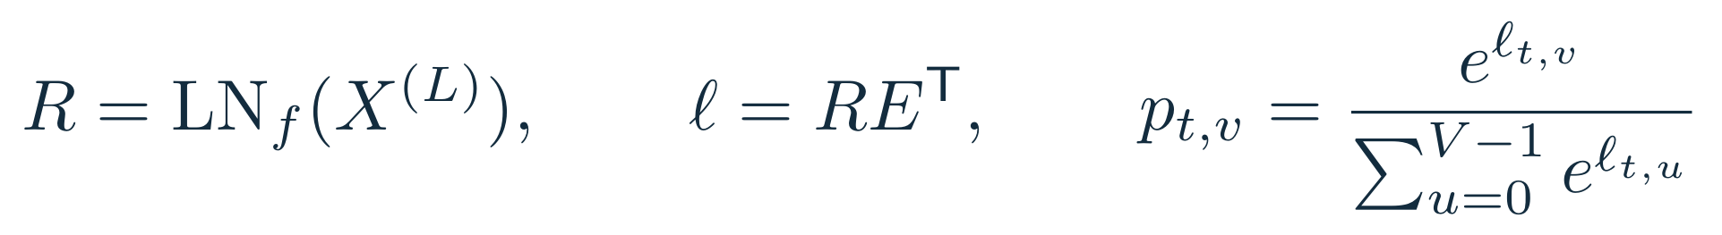
The vocabulary head turns features into logits
A logit is an unnormalized score for one possible next token
Final token state
r: 1 × d
Eᵀ
d × V
Logits
1 × V
Softmax
probabilities
Weight tying reuses the input embedding table E for the output projection.
Training scores all positions. Generation uses only the final position’s logits.
13
Notes:
The vocabulary head turns features into logits
After the last block, final LayerNorm produces R with shape [B,T,d]. The vocabulary head takes a dot product between each token state and each row of E. In row-vector notation that is R E-transpose, with shape [B,T,V]. Each scalar logit is a score for a possible next token. It can be negative and is not a probability. Applying softmax across the vocabulary converts logits into a distribution over the V IDs. Weight tying means the same parameter table E participates in input lookup and output scoring; gradients from both uses update it. Our head has no additional output bias. F.linear(x, token_embedding.weight) is the exact implementation. During training every token position contributes a target and loss. During generation the state at the last prompt position produces the distribution for the next new token. The head can score arbitrary byte IDs, including bytes that may not form valid text, which is a limitation of a tiny byte model.
References
Radford et al. (2019), Language Models are Unsupervised Multitask Learners. https://github.com/openai/gpt-2/blob/master/src/model.py

Slide 14
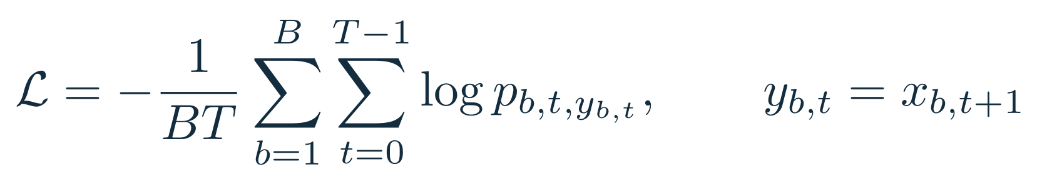
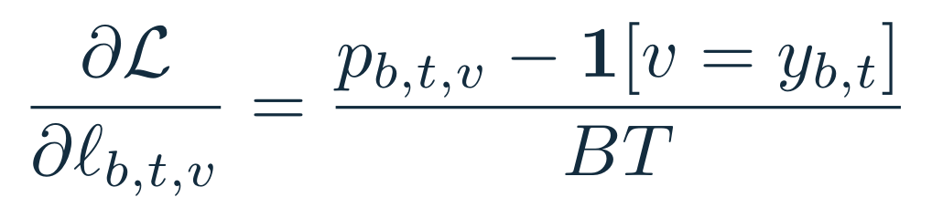
Cross-entropy and backpropagation
Training increases the probability of the observed next token
Logits
Cross-entropy
with target IDs
Scalar loss
Backward
For p = [0.665, 0.245, 0.090] and target 0: loss = −log(0.665) ≈ 0.408 nats.
Pass raw logits to cross_entropy. It performs log-softmax internally.
14
Notes:
Cross-entropy and backpropagation
For each prediction, cross-entropy is minus the natural logarithm of the probability assigned to the true next token. Average over B×T predictions to obtain the training loss. A confident correct prediction gives a small loss; assigning a tiny probability to the target gives a large loss. For our three-way example, a target probability 0.66524 gives loss 0.40761 nats. Differentiating the softmax-plus-cross-entropy combination produces a particularly simple expression: predicted probability minus the one-hot target, divided by B×T. The target logit has a negative gradient when its probability is below one, so gradient descent tends to raise it. Other logits have positive gradients. Autograd applies the chain rule backward through the vocabulary head, blocks, attention, and embeddings. In the code, logits and targets flatten to [B*T,V] and [B*T]. CrossEntropyLoss expects raw logits. Passing probabilities would apply the wrong computation. Perplexity is exp(mean loss) using natural logs and is meaningful only relative to a particular tokenizer and evaluation distribution.
References
PyTorch documentation: https://docs.pytorch.org/docs/stable/generated/torch.nn.CrossEntropyLoss.html and https://docs.pytorch.org/docs/stable/generated/torch.optim.AdamW.html

Slide 15
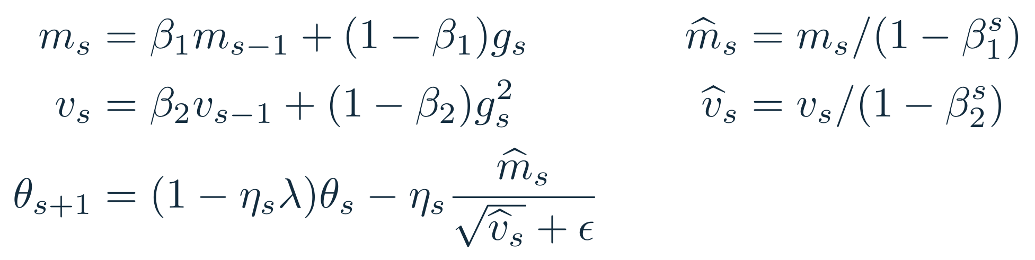
AdamW updates the learned parameters
Momentum smooths gradients, adaptive scaling adjusts steps, and weight decay shrinks matrices
gₛ is the gradient after global norm clipping at 1.0. Squares and division are elementwise.
Choice | Classroom setting
β₁, β₂ | 0.9, 0.95
ε; matrix weight decay | 10⁻⁸; 0.1
Peak learning rate | 0.001
Warmup / total steps | 20 / 300
15
Notes:
AdamW updates the learned parameters
An optimizer step follows backpropagation. The harness first clips the global gradient norm to 1.0, limiting unusually large updates. Adam maintains an exponential moving average m of the gradient and v of its elementwise square. The hats correct the initialization bias from starting these moments at zero. The adaptive update divides the first moment by the square root of the second moment plus epsilon. AdamW applies parameter shrinkage separately from those moments, which is why weight decay is called decoupled. The displayed lambda is 0.1 for matrix parameters and zero for vectors, including biases and LayerNorm scale and shift. Input/output E is a single shared matrix and appears in one optimizer group. Our classroom configuration uses beta1=0.9 and beta2=0.95, with 20 warmup steps followed by cosine decay to 10% of the peak learning rate. These are explicit teaching choices, not universal optimal settings. The generic harness defaults to a peak of 3e-4; slide 19 overrides it to 1e-3 for the measured run.
References
Loshchilov & Hutter (2019), Decoupled Weight Decay Regularization. https://arxiv.org/abs/1711.05101
PyTorch documentation: https://docs.pytorch.org/docs/stable/generated/torch.nn.CrossEntropyLoss.html and https://docs.pytorch.org/docs/stable/generated/torch.optim.AdamW.html

Slide 16
The training harness
A complete experiment needs data boundaries, evaluation, and recoverable state
Documents
Deduplicate
and split
Token streams
Shifted batches
optimizer.zero_grad(set_to_none=True)
for microbatch in range(accum):
logits, loss = model(x, y)
(loss / accum).backward()
clip_grad_norm_(model.parameters(), 1.0)
optimizer.step()
Validation
model.eval() + no_grad()
Fixed evaluation windows
Loss, perplexity, accuracy
Checkpoint
Weights, optimizer, step,
configuration, and RNG states
Effective batch = batch_size × accumulation steps
16
Notes:
The training harness
train.py starts from UTF-8 documents separated by blank lines. It removes exact duplicate documents, shuffles deterministically, and holds out about 10% before creating token streams. Each document has BOS and EOS delimiters. Windows may span document boundaries, so the model can condition across the explicit separators. Real datasets also require near-duplicate control and appropriate source/group splits. Each sampled window has T inputs and T targets shifted one token forward. The diagram’s loop is a compact excerpt; the actual harness draws a new batch for each microbatch, sets a warmup/cosine learning rate, supports optional CUDA bf16 autocast, and logs JSONL records. Dividing each microbatch loss by the accumulation count preserves the mean-gradient scale. Evaluation switches off dropout and gradients, uses fixed seeded windows, and restores training mode afterward. best.pt tracks validation improvement, and last.pt supports resume. Resume checks corpus hash and configuration and restores optimizer and RNG states. Keep the original total-step horizon when resuming. This is a single-process harness; it does not implement distributed training.
References
PyTorch documentation: https://docs.pytorch.org/docs/stable/generated/torch.nn.CrossEntropyLoss.html and https://docs.pytorch.org/docs/stable/generated/torch.optim.AdamW.html

Slide 17
The entire forward pass in code
The executable implementation keeps the mathematics visible
positions = torch.arange(T, device=ids.device)
x = token_embedding(ids) + position_embedding(positions)
for block in blocks:
x = block(x)
x = final_norm(x)
logits = F.linear(x, token_embedding.weight)
loss = F.cross_entropy(
logits.reshape(B*T, V), targets.reshape(B*T))
Each block: x = x + attention(ln1(x)), then x = x + ffn(ln2(x)).
17
Notes:
The entire forward pass in code
This excerpt is the complete mathematical path with optional dropout and error checking omitted for readability. An arange creates position indices. Embedding lookup broadcasts the position vectors across all sequences. The loop passes the residual stream through L independently parameterized blocks. Final normalization and F.linear with the token embedding weight produce vocabulary logits. The executable implementation computes cross-entropy only when targets are supplied and explicitly converts logits to float32 before loss calculation. Tensor dimensions make every line checkable: IDs are [B,T], embeddings are [B,T,d], and logits are [B,T,V]. PyTorch nn.Linear stores its weight as [out_features,in_features], so F.linear(x,weight) internally multiplies by weight-transpose. That convention explains why the mathematical vocabulary projection is R E-transpose while code passes E directly. The source uses ordinary PyTorch modules, which lets autograd discover all parameter dependencies without manually coding derivatives. Read dense_lm.py next to slides 5–15 to connect each formula to an operation.
References
Radford et al. (2019), Language Models are Unsupervised Multitask Learners. https://github.com/openai/gpt-2/blob/master/src/model.py
PyTorch documentation: https://docs.pytorch.org/docs/stable/generated/torch.nn.CrossEntropyLoss.html and https://docs.pytorch.org/docs/stable/generated/torch.optim.AdamW.html

Slide 18
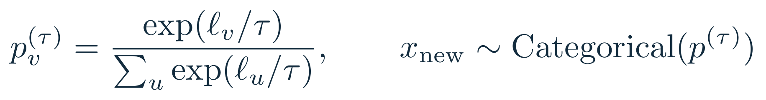
Generating a token and continuing the sequence
The model predicts a distribution. A decoding rule chooses what to append.
Prompt IDs
Last-position
logits
Temperature
and top-k
Sample
and append
Temperature τ | p₀ | p₁ | p₂
0.5 | 0.867 | 0.117 | 0.016
1.0 | 0.665 | 0.245 | 0.090
2.0 | 0.506 | 0.307 | 0.186
logits = model(ids)[0][:, -1]
probs = softmax(logits / tau)
next_id = multinomial(probs, 1)
ids = cat([ids, next_id], dim=1)
Greedy decoding takes argmax. EOS or a length limit stops generation.
18
Notes:
Generating a token and continuing the sequence
Generation first processes the prompt and selects logits at its final position. Positive temperature divides logits before softmax. Lower temperature makes the distribution more concentrated; higher temperature flattens it. The table uses the same logits [2,1,0] as earlier, with no top-k filtering, so the comparison isolates temperature. Top-k retains the k highest-scoring candidates and sets all other scores to negative infinity before normalization. Categorical sampling draws one token ID, which is appended to the prompt. The new sequence becomes the next input. Temperature zero uses a separate argmax branch, avoiding division by zero. The full generator suppresses BOS, stops on EOS or a token limit, and turns off dropout with eval(). It recomputes the current context each step and does not implement a KV cache. If the context fills, it keeps the recent window and restarts absolute position indices. A KV cache is a useful later optimization, but needs careful position and mask handling. The code snippet omits these controls for readability.
References
Radford et al. (2019), Language Models are Unsupervised Multitask Learners. https://github.com/openai/gpt-2/blob/master/src/model.py

Slide 19
Running and checking the tutorial
A measured CPU run on an original synthetic science corpus
120,704 parameters
5.56 → 0.81 held-out loss
2.26 byte-token perplexity
Checks: causal independence, normalized attention, manual/SDPA agreement, gradients, and learning.
python corpus.py
python train.py --steps 300 --context 64 --width 64 --layers 2 \
--heads 4 --batch-size 8 --lr 0.001 --out runs/classroom
python generate.py --checkpoint runs/classroom/best.pt
19
Notes:
Running and checking the tutorial
These measurements come from running the supplied code on a CPU using PyTorch 2.14.1+cpu. The corpus has 288 synthetic documents formed from a small grammar, split into 260 training and 28 validation documents. The model has 120704 parameters. It trains for 300 optimizer steps with 8 sequences of 64 tokens per step, processing 153,600 token targets. Fixed sampled held-out windows give initial loss 5.556281 and final loss 0.814793, with final perplexity 2.258709. This demonstrates that the training pipeline learns a restricted distribution. It does not measure scientific reasoning, language understanding, or general-purpose LLM quality. Actual sampling can still contain errors. The code supports CPU, CUDA, and Apple MPS, with bf16 optional on supported CUDA hardware. Only CPU execution was available for this run. Try changing temperature, increasing layers, or removing the mask in a separate experiment. Removing the mask may lower training loss deceptively because targets leak through future input positions. Tests and full commands are in README.md.
References

Slide 20
References and a reading path
Primary sources for the architecture, mathematics, and implementation
1
Vaswani et al. · Attention Is All You Need
2017 · arxiv.org/abs/1706.03762
2
Radford et al. · Language Models are Unsupervised Multitask Learners
2019 · github.com/openai/gpt-2
3
Sennrich et al. · Neural Machine Translation of Rare Words with Subword Units
2016 · arxiv.org/abs/1508.07909
4
Ba et al. · Layer Normalization
2016 · arxiv.org/abs/1607.06450
5
Hendrycks & Gimpel · Gaussian Error Linear Units
2016 · arxiv.org/abs/1606.08415
6
Loshchilov & Hutter · Decoupled Weight Decay Regularization
2019 · arxiv.org/abs/1711.05101
7
PyTorch · Linear, LayerNorm, GELU, CrossEntropyLoss, AdamW, SDPA
docs.pytorch.org · API details and numerical conventions
Read 2 for the decoder architecture, 1 for attention, and 6 for the optimizer.
20
Notes:
References and a reading path
The deck uses a GPT-style teaching architecture and does not claim to reproduce every GPT-2 engineering detail. The original 2017 transformer includes an encoder, cross-attention, post-LayerNorm, and ReLU; these choices differ from this decoder-only baseline. Read the original attention equations, then compare the GPT-2 implementation’s causal self-attention and pre-normalization structure. The BPE paper gives the subword-learning idea, while the runnable tokenizer here intentionally uses fixed UTF-8 bytes. The GELU paper defines the chosen activation, the LayerNorm paper defines feature normalization, and the AdamW paper explains decoupled weight decay. Full source URLs appear below and in REFERENCES.md. Equations and numerical examples are original teaching derivations. All diagrams are editable slide objects, and charts retain their underlying values. The source package also includes LaTeX expressions for the typeset equations.
References
Vaswani et al. (2017), Attention Is All You Need, Sections 3.2–3.4. https://arxiv.org/abs/1706.03762
Radford et al. (2019), Language Models are Unsupervised Multitask Learners. https://github.com/openai/gpt-2/blob/master/src/model.py
Sennrich, Haddow & Birch (2016), Neural Machine Translation of Rare Words with Subword Units. https://arxiv.org/abs/1508.07909
Ba, Kiros & Hinton (2016), Layer Normalization. https://arxiv.org/abs/1607.06450
Hendrycks & Gimpel (2016), Gaussian Error Linear Units. https://arxiv.org/abs/1606.08415
Loshchilov & Hutter (2019), Decoupled Weight Decay Regularization. https://arxiv.org/abs/1711.05101
PyTorch documentation: https://docs.pytorch.org/docs/stable/generated/torch.nn.CrossEntropyLoss.html and https://docs.pytorch.org/docs/stable/generated/torch.optim.AdamW.html
PyTorch scaled dot-product attention. https://docs.pytorch.org/docs/main/generated/torch.nn.functional.scaled_dot_product_attention.html

