Slide 1
Vibe Coding: Session 1

Slide 2
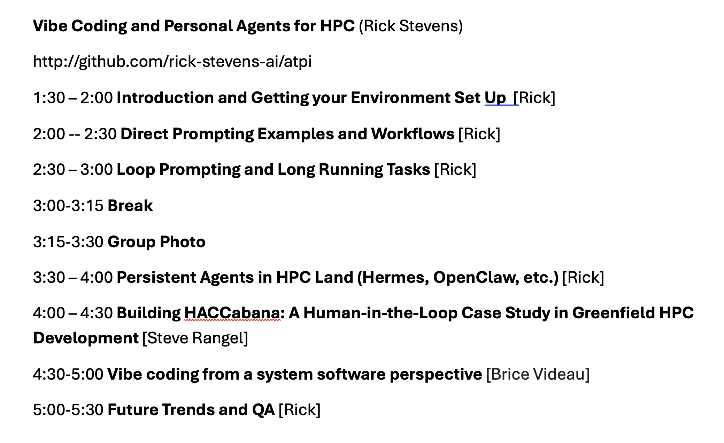

Slide 3
Vibe Coding Session 1
Goals:
  Get everyone up on pi with Minerva endpoint
  Run through a set of basic pi exercises
  Explain how pi is different from other CLI based coding agents
  Bonus - get codex up talking to Minerva
  Bonus - get pi working on free endpoints
  Bonus - build library of skills that pi can leverage

Slide 4
Installing pi
Two paths are commonly used npm and brew
Https://github.com/rick-stevens-ai/atpi has instructions
I wrap pi in a helper script that does a few things
  Upon invocation it checks for updates (pi dev is very active)
  Connects to my preferred endpoint to drive the model
I have prepared a prototype wrapper for you called “atpi” which has two variants (atpi-I and atpi-N) I for Inkling and N for nemotron
You should install these and test both atpi-I and atpi-N
These are going to point to the Minerva endpoint which hopefully you got working on tuesday

Slide 5
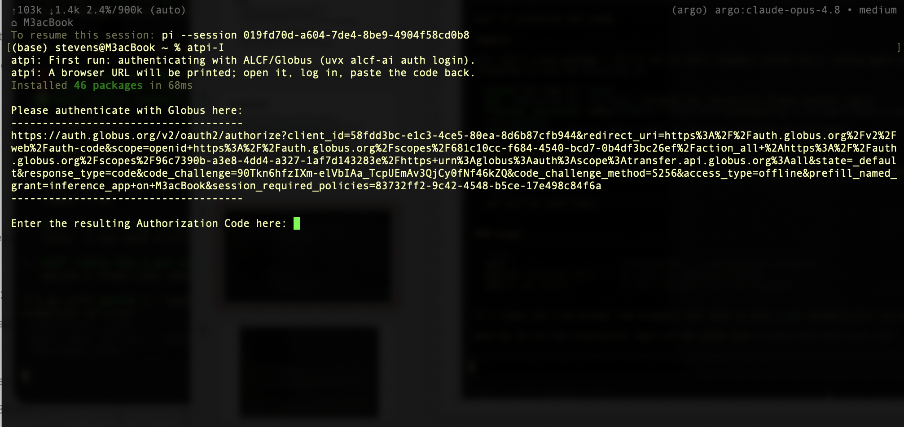

Slide 6
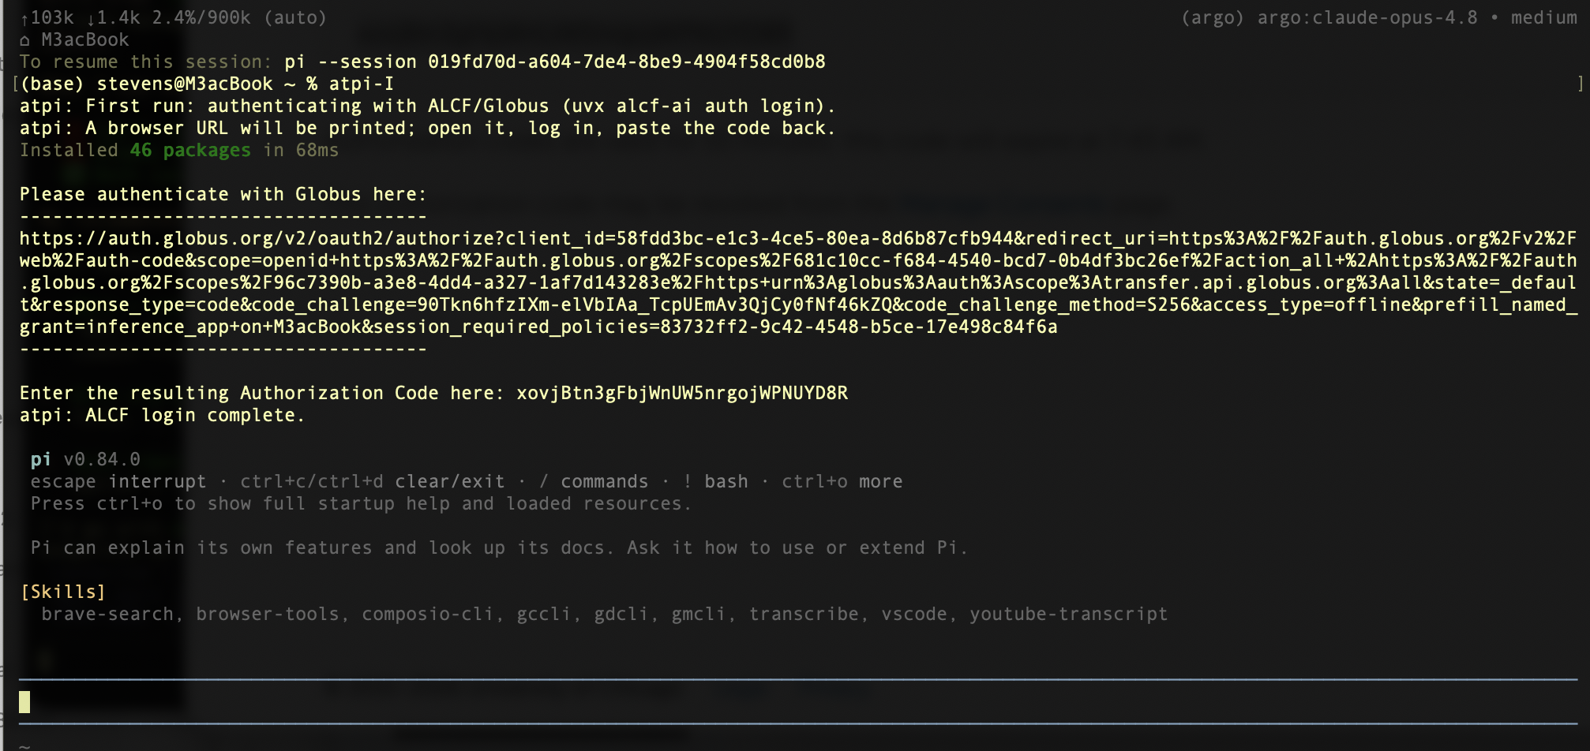

Slide 7
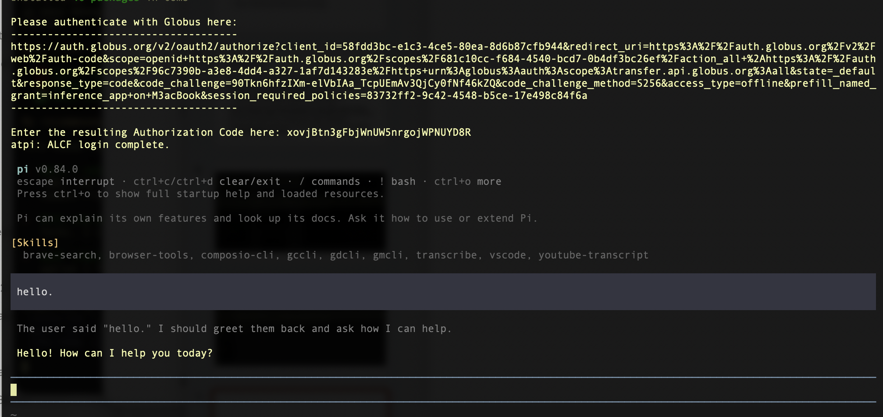

Slide 8
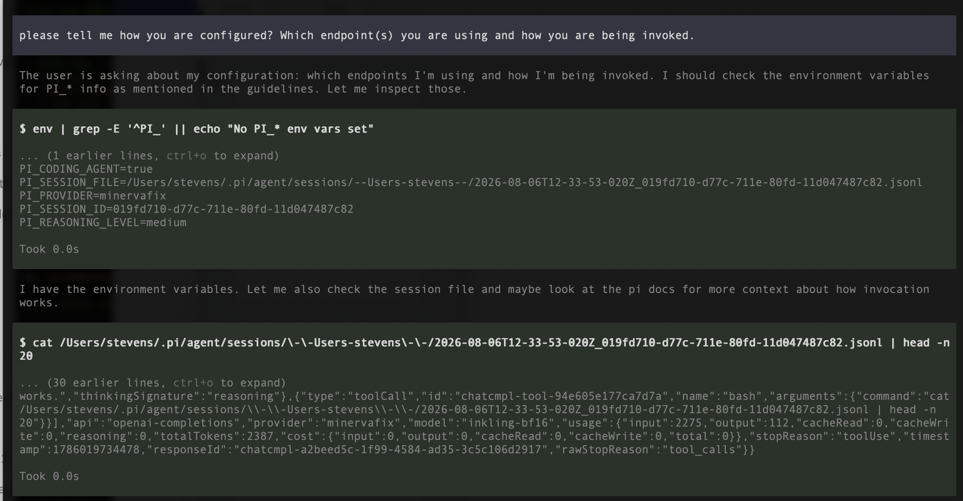

Slide 9
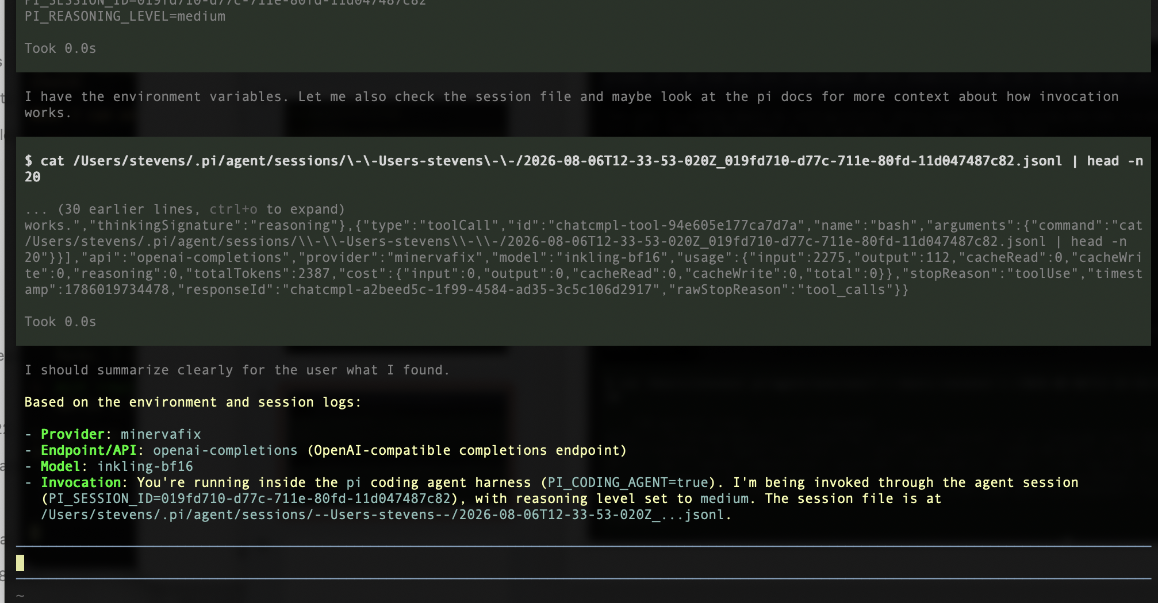

Slide 10
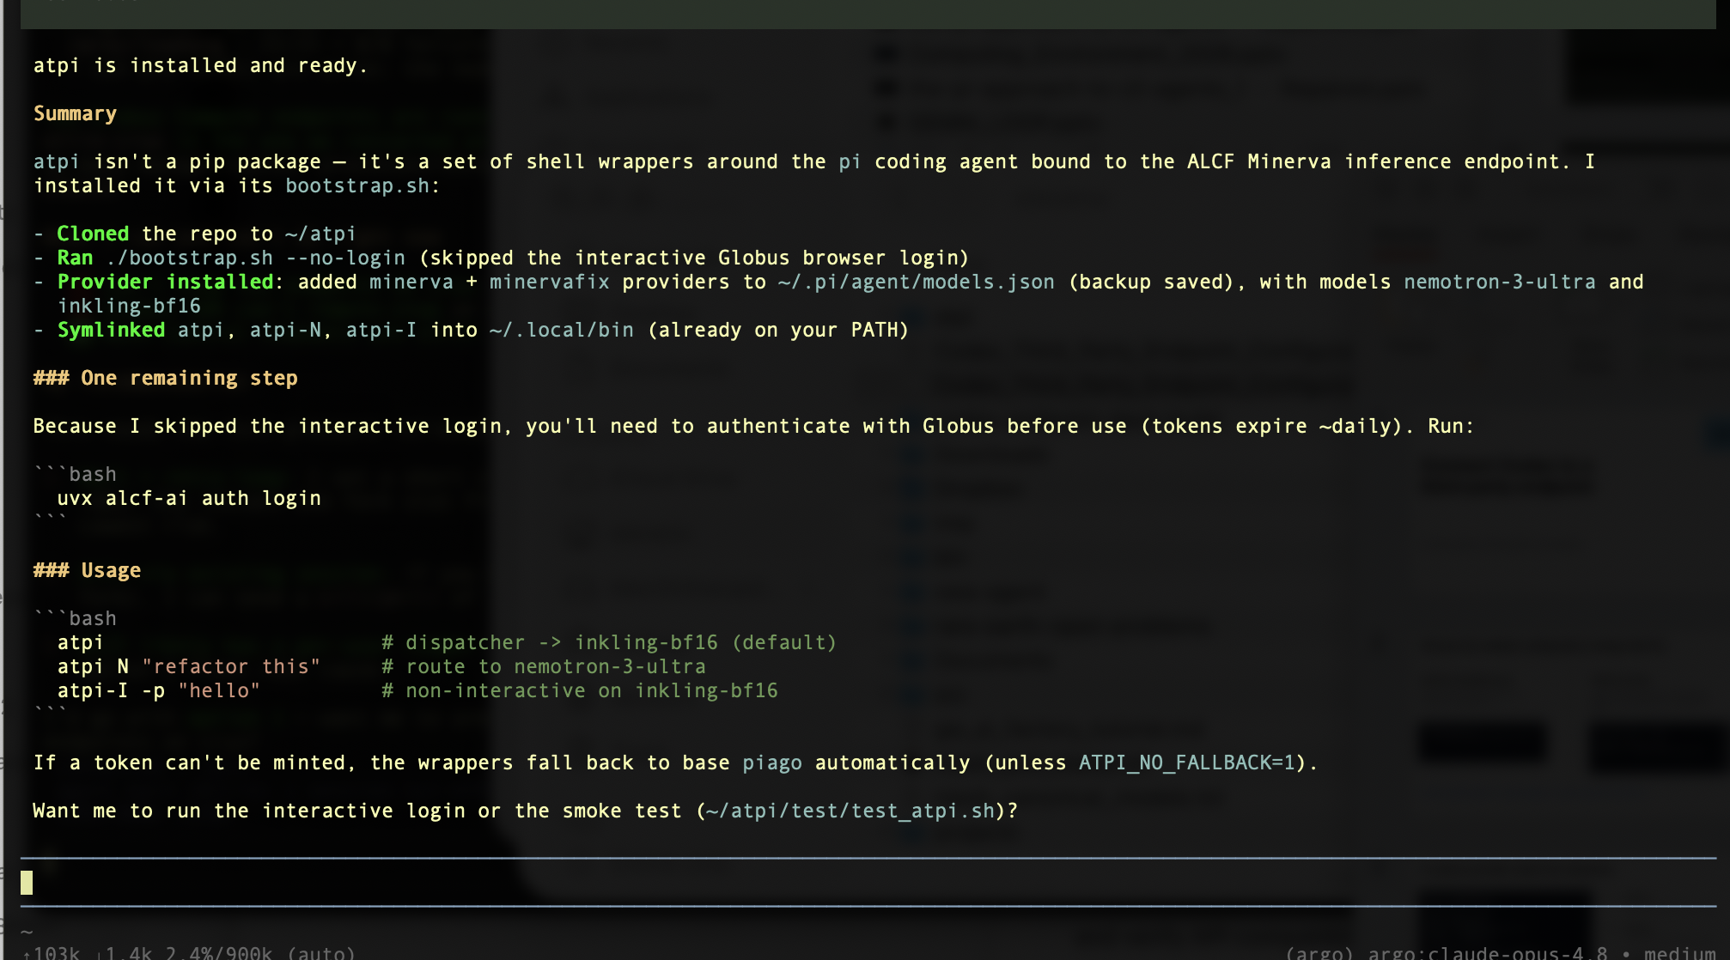

Slide 11
Typical npm update readout

Slide 12
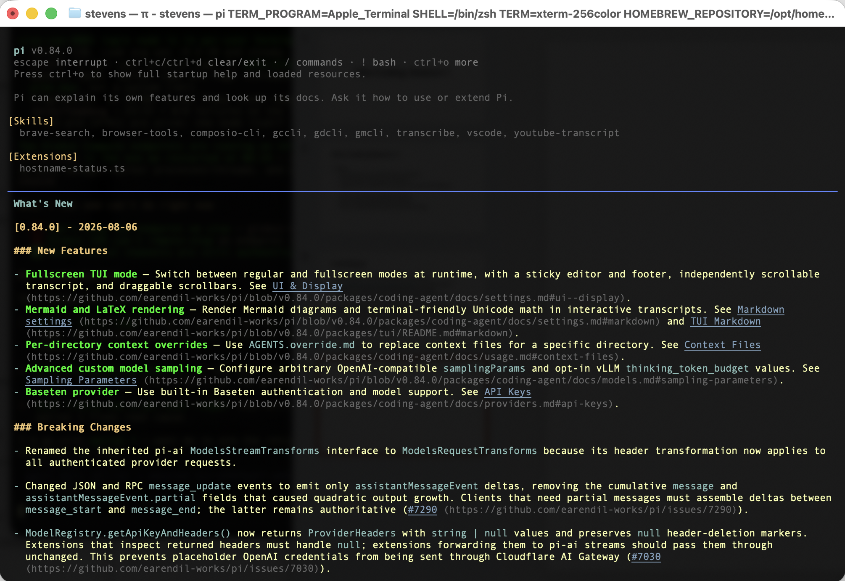

Slide 13
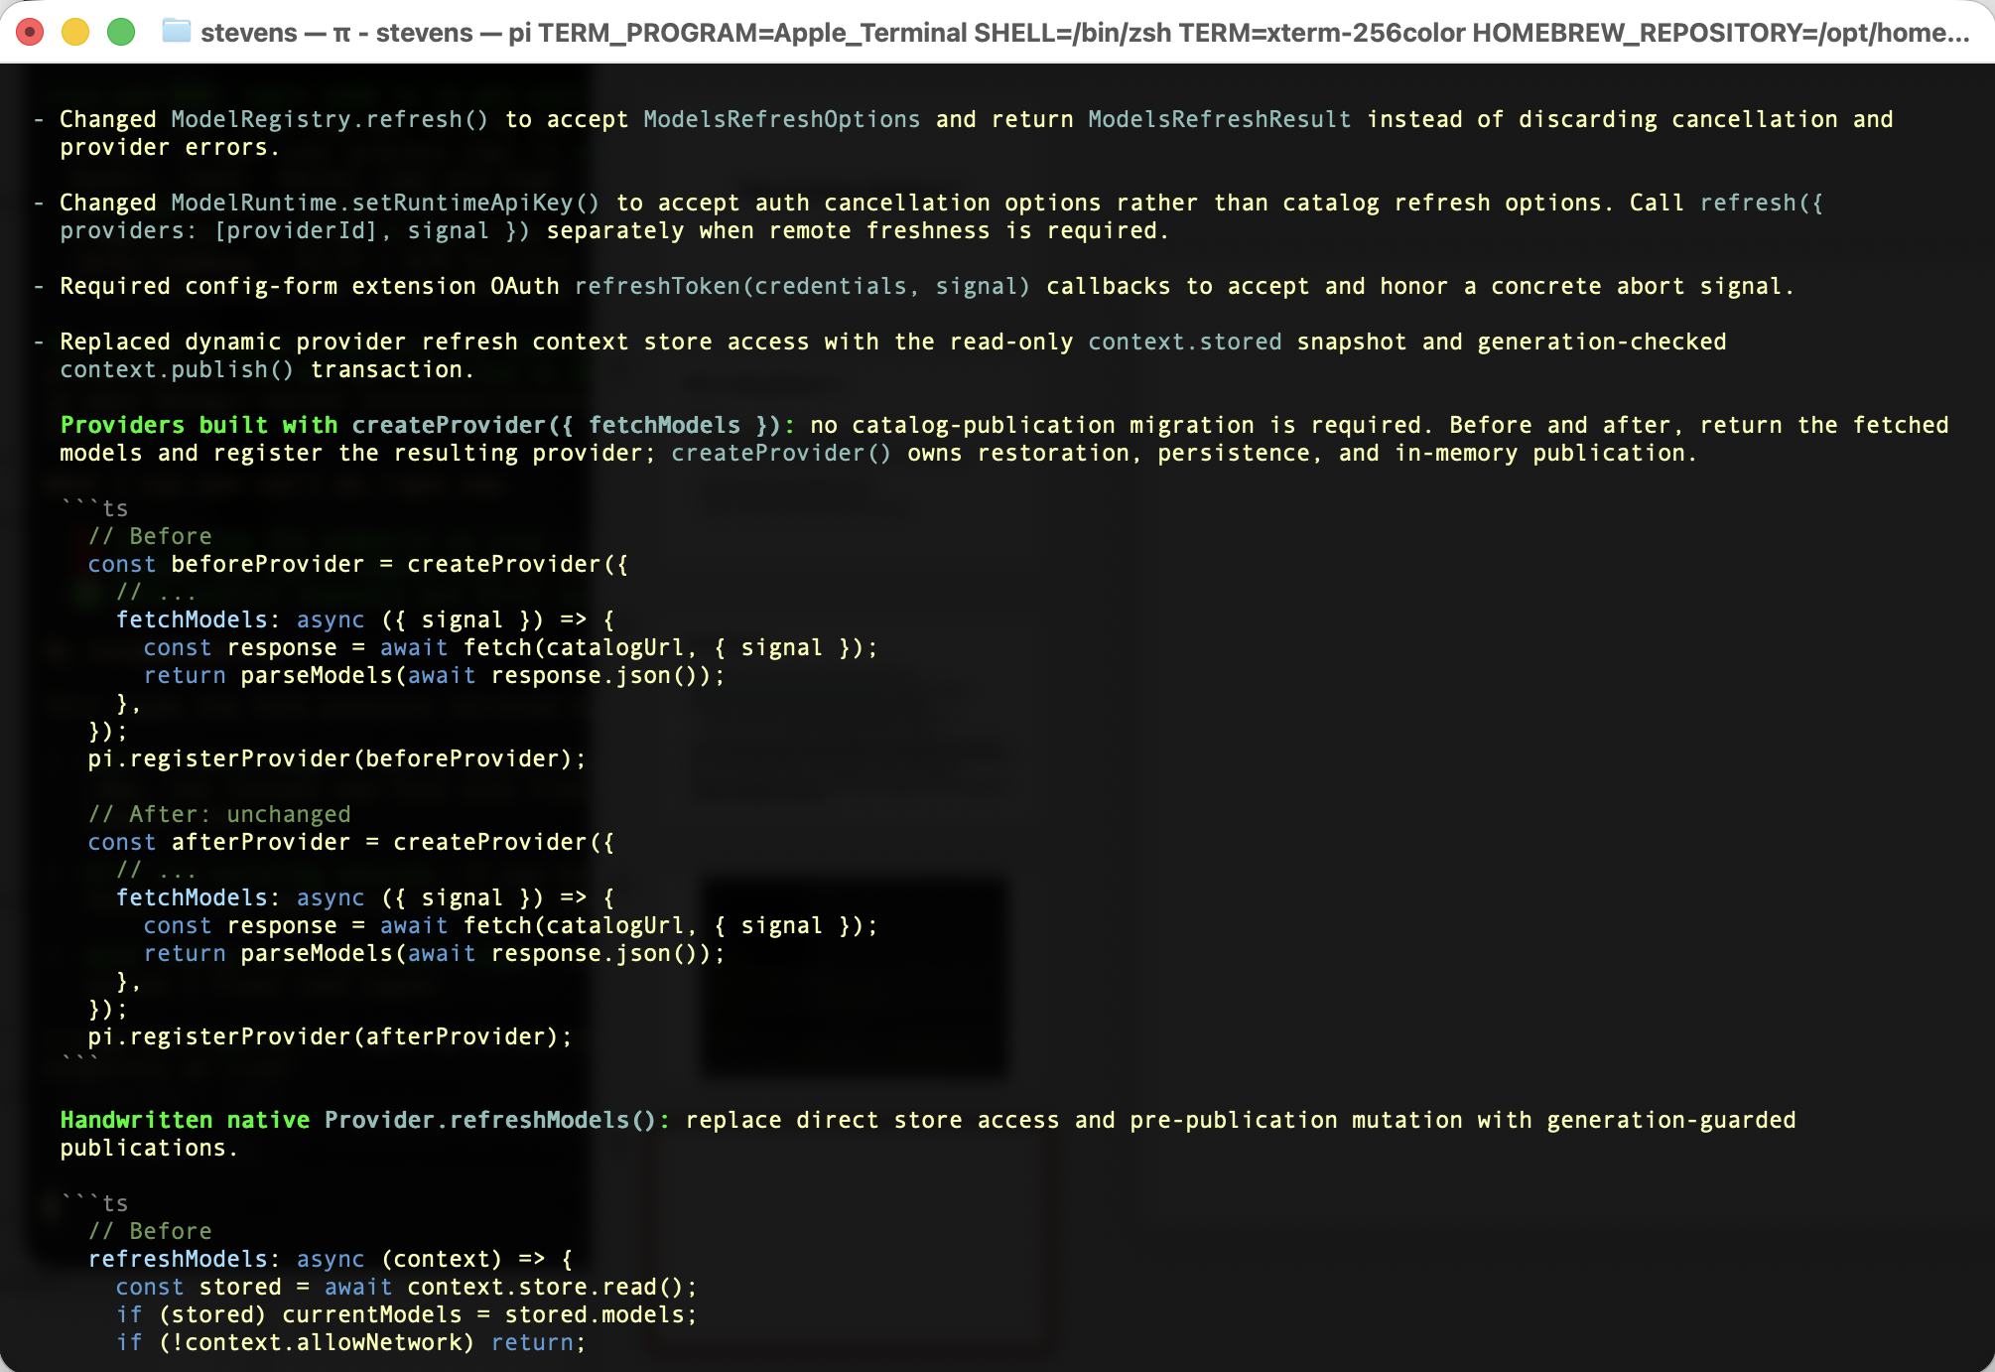

Slide 14
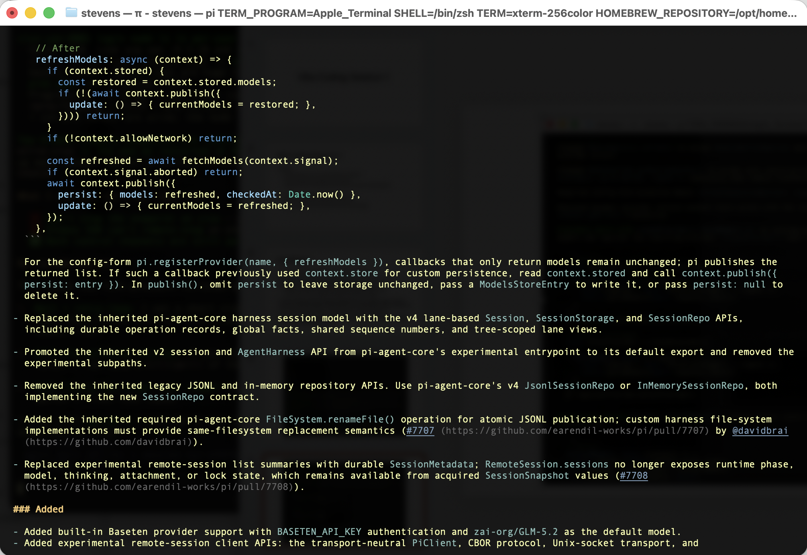

Slide 15
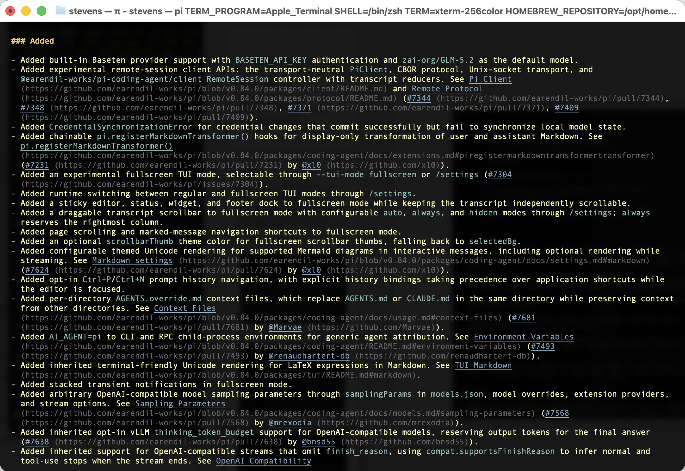

Slide 16
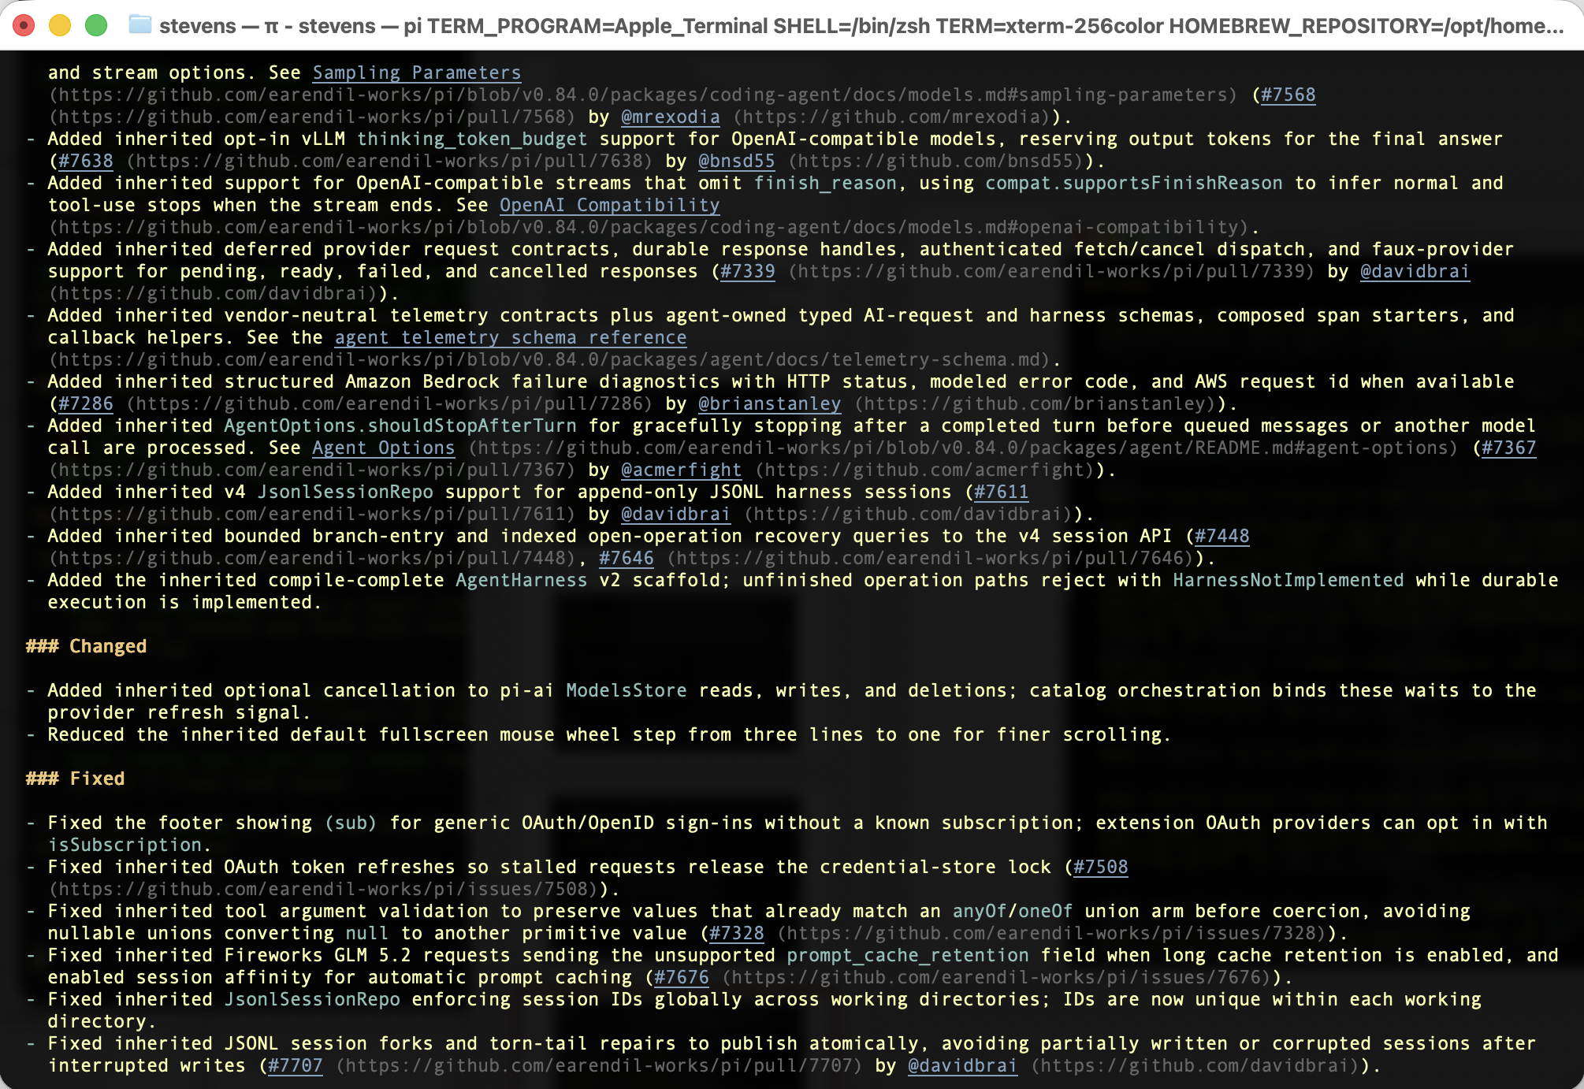

Slide 17
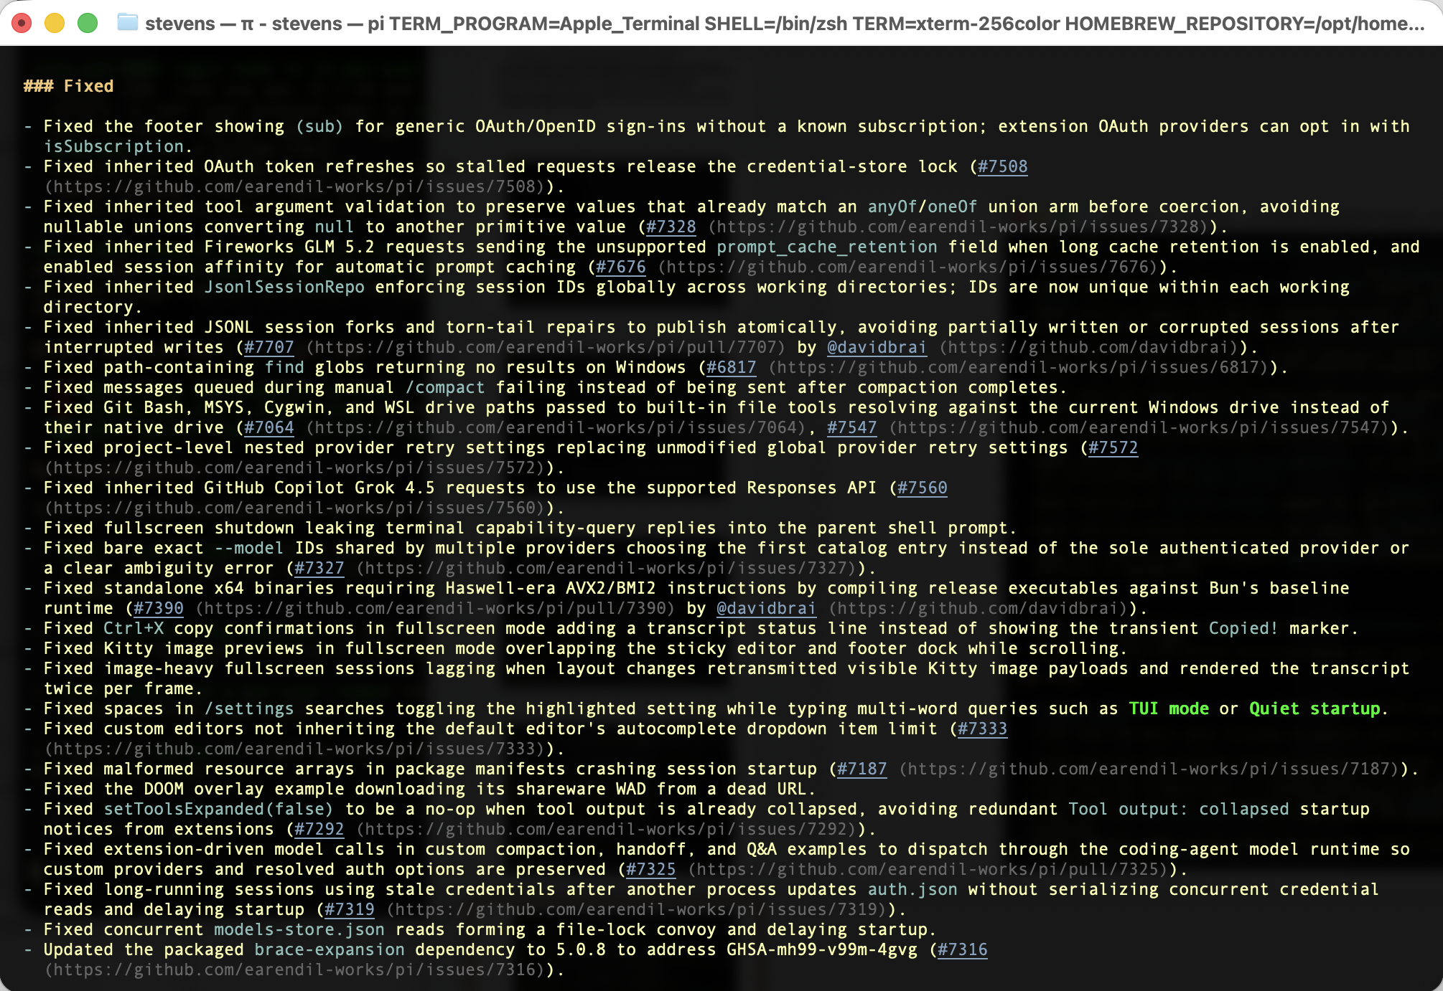

Slide 18
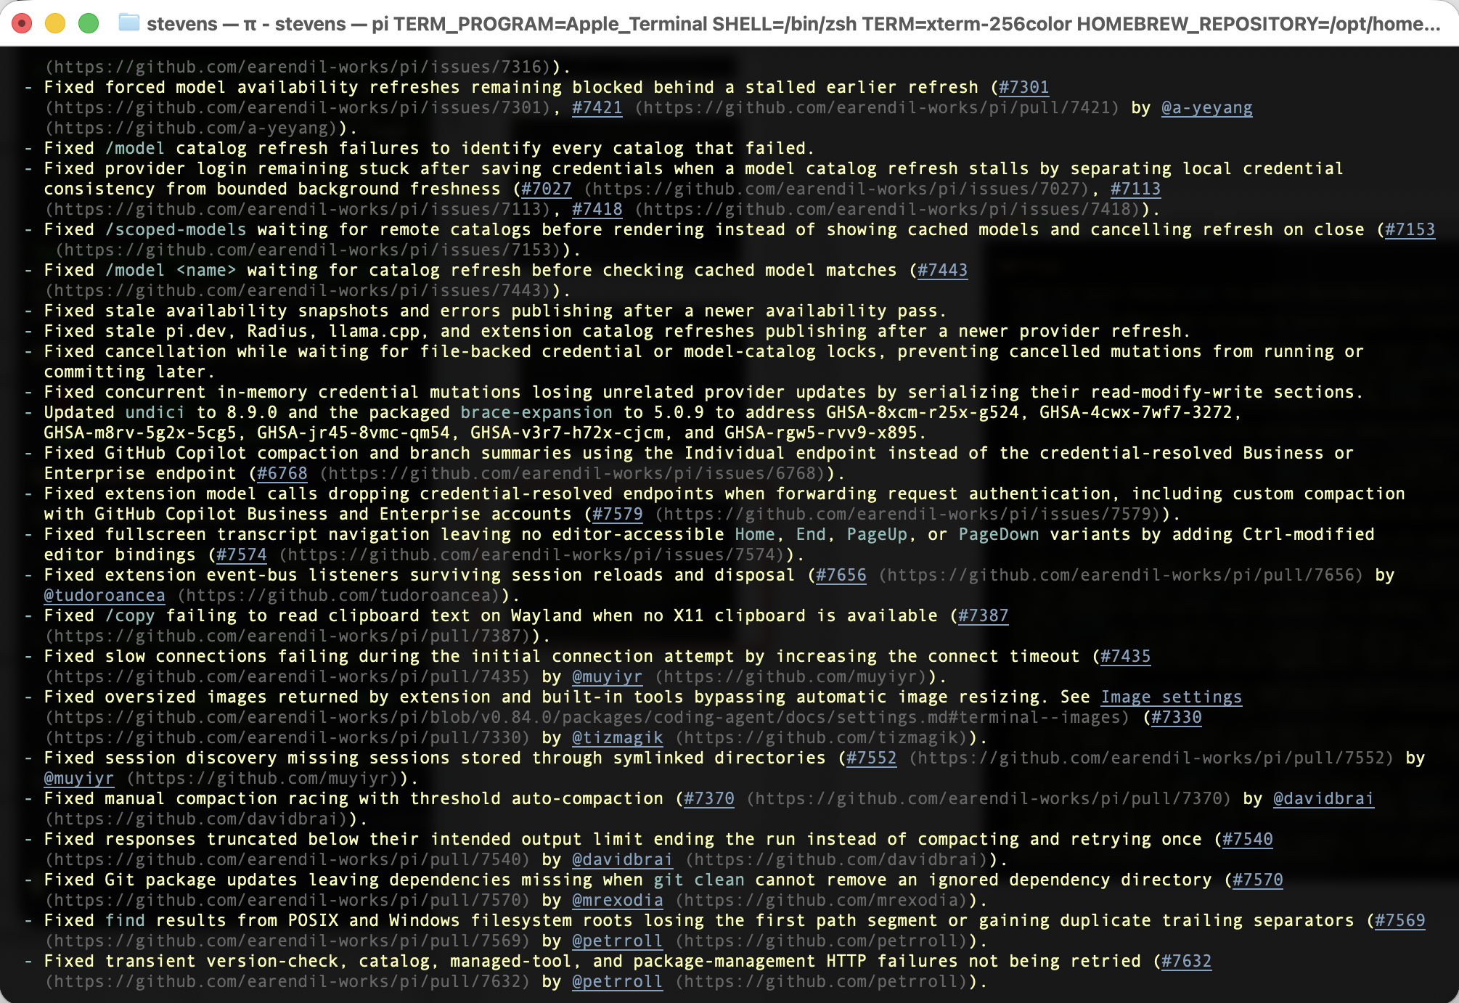

Slide 19
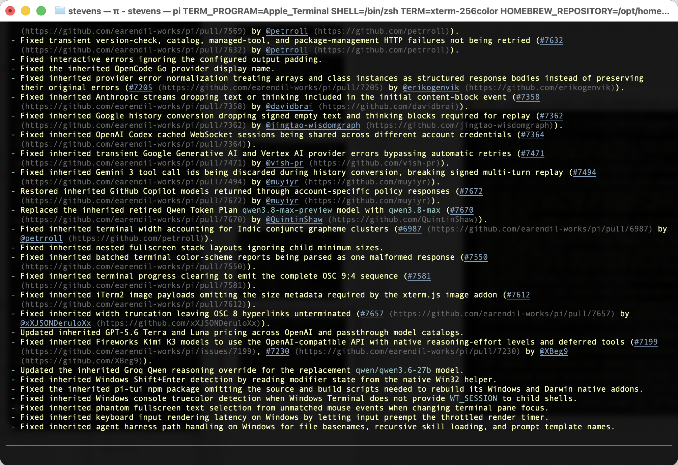

Slide 20
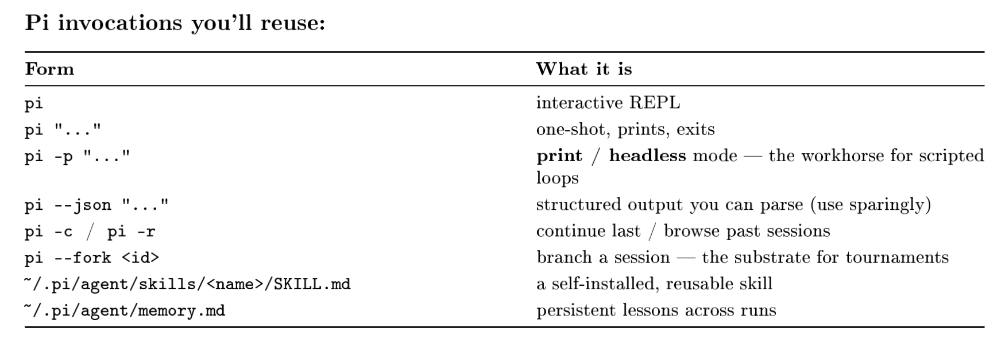
Pi basic commands and files

Slide 21
(base) stevens@M3acBook ~ % atpi-I -p "generate a simple fibonacci program to compute up to f(100)"
(about 1 minute later)
Created `/Users/stevens/fibonacci.py` — computes `f(0)` through `f(100)` iteratively. `f(100) = 354224848179261915075`.

Slide 22
Basic sanity check once you have pi up
“Please generate a 1 page cheat sheet for pi commands as a PDF”

Slide 23
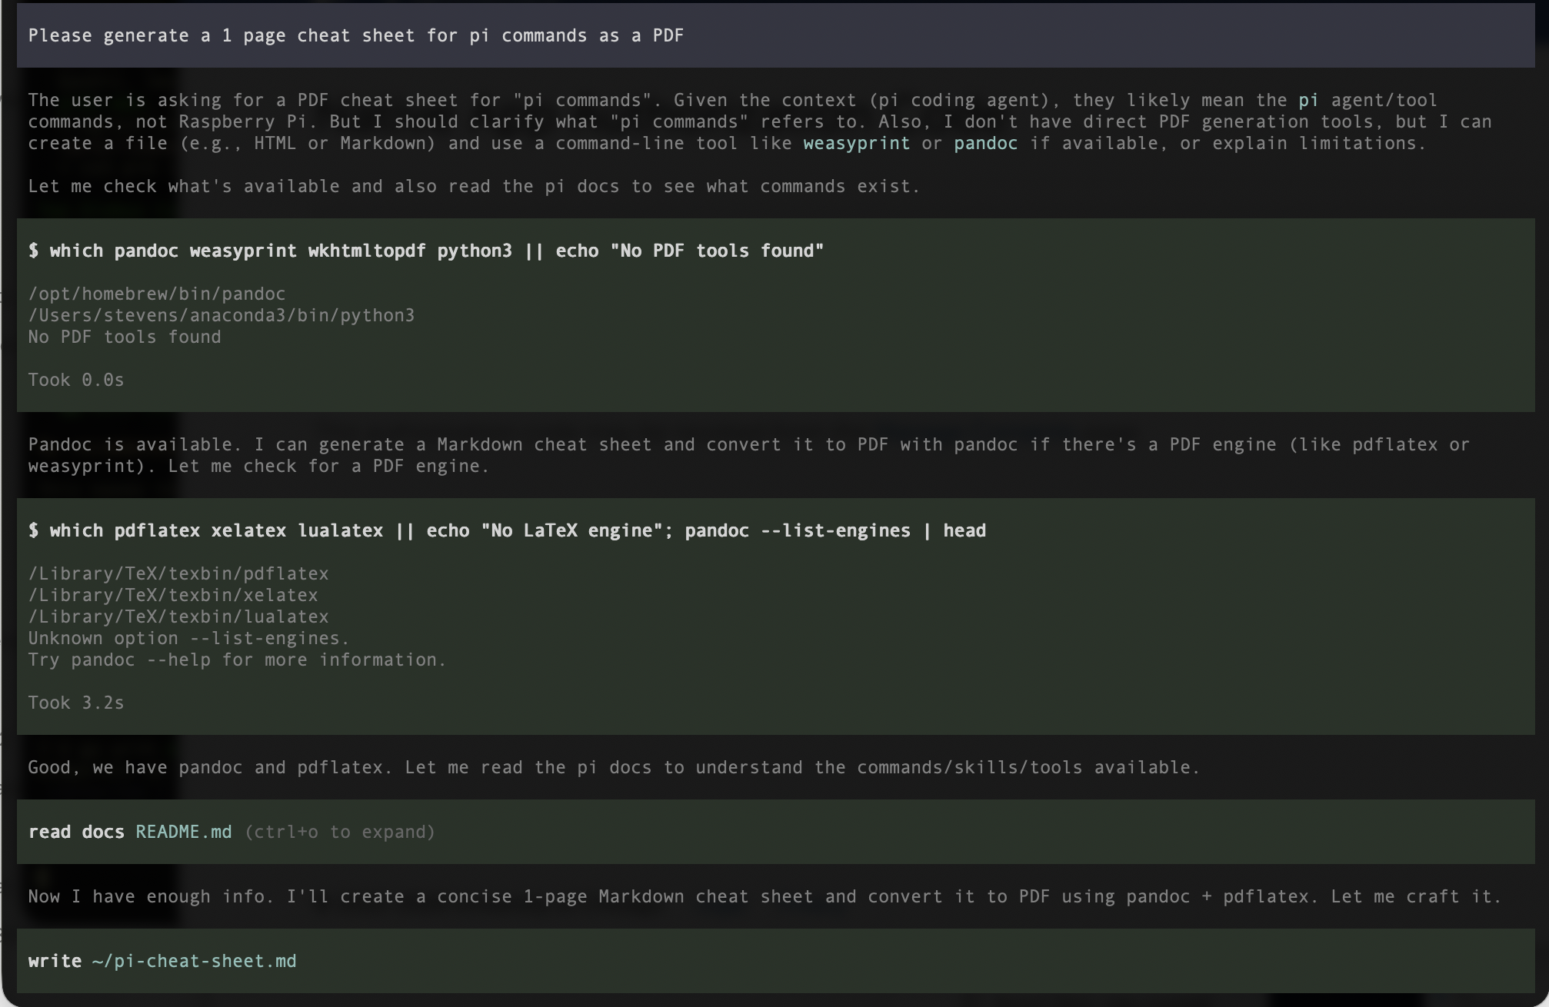

Slide 24
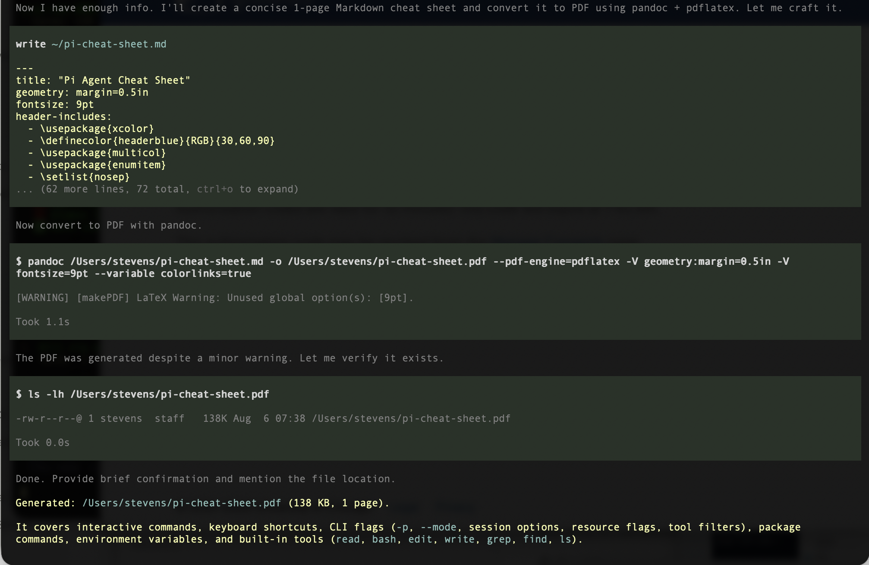

Slide 25
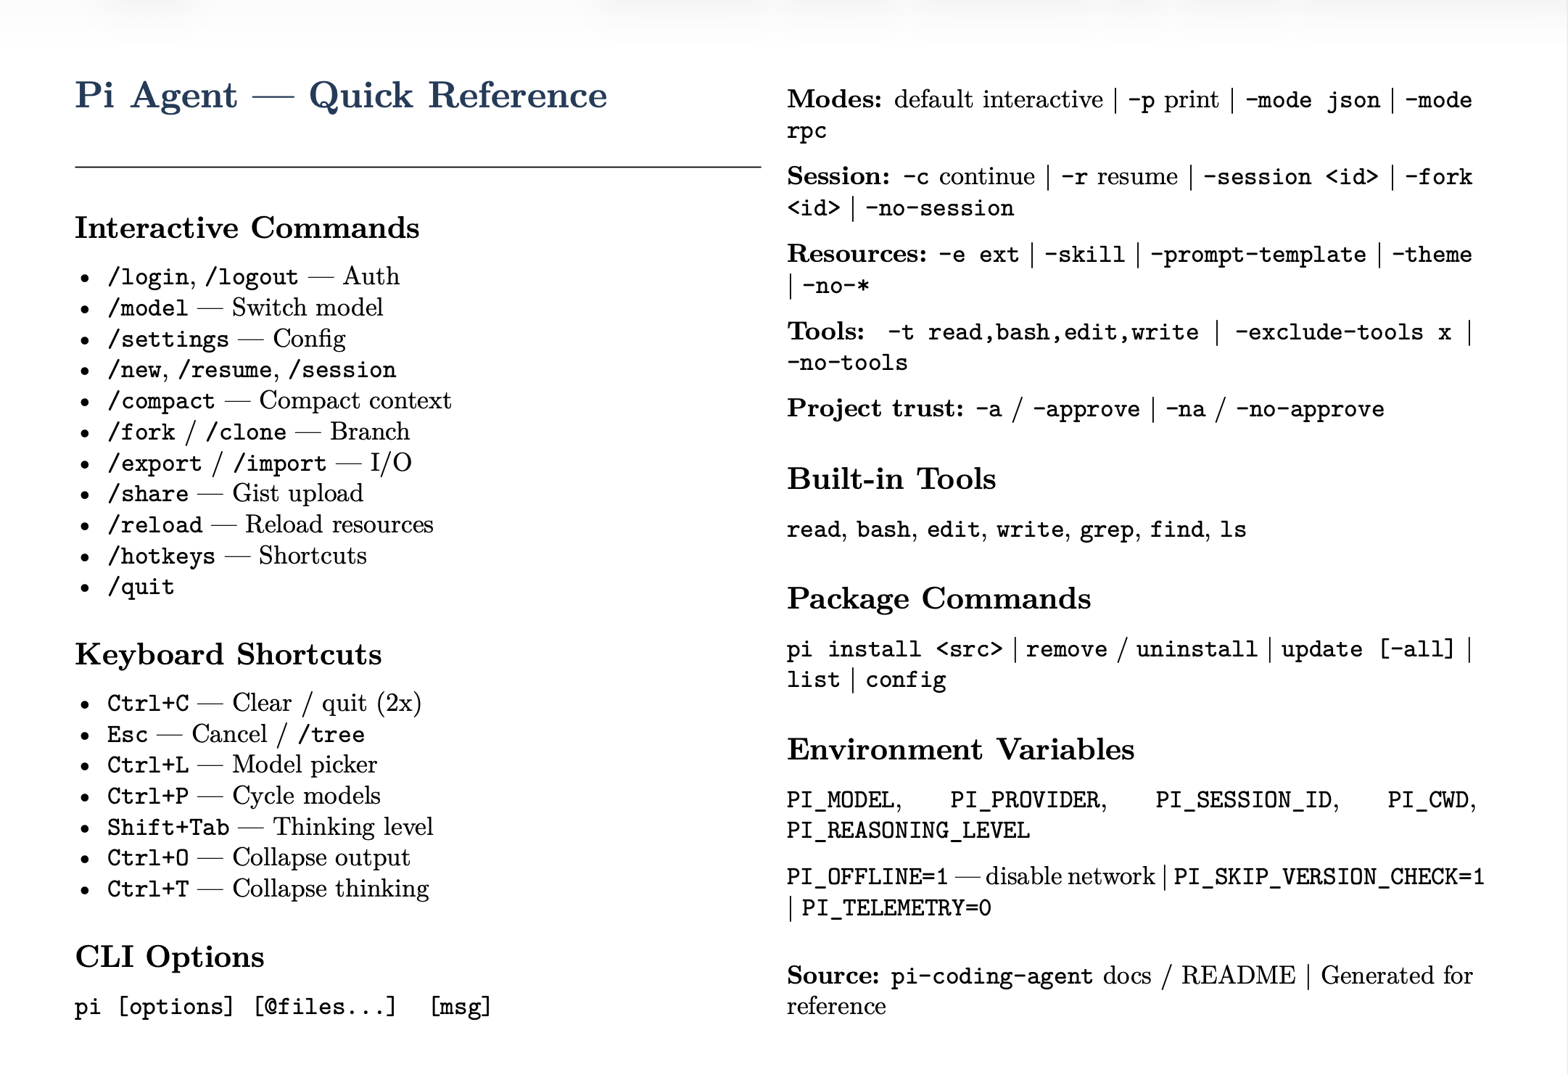

Slide 26
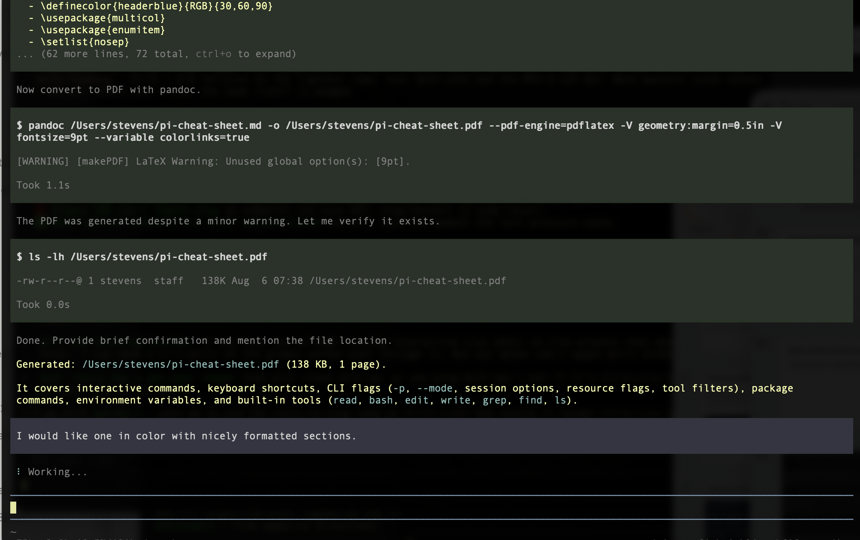

Slide 27
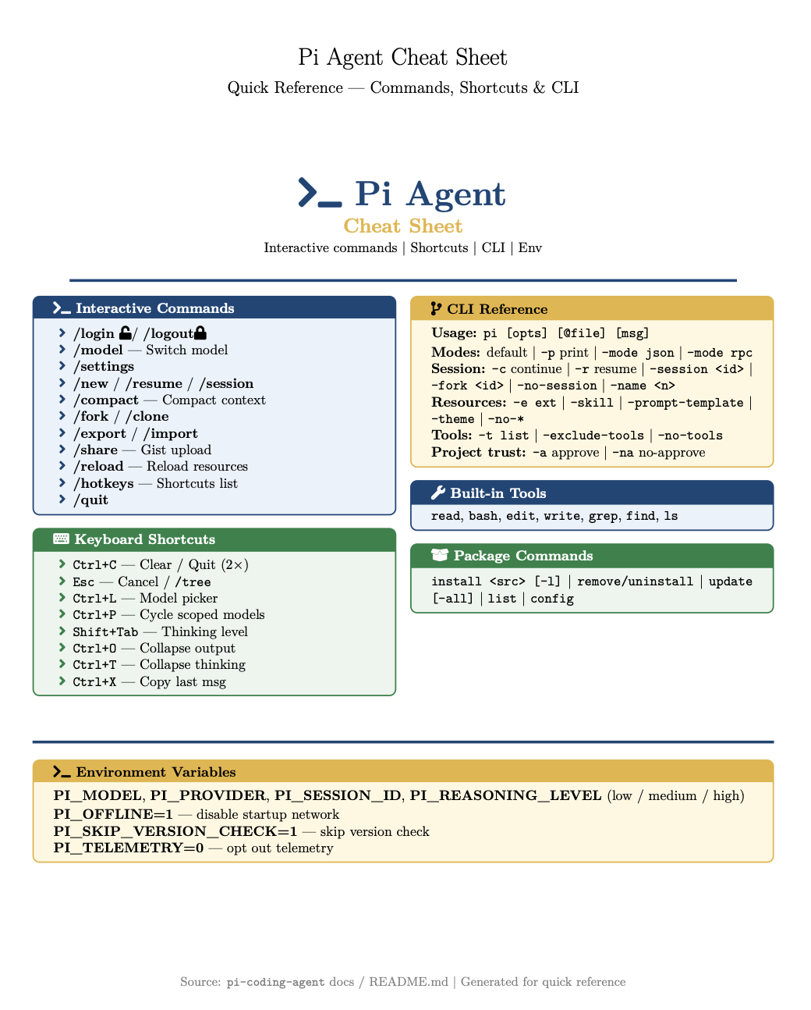

Slide 28
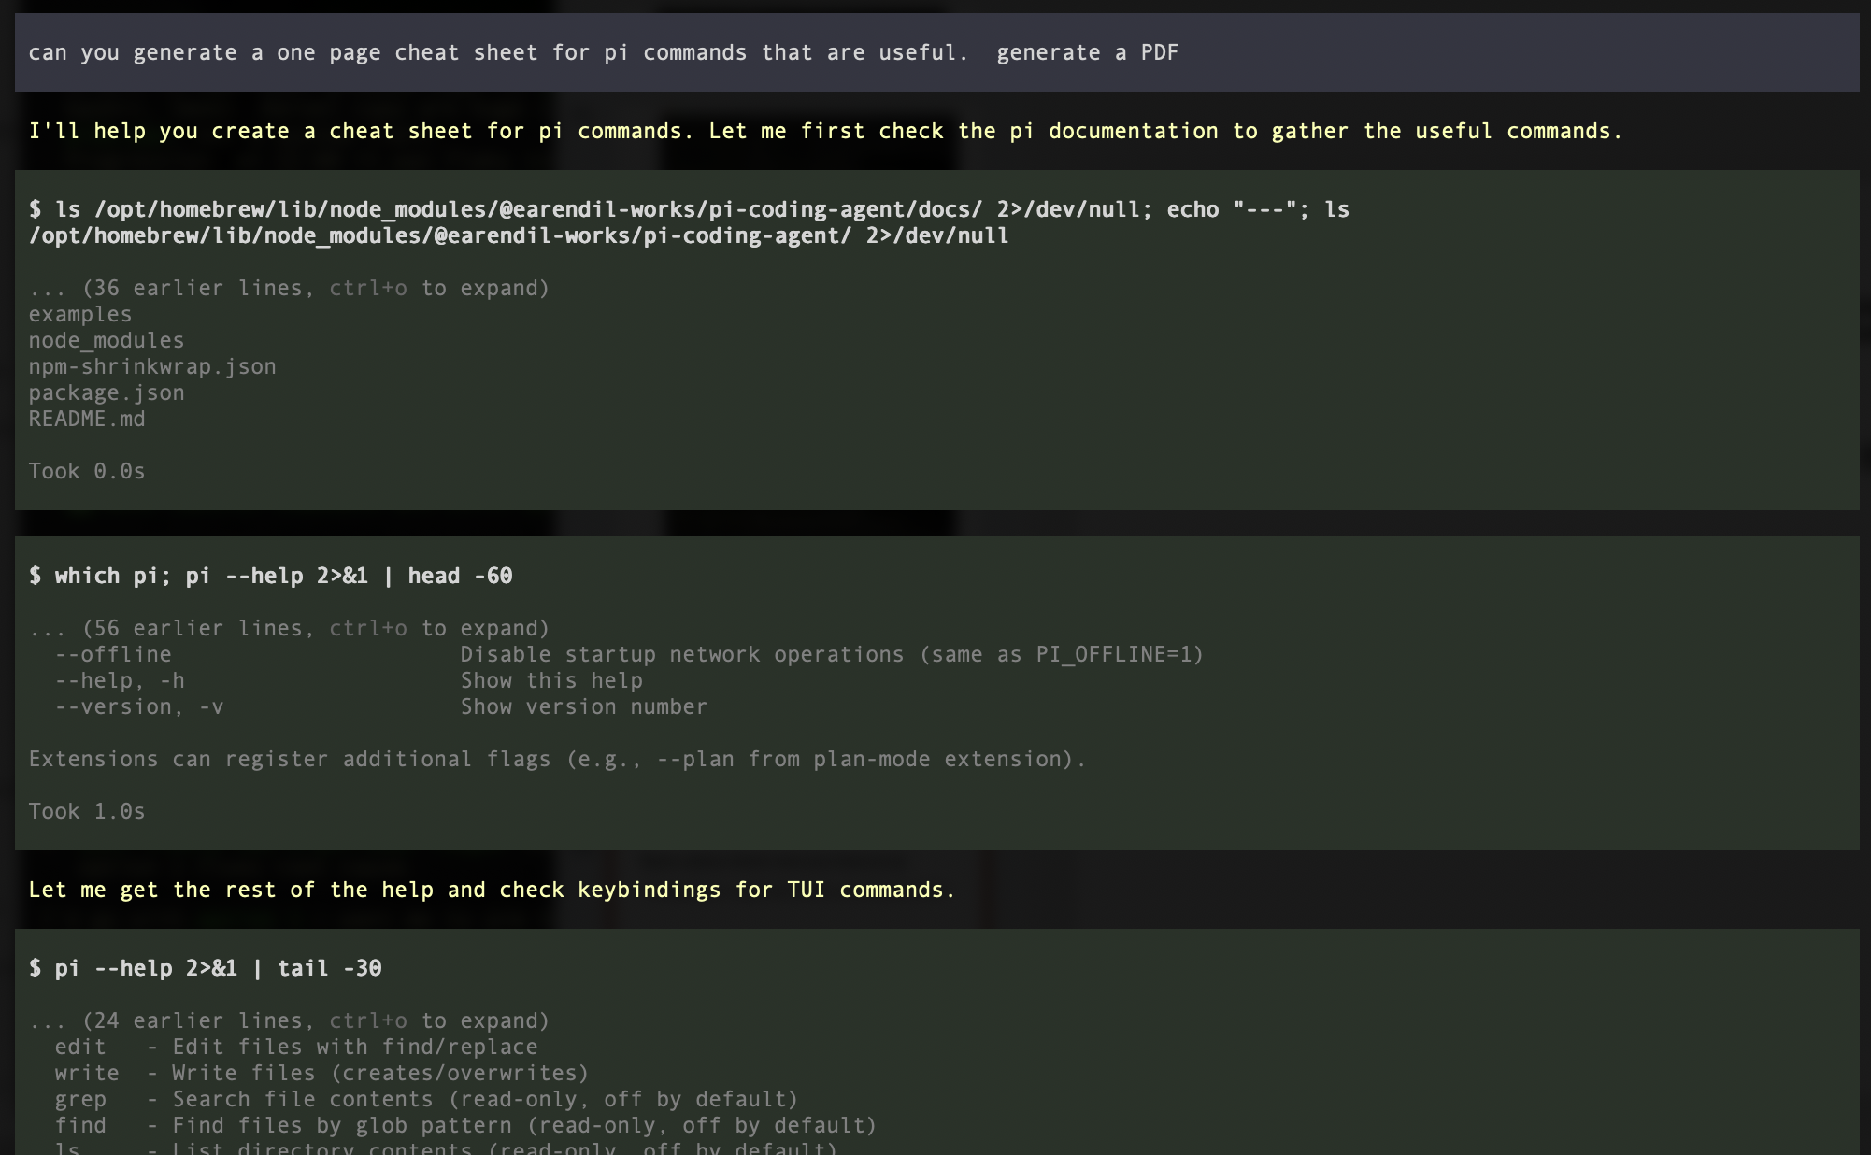

Slide 29
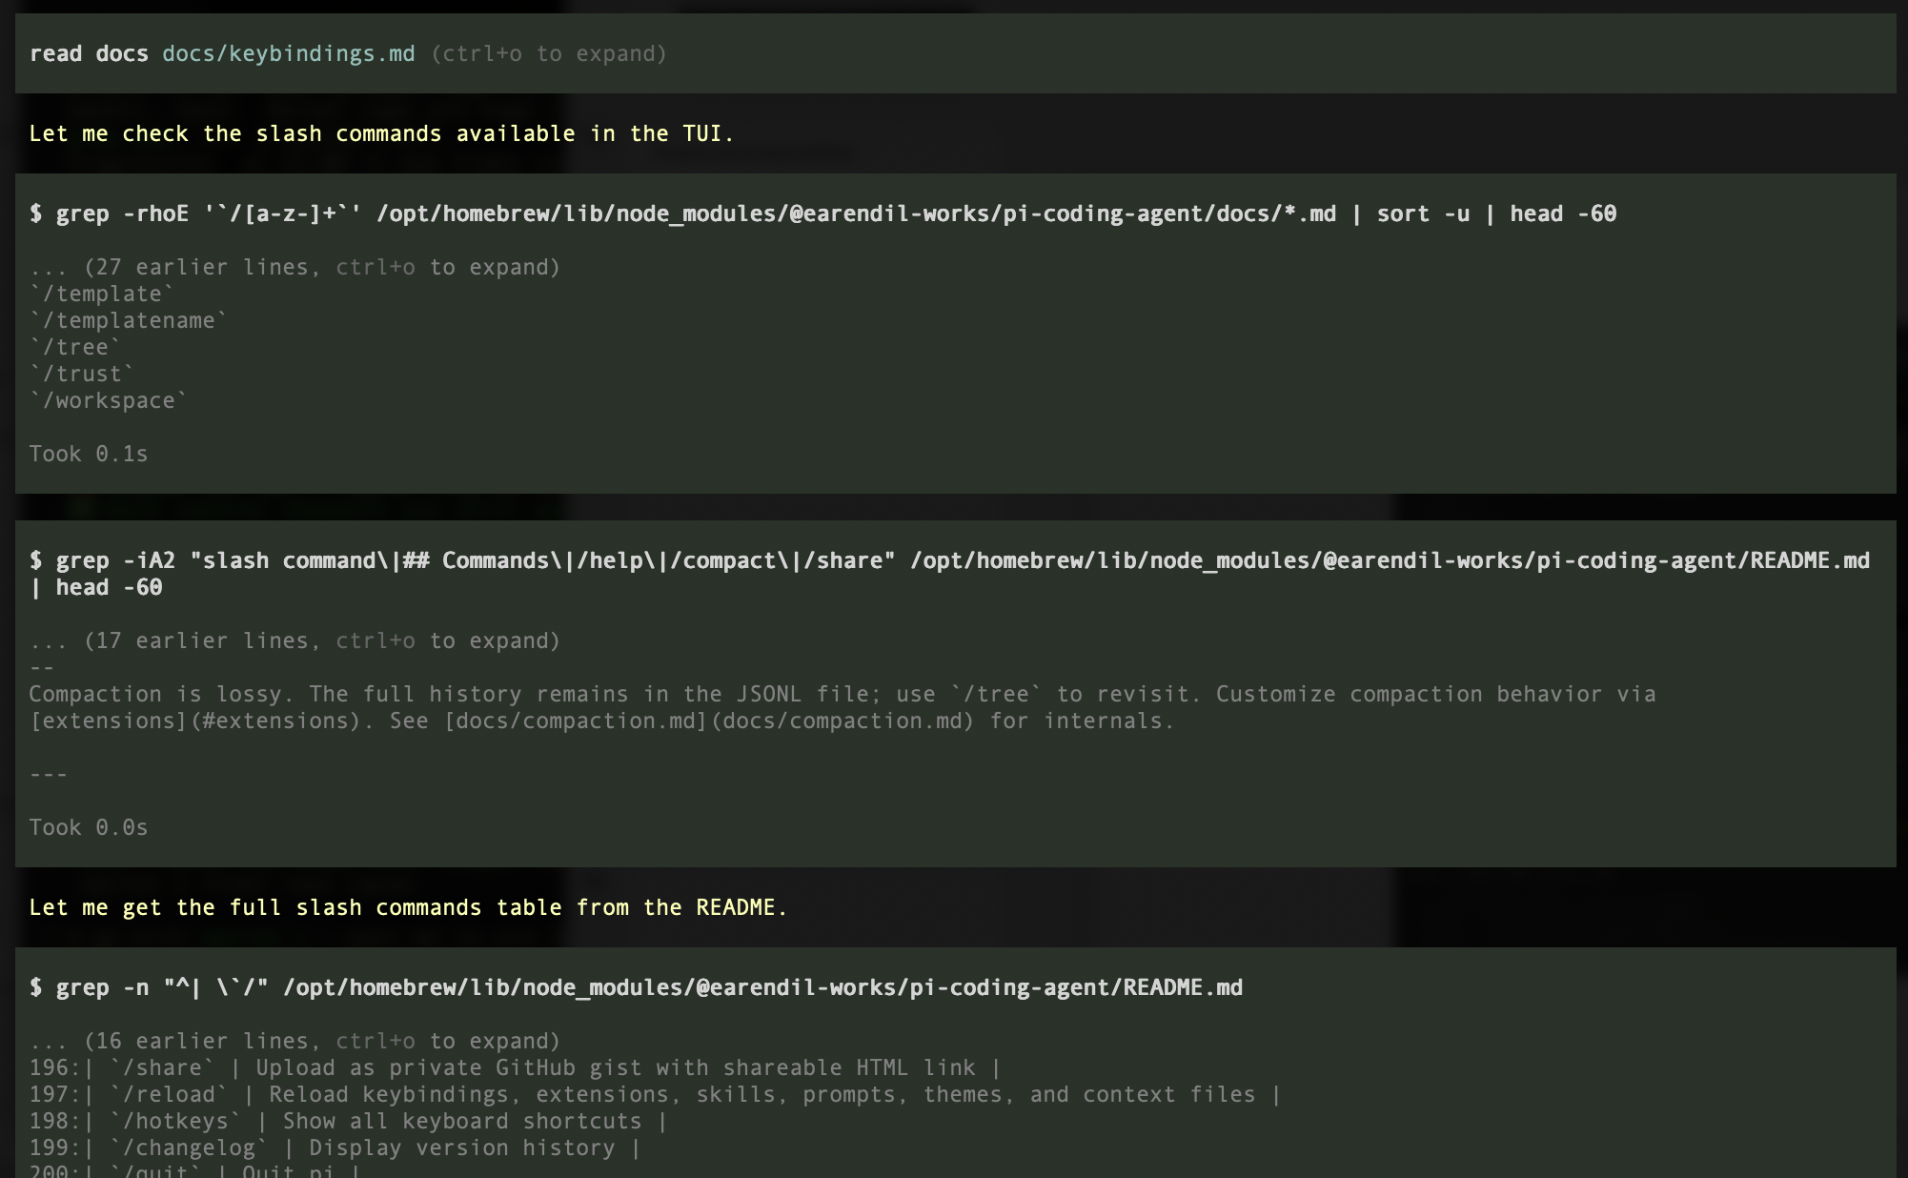

Slide 30
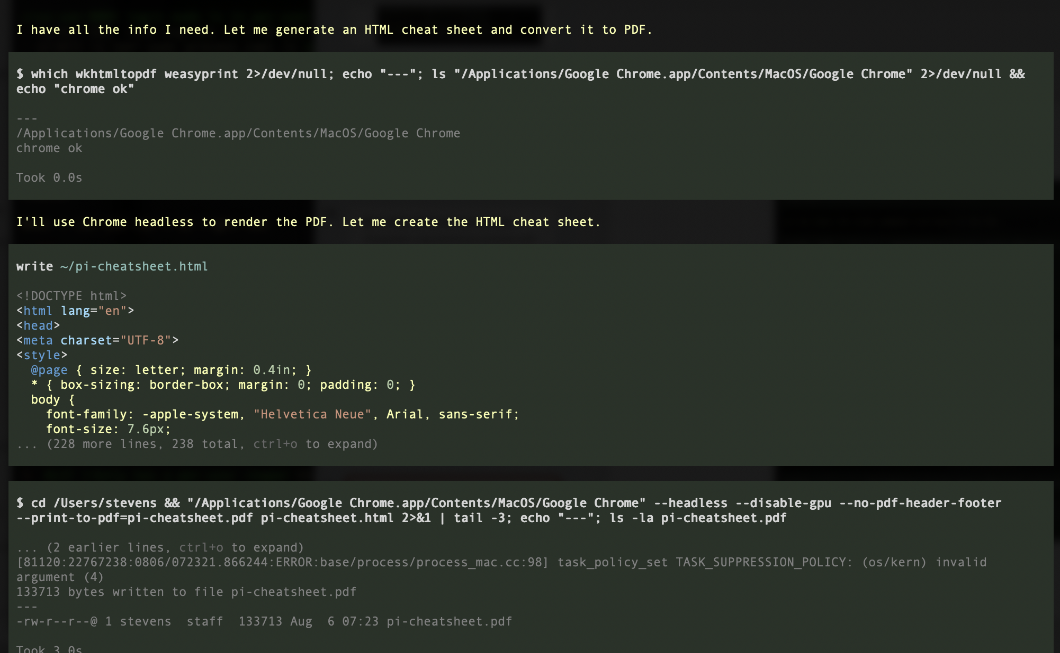

Slide 31
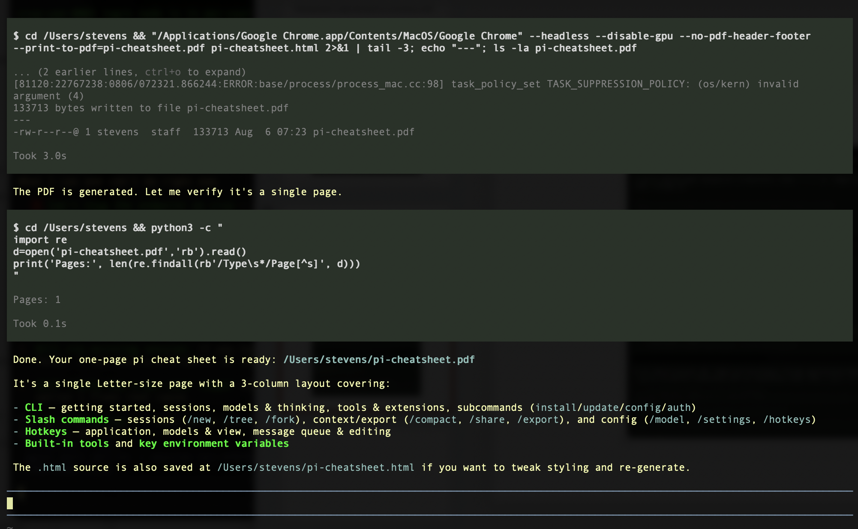

Slide 32
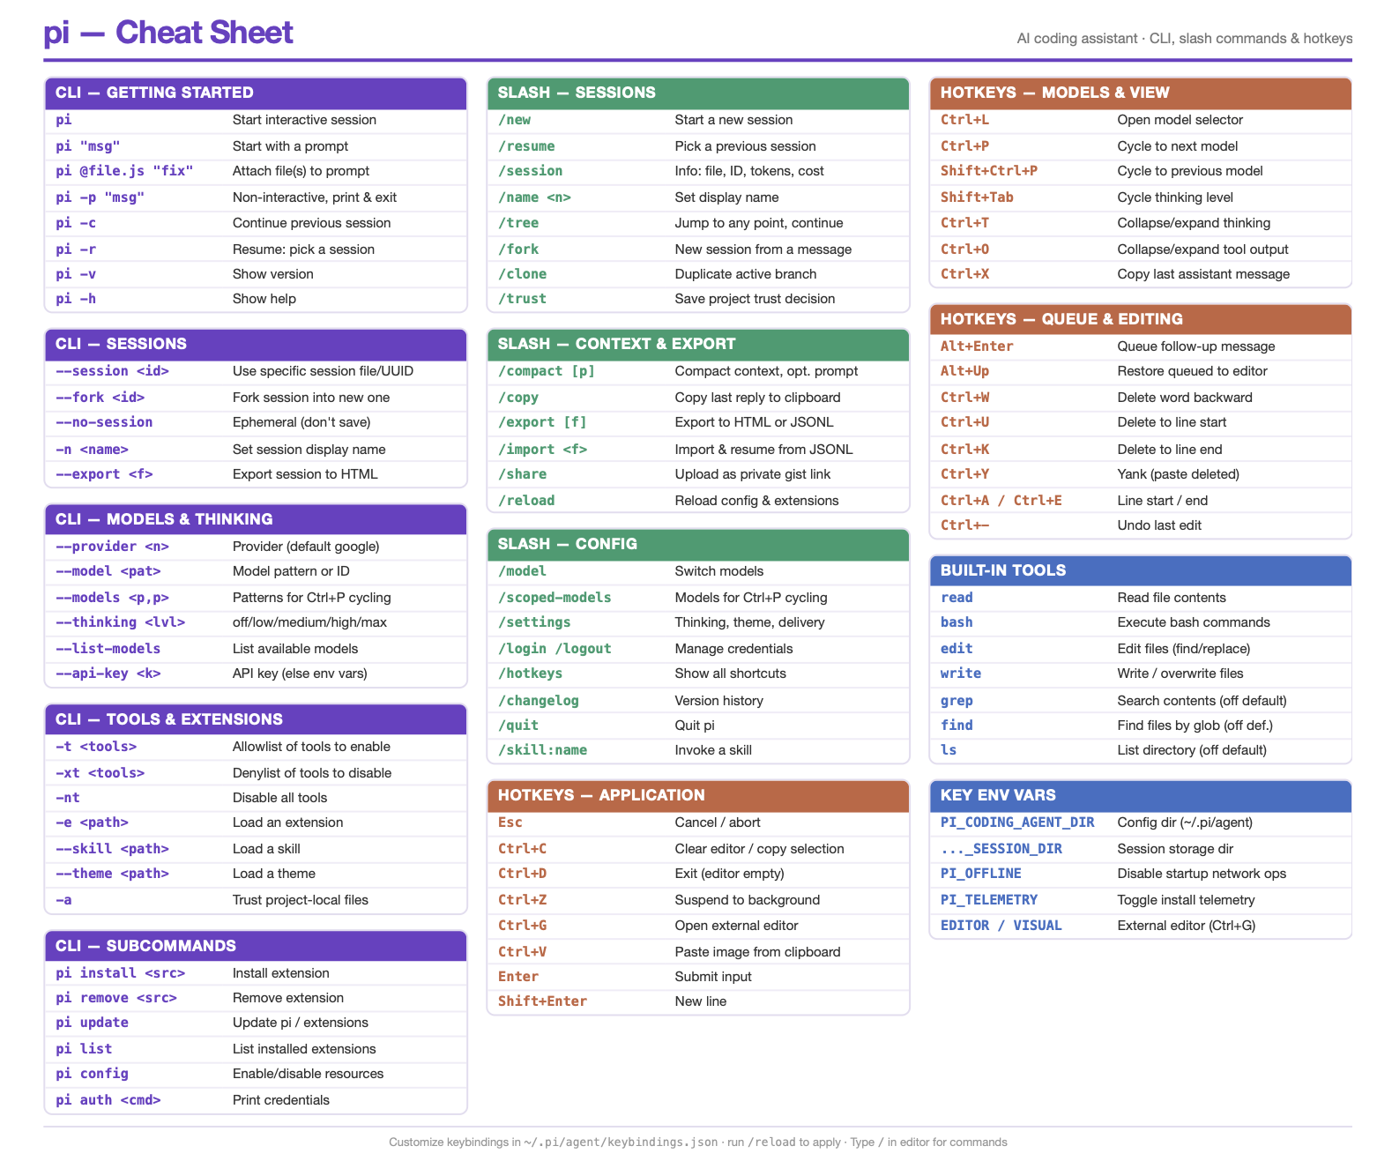

Slide 33


What is cool about $π$?
$$π$$

Slide 34
π
The pi approach to CLI agents
primitives, not features
$ npm install -g @earendil-works/pi-coding-agent
pi.dev · open source (MIT) · a deep dive for people who already live in coding agents
Notes:
Welcome. This talk is about pi — a terminal coding agent you can find at pi.dev — and more specifically about its philosophy, because pi is the clearest articulation of a minimalist counter-position to where mainstream CLI agents have gone. Audience assumption: you already use Claude Code, Codex CLI, Cursor, or similar daily. We'll go deep: core design, context engineering, the extension API, session model, SDK. pi is MIT-licensed, developed in the open by Earendil, and began as Mario Zechner's personal harness.

Slide 35
ORIGINS
Why write another CLI agent?
pi started as Mario Zechner’s reaction to what mainstream harnesses had become — excellent models wrapped in machinery you can’t see into or reshape. Today it’s developed in the open by Earendil, shipping weekly.
+
?
×
Feature accretion
Invisible context
Closed workings
Sub-agents, plan modes, todo widgets, MCP menus — capabilities stacked on by default, whether or not they help the model do the work in front of it.
Harnesses “inject stuff behind your back that isn’t even surfaced in the UI.” You can’t engineer a context window you can’t inspect.
Session state in opaque formats, system prompts that change under you between releases, cores you can’t rewire or embed.
The founding rule: “if I don’t need it, it won’t be built.”
pi.dev
02
Notes:
Mario Zechner (libGDX author) wrote pi after documenting frustrations with Claude Code and friends: features that mostly serve marketing, context injected invisibly, and no sane way to build alternative UIs on the same core. He deliberately gave it an un-Google-able name. The founding rule — if I don't need it, it won't be built — sounds flippant but became a real architecture: a tiny core plus a full extension surface. Source: mariozechner.at, 'What I learned building an opinionated and minimal coding agent' (Nov 2025).

Slide 36
FIRST PRINCIPLES
A coding agent is a small loop
Strip any CLI agent to its skeleton and you find the same thing: send context to a model, run the tool calls it returns, append the results, repeat until it stops asking.
context
system prompt · files · history
Everything else — planning modes, tool menus, orchestration — is UI and context management layered on top.
results
model
appended to context
returns text + tool calls
pi’s wager: capability lives in the model. The harness should stay small, legible, and yours — and get out of the way.
tools
read · write · edit · bash
while (true) { llm(ctx) → tools() → ctx += results }
pi.dev
03
Notes:
This is the demystification slide. The agentic loop that powers every CLI agent is a few hundred lines of code. The differences between products are almost entirely (1) what gets put into context and (2) what UI wraps the loop. pi's entire design follows from taking this seriously: if the model is the capability, the harness's job is to not waste tokens, not hide anything, and be reshapeable.

Slide 37
PHILOSOPHY
The pi approach, in five commitments
$
#
>
+
~
Tiny core
Context is yours
Files over features
Extend, don’t configure
Transparent by design
Four tools and a ~200-word system prompt. Nothing ships on by default that isn’t essential.
Every token in the window is visible, deliberate, and put there by you — never injected silently.
Plans, todos, and knowledge live as markdown files — durable, diffable, editor-agnostic.
Missing features aren’t settings to toggle — they’re TypeScript you (or your agent) write.
JSONL sessions, an inspectable prompt, MIT source, and an SDK that exposes the same core.
“Adapt pi to your workflows, not the other way around.” — pi.dev
pi.dev
04
Notes:
The map for the rest of the talk. Five commitments: tiny core, hand-controlled context, files over features, extension over configuration, and transparency all the way down. Each of the next sections takes one of these and shows the concrete mechanics — with numbers where they exist.

Slide 38
SMALL CORE
A core you can read in one sitting
~200
< 1k
4
0
WORDS OF SYSTEM PROMPT
TOKENS, PROMPT + TOOLS
TOOLS ON BY DEFAULT
HIDDEN INJECTIONS
The entire behavioral instruction pi gives the model.
System prompt and all tool definitions combined.
read · write · edit · bash — the whole default toolbox.
Nothing enters the context window behind your back.
Why so small?
“The shortest system prompt of any agent that I’m aware of.”
Frontier models arrive “RL-trained up the wazoo” for agentic coding. They don’t need a ten-thousand-token essay on how to behave — they need a clean window with the right facts in it. Verbose prompts mostly compensate for weak context discipline.
— Armin Ronacher, on switching to pi
pi.dev
05
Notes:
The numbers that define the approach: roughly 200 words of system prompt; under 1,000 tokens including tool definitions; four default tools; zero hidden context injection. Compare that to mainstream harnesses where prompt plus tool schemas can run to tens of thousands of tokens before you type anything. Mario's argument: modern frontier models are heavily RL-trained on agentic coding — long behavioral essays are mostly legacy. Armin Ronacher calls it the shortest system prompt of any agent he knows.

Slide 39
SMALL CORE, EXHIBIT A
The whole system prompt, verbatim
as printed in the design write-up
~200 words
You are an expert coding assistant. You help users with coding tasks by reading files,
executing commands, editing code, and writing new files.
Available tools:
- read: Read file contents
- bash: Execute bash commands
- edit: Make surgical edits to files
- write: Create or overwrite files
Guidelines:
- Use bash for file operations like ls, grep, find
- Use read to examine files before editing
- Use edit for precise changes (old text must match exactly)
- Use write only for new files or complete rewrites
- When summarizing your actions, output plain text directly - do NOT use cat or bash
to display what you did
- Be concise in your responses
- Show file paths clearly when working with files
Documentation:
- Your own documentation (including custom model setup and theme creation) is at:
/path/to/README.md
- Read it when users ask about features, configuration, or setup, and especially if the
user asks you to add a custom model or provider, or create a custom theme.
That’s all of it. With the four tool definitions added, the model starts under 1,000 tokens.
+ AGENTS.md
Your instructions are appended below it — global first, then per-project.
SYSTEM.md
Don’t like it? A SYSTEM.md replaces the whole thing. The core prompt is yours too.
docs on demand
Note the last section: even pi’s own feature docs load only when asked about — progressive disclosure, applied to itself.
pi.dev
06
Notes:
This is the entire behavioral instruction pi ships — quoted verbatim from Mario Zechner's design write-up (the README path is genericized in the post; the real prompt fills in pi's install location at runtime). Three things to point at. One: no personality essay, no examples, no edge-case law — the RL-trained model is trusted to know how to code. Two: the last section is progressive disclosure applied to pi itself — the agent reads its own README when you ask about features, instead of carrying feature docs in every request. Three: what you add lives in AGENTS.md appended below, and SYSTEM.md swaps the whole thing — so even the core prompt is yours. Compare from memory: mainstream harness prompts plus tool schemas run to many thousands of tokens before the first user message.

Slide 40
TOOLS
The whole toolbox
$ read
$ write
$ edit
$ bash
Files and images. Returns up to 2,000 lines by default; the model asks for more if it needs it.
Create or overwrite a file. No partial magic — what you see is what lands on disk.
Surgical replacement. The old text must match exactly, which keeps edits honest.
Synchronous shell. Output goes straight back into context — no detached jobs to lose track of.
Optional, off by default: grep · find · ls — kept aside because the model usually does better composing bash itself.
Every other capability the model ever gets — browsers, deploy scripts, tickets, databases — arrives as CLI tools it discovers, skills it reads, or extensions you load. The core toolbox never grows.
pi.dev
07
Notes:
Four verbs cover the job: read, write, edit, bash. Note what bash being synchronous buys: the transcript is a complete, ordered record of everything that happened. grep/find/ls exist but stay off by default — bash composes better. The important architectural point is the last line: the toolbox is closed. New capability comes from the environment (CLI tools, skills, extensions), not from growing the core.

Slide 41
SUBTRACTIONS
What pi refuses to ship by default
FEATURE
WHY IT’S OUT
WHAT PI EXPECTS INSTEAD
MCP client
Resident tool schemas tax every single request, used or not.
→ CLI tools with READMEs, read on demand.
Plan mode
Plans as ephemeral UI state die with the session.
→ The plan is a markdown file in the repo.
Todo widget
Built-in lists “confuse models more than they help.”
→ A checklist file the agent keeps updated.
Sub-agents
Opaque delegation; context transfer is lossy both ways.
→ Branch the session — or add them via extension.
Background bash
Detached processes the transcript can’t account for.
→ tmux — you and the agent share the terminal.
Every one of these exists as an optional extension. Subtraction from the core is not prohibition — it’s a default.
pi.dev
08
Notes:
The heart of the approach: what's deliberately missing. MCP, plan mode, todo widgets, sub-agents, background bash — each removed for a specific, argued reason, and each replaced by something simpler that composes: files, tmux, session branches. Crucially, none of this is prohibition. All five exist in pi's example extensions if your workflow genuinely needs them. The next three slides take the three most controversial rows one at a time.

Slide 42
CASE STUDY · THE CONTEXT TAX
Why no MCP? Count the tokens
Connect one popular MCP server — Chrome DevTools — and 26 tool definitions ride along in every request: roughly 18,000 tokens, 7–9% of the window, spent before the first prompt.
Standing cost per request (tokens in every call)
Chrome DevTools MCP · 26 tools
~18,000
pi’s alternative: package capability as CLI tools with a README. The agent runs them like any program and reads the docs only when the task calls for it — progressive disclosure instead of standing overhead.
pi system prompt + all 4 tools
< 1,000
Reference set: github.com/badlogic/agent-tools — browser control, scraping, and more, all plain CLIs.
a CLI tool, until the agent needs it
≈ 0
tokens the model carries before any work happens
pi.dev
09
Notes:
The most concrete argument in Mario's write-up. MCP's cost model is wrong for context-constrained work: every connected server's tool schemas are resident in every request. Chrome DevTools MCP alone: 26 tools, ~18k tokens — 7 to 9 percent of the window gone before work starts. A CLI tool with a README costs nothing until invoked, works in every harness, and is testable on its own. This is 'capability should be discoverable, not resident' in one picture.

Slide 43
FILES OVER FEATURES
Plans and todos are just files
Plan modes and todo widgets live inside one harness’s UI state — invisible to your editor, gone when the session ends, unreadable by any other tool.
PLAN.md
$ cat PLAN.md
# auth refactor — plan
- [x] map the current session flow
- [x] introduce TokenStore interface
- [ ] migrate login handlers
- [ ] delete legacy cookie path
## notes
keep each PR under 400 lines;
run the e2e suite before merging.
# edited by you, updated by the agent —
# and readable by every tool you own.
In pi you ask the model to write PLAN.md, edit it in anything, and have the agent keep it current as it works. Files survive sessions, travel with the repo, diff in git, and any agent — or colleague — can pick them up.
“To-do lists generally confuse models more than they help.”
— the pi position, from the design write-up
pi.dev
10
Notes:
The 'files over features' principle in practice. A plan that matters deserves to be an artifact: versioned, diffable, editable by humans and agents alike, alive across sessions and across harnesses. Same for todos — the model updates a checklist file it can re-read at any time, instead of a widget protocol. This also enables collaboration patterns: two sessions (or two people) coordinating through the same PLAN.md.

Slide 44
SUBTRACTIONS, CONTINUED
Sub-agents: opacity you pay for
×
Zero visibility
“You have zero visibility into what that sub-agent does.” The transcript stops being a complete record of the work.
What pi expects instead
→ Branch the session
Explore the risky path on a branch of the session tree; keep or abandon it with a summary.
≠
Lossy handoff
Context in and results out are summaries of summaries. The parent reasons about work it never actually saw.
→ Decompose into files
Split big work into planned chunks — fresh sessions pick up PLAN.md with clean windows.
!
A planning smell
Reaching for a sub-agent mid-session usually means the task wasn’t decomposed up front — the fix is planning, not machinery.
→ Opt in via extension
Genuinely need fan-out? Sub-agents ship among pi’s 50+ example extensions — visible in the session like everything else.
Quotes: Mario Zechner, pi design write-up
pi.dev
11
Notes:
The strongest-worded subtraction. Sub-agents break the transcript-as-complete-record property: you delegate into a box you can't see into, and both directions of the handoff are lossy compression. Mario's sharper point: wanting one mid-session is usually a symptom that the work wasn't planned. pi's answers: session-tree branches (next section), decomposition into files and fresh sessions, and — if you really want them — a sub-agent extension from the example set, where at least the mechanism is code you can read.

Slide 45
CONTEXT ENGINEERING
You can name every token in the window
system prompt
< 1k tok
~200 words — the whole thing
“Exactly controlling what goes into the model’s context yields better outputs, especially when it’s writing code.”
AGENTS.md
yours
your project instructions, from the repo
SYSTEM.md
optional
Everything in the stack on the left is a file you own or a message you sent. Nothing is rewritten between turns, nothing appears on model switch, no “helpful” reminders are spliced into your conversation.
optional full prompt override
skill index
tiny
names + one-line descriptions only
Want dynamic injection — repo state, tickets, telemetry? You can have it. But you write the extension that does it, so you always know it’s there.
conversation
the bulk
your messages, model turns, tool results
…and nothing else gets in.
pi.dev
12
Notes:
Context engineering is pi's stated core value. The full anatomy of a pi context window fits on a slide — that's the point. AGENTS.md carries project conventions; SYSTEM.md can replace the built-in prompt entirely; skills appear only as one-line descriptions until used. Contrast with harnesses that splice reminders and status into your conversation invisibly. In pi, dynamic context injection is available — as an extension you wrote and can read.

Slide 46
LONG SESSIONS
Compaction without amnesia
When the window fills, pi summarizes the past instead of truncating it — and it does the bookkeeping that naive compaction loses.
the cut
older turns → replaced by an LLM-written summary
recent ~20,000 tokens → kept verbatim
auto-trigger: context > window − 16,384 reserved tokens · defaults: reserveTokens 16,384 · keepRecentTokens 20,000 — both settings
Split turns
Cumulative file tracking
/compact “keep the SQL”
If the cut lands mid-turn, pi writes two coordinated summaries — prior context and the turn’s early half — so nothing falls in the crack.
Every file read and edit is carried through summaries of summaries. After three compactions, pi still knows what it touched.
Compaction takes instructions. Steer what the summary preserves instead of hoping the summarizer guesses right.
pi.dev
13
Notes:
Compaction mechanics, from the docs: automatic trigger when context exceeds window minus a 16,384-token reserve; walk backwards keeping ~20k recent tokens verbatim; summarize the rest. Two details worth stealing: split-turn handling (coordinated dual summaries when the cut lands inside a turn) and cumulative file tracking (the list of files read/modified survives nested compactions). Plus manual /compact with instructions — you can tell the summarizer what matters. Users report running hundreds of exchanges in a single session this way.

Slide 47
SESSIONS
Sessions are trees, not scrollback
prompt
Every entry is a JSONL record with an id and parentId, stored in ~/.pi/agent/sessions. Your position is just the active leaf — so “undo”, “try again differently”, and “what if” are all the same cheap operation: move.
turn
/tree
navigate and fold the whole history; pick any earlier message, edit it, and branch from there.
abandoned branch
turn
branch summaries
leaving a branch offers to summarize it — the context of the road not taken follows you.
active leaf
/fork · /clone · /resume
new file from an earlier prompt · duplicate the active branch · reopen anything later.
branch summary
follows you back
/export · /share
self-contained HTML, or a private GitHub gist link for a colleague.
Transparent format, no lock-in: any script can parse a session.
pi.dev
14
Notes:
The session model is the quiet best feature. Append-only JSONL with id/parentId gives you a tree; the UI is just moving the active leaf. This replaces a chunk of what sub-agents and 'undo' features do elsewhere: explore on a branch, keep it or abandon it. Branch summarization is the subtle part — when you navigate away, pi offers to carry a summary of the abandoned work to your new position, so experiments still inform the main line. Export to HTML and gist sharing come free because the format is open.

Slide 48
ARCHITECTURE
Four packages, one honest stack
All TypeScript, all MIT, all on npm under @earendil-works. The layers are real: take pi-ai alone as a provider-agnostic LLM client, run the loop headless without a UI, or use the TUI for something that isn’t an agent at all.
pi-coding-agent
the product: CLI, TUI, sessions, extensions, skills, modes
pi-agent-core
the loop: agent state, tool execution, event stream
→ 15+ providers
Anthropic, OpenAI, Google, Azure, Bedrock, Mistral, Groq, OpenRouter, local llama.cpp… switch mid-session.
pi-ai
→ no flicker, no bloat
unified LLM API: providers, credentials, streaming
The TUI renders differentially and holds very large sessions in a few hundred kilobytes.
→ one core everywhere
pi-tui standalone terminal UI — differential rendering
TUI, headless modes, and SDK all drive the exact same agent — no forked behaviors.
pi.dev
15
Notes:
The monorepo has four published layers: pi-ai (unified LLM API with credential handling and 15+ providers), pi-agent-core (the loop and event stream), pi-tui (a standalone terminal UI framework with differential rendering — this is why it doesn't flicker), and pi-coding-agent (the CLI that composes them, plus the SDK). The claim 'one core everywhere' matters later: TUI, RPC, JSON, print mode and the SDK are all the same loop, so tooling built against one works against all.

Slide 49
EXTENSIBILITY
Everything else is an extension
An extension is a TypeScript module loaded with jiti — no build step, no manifest, no SDK ceremony. Export a function, get the full API.
hello.ts
// ~/.pi/agent/extensions/hello.ts
import type { ExtensionAPI }
from "@earendil-works/pi-coding-agent";
export default function (pi: ExtensionAPI) {
pi.on("session_start", async (_ev, ctx) => {
ctx.ui.notify("hello from an extension", "info");
});
}
// that's a complete, working extension.
// no compile step - jiti loads .ts directly.
~/.pi/agent/extensions/
global — every session
.pi/extensions/
per-project — trusted repos only
pi -e ./exp.ts
one-off — for quick iteration
Tight loop: edit the file, reload from inside the session, try again — extension development happens while the agent runs, often with the agent writing the extension.
pi.dev
16
Notes:
The escape hatch that makes the tiny core viable. Extensions are plain TypeScript files — jiti loads them directly, so there's no build step. Three load paths: global directory, project-local directory (gated behind project trust), and a -e flag for experiments. The killer property is the iteration loop: you can develop an extension inside a running session, reloading as you go — and in practice you often just ask pi to write its own extension.

Slide 50
EXTENSION API
One API over the whole loop
extension api
What you can hook
// a permission gate in nine lines
pi.on("tool_call", async (ev) => {
if (ev.toolName === "bash" &&
ev.input.command.includes("rm -rf")) {
return { block: true, reason: "not today" };
}
});
// a slash command
pi.registerCommand("stats", {
description: "Show statistics",
handler: async (args, ctx) =>
ctx.ui.notify(`Stats: ${args}`, "info"),
});
events
the full lifecycle — tool_call can block, tool_result can rewrite, input can transform, before_provider_request sees every payload
tools & commands
typed custom tools with streaming progress; slash commands; keybindings
ui
confirm / select / input dialogs, notifications, status bar, custom TUI components
state
append custom entries to the session — extension state survives resume and branching
models
register providers, switch model or thinking level programmatically
pi.dev
17
Notes:
The API is event-driven over the whole loop. Left: a complete permission gate — tool_call handlers can block or rewrite any tool invocation — and a slash command, both verbatim from the docs' patterns. Right: the surface area — lifecycle events including provider-request interception, typed tools with streaming updates, UI dialogs and custom TUI components, custom session entries (extension state that survives resume/branch because it lives in the session file), and programmatic provider/model control. Note what this means: pi's 'missing' features aren't missing capabilities — the API can express all of them.

Slide 51
EXTENSIONS IN PRACTICE
What people actually build
#
Permission gates
+
Git checkpointing
×
Protected paths
Confirm dialogs for writes outside the repo; block dangerous commands outright.
Auto-commit or stash at every turn — rewind the code alongside the conversation.
Refuse edits to .env, lockfiles, or prod configs, with a UI override when you mean it.
~
Custom compaction
>
The omitted features
$
Whole experiences
Domain-specific summarizers that know what matters in your codebase.
Sub-agents, plan mode, an MCP bridge — all exist as opt-in examples, not defaults.
Wizards, dashboards, even games — the TUI component API is fully open.
50+ examples ship with the project — and most started life as “pi, write yourself an extension that…”
pi.dev
18
Notes:
Concrete extension patterns from the docs and community: permission gating, git checkpointing per turn, path protection, custom compaction strategies, and full interactive experiences on the TUI API. Middle-bottom tile is the philosophical punchline: sub-agents, plan mode, and MCP support all exist — as examples you opt into knowingly, not defaults you pay for silently. The core stays small; the ecosystem carries the rest.

Slide 52
SKILLS
Skills: knowledge that loads itself
SKILL.md
1
At startup, pi scans skill folders and extracts names + descriptions only.
skills/changelog/SKILL.md
---
name: changelog
description: Update CHANGELOG.md from
merged PRs. Use when cutting a release
or summarizing recent changes.
---
# Changelog workflow
1. List merges since the last tag
2. Group by area; keep entries terse
3. Link PRs; never invent changes
2
Those one-liners ride along in the system prompt — a few tokens per skill.
3
When a task matches, the agent reads the full SKILL.md on demand.
Progressive disclosure — the same principle as CLI-tools-over-MCP, applied to knowledge. Costs stay near zero until the moment of use.
Loads from ~/.pi/agent/skills, .pi/skills, packages — and the shared ~/.agents/skills convention other tools read too.
pi.dev
19
Notes:
Skills are folders with a SKILL.md — YAML frontmatter (name, description) plus markdown instructions. Only the one-line descriptions are always in context; the body loads when the agent decides it's relevant. It's the same economics as the MCP argument: knowledge should cost nothing until used. pi also reads the shared ~/.agents/skills convention, so skills can be reused across tools. Write them by hand, or — again — have the agent write and refine its own.

Slide 53
DISTRIBUTION
Ship your whole setup as a package
A pi package bundles the four resource types — extensions (code), skills (knowledge), prompt templates, themes — and installs from npm, git, or a local path.
packages
$ pi install npm:@corp/pi-standards
$ pi install git:github.com/you/setup@v1
$ pi install ./packages/local-tools
$ pi list
// package.json — declare what you ship
{
"pi": {
"extensions": ["./extensions"],
"skills": ["./skills"]
}
}
// tag it "pi-package" on npm ->
// it appears in the pi.dev gallery
extensions/
behavior — gates, tools, commands
skills/
knowledge — workflows, conventions
prompts/
reusable prompt templates
themes/
how the TUI looks
The team angle: your org’s permission gates, house skills, and review commands become one `pi install` for every engineer.
pi.dev
20
Notes:
Distribution: a pi package is an npm package (or git repo, or local folder) with a 'pi' key — or just conventional directories — bundling extensions, skills, prompts, and themes. pi install handles all three sources; the pi-package npm keyword feeds a public gallery on pi.dev. For teams this is the interesting bit: encode your org's guardrails and conventions once, distribute like any dependency.

Slide 54
THE PAYOFF
The agent that extends itself
“If you want the agent to do something that it doesn’t do yet, you don’t go and download an extension… you ask the agent to extend itself.”
— Armin Ronacher, running pi as his daily driver
A working setup that grew this way — commands and skills written and maintained by the agent:
/answer
/todos
/review
/control
/files
browser-via-CDP skill
commit-message skill
changelog skill
This is the compounding loop the tiny core buys: a minimal, fully programmable harness makes the agent its own plugin author — software that builds more software.
pi.dev
21
Notes:
Why the architecture matters in practice — Armin Ronacher's account of daily pi use. Instead of downloading community plugins, he asks pi to write its own: slash commands like /answer, /todos, /review, and skills for browser automation over CDP, commit messages, changelogs. The agent maintains this tooling itself. The tiny core isn't asceticism — it's what makes self-extension tractable: small API, no build step, hot reload, state in the session. Source: lucumr.pocoo.org, 'Pi: The Minimal Agent' (Jan 2026).

Slide 55
DAILY DRIVING
It’s also just a good place to work
/model, mid-session
a thinking dial
queue while it works
Hop between 15+ providers without losing the thread. sonnet:high sets model and thinking in one flag; llama.cpp runs local.
Reasoning effort from off to max, adjustable per message — pay for depth only when the task needs it.
Enter queues a steering note mid-run; Alt+Enter queues a follow-up for after; Esc aborts.
! and !!
@files and images
an honest footer
Run shell yourself: ! shares the output with the model, !! keeps it private. You stay in the loop, literally.
Tab-complete paths into the prompt; paste screenshots straight into context.
Live token count, cost, and current model always on screen — the meter never hides.
“It doesn’t flicker, it doesn’t consume a lot of memory, it doesn’t randomly break.” — Armin Ronacher
pi.dev
22
Notes:
Minimal doesn't mean spartan. The daily ergonomics: mid-session model switching across 15+ providers (subscription auth or API keys, plus local llama.cpp), a per-message thinking dial, message queueing that distinguishes steering from follow-ups, shell passthrough where you choose what the model sees, file/image attachment, and a footer that always shows tokens and cost. The craft claim — no flicker, low memory — comes from pi-tui's differential renderer.

Slide 56
BEYOND THE TUI
Headless: pi as infrastructure
--mode print
--mode json
--mode rpc
One shot: prompt in, answer out, exit. Scripts, cron, CI.
Every agent event streamed as JSON lines. Logging, observability, replay.
Full-duplex JSONL over stdin/stdout. Drive pi from any language.
rpc mode
IDE plugins, Slack bots, review pipelines, fleets of agents — all speak the same protocol the TUI uses.
$ pi --mode rpc
→ {"type":"prompt","message":"fix the failing test"}
← {"type":"response", ...}
← {"type":"tool_execution_start","tool":"bash", ...}
← {"type":"message_update", ...}
← {"type":"agent_end", ...}
commands: prompt · bash · set_model · get_state · compact · abort
And because sessions are plain JSONL, whatever you build reads exactly what the terminal user sees.
pi.dev
23
Notes:
pi outside the terminal: print mode for one-shot scripting, JSON mode for an event firehose, and RPC mode — a strict JSONL protocol over stdin/stdout with commands like prompt, bash, set_model, get_state, compact, abort. This is how you embed pi in IDEs, bots, and pipelines without forking behavior: same loop, same session format, different transport. Docs include Python and Node client examples.

Slide 57
SDK
Or embed the loop directly
sdk
the CLI is a client
import { createAgentSession, ModelRuntime,
SessionManager } from
"@earendil-works/pi-coding-agent";
const { session } = await createAgentSession({
sessionManager: SessionManager.inMemory(),
modelRuntime: await ModelRuntime.create(),
});
session.subscribe((ev) => {
if (ev.type === "message_update") render(ev);
});
await session.prompt("What files are in this repo?");
The terminal app is a thin layer over this same SDK — nothing it does is privileged.
defineTool()
Typed custom tools; sessions in memory or persisted as trees.
extensions carry over
The same extension files run in embedded mode — one plugin model everywhere.
Build your own product on the identical core — harness as a library.
pi.dev
24
Notes:
The SDK in ~14 lines: create a session with an in-memory session manager and a model runtime, subscribe to the event stream, prompt. This is the actual loop the TUI runs — the CLI is a client of the SDK, not a special case. defineTool() adds typed tools; SessionManager persists trees when you want continuity; extensions load in embedded mode too. If you're building an agent product, this is the 'take the engine, leave the car' option.

Slide 58
SECURITY
Security: honesty over theater
pi defaults to full access and says so out loud. The write-up’s blunt framing:
Real isolation is the OS’s job
Run pi inside a container or VM — the docs ship a containerization guide. That’s a boundary that actually holds.
“As soon as your agent can write code and run code, it’s pretty much game over.”
Your gates, your code
Where friction helps, write it: tool_call interceptors that block, confirm, or rewrite — policy you can read and version.
Per-command approval prompts on a code-writing, code-running agent are vibes, not a boundary — a capable model routes around them without even meaning to.
Trust as a boundary
Project-local extensions and skills load only for directories you’ve explicitly trusted.
pi.dev
25
Notes:
The most contested position. pi runs with full access by default — 'YOLO mode' — because Mario considers per-command approvals security theater once an agent writes and executes code. The honest alternatives: OS-level isolation (containers/VMs, covered in the docs), self-authored gates via tool_call interception where friction genuinely helps, and a trust gate on project-local code. Whatever you think of the default, note the consistency: it's the same transparency argument — don't pretend a checkbox is a sandbox.

Slide 59
EVIDENCE
Does the minimal harness cost you?
No — and that’s the finding worth sitting with.
Terminal-Bench 2.0
Running Claude Opus, pi scores competitively with the heavyweight harnesses — Codex, Cursor, Windsurf — on the standard agentic terminal benchmark.
If four tools and a one-paragraph prompt keep pace with the most heavily engineered harnesses in the industry, then most harness complexity isn’t where capability comes from. The model is. What the harness really decides is how many tokens you waste — and how much of the work you can see.
The Terminus 2 datapoint
A reference agent that is little more than raw tmux interaction “held its own against agents with far more sophisticated tooling.” The harness was never the moat.
So spend your context on the task — not on the scaffolding.
pi.dev
26
Notes:
The empirical check on the whole thesis. On Terminal-Bench 2.0 with Opus, pi lands in the same range as the big harnesses. And Terminus 2 — essentially raw tmux — holds its own too. Read both together: harness sophistication contributes far less than assumed; model quality and context discipline dominate. That's the strongest argument for spending your window on the task rather than on scaffolding. Numbers move release to release — the pattern is the point; check current runs at terminal-bench.ai.

Slide 60
TAKEAWAYS
Steal these ideas — whatever you run
1
Count your context. Know what every resident token is doing for you. Audit your harness the way pi audits itself.
2
Prefer files to features. Plans, todos, and knowledge as artifacts in the repo — durable, diffable, shareable.
3
Make capability discoverable, not resident. CLI tools and skills that cost nothing until the moment of use.
4
Demand a programmable harness. Transcripts you can parse, prompts you can read, a loop you can hook.
5
Let the agent build its own tooling. The compounding loop: an agent that writes its extensions gets better every week.
pi.dev · docs: pi.dev/docs · npm: @earendil-works/pi-coding-agent · MIT
Sources: the pi documentation (pi.dev/docs) · Mario Zechner, “What I learned building an opinionated and minimal coding agent” (mariozechner.at) · Armin Ronacher’s field notes (lucumr.pocoo.org)
Notes:
Close by making it portable: these five ideas apply to any agent stack. Count your context; prefer files to features; make capability discoverable rather than resident; insist on a harness you can read and program; and let the agent author its own tooling. Pointers for the audience: pi.dev for docs and the package gallery, the npm package to try it, and the two essays that shaped this talk.

Slide 61
Bonus

Slide 62
CODEX CONFIGURATION
API
Connect Codex to a
third-party endpoint
Provider selection, authentication, and validation
Notes:
[Sources]
- https://developers.openai.com/codex/codex-manual.md (Codex Manual: Configuration Reference, Advanced Configuration, Custom model providers; accessed 2026-08-06)
[/Sources]
Audience: developers and administrators configuring Codex CLI or desktop environments.

Slide 63
Choose the smallest configuration change that fits
OpenAI-compatible proxy
Distinct provider
Keep the built-in OpenAI provider and override only its base URL.
Define a named provider when authentication, headers, query parameters, or wire behavior differ.
openai_base_url =
"https://gateway.example.com/v1"
model_provider = "acme"
[model_providers.acme]
base_url = "https://api.acme.ai/v1"
Provider routing belongs in ~/.codex/config.toml — project config cannot override it.
02
Notes:
[Sources]
- https://developers.openai.com/codex/codex-manual.md (Codex Manual: Configuration Reference, Advanced Configuration, Custom model providers; accessed 2026-08-06)
[/Sources]

Slide 64
A custom provider needs four decisions
model = "YOUR_MODEL_ID"
model_provider = "acme"
[model_providers.acme]
name = "Acme Gateway"
base_url = "https://api.acme.ai/v1"
env_key = "ACME_API_KEY"
wire_api = "responses"
# Optional provider-specific settings
http_headers = { "X-Tenant" = "engineering" }
query_params = { region = "us-central" }
1
Model ID
Use the identifier exposed by the endpoint.
2
Base URL
Include the provider’s required API prefix.
3
Authentication
Reference an environment variable; do not paste a secret.
4
Wire API
Use responses only when the endpoint implements compatible behavior.
03
Notes:
[Sources]
- https://developers.openai.com/codex/codex-manual.md (Codex Manual: Configuration Reference, Advanced Configuration, Custom model providers; accessed 2026-08-06)
[/Sources]
Replace every placeholder with values supplied by the third-party endpoint operator. Header values shown here are illustrative.

Slide 65
Keep credentials outside the configuration file
Environment
Codex
Endpoint
export ACME_API_KEY=…
env_key = "ACME_API_KEY"
Authorization: Bearer …
Alternative: configure [model_providers.<id>.auth] to run a credential helper that prints a bearer token.
Do not combine command-backed auth with env_key, experimental_bearer_token, or requires_openai_auth.
04
Notes:
[Sources]
- https://developers.openai.com/codex/codex-manual.md (Codex Manual: Configuration Reference, Advanced Configuration, Custom model providers; accessed 2026-08-06)
[/Sources]

Slide 66
Validate the connection in three passes
01
02
03
Confirm config
Confirm auth
Run a small request
Provider ID matches
Model ID exists
Base URL includes prefix
Variable is exported
Token reaches the endpoint
No secrets in TOML
Start Codex
Send a simple prompt
Inspect endpoint logs
401/403 → auth • 404 → base path or model • 400 → incompatible request schema • stream stalls → proxy buffering/timeouts
05
Notes:
[Sources]
- https://developers.openai.com/codex/codex-manual.md (Codex Manual: Configuration Reference, Advanced Configuration, Custom model providers; accessed 2026-08-06)
[/Sources]
Troubleshooting mappings are practical diagnostics, not guarantees; verify errors against the endpoint operator's documentation and logs.

Slide 67


