Slide 1
Vibe Coding: Session 2

Slide 2
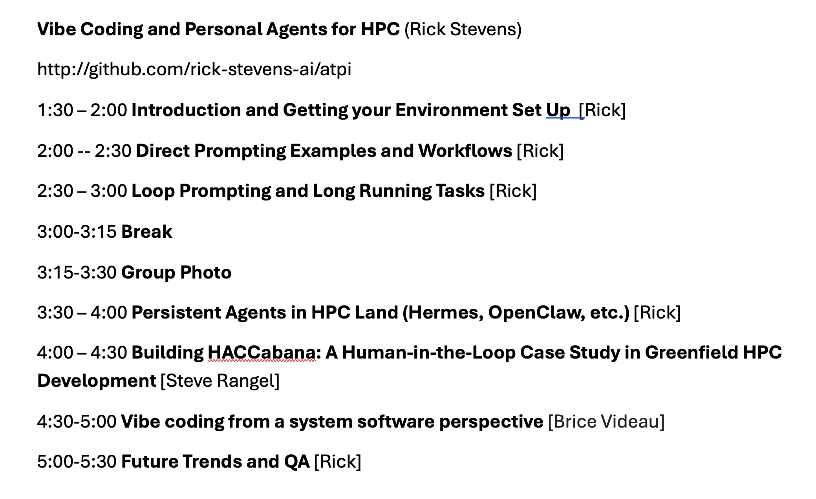

Slide 3
Vibe Coding Session 2
Goals:
  Work through some HPC oriented examples of direct prompting
  Demonstrate how to use the ATPI directly
  Build up some basic strategies for direct prompting and semi-autonomous runs
  We will use GEMM and FFT examples
  Feel free to use other examples you are interested in after these

Slide 4
Repos you want to grab
Here are the full URLs:
https://github.com/rick-stevens-ai/gemm-rust
https://github.com/rick-stevens-ai/gemm_loop
https://github.com/rick-stevens-ai/fft_loop
https://github.com/rick-stevens-ai/pi-coding-loops

Slide 5
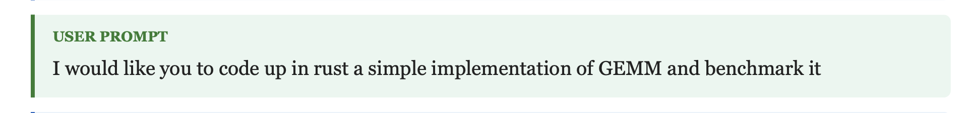
Lets gen up GEMM
We will prompt the model to build a GEMM implementation from scratch in RUST

Slide 6
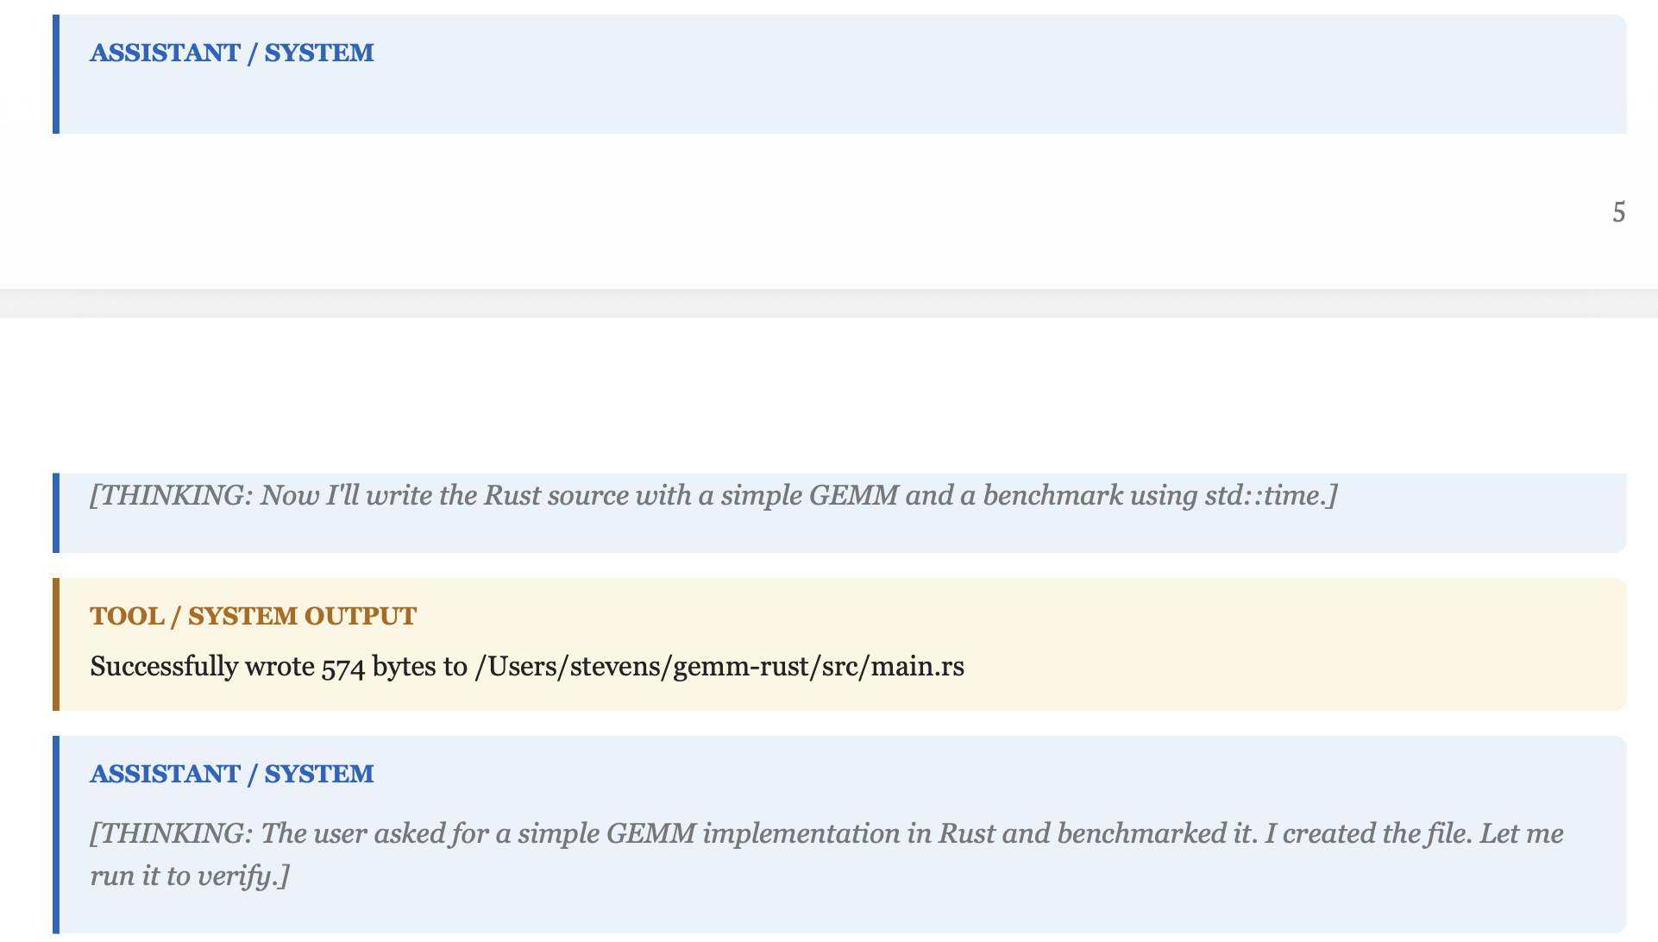

Slide 7
Switch over to scrolling the PDF

