Slide 1
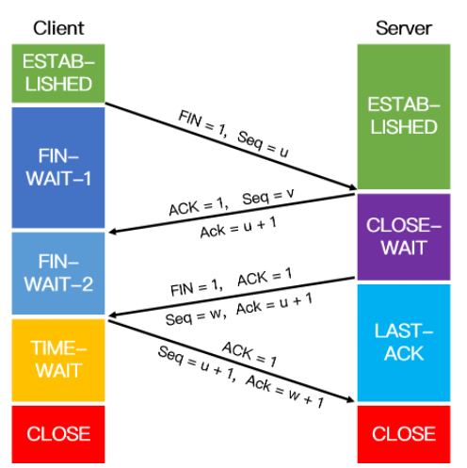
ESTABLISHED
ESTABLISHED
FIN-
WAIT-1
FIN=1，Seq=u
ACK=1，Seq=v
CLOSE-
WAIT
Ack=u+1
FIN-
WAIT-2
FIN=1，ACK=1
Seq=w，Ack=u+1
LAST-
ACK
TIME-
WAIT
ACK=1
CLOSE
Seq=u+1，Ack=w+1
CLOSE

