Slide 1
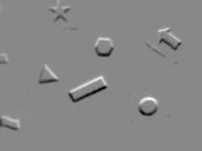
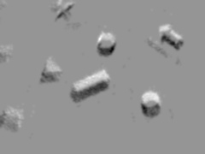

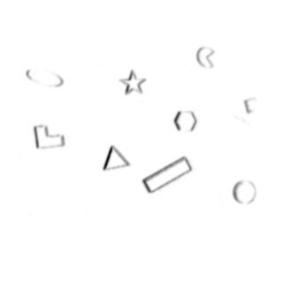
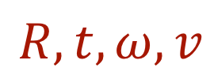
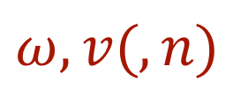

$$ω, v(, n)$$
$$R,t,ω, v, n$$
$$R, t,ω, v$$
Notes:
To
Similar cost function as we sowed before to match the shapes in the frame and map together

