Slide 1

Part I-Chapter1 Introduction And Overview
Protocol
Network Protocol
A set of rules to exchange message
The format of message
Protocol Software
The software that implements the Network Protocol
he appropriate actions required for each message

Slide 2
Part I-Chapter1 Introduction And Overview
Network Protocol
Layering Model
The communication problem can be devided into subpieces called layers
A protocol can be designed to corresponds to each layer
Each module only communicates with the module for the next highest layer and the next lowest
Suites
A complete, cooperative sets of protocols
Each protocol in a suite solves one part of the communication problem
Together, they solve the entire communication problem

Slide 3
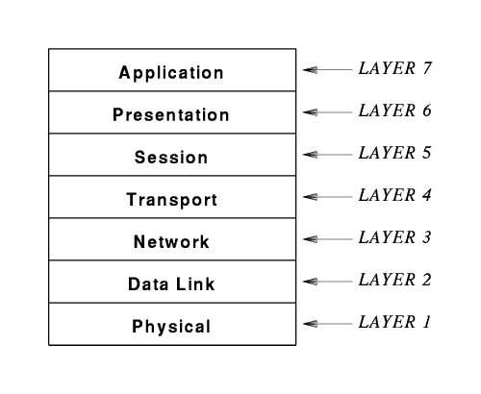
Part I-Chapter1 Introduction And Overview
Open Systems Interconnection Reference Model
Published by ISO
The argument is whether the network layer includes the Internet

Slide 4
Part I-Chapter1 Introduction And Overview
OSI Hardware installed Host and Switch
Physical Layer
Signal communication for binary code
Data Link Layer
Multi hops
Automatic Repeat request(ARQ) Mechanism for frame
Manchester Encoding for Ethernet
Mac sublayer
Sending a frame based on CSMA/CD
LLC sublayer with Channel Coding
Demultiplexing a frame with a physical address
Sliding window for frame transmission

Slide 5
Part I-Chapter1 Introduction And Overview
OSI Hardware installed Host and Switch
Network Layer
Store And Forward Paradigm
Forward Paradigm based route mechanism
Service Paradigm
Connectionless
Connection-oriented
ATM
Ethernet
Suitable for multi hop networks

Slide 6
Part I-Chapter1 Introduction And Overview
OSI Software Run on The End Host
Transport
Session
How to identify the end process on remote hosts
Presentation
How to keep the data bit order consistent for data on remote hosts
Application
Sender will divide the data into multiple frames
Receiver will reassemble the frames into the data
How to convert between raw data and network frames
How to using the end process on remote host

Slide 7
Part I-Chapter1 Introduction And Overview
OSI Protocols & TCP/IP Protocols
OSI Protocols
They are designed by ISO huge standards bodies
TCP/IP Protocols
They were created by a small group of about a dozen researchers
TCP/IP protocols was technically superior to OSI protocols

Slide 8
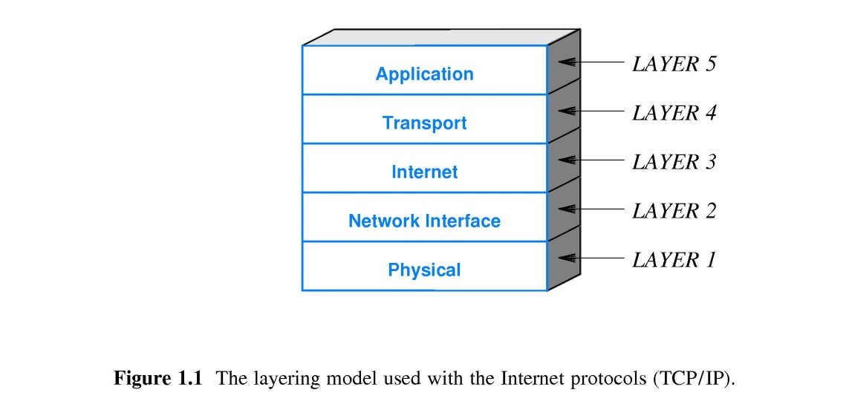
Part I-Chapter1 Introduction And Overview
TCP/IP Stack
Network card function for transmitting frames, which comes from OSI model
Network Interface Protocol
Network layer of OSI model
Link layer of OSI model
Physical layer of OSI model

Slide 9
Part I-Chapter1 Introduction And Overview
TCP/IP Stack
Internet Protocol(IP)
Virtual Network
The IP datagram format
The mechanisms used to forward IP datagrams
Transport Control Protocol(TCP)
Transport layer of OSI model
TCP segment
Datalink layer of IP
Automatic Repeat request(ARQ) Mechanism for TCP segment
Sliding Window for TCP segment
Session layer of OSI model
Identify the processes of communication
Application Protocol
Presentation layer of OSI model
Application layer of OSI model

Slide 10
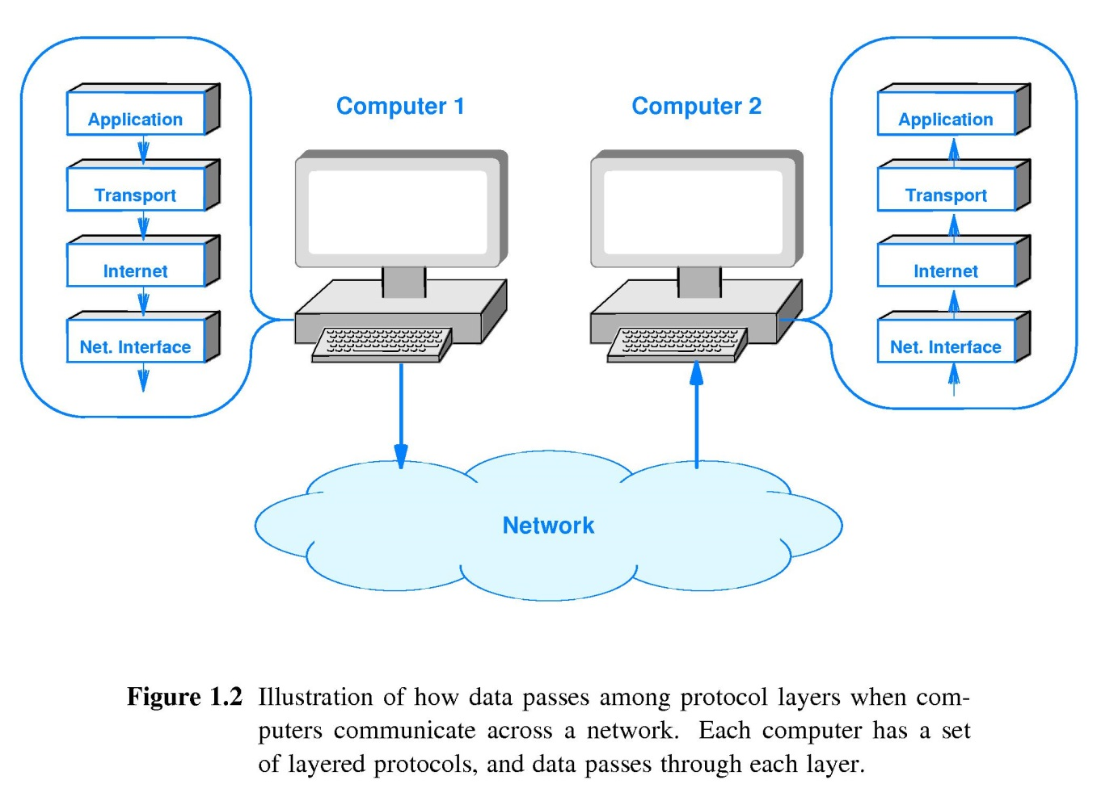
Part I-Chapter1 Introduction And Overview
TCP/IP Communication
The Conceptual Path of Data
Service
Protocol
Physical Communication

Slide 11
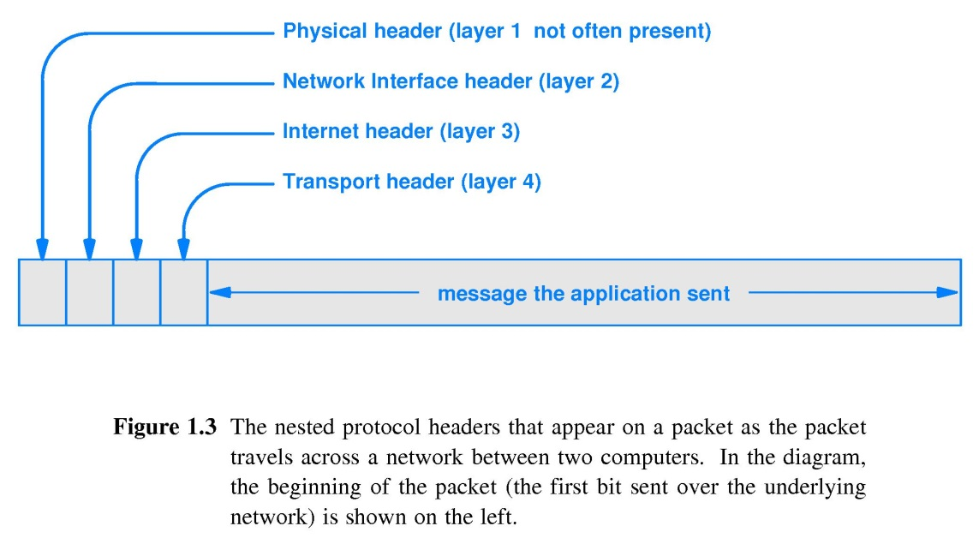
Part I-Chapter1 Introduction And Overview
Heads And Layers
Head
Additional information added by a protocol

