Slide 1
Web Design
2051840-Hou Liang
School of Software Engineering
TongJi University

Slide 2
Introduction
This system is a private website only for presenting some personal essays about films and literature works to the public.

Slide 3
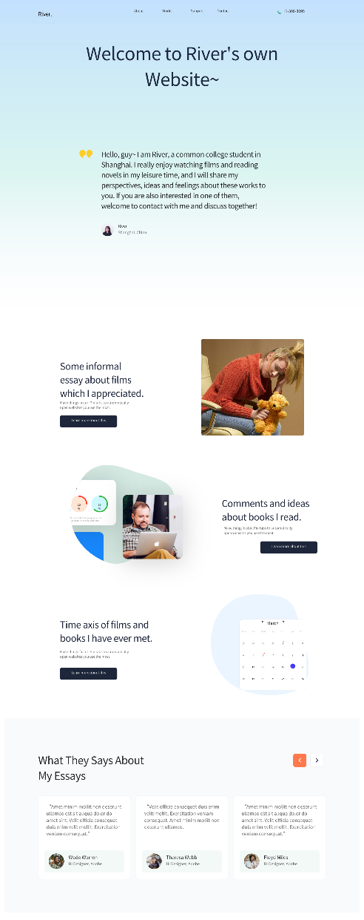
Main Page
Discussion:
In the top of this page, I designed 4 sections, include ‘about’, ‘works’, ‘support’ and ‘contact’, which compose the whole presentation of website. It will be convenient for browsers to find the section they want.
In the center of this page, I put forward my key idea of website, interpreting the main purpose of this personal blog, what kind of content I will share and some basis information rewarding author. It will make it easy for browsers to grasp the core text of web.
Considering the main purpose of website is sharing some ideas about films and literatures, I make two direction, browsers are able to click the button to skip to particular page.
However, I do not set a selector to distinguish different types of essays, so both button will lead to the same page ---- work page.

Slide 4
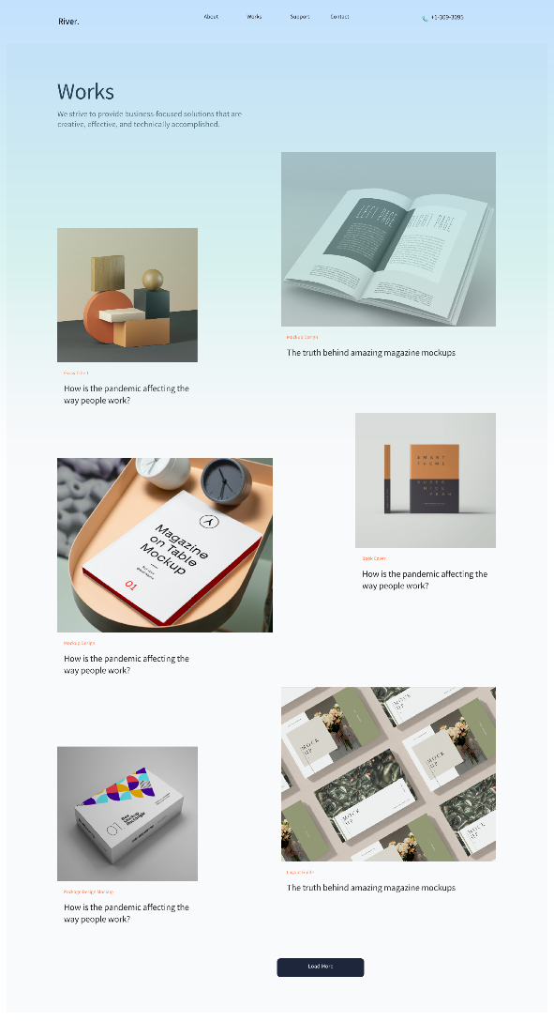
Work Page
Discussion:
In this page, I mainly intend to represent all essays which have been uploaded to the website.
The advantage of this page may it would be simple for users to browse these essays when they are not concerning about particular type of essays. In this case, they may discover some essays really interested them, while these fields they have never expected before.
The drawback is it is not likely to select particular types of essays or select them via key words.

Slide 5
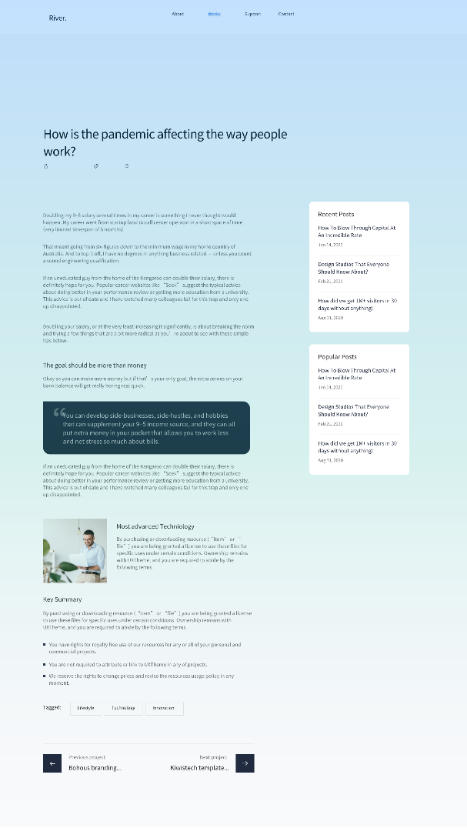
Essay Page
Discussion:
In the main function of this page is presenting the content of one essay.
On the left side of page, I set two module to recommend relevant texts.
In the bottom of page, users can change to next/last essays by clicking the buttons.
However, this page does not offer a button to return to the work page. browsers can only click ‘works’ in the navigation (in the top of page) to go back.

Slide 6
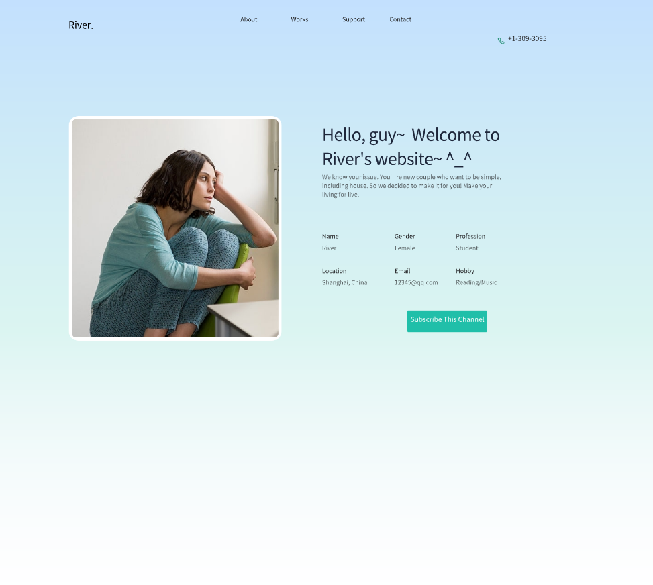
Personal Page
Discussion:
This page primarily offers some brief details of the website owner. Browsers can have a rapid mastering of the author.

Slide 7
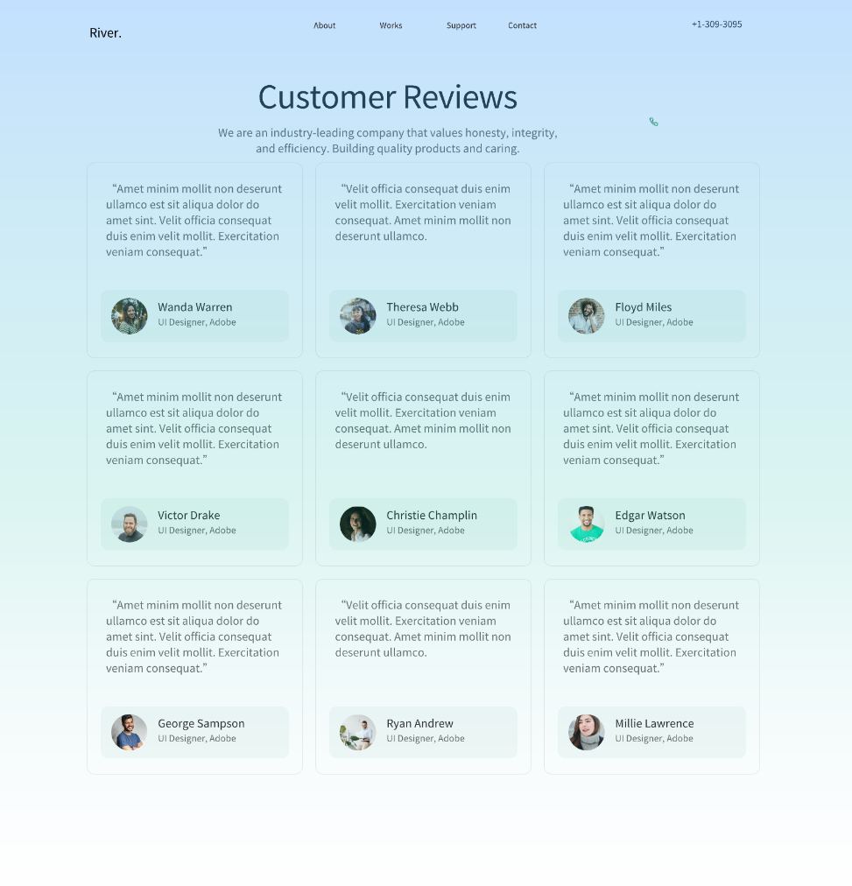
Support Page
Discussion:
In support section, I design mainly for showing some comments of other viewers.
The positive side of this page is it only shows nine comments which are selected by the website owner. So that browsers easily hold a basic understanding of other views to the website.
However, browsers can not view all comments from others.

Slide 8
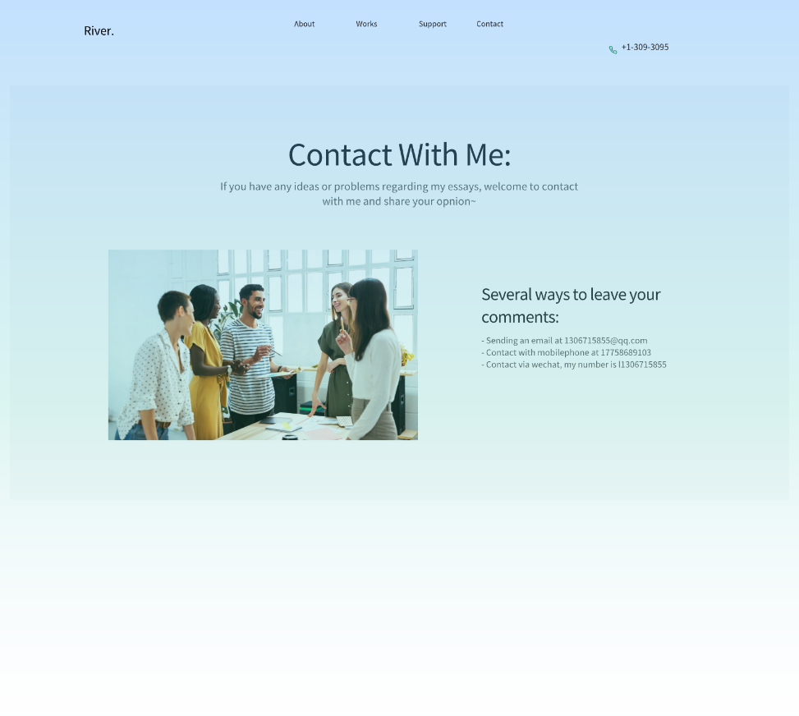
Contact Page
Discussion:
In contact section, I only present some ways to contact with website owner, include email, phone and WeChat.
However, browsers are not allowed to leave a comment directly via this page.
The advantage is it make this system very simple, which means a complex database is not necessary, so that there will be less security problems or latent risks.
The drawbacks may include it has not a formal subsystem to manage all comments, and comment owners are unable to view all his/her comments in this website.

