Slide 1
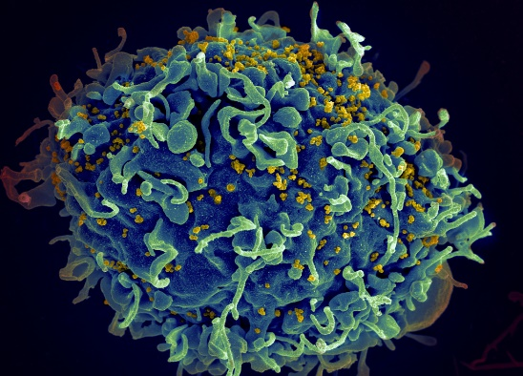
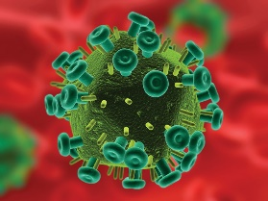
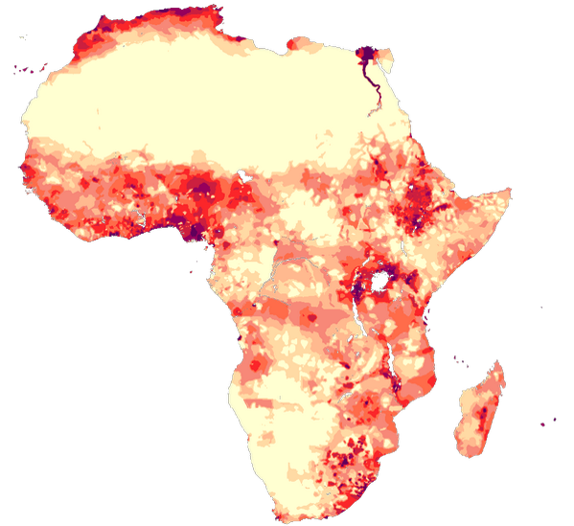
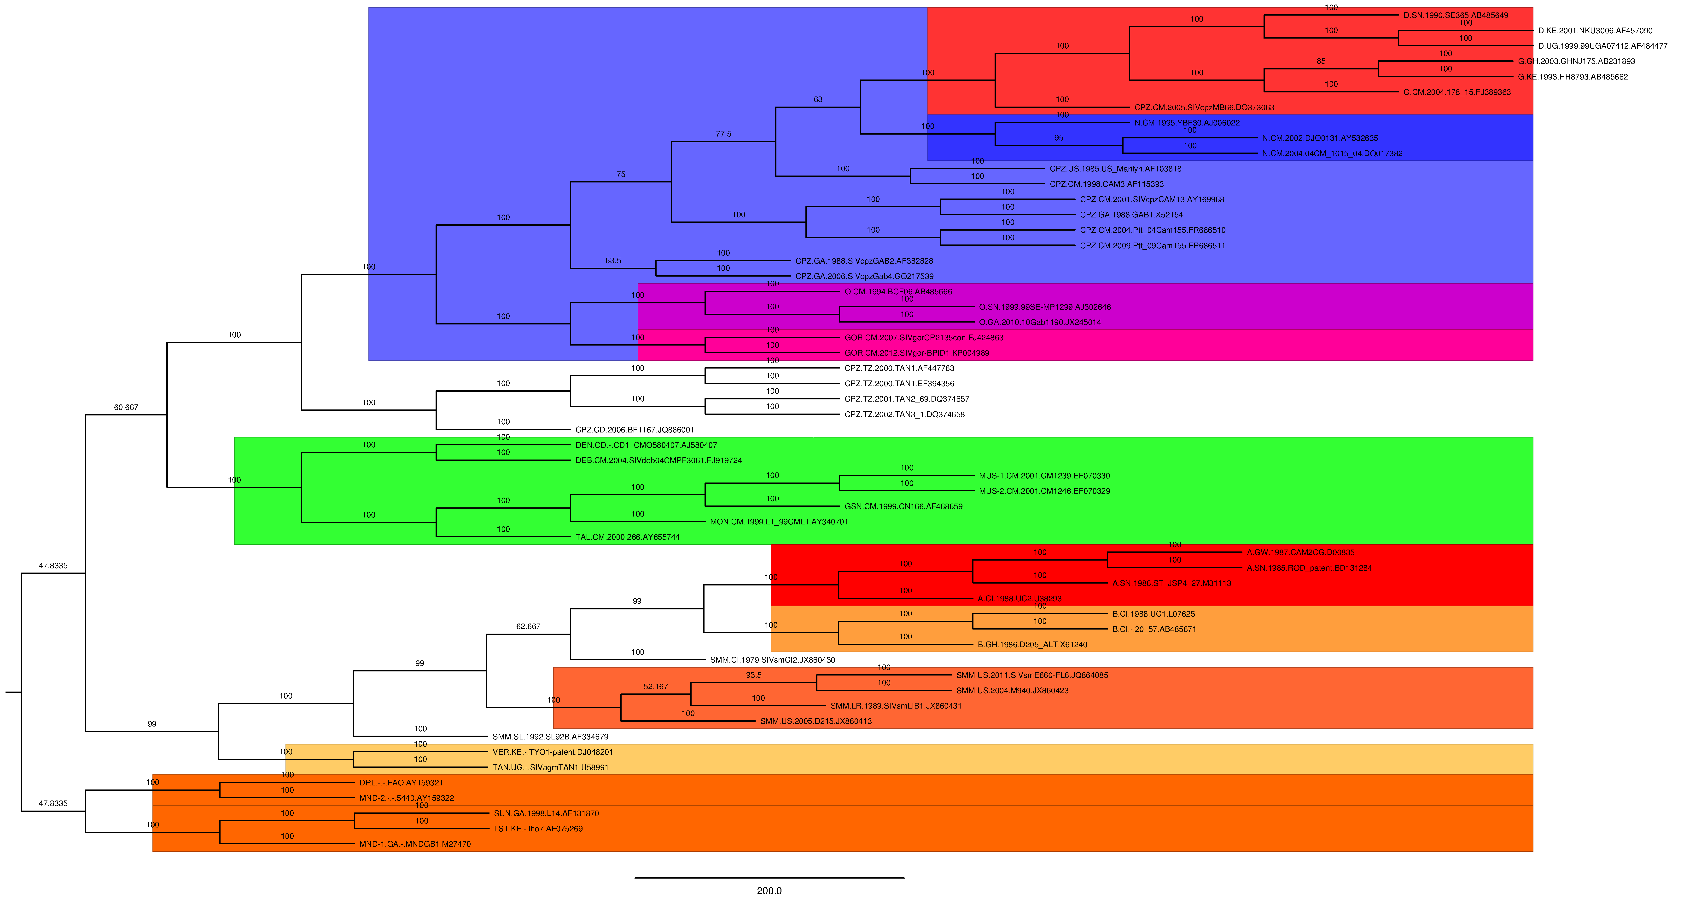
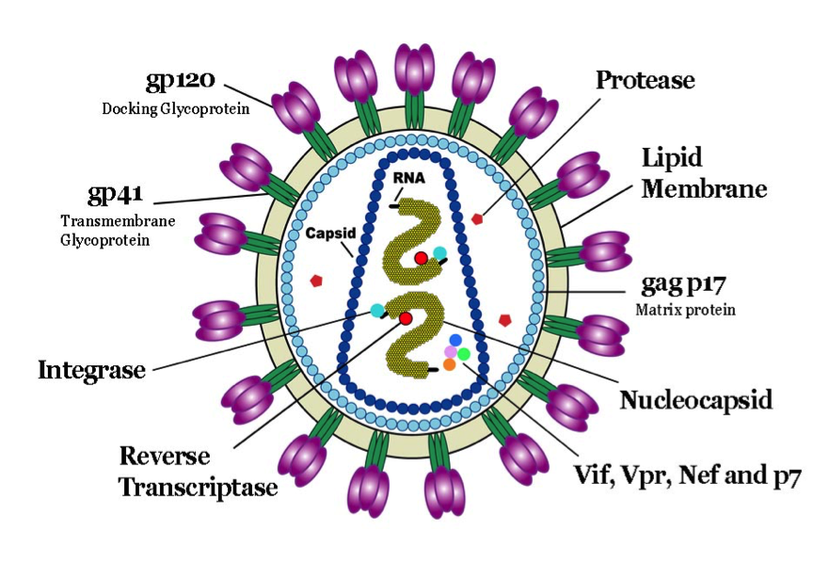
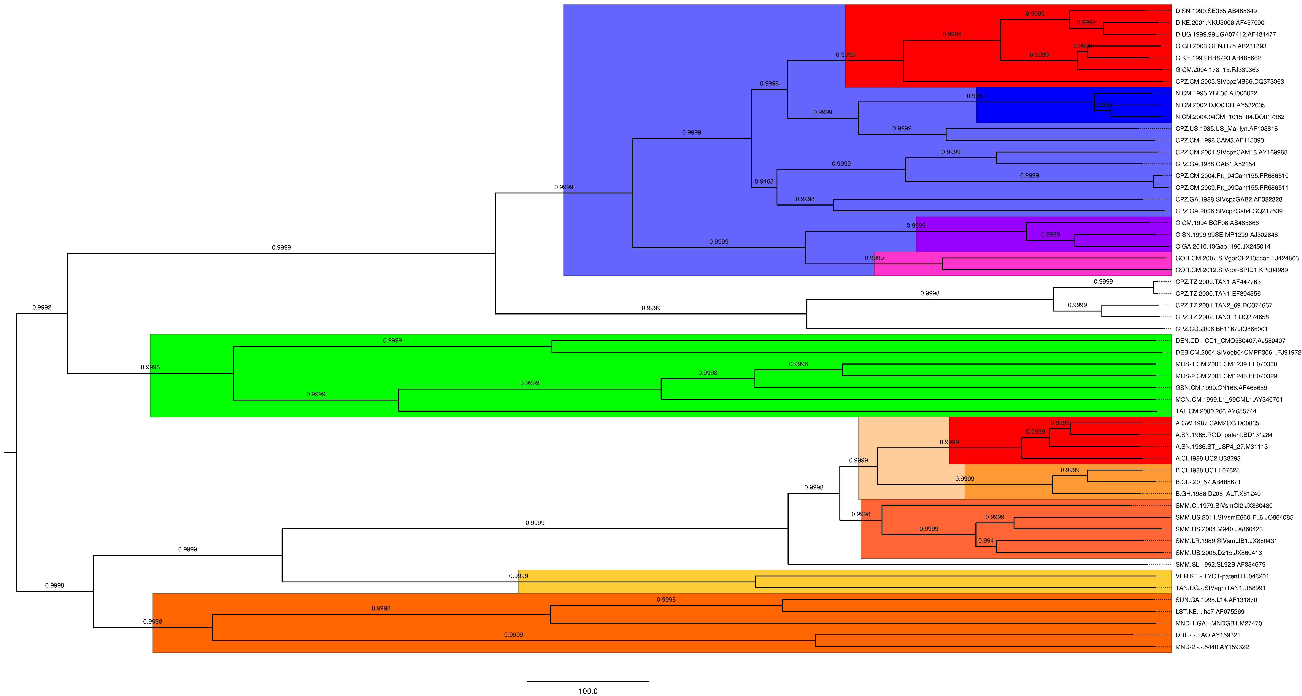
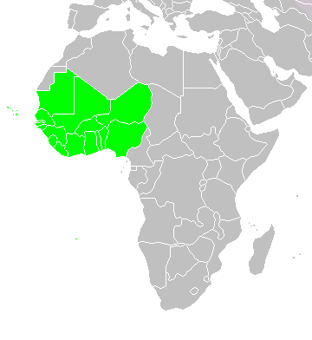
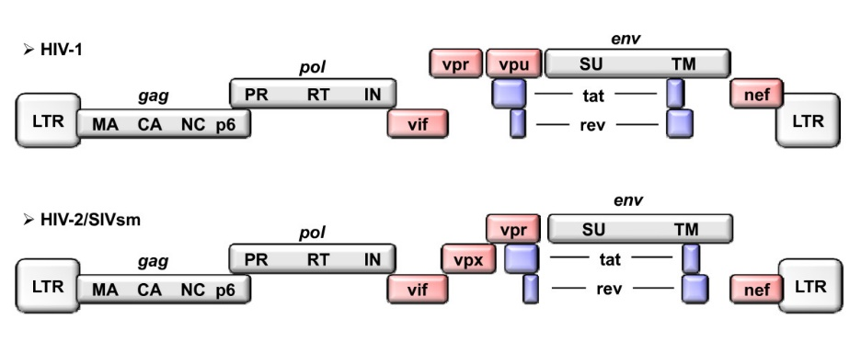
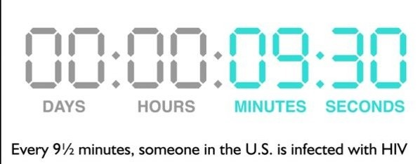
PURPOSE
TITLE BOARD
CONCLUSIONS
After close inspection of more than thirty research papers detailing the evolutionary history of the HIV virus, it was discovered both that very few mapped the history of HIV strains prevalent in the densely populated region of West Africa and that every paper lacked adequate support for the trees created.
By examining lesser studied HIV-1 and HIV-2 strains with a unique regional focus on Western Africa, can new evolutionary and geographic relationships be found and backed using well-supported trees?
METHODS
b) BEAST (Bayesian Evolutionary Analysis Sampling Trees). The second program used; an XML file was created using BEAUTi where the MCMC chain was specified at 120,000,000 and a strict molecular clock was used. Each of the 20,000 trees produced by the BEAST run was weighted based on its posterior probability, and the best tree was annotated using another program called TreeAnnotator. The annotated tree was then viewed in FigTree, and statistical results from the MCMC analysis was viewed in Tracer.
3) Revision of Gene Pool and Outgroups. To produce high-quality trees, many deletions and additions were made to the sequences used; each combination was then tested to see how it performed in PAUP. Almost 40 different changes were tested before creating the final tree. PAUP* also requires the user to set an outgroup, a species known to have diverged before the species in study. As a result of this, about 15 different outgroups were attempted before finding one with both good scientific and phylogenetic backing.
With the near perfect bootstrap values and posterior probabilities, the following conclusions can be made with high confidence:
Production of Trees With A Specific Region and High Bootstrap/Posterior Probability. The tree itself is a conclusion – almost no trees regarding HIV-1 and HIV-2 produced to date have had such incredible bootstrap values or posterior probabilities, which is impressive to find after almost 50 years of research in the field. And certainly no tree with as specific a focus as this has been published with such high values, adding to the value of the produced trees.
Identification of Correlation Between HIV-1 Type O and Gorilla SIV. A very new theory, only a couple years old, is the idea that HIV-1 Type O, or the outlier group, in fact came from SIV from gorillas and not chimpanzees. My trees provide strong support for this idea, showing a clear relationship between the two.
Support for HIV-2 Types A and B Being From One Independent Transmission. The leading theory regarding the subtypes A and B of HIV-2 is that they came from separate sooty mangabey to human transmissions. However, my trees provide strong evidence for the alternative idea that they in fact came from one transmission, an idea that completely changes the evolutionary ideas behind the two subtypes of HIV-2.
New Geographic Routes of Transmission for HIV-1 Type O. Both trees support a connection between more recent HIV-1 Type O strains from Gabon and Senegal (both West Africa) and a split from the oldest known strain of HIV-1 Type O, found in Cameroon (closer to Central Africa). This provides evidence for the new idea that HIV-1 Type O originated in Cameroon, mutated, and was spread to West African countries in a slightly different form. From these two locations, HIV-1 Type O has not made much of an impact in other regions, albeit a couple cases in France and Western Europe.
1) Gathering and Alignment of Sequences. Using online databases (primarily hiv.lanl.gov), about 80 different sequences were gathered amongst thousands, with the final trees consisting of 55 sequences. These sequences would then be opened in SeaView, a GUI for viewing sequences, and then aligned using MAFFT and its Fast Fourier Transformations.
2) Creation of Trees. The two main programs used were PAUP* and BEAST for this step:
a) PAUP* (Phylogenetic Analysis Using Parsimony). The first program used, PAUP took the aligned sequences and performed parsimony-constraint heuristic search and bootstrap analysis of over 100 different trees.
BACKGROUND
Identification and Support of General Theories Found in Other Regions. Major general theories found in other regions are also shown on the tree, which have been discovered over the
The human immunodeficiency virus, or HIV, is a relatively new pandemic, responsible for causing AIDS and killing almost 40 million people around the world. It belongs to a family of retroviruses known as lentiviruses, which are found in a number of non-human primates.
Source: nih.gov
DATA / TREES
years. These patterns include: HIV-1 with SIVcpz, HIV-2 with SIVsmm, a large split between the two and that major subtypes of the viruses split at different points.
Source: 123rf.com
In humans, HIV attacks the body’s immune system, specifically the CD4 cells (T cells), which help the immune system fight off infections. If left untreated, HIV reduces the number of CD4 cells (T cells), getting to a point where the body can’t fight off infections and diseases. AIDS is defined as the stage of HIV infection when your CD4 counts fall below 200 cells per cubic millimeter of blood.
Area of Research
Figure A
PAUP* Tree
African
Population
Density
Source: wikipedia.com
HIV is also divided into 2 main types – HIV-1 and HIV-2. More well-known is the former; it is responsible for the vast majority of AIDS cases and has spread worldwide while HIV-2 is prevalent mainly in West Africa and is less pathogenic.
In order to track evolutionary relationships and rates/dates of divergence, scientists have created phylogenetic trees with both subtypes of HIV-1 and 2. In doing so, scientists have discovered that HIV evolved from simian immunodeficiency virus, or SIV, a similar virus found in non-human primates.
Source: nih.gov
However, the focus of these trees has long been on the Western World or Central Africa, the virus’s predicted location of origin; very few trees have been published documenting strains of HIV in Western Africa, which is both the major population center of the industrializing continent and home to unique strains of SIV, HIV-1, and HIV-2. And of the trees that have been published documenting this region, all are of either low or unpublished bootstrap and/or posterior probability, both of which are indicators of a strong tree. As a result, a decision was made to attempt to create a well-supported tree with SIV, HIV-1, and HIV-2 sequences solely from West Africa. From the trees, succinct evolutionary and geographic relationships between strains can be found and medicine and treatments can be developed to focus on unchanging or weak areas in the virus.
IMPORTANCE
Figure B
BEAST Tree
With this research and its conclusions, scientists can:
Better understand the origin of HIV-1 and HIV-2
Better understand spread of the virus
Create medicine and treatments aimed at certain unchanging or weak areas of HIV
On a pure side, this research has helped in:
Creating a strong hypothesis (the tree) for the evolutionary history of the taxa
How they are related
How they evolved
Potentially guiding our search for new subtypes of HIV
HYPOTHESIS
Source: biomedcentral.com
Source: iup.edu
By inspecting West African HIV-1, HIV-2 and SIV genomes, it is hypothesized that information will be produced that ties together the three viruses in a well-supported phylogenetic tree. From the tree, it is expected that we will find evidence for relationships found in different regions as well as discovering some of our own new theories regarding the evolution of the virus.
MATERIALS
FUTURE WORK
The following materials were used to gather sequences, align said sequences, and create and manipulate phylogenetic trees:
Computer with proper software downloaded and internet
A Nucleotide Database: ncbi.nlm.nih.gov OR hiv.lanl.gov
Version Control
Required in order to recover old files
Used GitHub
Software
Sequence Manipulation
Komodo Edit, SeaView, Mafft, Mesquite, Linsi
Phylogenetic Analysis Using Parsimony
PAUP*
Bayesian Analysis / BEAST Suite
BEAST, BEAUTi, Tree Annotator, Tracer
Tree Viewing
FigTree
ANALYSIS OF DATA
Figure B (BEAST Tree). The tree produced by BEAST was produced using a strict molecular clock, an exponential clock rate, and the MCMC chain set at 120,000,000. The numbers on the branches represent posterior probabilities; as such, values closer to 1 mean better supported branches. This tree has incredibly high posterior probabilities, with all but one branch having probabilities of 0.999 or greater.
The same coloring scheme was used, and a very similar tree was produced with only one or two major differences.
Analysis. The first thing to notice is the raw similarity - it shows that this tree is likely the true phylogenetic tree, as it was replicated almost entirely using two entirely different algorithms. Their high probabilities also increase this likeliness of being the true tree. The main pattern to be noticed is the clear split between HIV-1 and HIV-2: the two take up completely different branches and as a result are quite different. Another pattern to be noted is that the two also identify almost entirely with SIVcpz (chimpanzee SIV) and SIVsmm (sooty mangabey SIV) respectively.
Results of this project are independent, self-contained and mathematically sound, but bounds and conclusions can be improved in several ways:
Tracking specific genes and protein sequences. When more data becomes available for HIV-2 and SIV, the production of trees with more specific DNA sequences could help provide stronger backing for theories
Focusing on different regions and tracking spread from Africa to those regions. Population centers such as India and China are beginning to have more and more AIDS cases, and tracking HIV to those areas can help prevent future spread of the virus.
More data and more powerful programs to produce even more accurate trees. The trees produced were limited by sheer computing ability, as too many sequences would take an incredibly long time; more data and more powerful programs could help increase the integrity of the trees.
Figure A (PAUP Tree). The tree produced by PAUP* was done first using a heuristic search of about 30,000 trees, and then a bootstrap analysis; the combination of the two led to this tree being outputted as it had the highest bootstrap scores. The numbers on the branches represent the bootstrap values extracted; a value of 90 or above demonstrates incredibly strong support, a quality which nearly all of the branches satisfy.
Each colored box represents a clade, a group of organisms that share a common ancestor. The big blue box represents the clade that contains all of the HIV-1 sequences, the pale box represents the clade that contains all of the HIV-2 sequence, sand other clades are colored for comparison and labeling purposes.

