Slide 1
Unlisted YouTube
ETL Data Warehousing
& Cloud Search
Carver Ossoff [2677568]​
River Stepp [2857417]​
Quynh Tran [2777918]

Slide 2








Project Overview & Goals
API
YouTube
"Unlisted" videos are videos that do not appear in YouTube's search results, except in playlists, and can be watched if the URL is known or if a webpage either links or embeds the videos
Project Goals
Collect: Pull unlisted video metadata via hosted API
Store: SQL Server (SMSS) and MongoDB for relational and semi-structured data
Search and Explore: Elastic Search + Vue/Vite UI
Analyze and Log: Metrics (views, likes, playlists) via hosted API
Middleware
Data is collected, parsed, and inserted into a databases
Key Data Collection & Metadata Fields
Metrics Logging
Main Datastore
Elastic Searching
API
Metric data available for unlisted videos globally
M
User Interface for searching through unlisted videos
M

Slide 3
Data Description, Size & Collection
Focus: Unlisted YouTube Videos
~ 11k records (videos) collected and stored
~ 5GB of data parsed
~Continuously growing data bank
Data Collection Method:
Uses a scraper to collect only unlisted videos and then extracts as much metadata as possible
Data Storage: Inserted into MongoDB and SQL Server
Records include 16 relevant attributes:
Video Title
Availability
Playlist Title
Channel
Uploader
Duration in Seconds
Number of Views
Upload Date
….
Relevant metadata fields pulled and logged in addition to relevant attributes include:
Video Description
Video Embed (Boolean)
Category/Video Category
Tags

Slide 4







Platform Setting & System Configuration Procedures
Frontend: Vue 3 + Vite
Backend: .NET 8 API
Database: SQL Server (SMSS) and MongoDB for storing relational data
Setup Highlights:
Docker: Used for containerization
Node.js: Used for building & running the Vue 3 frontend
Git: Used for version control

Slide 5
System Design & Architecture
Frontend and Backend Interaction: Vue 3 frontend communicates with .NET API
Main Datastore: MongoDB + Storage of original collection of links in SQL Server
Layered Database Approach: Relational + Semi-structured
Elastic Search: Efficient searching and indexing

Slide 6









System Design & Architecture Continued
Scripts are activated via threading from a previous script
Main
Activates Pipeline
Elastic Search Server
Searches through unstructured data
.NET API
Middleman
ETL Parser pulls valued data and inserts
Metrics
Runs SQL functions
Hoster
Collects JSON and hosts API
UI visualizes
searches
Mongo DB
Transaction and Interaction
SQL Server
Data bank of key data
JSON of YouTube metrics
Self-hosted API for metric analytics

Slide 7
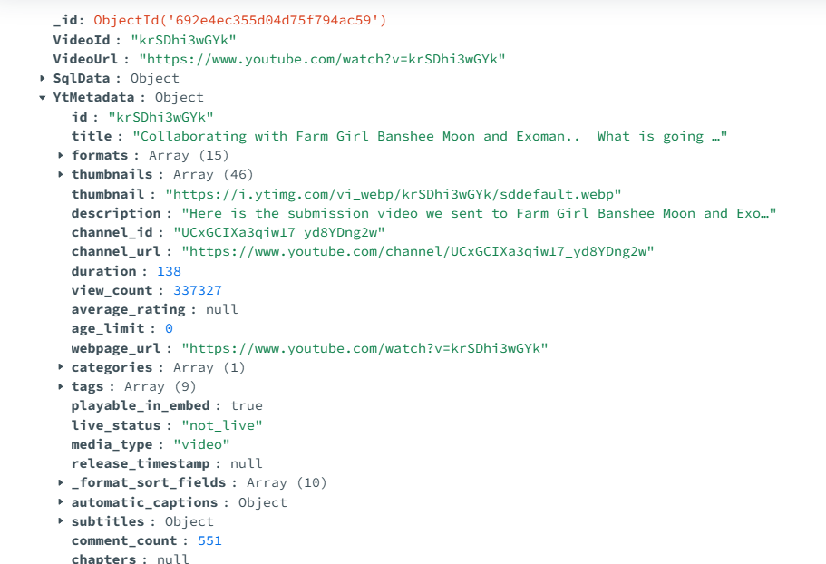
Big Data Processing Pipeline & Data Transformations (Pt. 1)
Scraping
  Generates random YouTube searches
  Filters result to only include playlists
  Sorts by recency
  Enumerates over each playlist one video at a time
  Stores result in database
  For each link in the database, as much metadata as possible is extracted
  Data is written back to database

Slide 8
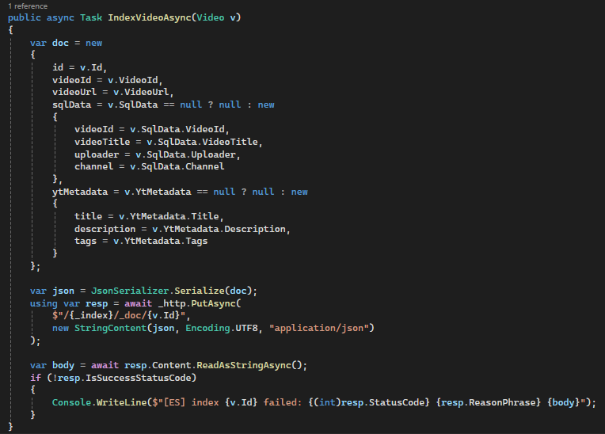
Big Data Processing Pipeline & Data Transformations (Pt. 2)
API invokes Elasticsearch indexing
  Tokenizes text into searchable terms
  Normalizes terms
    Lowercasing, removing accents, etc.
  Applies stemming algorithms
  Removes stop words
  Builds inverted indexes to map terms to documents
  Stores indexed documents for efficient retrieval
Note: The implementation details of these algorithms are abstracted away from the programmer
Must be ran before any searches are performed if there is new data

Slide 9
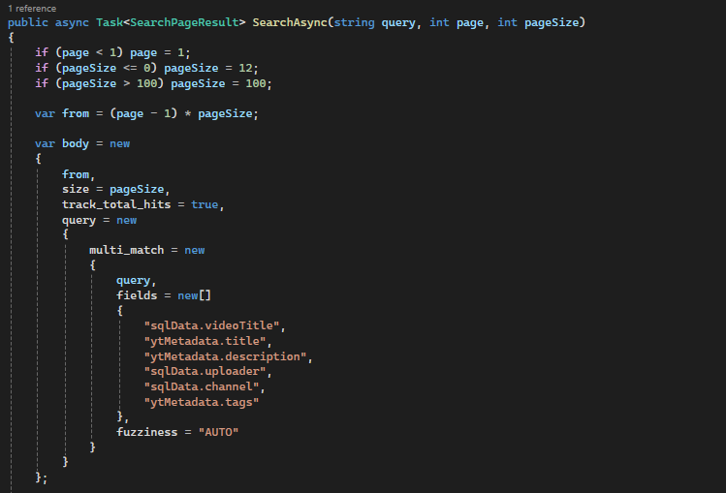
Big Data Processing Pipeline & Data Transformations (Pt. 3)
API invokes Elasticsearch searches
  Query text is analyzed using the tokenizer and filters used for searching
  Looks up matching terms in the inverted index
  Uses BM25 to compute relevancy scores
    More modern variant of TF-IDF
    Improves TF weighting with saturation
    Probabilistic
  Ranks documents by score
  Returns paginated results to the API for the frontend to display
Note: The implementation details for searching are abstracted away from the programmer

Slide 10
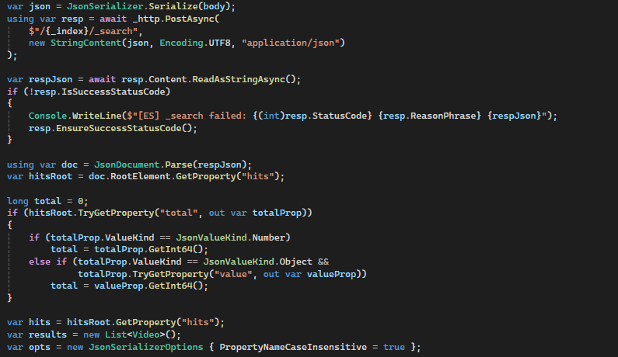
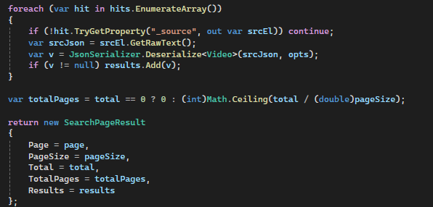
Big Data Processing Pipeline & Data Transformations (Pt. 4)

Slide 11
Database Design (MongoDB)

Slide 12
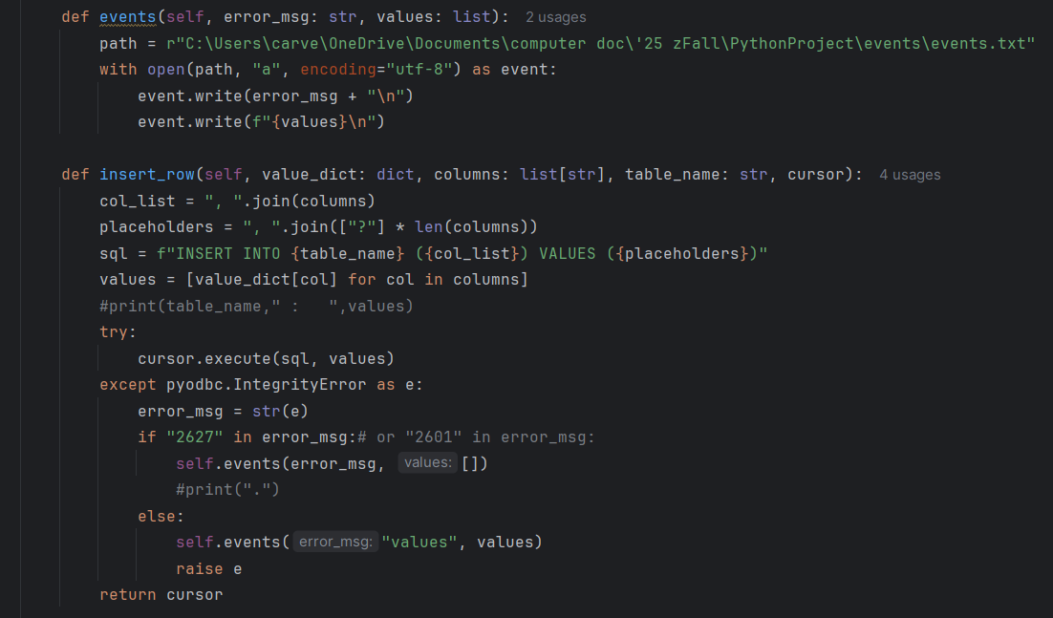
ETL Pipeline
This portion of the application collects data from the Mongo DB server to parse and transform for a relational database
Some fields required construction from multiple fields. (URL's involve destructing and rebuilding multiple fields)
Sends a trigger to Metrics to rerun SQL functions for up-to-date analytics. Allows modularity for quick and easy changes to the design

Slide 13
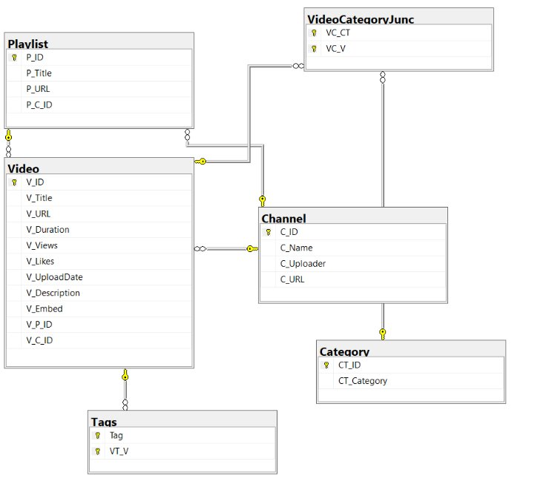
Unlisted Video Metric Logging (Pt. 2)
Structured Metadata Model
Use table prefixes to organize fields
Build constraint logic into the tables and the ETL pipeline to ensure atomic state when parsing and when inserting.
Category
  Many to many relationship
  Requires junction table to link videos to its categories
    Categories = finite set
Tags
  Many to many relationship
  Messy, infinite, user-generated
  Store each tag directly with video it belongs to

Slide 14
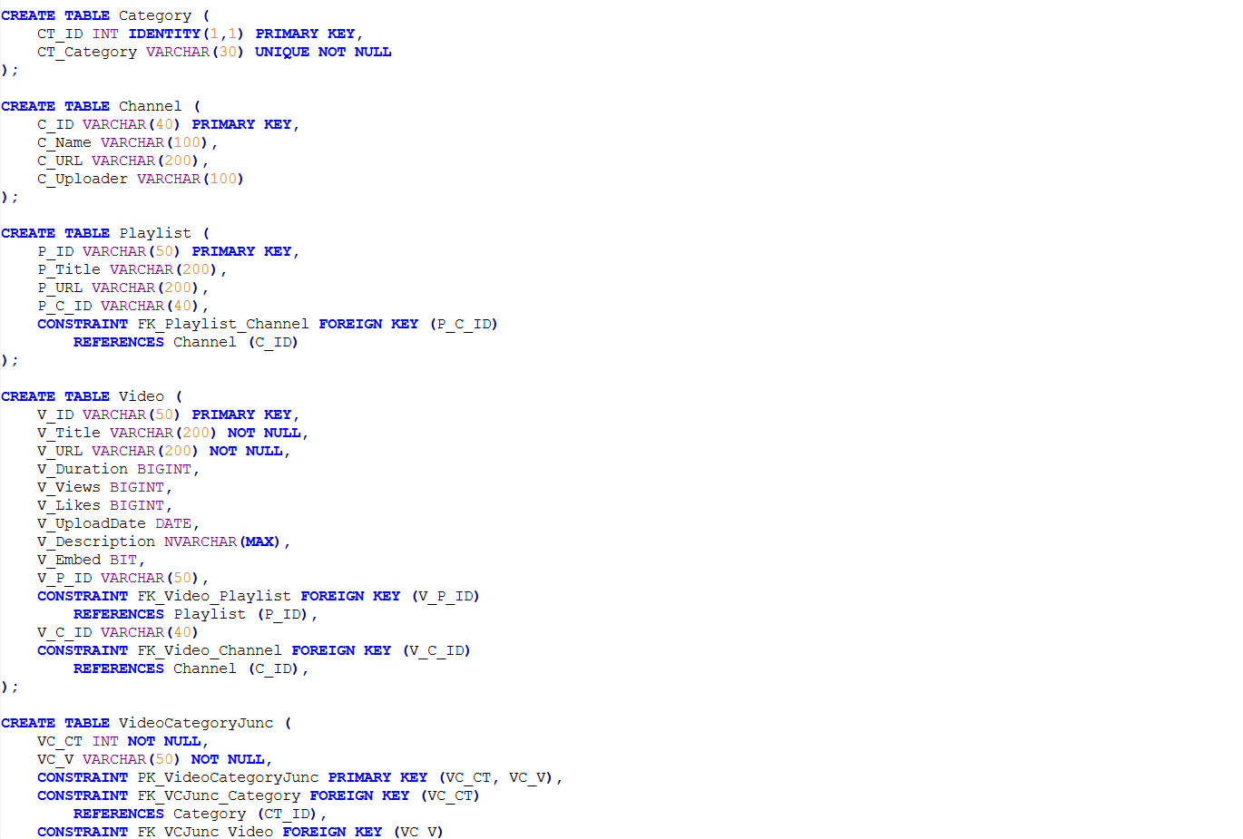
Database Design Sample (SQL)

Slide 15
Unlisted Video Metric Logging (Pt. 1)
Metrics Logging Pipeline:
Metrics is activated by The ETL node. It collects information such as average video length, number of videos collected, and longest playlist.
Metrics calls stored SQL functions to retrieve the most up to date data.
These metrics are written to a JSON file.
The JSON file is collected by Hoster which hosts metric data for pulling and viewing.
Metrics
JSON
.
.
.
API
Hoster

Slide 16
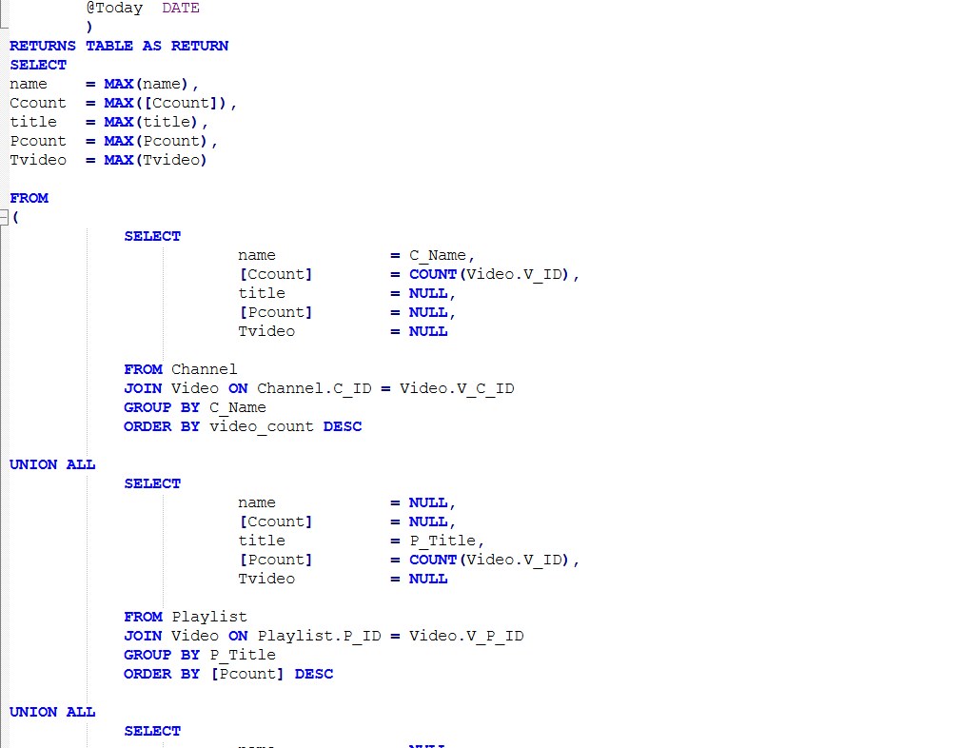
Metric Collection Sample

Slide 17
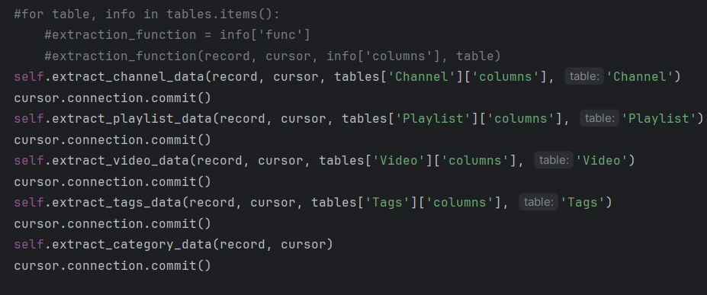
Problems Encountered & Resolutions
Elasticsearch was silently failing initially, making debugging incredibly difficult
  Had to improve logging in our application
  Switched from ElasticsearchClient class from NuGet package to a raw HttpClient class to make failures more obvious
  Sent requests directly to Elasticsearch server using the raw HttpClient class
We lost a lot of data initially
  In an earlier version of our script, database commits did not occur until all playlist search results were processed
  Some search results had very large processing times, causing data loss
  We altered our scripts to commit after each individual playlist was processed

Slide 18


Future Work
Generate more intelligent searches that yield more results
Currently, searches are generated in a naïve way
Find a way to accumulate data faster
We were limited to scraping at a rate of 3 MB/s on one machine
More Flexible API requests
The current API pulls only metrics. This could be improved with dynamic stored procedures

Slide 19


Final Thoughts
A project of this nature has the potential to be useful in a couple of domains
Archival
Training Data
  Generative AI products, such as Sora, rely on large volumes of video training data.
  A tool like this could help uncover new training data for these models
  In the week since we've scraped this data, many of the videos we uncovered have been set to private or deleted
  Unlisted content may be at risk of complete removal

Slide 20
System Demo

Slide 21


