Slide 1



Slide 2
Mothers
The Bible has a lot to say about mothers. God gave us our mothers just as he gave us our lives through our mothers and teaches things to them and through them.

Slide 3
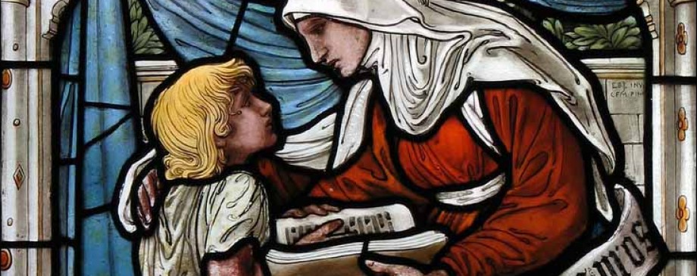
Just how much influence does a mother have?
Many great mothers led to great men throughout history including men in the Bible

Slide 4
Two Passages and Two Lessons
A mother’s best place and a mother’s best advice
  John 2:1-5
  John 19:23-26

Slide 5
A Mother’s Best Place
John 19:23-26
Verse 26:
“Jesus therefore, seeing his mother, and the disciple standing by, whom he loved, says to his mother, Woman, behold thy son.”

Slide 6
A Mother’s Best Advice
John 2:1-5
Verse 5:
“His mother said unto them:
Whatsoever he said unto you, do it.”

Slide 7
Why do we need to do all He says?

Slide 8
Why do we need to do all He says?
He speaks with words of authority (Matt. 7:29)

Slide 9
Why do we need to do all He says?
He speaks with words of authority (Matt. 7:29)
He speaks with words of pardon (Luke 5:23)

Slide 10
Why do we need to do all He says?
He speaks with words of authority (Matt. 7:29)
He speaks with words of pardon (Luke 5:23)
He speaks with words of peace (John 14:27)

Slide 11
Why do we need to do all He says?
He speaks with words of authority (Matt. 7:29)
He speaks with words of pardon (Luke 5:23)
He speaks with words of peace (John 14:27)
He speaks with words of power (John 11:43)

Slide 12
Why do we need to do all He says?
He speaks with words of authority (Matt. 7:29)
He speaks with words of pardon (Luke 5:23)
He speaks with words of peace (John 14:27)
He speaks with words of power (John 11:43)
He speaks the words of provision (Matt. 11:28)

Slide 13
Why do we need to do all He says?
He speaks with words of authority (Matt. 7:29)
He speaks with words of pardon (Luke 5:23)
He speaks with words of peace (John 14:27)
He speaks with words of power (John 11:43)
He speaks the words of provision (Matt. 11:28)
He speaks the words of warning (Heb. 3:8)

Slide 14
Why do we need to do all He says?
He speaks with words of authority (Matt. 7:29)
He speaks with words of pardon (Luke 5:23)
He speaks with words of peace (John 14:27)
He speaks with words of power (John 11:43)
He speaks the words of provision (Matt. 11:28)
He speaks the words of warning (Heb. 3:8)
He speaks the words of love, grace, mercy, justice, judgment, life, hope, forgiveness and much, much more(see John 21:25)!

