Slide 1

Timothy Bender CSCI – 347 Wine Quality Classification
An exploration of the Wine Quality dataset and Keras Binary Classification

Slide 2



The Dataset
Wine Quality (Red) : https://archive.ics.uci.edu/ml/datasets/wine+quality
Attributes: 11 Numerical | 1 Categorical(I)
1499 Instances
0 Null values

Slide 3

Project Genesis
Perform data analysis
Determine high correlations
What makes a good wine?
Pre-Processing
Create and train a Keras neural network
Evaluate model and recommend improvements

Slide 4
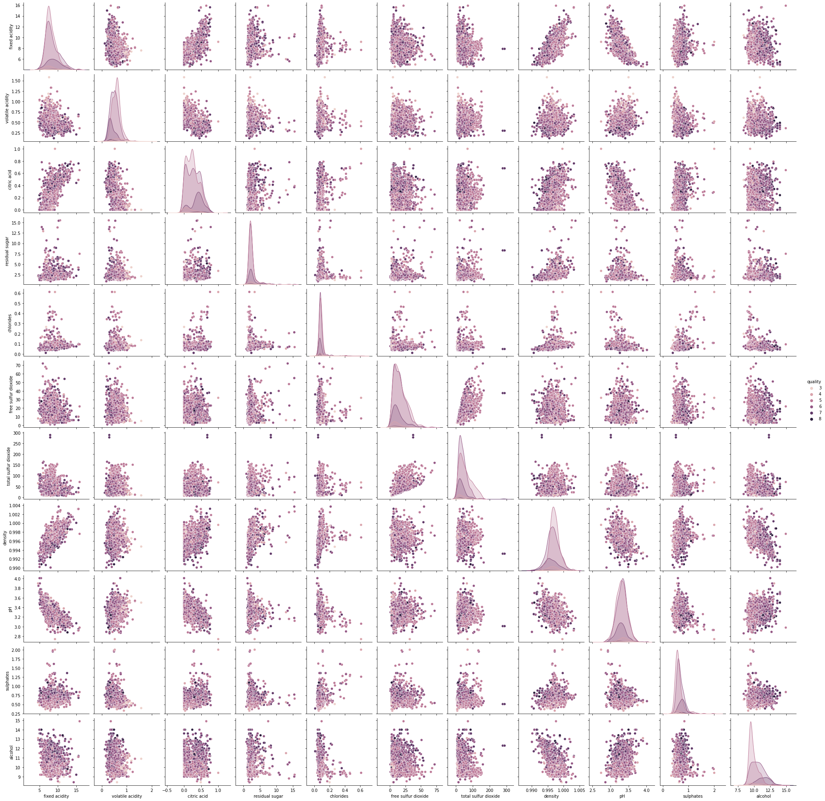
Seaborn Pair Plot
Correlated Attributes
Density – Fixed Acidity
Density – Citric Acid
Free – Total Sulfur Dioxide
Quality Alcohol Content ?

Slide 5
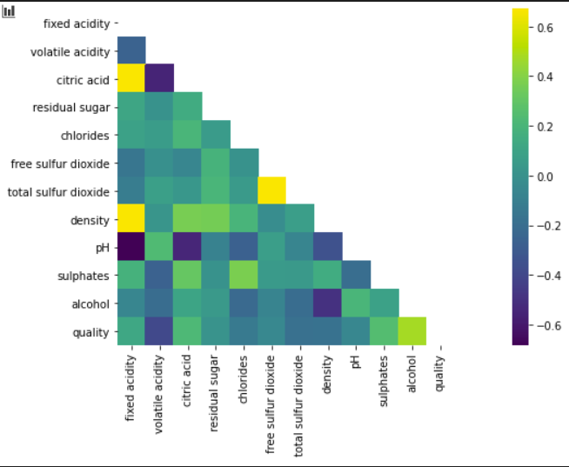
Confirming Correlation
Confirmed correlation between the suspected attributes.
Suspected correlation between alcohol content and quality

Slide 6
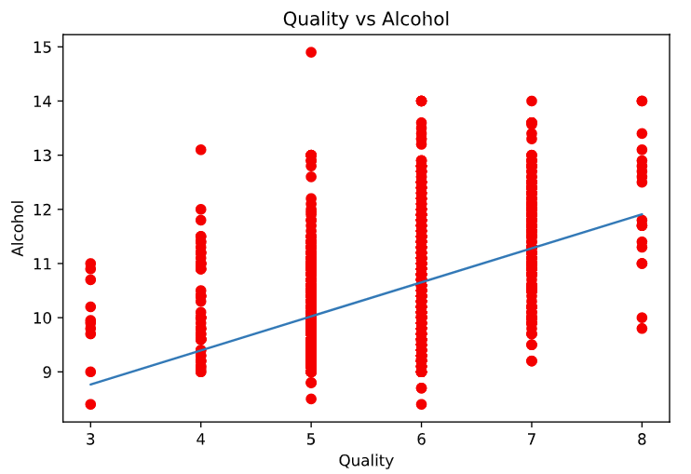
Linear Relation
Definite linear relation between Alcohol content and the quality of red wine.
Correlation not strong enough to predict based on one attribute.

Slide 7
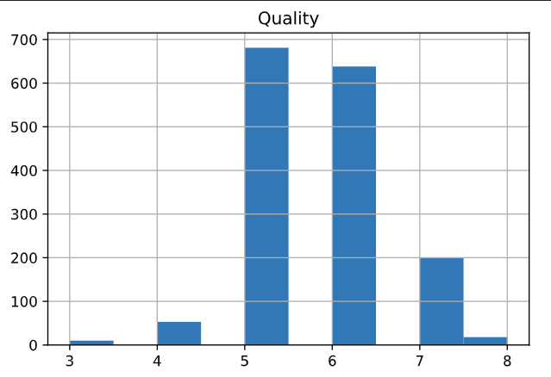
Quality - Low Variance
Quality Attribute displays a low variance
Any predictive model will likely be skewed

Slide 8
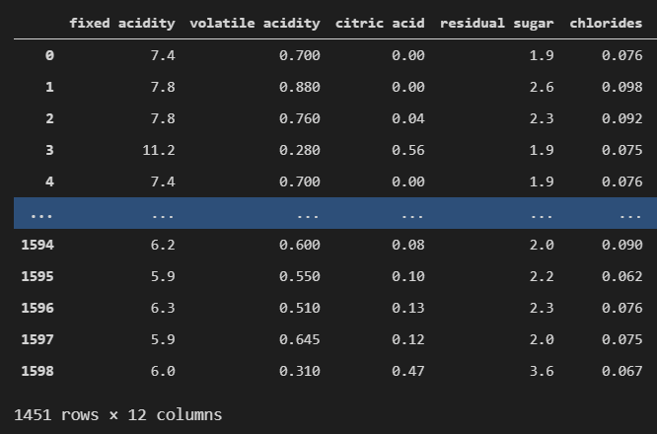
Z-Score Anomaly Removal
The Z-score of each attribute was used to remove any outlying datapoints which would otherwise skew the dataset and hurt the training of our model

Slide 9
Generating Training and Testing Subsets
Label encoding was used to prepare the quality attribute for binary classification.
Data was split into training and test subsets.
10% - Testing

Slide 10
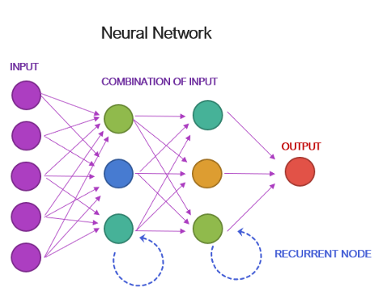
Keras Neural Network
6 Dense layers
Relu activation function
Single Decision Dense Layer – Sigmoid function
300 Epochs
Credit: Goldberger, Ariel. “Training Neural Networks for Binary Classification: Identifying Types of Breast Cancer (Keras in R).”
Medium, Duke AI Society Blog, 12 Mar. 2019, medium.com/duke-ai-society-blog/training-neural-networks-for-binary
-classification-identifying-types-of-breast-cancer-keras-in-r-b38fb26a500c.

Slide 11
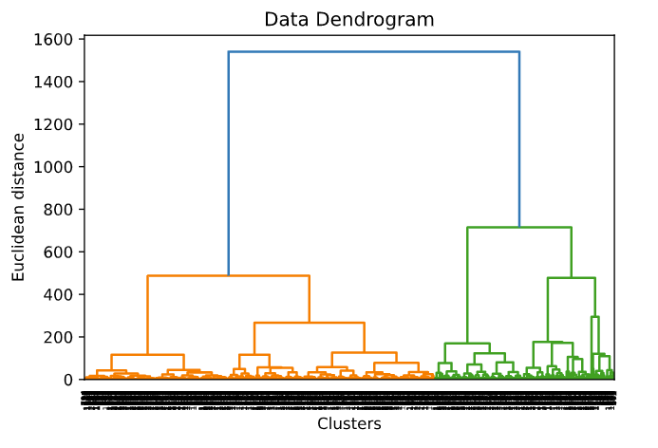
Random Forest Classification
Dendrogram suggests RFC Algorithm competency.
Much faster classification model to train.
Simpler implementation

Slide 12
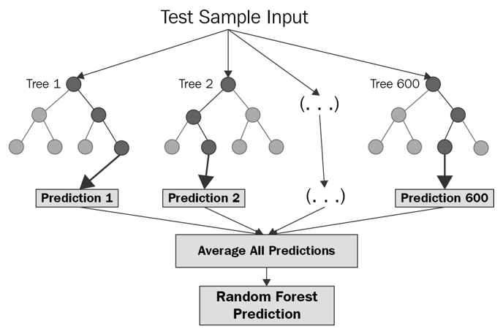
Evaluating the Models
Keras: 92.5% Accuracy
25s Training time
RFC: 92.9% Accuracy
< 1s Training time
Effectively equivalent
More diverse data set Keras would likely exceed RFC.
Credit: “Random Forest - Overview, Modeling Predictions, Advantages.” Corporate Finance Institute,
13 Apr. 2021, corporatefinanceinstitute.com/resources/knowledge/other/random-forest/.

Slide 13
Key Findings
Alcohol content strongly correlated with quality
All attributes of wine required to generate an accurate prediction of quality.
In this specific case RFC equivalent to NN.
Biased unvaried dataset.

