Slide 1
Netart Process Book
Jordan Tecumseh
Spring 2022
ART 2602c Intro to Digital Media

Slide 2
What is this project about?
For this project, we will find three news articles and take 25 words from each to cut up and resort so they are in a new order. This new order will create a new meaning and give us a personalized theme for our Netart project. A Netart project is a piece of artwork that can only be viewed on the internet. This is what we are making.

Slide 3
Brainstorming for possible themes…
That applying global intelligence unknown for available
Good advance and technology have models showing
See environmental holds some news many not new

Slide 4
Theme for Netart Project:
The environment holds some news, many not new.

Slide 5
Word Brainstorming
-Environmental changes
-weather
-global warming
-Natural disasters
The environment creates news everyday and although it is “news”, it is not new. We have experienced and endured the natural struggles of our world for a very long time.

Slide 6
Natural Disasters:
-Tsunami
-Hurricane
-Tornado
-Earthquake
-Wild Fire
-Avalanche
-Volcano

Slide 7
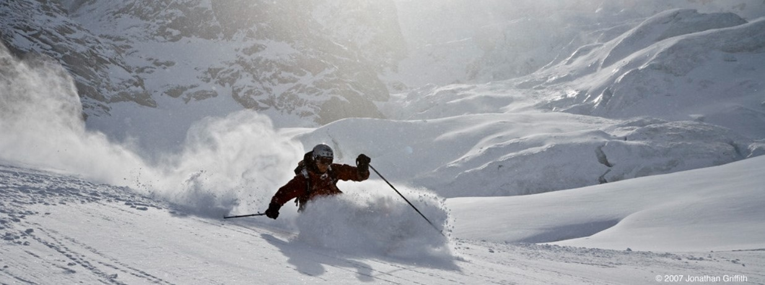
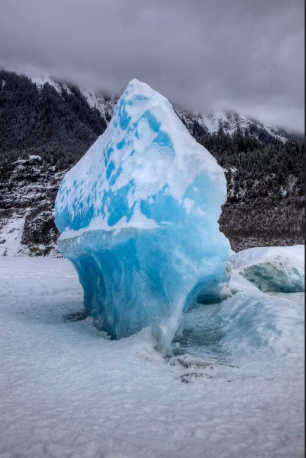
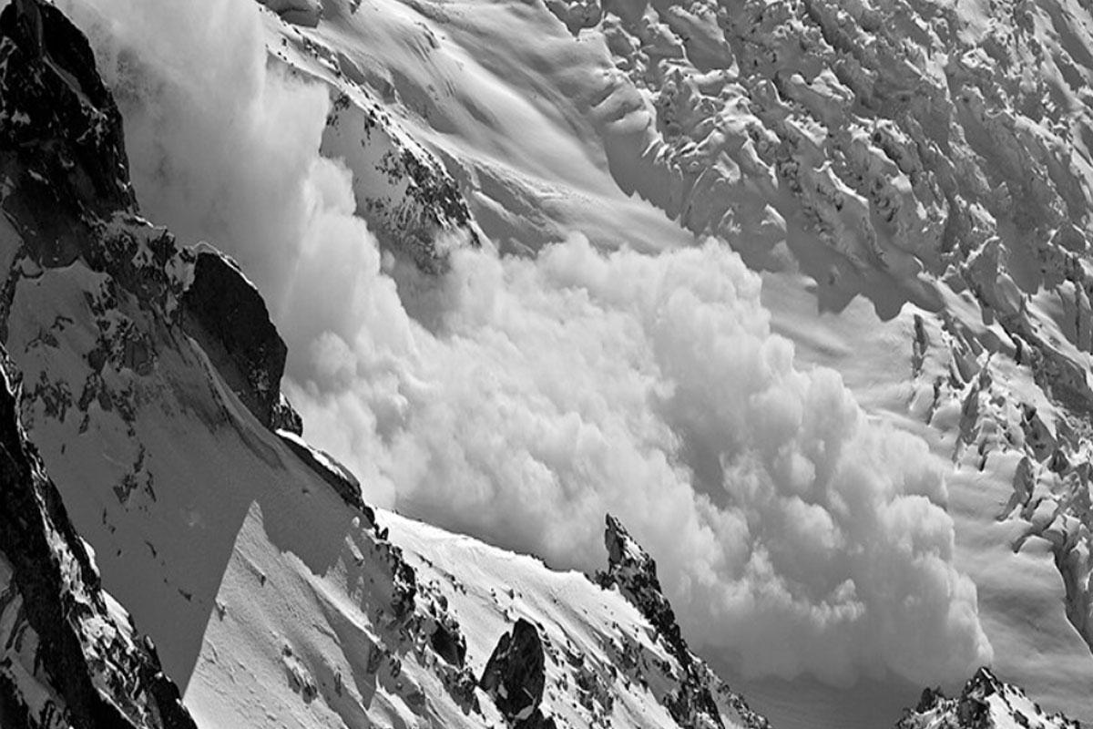
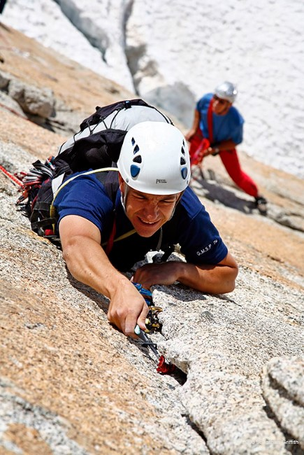
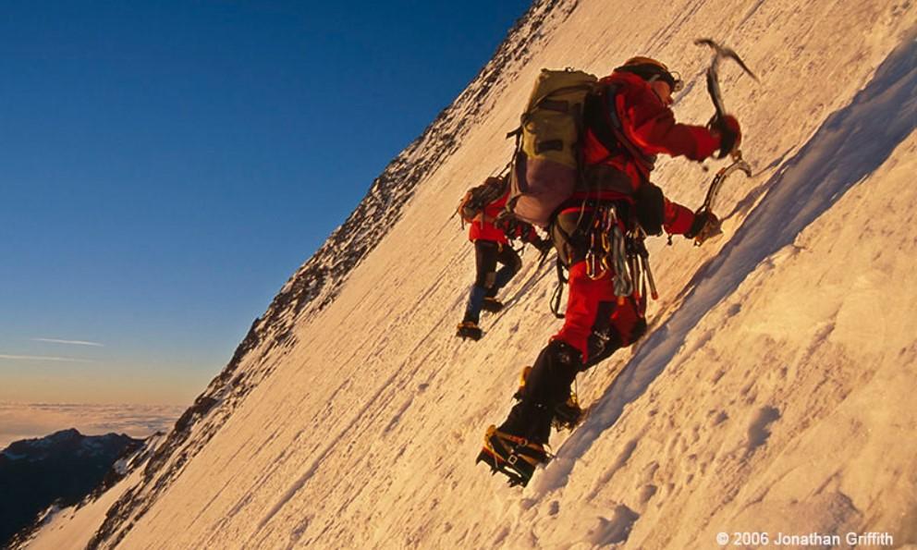
Images:Brainstorming Avalanche

Slide 8
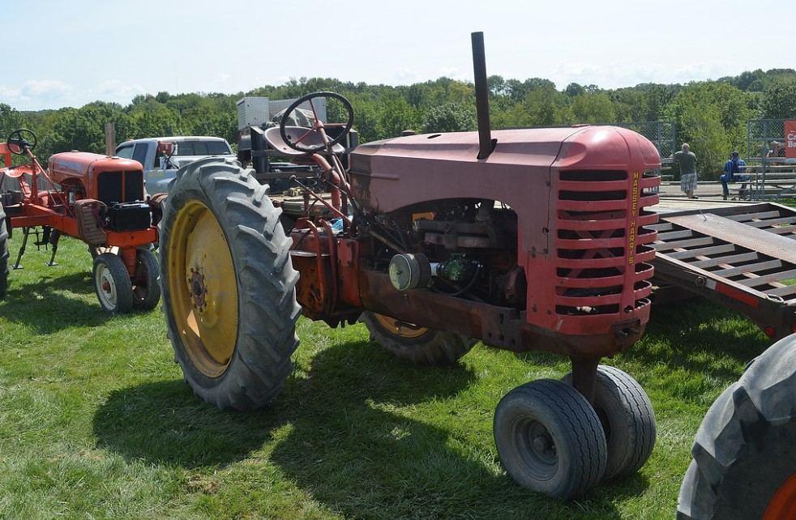
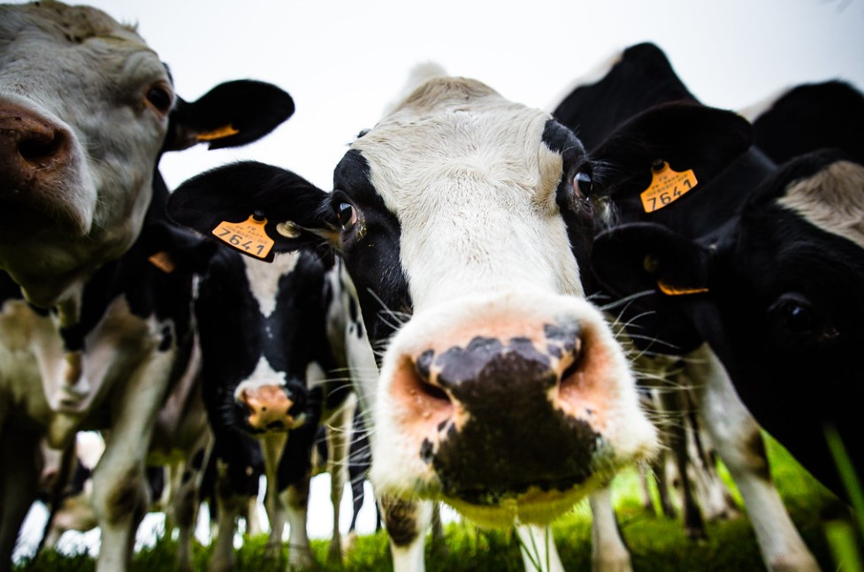
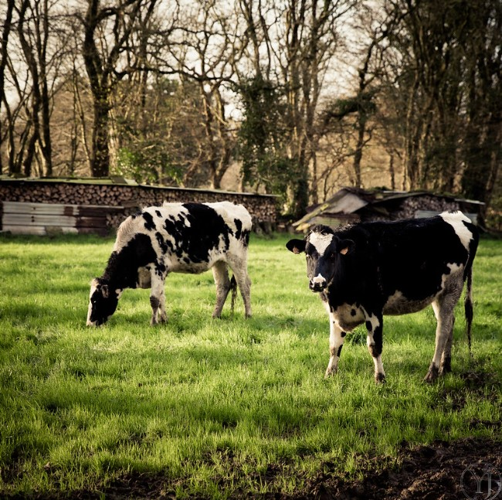
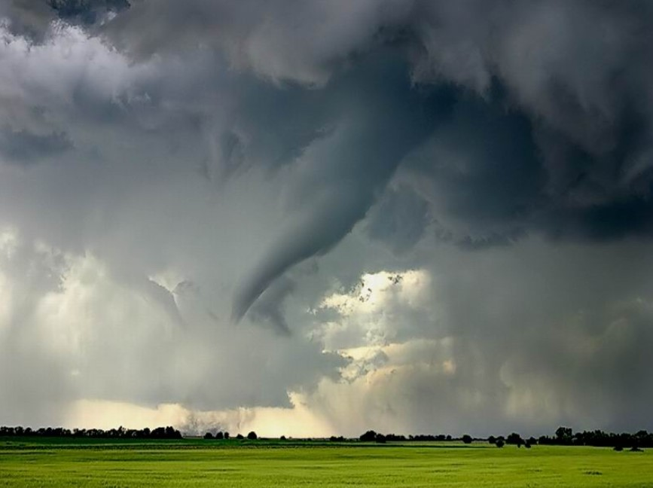
Images: Brainstorming Tornado

Slide 9
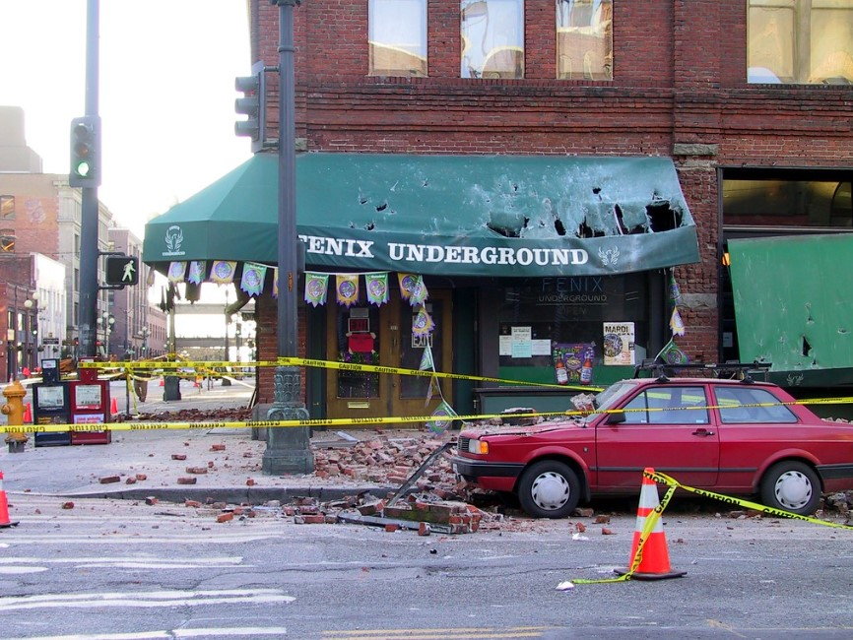
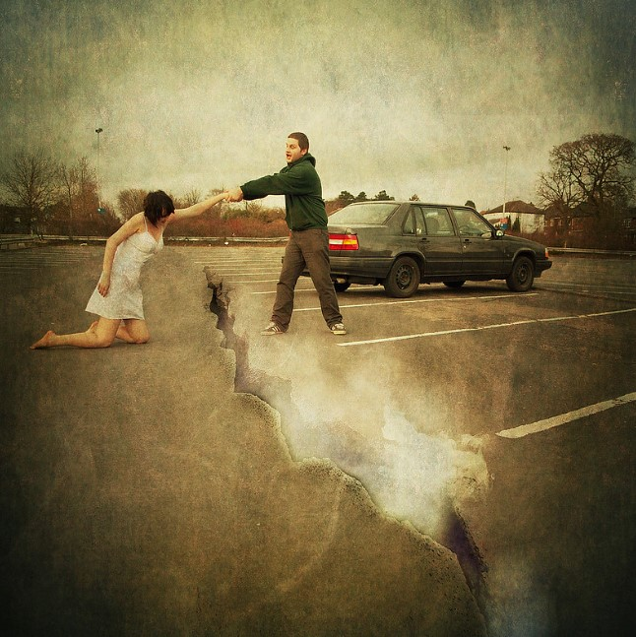
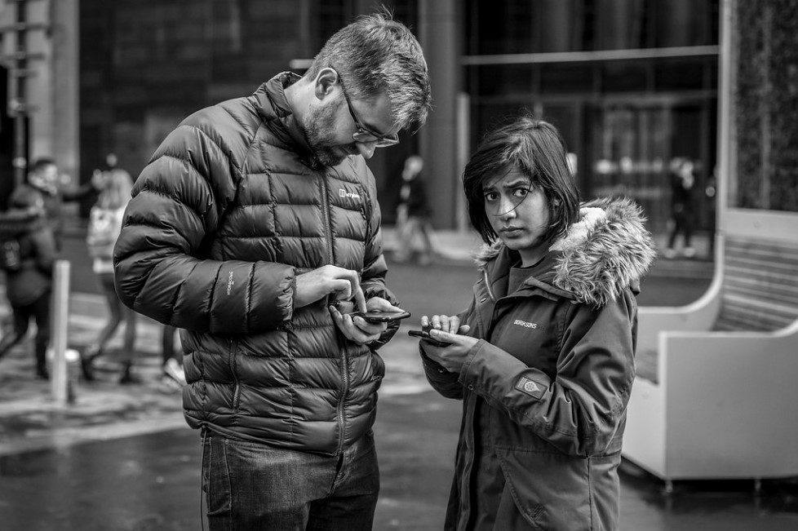
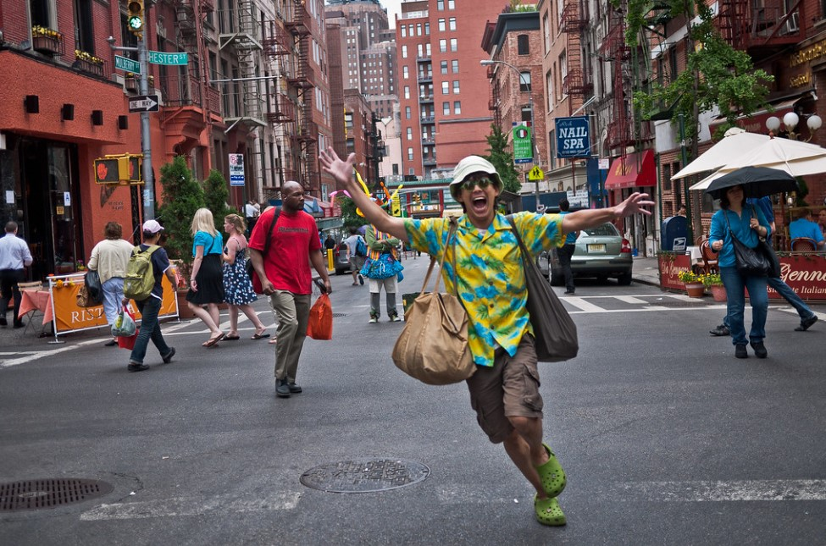
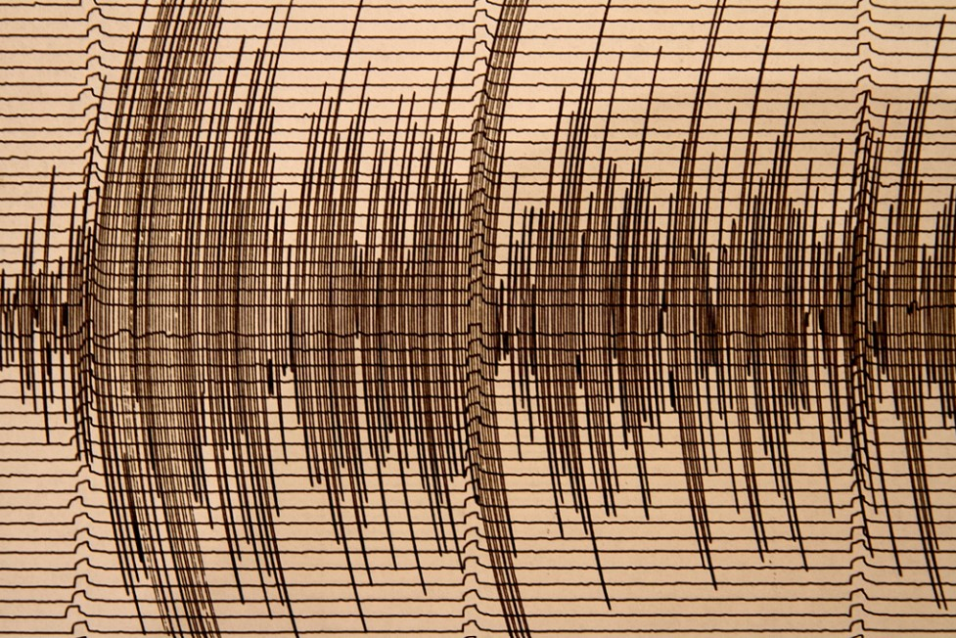
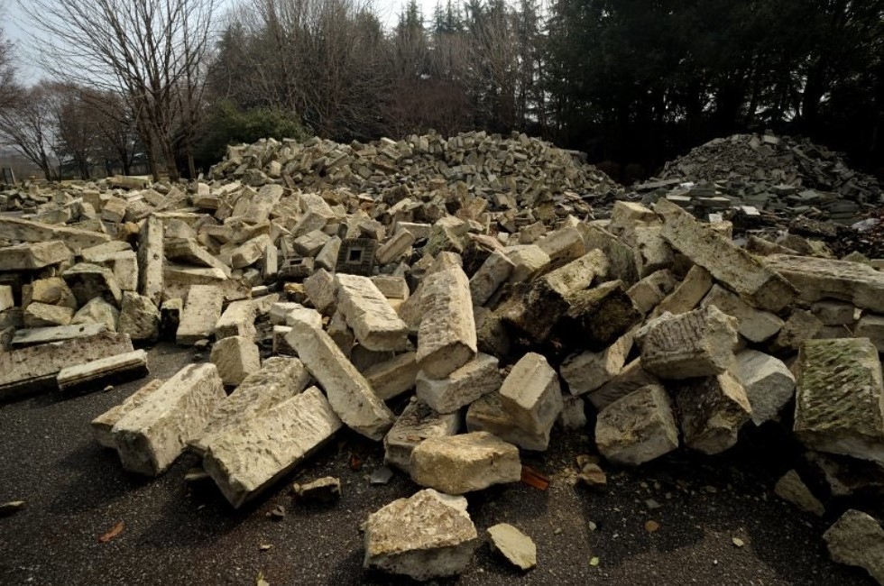
Images: Brainstorming Earthquake

Slide 10
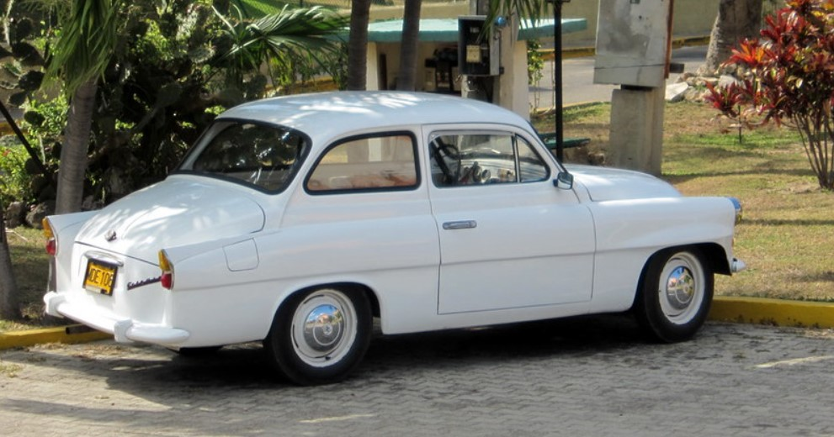
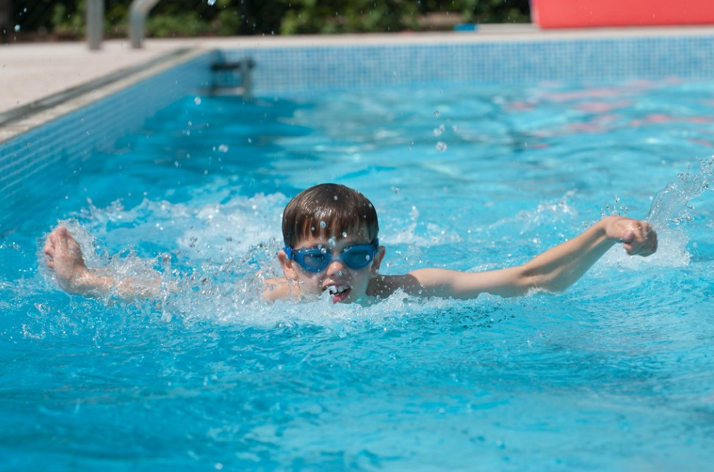
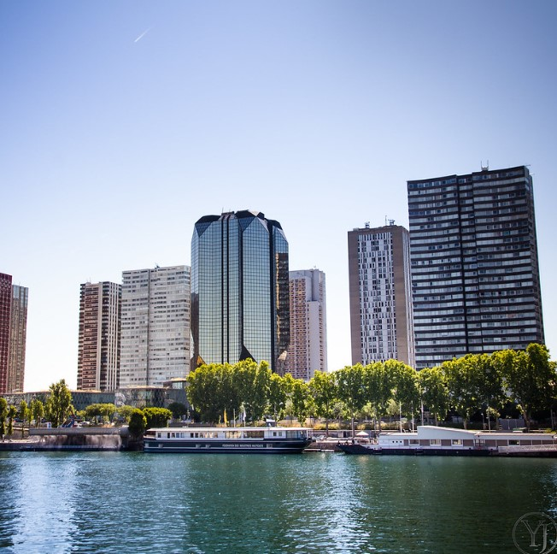
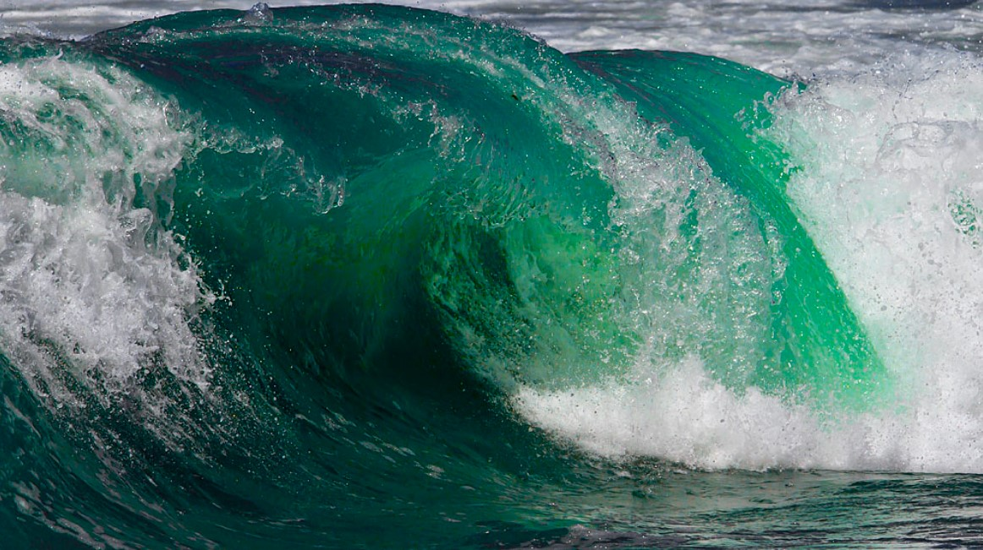
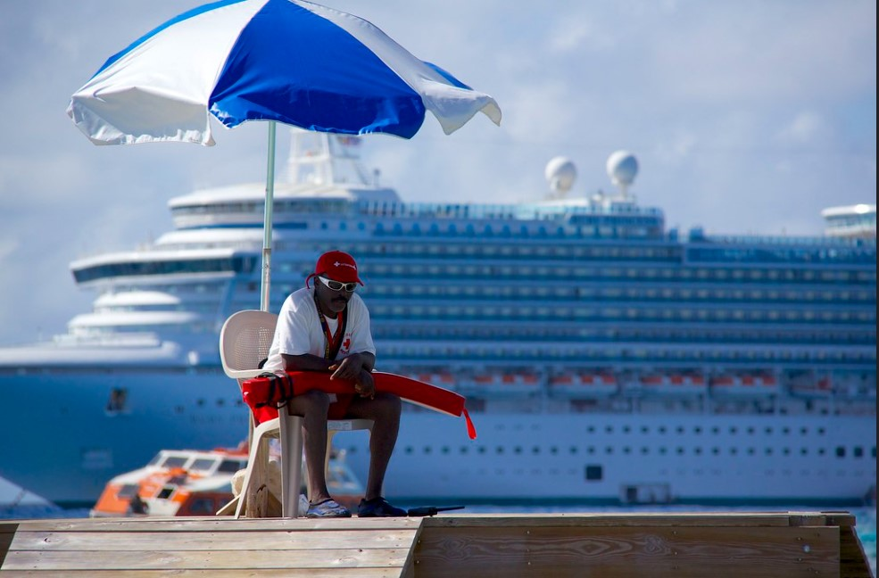
Images: Brainstorming Tsunami

Slide 11
Images: Brainstorming Wildfires

Slide 12
Avalanche draft

Slide 13
Sentence Sources:
Colleton, Nancy. “Perspective | How a Booming 'Environmental Intelligence' Sector Is Confronting Extreme Weather and Climate Change.” The Washington Post, WP Company, 21 Feb. 2022, www.washingtonpost.com/weather/2022/02/18/environmental-intelligence-extreme-weather-climate/.
Smith, Roberta. “The Outsider Art Fair Returns, in Top Form.” The New York Times, The New York Times, 3 Mar. 2022, www.nytimes.com/2022/03/03/arts/design/outsider-art-fair.html?searchResultPosition=1.
Staff, Innovation District. “OK's Tribal Nations Play Vital Role in Global Aerospace Sector.” OKC VeloCity | OK's Tribal Nations Play Vital Role in Global Aerospace Sector, 3 Mar. 2022, www.velocityokc.com/blog/economy/ok-s-tribal-nations-play-vital-role-in-global-aerospace-sector/?back=super_blog.

Slide 14
Image Sources
Avalanche
Earthquake
Wild Fire
here
https://flic.kr/p/aEAtyJ is earthquake scale
https://flic.kr/p/CBr6S is earthquake scene
https://flic.kr/p/9pEvLo is man saving woman
https://flic.kr/p/9uKf4T is rubble
https://flic.kr/p/24xipE9 is people concerned
https://flic.kr/p/9QzQCv is man running
Tsunami
https://flic.kr/p/8WpXeg is big wave1
https://flic.kr/p/nowZsb is city1
https://flic.kr/p/xqgBrD is city2
https://flic.kr/p/dDQWzo is lifeguard
https://flic.kr/p/asDV3C is car
https://flic.kr/p/eCLGW7 is swimming boy
https://flic.kr/p/HLQmQ is avalanche
https://flic.kr/p/9rRa7X is glacier
https://flic.kr/p/HxLSn is man struggling
https://flic.kr/p/HxHtQ is man with pickaxe 1
https://flic.kr/p/HLUA6 is skiing man
https://flic.kr/p/WWHmf4 is tractor1
https://flic.kr/p/29wJm3V is cow2
https://flic.kr/p/ByHwLi is cow1 and cow3
https://flic.kr/p/5MFHxa is tornado1
Tornado

