Slide 1
New Media Art
Corporate Parody
By Jordan Tecumseh

Slide 2
Theme:
Corporate Parody- Is the emulation of a corporation with the purpose of critiquing and “making fun of”.
*Corporate Parodies were made to show a person’s beliefs or mistrusts towards
a corporation.

Slide 3
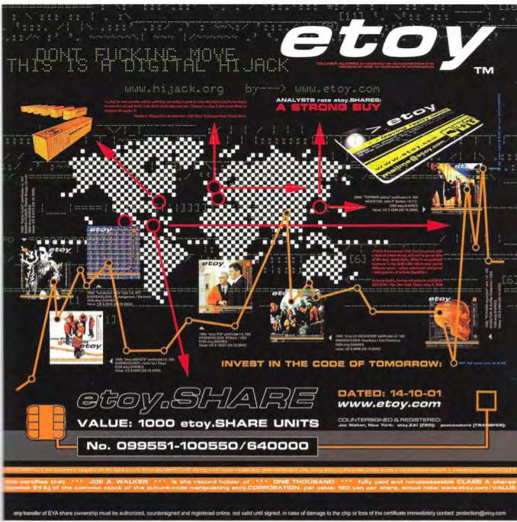
etoy.SHARE
Group of European Artists
Swiss corporation made in 1994/1995
Figure1
Notes:
In 1994, a group of European artists was inspired by the logos and brands of corporations to start up their own parody corporation. This parody corporation officially got its start up in 1995 when these Swiss artists built etoy’s website. (Tribe and Jana, 42).

Slide 4
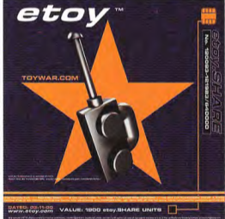
etoy.SHARE
“Corporate Sculpture”
“Toywar”
etoy vs. Etoys
“The most expensive performance in art history”
Figure 2
Notes:
Etoy once described themselves as a “Corporate Sculpture”. This was used to convey that they cover a vast area of genres in order to make a large impact on markets and new media culture. It could also be said that their use of “sculpture” could convey their likeness to other corporations. Simplified, not real, but they look real. Within etoy’s journey to success, the “Toywar” began. Etoys, the original corporation, wanted to buy out their corporate parody and their domain name so to end the confusion. The parody corporation, etoy, did not agree and did not back down. They created an online game that dropped the competition’s stock price and created “The most expensive performance in art history.” (Tribe and Jana, 42).

Slide 5
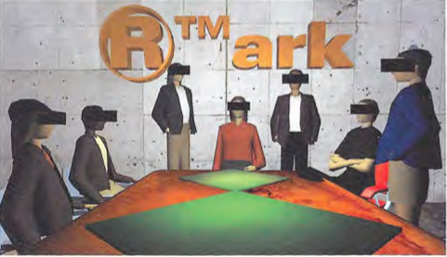
www.rtmark.com
*Pronounced “art mark”
Whitney Biennial
Anonymity
Figure 3
Notes:
This corporate parody is from an art-activist group called “Art Mark”. It was one of the first Net arts included in the Whitney Biennial exhibition. Art Mark is an anonymous New Media Art collective, similar to that of Etoy. In this image, the identity of the group behind Art Mark is masked by blocks and is meant to portray the anonymity of this group. (Tribe and Jana, 80).

Slide 6
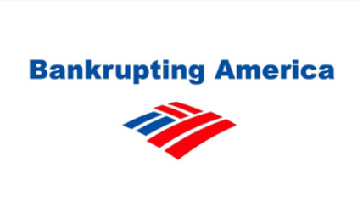
Bank of America Parody
Winning some, losing some, and lying some
Figure 4
Notes:
Bank of America is the largest bank in the United States and in 2008 one of their purchases took a turn for the worst. Merrill Lynch & Co., the company’s purchase, took large losses. The bank was too intimidated by shareholders to share this information and instead hid it from the public. Eventually this information got out and parodies such as Figure 4 started to arise. This corporate parody represents the major losses of one of the major corporations. (York Graphic Designers).

Slide 7
Work Cited:
Slide 3-6
New Media Art by Mark Tribe and Reena Jana
Figure 1
New Media Art by Mark Tribe and Reena Jana
Figure 2
etoy.SHARE, 2000
Figure 3
ⓇTMark boardroom, 1998
Figure 4
https://www.yorkgraphicdesigners.co.uk/top-ten-logo-parodies-and-manipulations/

