Slide 1

GenAI - Day 7

Slide 2

Syllabus
Pre Training – Data frames, Pandas
Training
Data Frames, data manipulation, and indexing.
Hands-On: Load, filter, and analyze a sample dataset.
Post Training – Case Study: Analyze a simple dataset, such as customer sales data, to find trends.

Slide 3


Pandas
Pandas = Python Data Analysis
It is an open-source, BSD-licensed Python library created by McKinney in 2008
It provides high-performance, easy to use data structures and data analysis tools to streamline the processes of cleaning, modifying, modeling, and organizing data to derive valuable insights.

Slide 4
Features of Pandas
Fast and efficient Data Frame object with default and customized indexing.
Tools to load data into in-memory data objects from different file formats.
Data alignment and integrated handling of missing data.
Reshaping and pivoting of date sets.
Label-based slicing, indexing and sub-set of large data sets.
Columns from a data structure can be deleted or inserted.
Group by data for aggregation and transformations of data.
High performance merging and joining of data.
Time Series functionality.

Slide 5
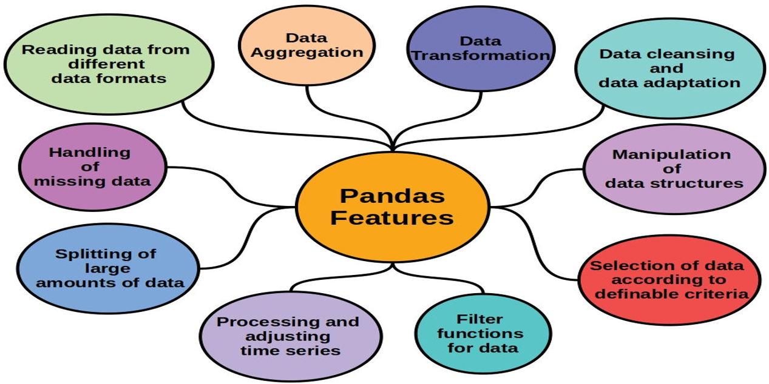
Features of Pandas

Slide 6
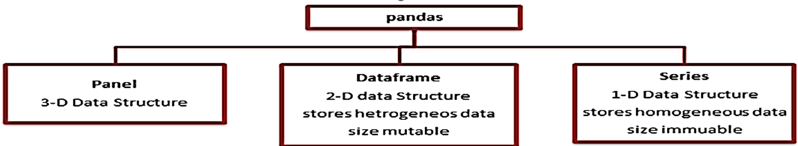
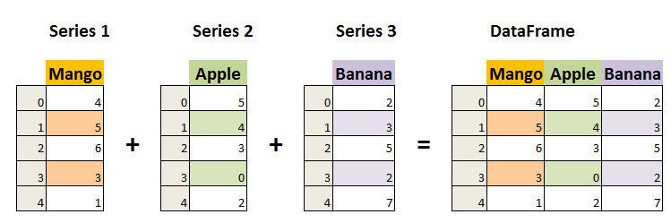
Data Structures in Pandas

Slide 7
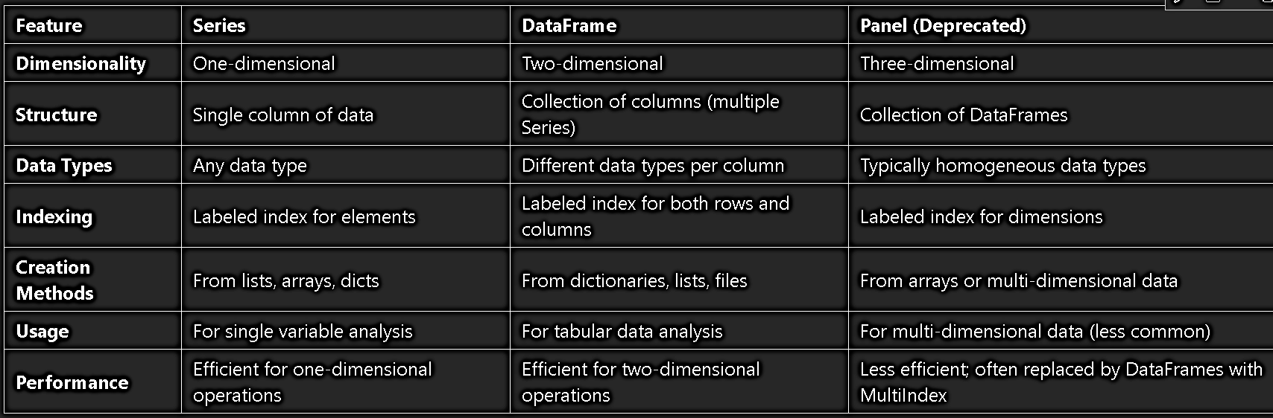
Data Structures in Pandas

Slide 8
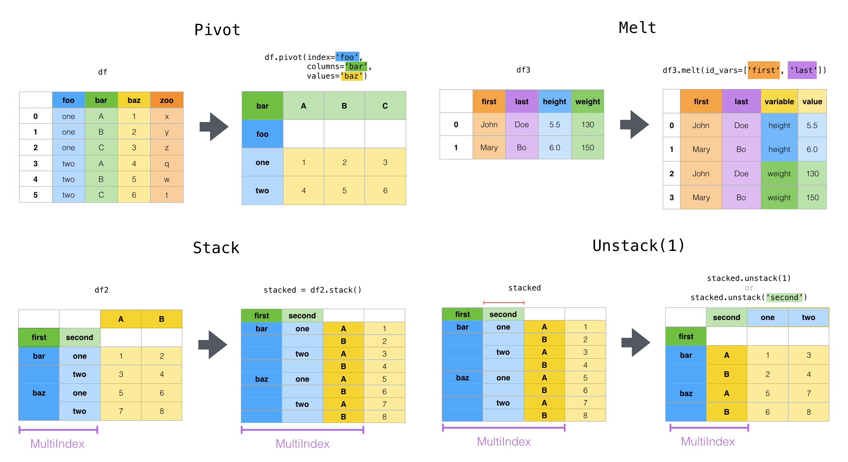

Slide 9
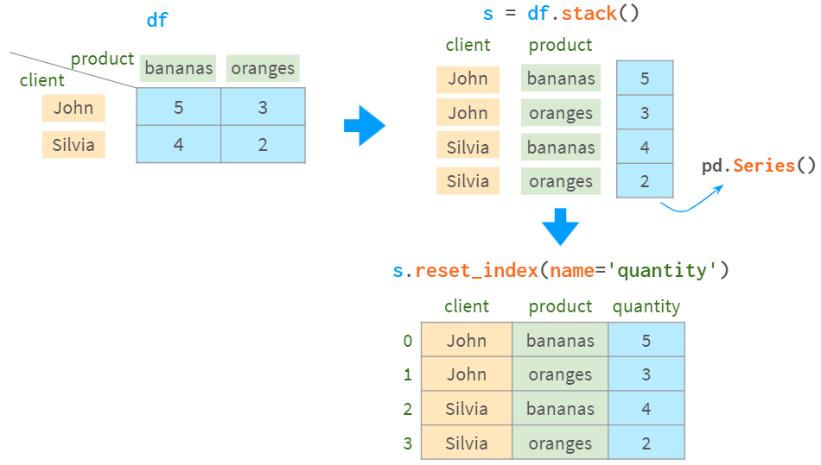
Data frame Stacking and index setting

Slide 10
Creating Series
pd.Series(data, index=None, dtype=None, name=None, copy=False)
data: Data to be stored (list, NumPy array, scalar value, or dictionary).
index: Labels for the data (default: numeric indices starting from 0).
dtype: Data type (optional).
name: Name of the Series (optional).
copy: If True, creates a copy of the data.
series = pd.Series([10, 20, 30], index=['a', 'b', 'c'], dtype='int64', name='Example Series')print(series)

Slide 11
Creating Data frames
pd.DataFrame(data=None, index=None, columns=None, dtype=None, copy=False)
data: Data to create the DataFrame (dictionary, list of lists, NumPy array, etc.).
index: Row labels (optional, default: numeric range starting at 0).
columns: Column labels (optional).
dtype: Data type for all columns (optional).
copy: If True, creates a copy of the data.
data = {'Name': ['Alice', 'Bob', 'Charlie'], 'Age': [25, 30, 35]}
df = pd.DataFrame(data, index=['Row1', 'Row2', 'Row3'])print(df)

Slide 12
Creating Multi-index
pd.MultiIndex.from_arrays(arrays, names=None)
pd.MultiIndex.from_tuples(tuples, names=None)
pd.MultiIndex.from_product(iterables, names=None)
from_arrays: Create MultiIndex from arrays.
from_tuples: Create MultiIndex from tuples.
from_product: Create MultiIndex from Cartesian product of iterables.

Slide 13
File loading with Pandas
File Format | Code | Description
CSV | pd.read_csv() | Comma-separated values, commonly used for tabular data.
Excel (XLSX) | pd.read_excel() | Microsoft Excel files, useful for spreadsheets and complex data organization.
Plain Text (TXT) | pd.read_csv() | Text files with delimited data, often using spaces or tabs as separators.
JSON | pd.read_json() | JavaScript Object Notation, a lightweight format for data interchange.
XML | pd.read_xml() | Extensible Markup Language, used for structured data representation.
HTML | pd.read_html() | Reads HTML tables into DataFrames, extracting tabular data from web pages.
Parquet | pd.read_parquet() | A columnar storage file format optimized for use with big data processing frameworks.
HDF5 | pd.read_hdf() | Hierarchical Data Format, suitable for storing large amounts of numerical data.
Feather | pd.read_feather() | A fast binary file format designed for efficient reading and writing of DataFrames.
Stata | pd.read_stata() | Used for reading Stata files, commonly used in statistical analysis.
SAS | pd.read_sas() | For loading SAS files, often used in statistical software environments.
ORC | pd.read_orc() | Optimized Row Columnar format, efficient storage and processing of large datasets.

Slide 14
Exporting data to File with Pandas
File Format | Code | Description
CSV | df.to_csv('filename.csv') | Copy Data frame to CSV file.
Excel (XLSX) | df.to_excel('filename.xlsx') | Copy Data frame to Excel file
JSON | df.to_json('filename.json') | Copy Data frame to JSON file
SQL | df.to_sql('table_name', con=connection) | Copy Data frame to a table in a database. You will need connection string with userid, password and database name.

