Slide 1

NumPy

Slide 2

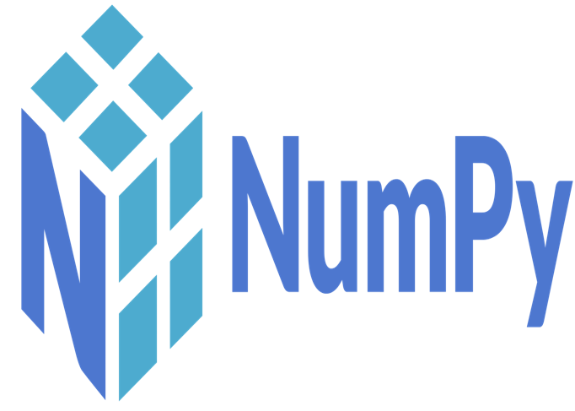
What is NumPy
NumPy stands for 'Numerical Python’.
NumPy is a open-source Python library consisting of multidimensional array objects and a collection of routines for fast operations on arrays, including mathematical, logical, shape manipulation, sorting, selecting, I/O, discrete Fourier transforms, basic linear algebra, basic statistical operations, random simulation and much more.

Slide 3
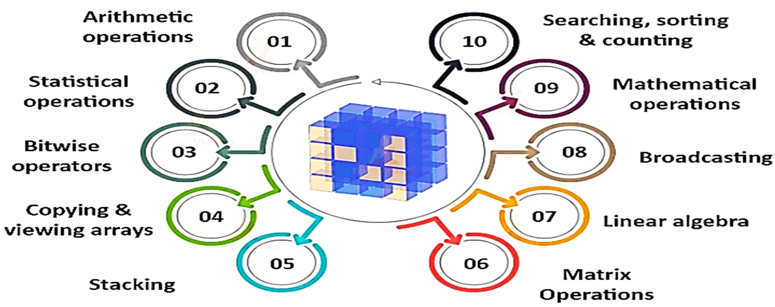
Uses of NumPy

Slide 4
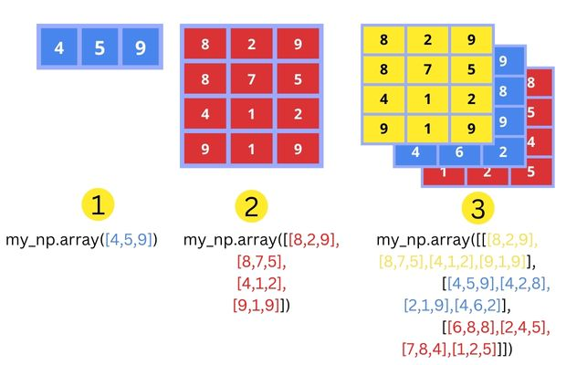
NumPy ND array object

Slide 5
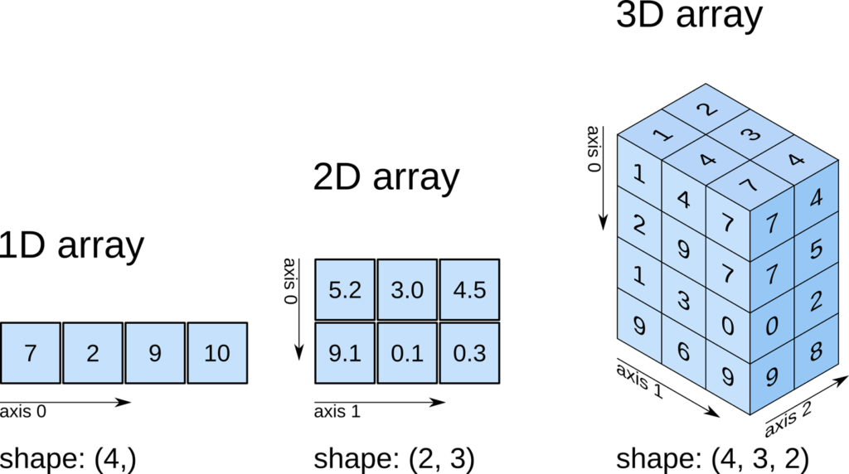
NumPy ND array object

Slide 6
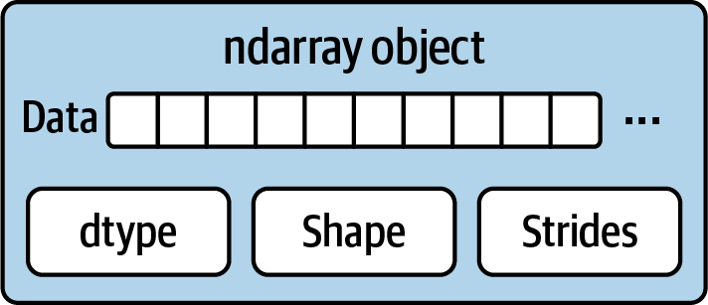
NumPy ND array object
The ndarray (N-Dimensional Array) is the core object of the NumPy library,.
It is a multidimensional array, that stores items of the same type and size in a grid, indexed by a tuple of non-negative integers.
Items in the collection can be accessed using a zero-based index.
Every item in an ndarray takes the same size of block in the memory.
Each element in ndarray is an object of data-type object (called dtype).

Slide 7
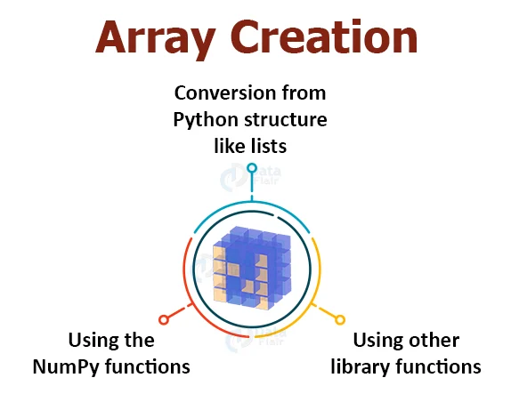
NumPy ND array object
import numpy as np
array=np.arange(20)
print(array)
array1=np.array([1, 2, 3, 4, 5])
print(array1)
array2= np.array([[1, 2, 3], [4, 5, 6]]) print(array2)
array3 = np.array([[[1, 2], [3, 4]], [[5, 6], [7, 8]]])
print(array3)

Slide 8
Creating a Array
numpy.array(object, shape, dtype=None, copy=True, order=None, subok=False, ndmin=0)
object - A object exposing the array interface method returns an array
Shape – number of rows and columns
dtype - Desired data type of array, optional
copy - Optional. By default (true), the object is copied
order - C (row major) or F (column major) or A (any) (default)
subok - By default, returned array forced to be a base class array
ndimin - Specifies minimum dimensions of resultant array

Slide 9
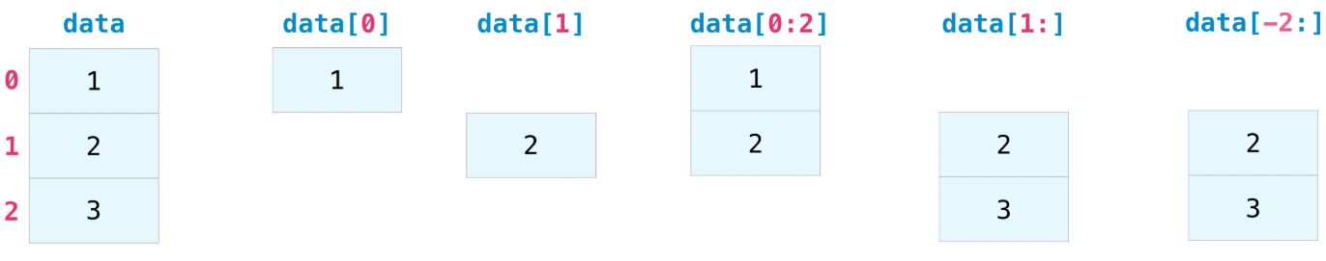
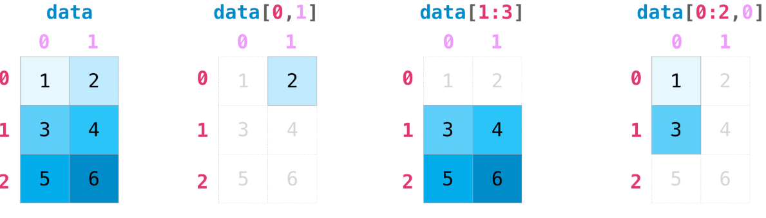
Index in Numpy

Slide 10
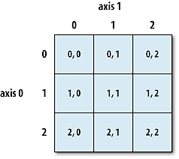
Arrays attributes in Numpy
!pip install numpy
import numpy as np
arr = np.array([[1, 2, 3], [4, 5, 6]])
print(arr)
print(f"Shape: {arr.shape}")
print(f"Size: {arr.size}")
print(f"Number of Dimensions: {arr.ndim}")
print(f"Data Type: {arr.dtype}")
print(f"Item Size: {arr.itemsize} bytes")

Slide 11
Creating arrays using Numpy
import numpy as np
a=np.array([1, 2, 3,4,5], ndmin=2) # minimum dimensions
b = np.array([1, 2, 3], dtype=complex) # dtype parameter
c=np.array([[1,2,3],[4,5,6]])
c.shape=(3,2)
d = c.reshape(2,3)
e = np.arange(24)
f = np.zeros(5)
print a, b, c, d, e, f
print e.flags

Slide 12
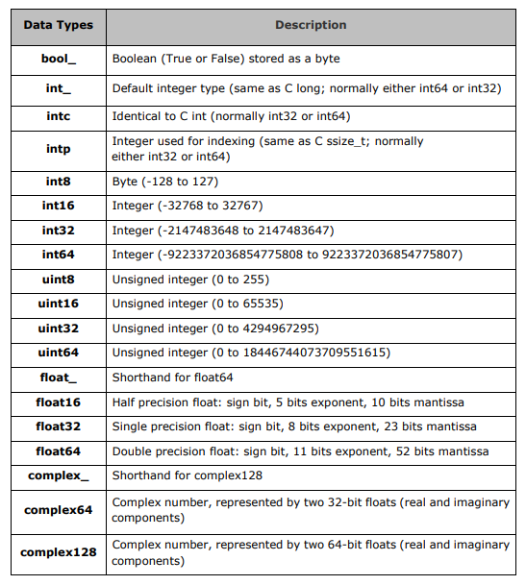
Data Types in numPy

Slide 13
Data Type Objects(dtype)
A data type object describes interpretation of fixed block of memory corresponding to an array, depending on the following aspects:
Type of data (integer, float or Python object)
Size of data
Byte order (little-endian or big-endian)
numpy.dtype(object, align, copy)
Object: To be converted to data type object
Align: If true, adds padding to the field to make it similar to C-struct
Copy: Makes a new copy of dtype object. If false, the result is reference to builtin data type obje

Slide 14
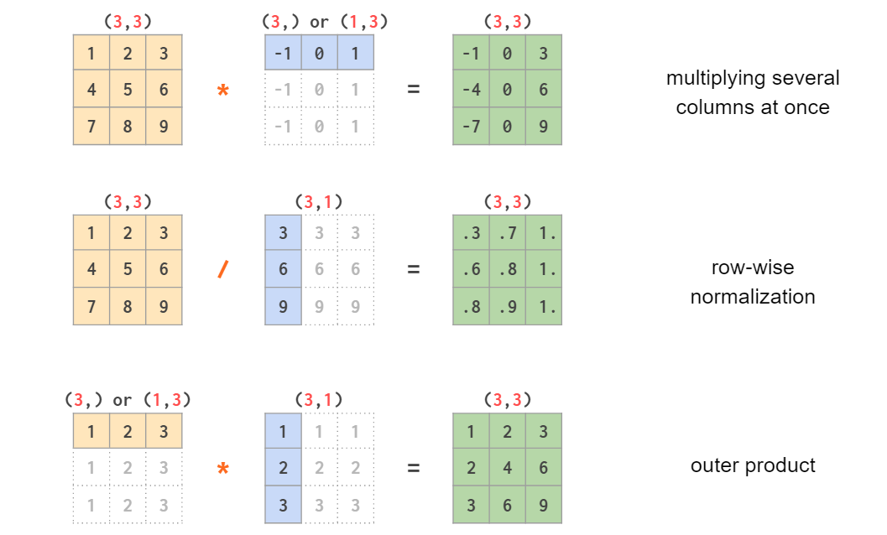
Broadcasting in Numpy

Slide 15
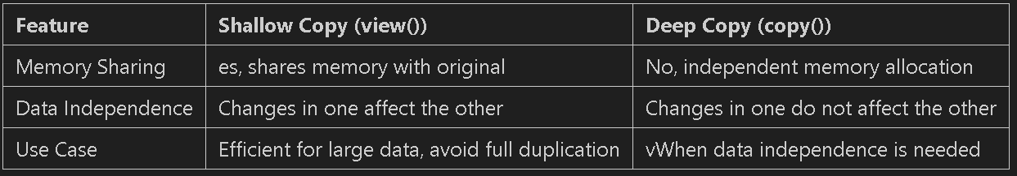
Duplicating Arrays in NumPy

