Slide 1

GenAI - Day 7

Slide 2

Syllabus
Pre Training – Data frames, Pandas
Training
Data Frames, data manipulation, and indexing.
Hands-On: Load, filter, and analyze a sample dataset.
Post Training – Case Study: Analyze a simple dataset, such as customer sales data, to find trends.

Slide 3


Pandas
Pandas = Python Data Analysis
It is an open-source, BSD-licensed Python library created by McKinney in 2008
It provides high-performance, easy to use data structures and data analysis tools to streamline the processes of cleaning, modifying, modeling, and organizing data to derive valuable insights.

Slide 4
Features of Pandas
Fast and efficient Data Frame object with default and customized indexing.
Tools to load data into in-memory data objects from different file formats.
Data alignment and integrated handling of missing data.
Reshaping and pivoting of date sets.
Label-based slicing, indexing and sub-set of large data sets.
Columns from a data structure can be deleted or inserted.
Group by data for aggregation and transformations of data.
High performance merging and joining of data.
Time Series functionality.

Slide 5
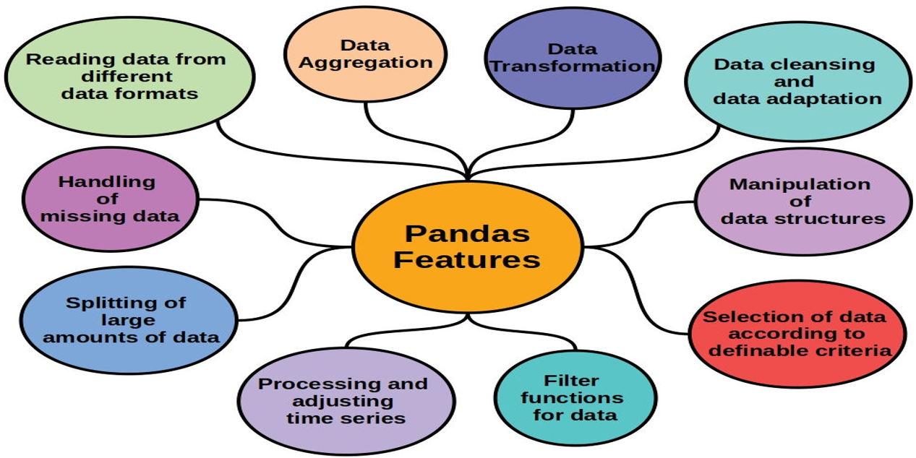
Features of Pandas

Slide 6
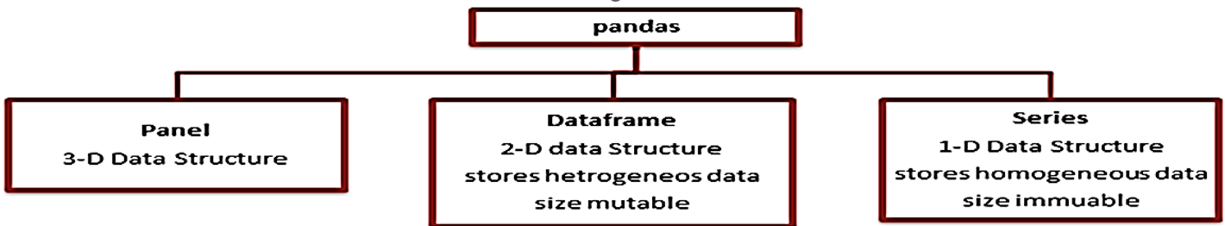
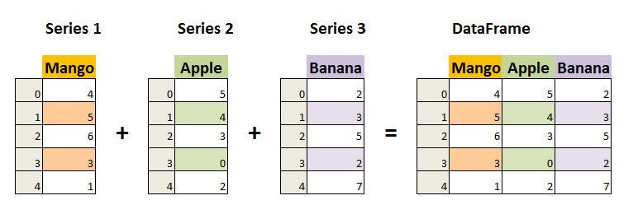
Data Structures in Pandas

Slide 7
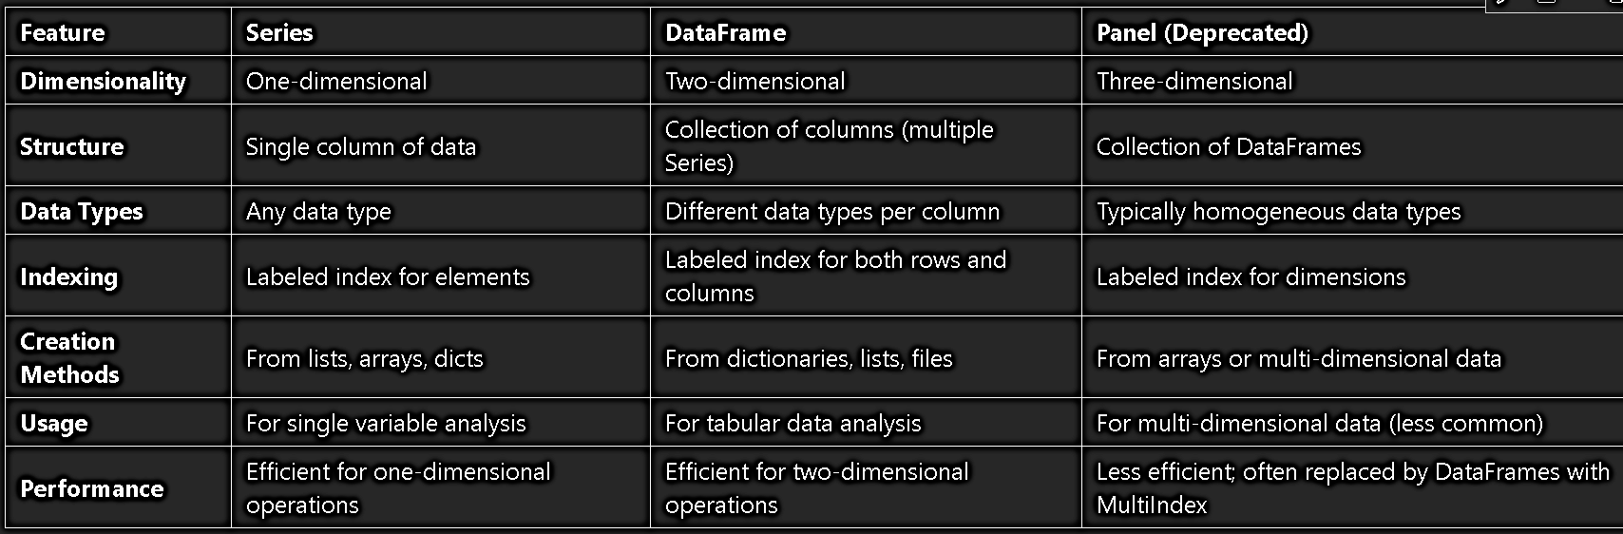
Data Structures in Pandas

Slide 8
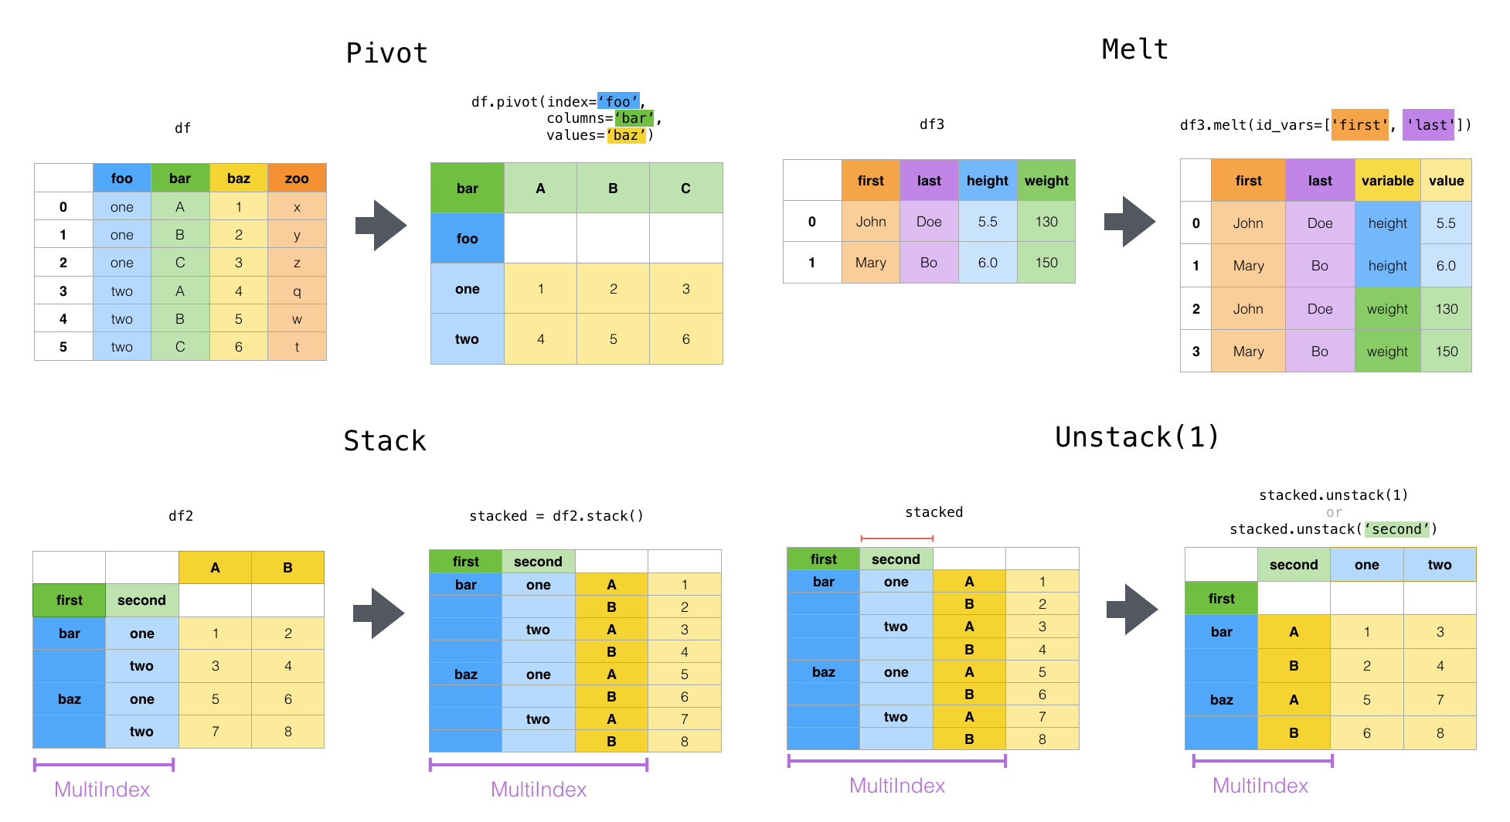

Slide 9
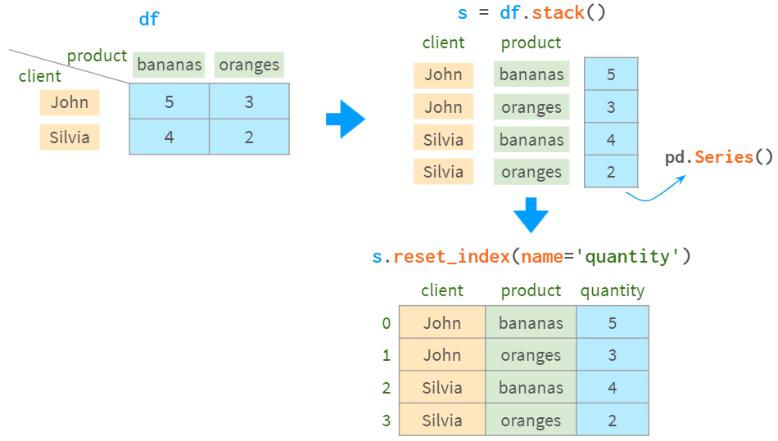

Slide 10
Creating Series
pd.Series(data, index=None, dtype=None, name=None, copy=False)
data: Data to be stored (list, NumPy array, scalar value, or dictionary).
index: Labels for the data (default: numeric indices starting from 0).
dtype: Data type (optional).
name: Name of the Series (optional).
copy: If True, creates a copy of the data.
series = pd.Series([10, 20, 30], index=['a', 'b', 'c'], dtype='int64', name='Example Series')print(series)

Slide 11
Creating Data frames
pd.DataFrame(data=None, index=None, columns=None, dtype=None, copy=False)
data: Data to create the DataFrame (dictionary, list of lists, NumPy array, etc.).
index: Row labels (optional, default: numeric range starting at 0).
columns: Column labels (optional).
dtype: Data type for all columns (optional).
copy: If True, creates a copy of the data.
data = {'Name': ['Alice', 'Bob', 'Charlie'], 'Age': [25, 30, 35]}
df = pd.DataFrame(data, index=['Row1', 'Row2', 'Row3'])print(df)

Slide 12
Creating Multi-index
pd.MultiIndex.from_arrays(arrays, names=None)
pd.MultiIndex.from_tuples(tuples, names=None)
pd.MultiIndex.from_product(iterables, names=None)
from_arrays: Create MultiIndex from arrays.
from_tuples: Create MultiIndex from tuples.
from_product: Create MultiIndex from Cartesian product of iterables.

