Slide 1

GenAI - Day 8

Slide 2

Syllabus
Pre Training – Data Visualization
Training
Creating plots, customizing graphs, subplots.
Hands-On: Generate bar and line charts.
Post Training – Case Study: Visualize customer purchase data to identify high sales products.

Slide 3
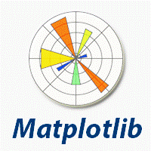
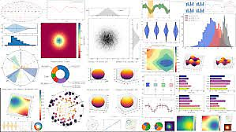

What is Matplotlib

Slide 4
Which are the most popular Python libraries?
pandas (data analysis)
NumPy (multi-dimensional arrays)
SciPy (algorithms to use with numpy)
Matplotlib (data visualization)
Seaborn (data visualization)
HDF5 (store & manipulate data)
Jupyter (research collaboration)
PyTables (managing HDF5 datasets)
HDFS (C/C++ wrapper for Hadoop)
pymongo (MongoDB driver)
SQLAlchemy (Python SQL Toolkit)
redis (Redis access libraries)
pyMySQL (MySQL connector)
scikit-learn (machine learning)
TensorFlow (deep learning with neural networks)
scikit-learn (machine learning algorithms)
keras (high-level neural networks API)

Slide 5
What is Matplotlib?
Matplotlib is a comprehensive library for creating static, animated, and interactive visualizations in Python.
Matplotlib is a open source, cross-platform, data visualization and graphical plotting library from data in NumPy arrays.
It provides an object-oriented API that helps in embedding plots in applications using Python GUI toolkits such as PyQt, WxPython or Tkinter.
Matplotlib was originally written by John D. Hunter in 2003.

Slide 6
Advantages of Matplotlib
Create publication quality plots.
Make interactive figures that can zoom, pan, update.
Customize visual style and layout.
Export to many file formats.
Embed in JupyterLab and Graphical User Interfaces.
Use a rich array of third-party packages built on Matplotlib.
Charts or plots provide a tool for absorbing information quickly
Visualize relationship and patterns between two or more variables in data
Data driven decision making allow quick actions on the emerging trends
Allows Geological based Visualization

Slide 7
What is Data Visualization?
Graphics provides an excellent approach for exploring huge and diversified amount of data, and for presenting the results. Ex: Population of a Town.
Data visualization is the graphical or pictorial representation of information or data, using visual elements like charts, graphs, or maps, to represent information graphically, highlighting patterns and trends in data, outliers, and patterns in an easy, intuitive way thus helping the reader to achieve quick insights.
Data visualization can be very helpful when discovering and getting to know a dataset and can help with classifying patterns, corrupt data, outliers, and much more.
Data visualizations can be used to display the key relationships between the data entities in plots and charts. The static does indeed focus on quantitative description and estimations of data. It provides an important set of tools for gaining a qualitative understanding.

Slide 8
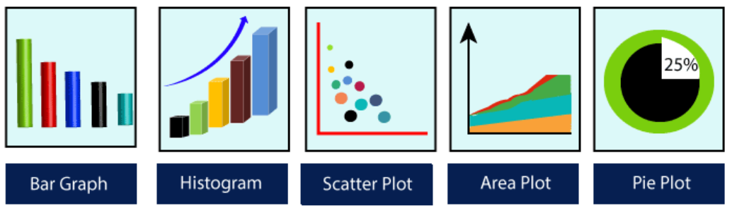
Top 5 charts used for Data Visualization

Slide 9
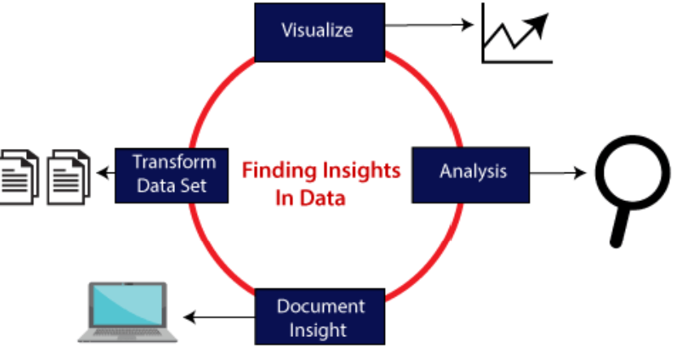
5 phases of finding Insights using Data Visualization

Slide 10
5 phases of finding Insights using Data Visualization
Transform Data Set: Standard or raw data is transformed in compliance to the data visualization tool or API.
Visualize: Visualization of raw data as charts or plots, makes complex data more accessible, understandable, and more usable. Tabular data representation is used where the user will look up a specific measurement, while the charts are used to show patterns or relationships in the data for one or more variables.
Analysis: Data analysis is defined as cleaning, inspecting, transforming, and modeling data to derive useful information, necessary for better decisions for any business or organization (DDDM - Data driven decision making).
Document Insight: Document insight is the process where the useful data or information is organized in the document in the standard format.
Knowledge Managment – The derived insights are documented and loaded into the knowledge management server

Slide 11
Top 5 tools in Matplotlib
Bashmap: It is a map plotting toolkit with several map projections, coastlines, and political boundaries.
Cartopy: It is a mapping library consisting of object-oriented map projection definitions, and arbitrary point, line, polygon, and image transformation abilities.
Excel tools: Matplotlib provides the facility to utilities for exchanging data with Microsoft Excel.
Mplot3d: It is used for creating 3D plots.
Natgrid: It is an interface to the Natgrid library for irregular gridding of the spaced data.

Slide 12
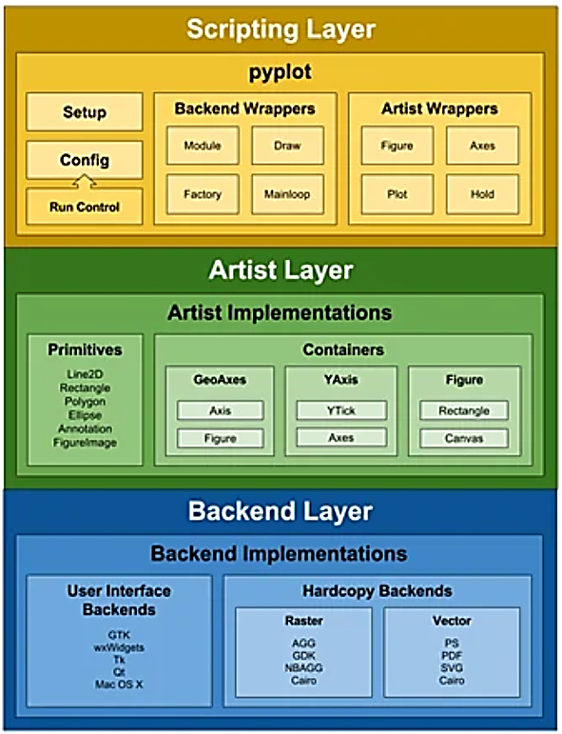
Matplotlib Architecture

Slide 13
Matplotlib Architecture
Scripting layer - The scripting layer is the topmost layer on which most of our code will run. The methods in the scripting layer, almost automatically take care of the other layers, and all we need to care about is the current state (figure & subplot).
Artist Layer - The artist layer is the second layer in the architecture. It is responsible for the various plotting functions, like axis, which coordinates on how to use the renderer on the figure canvas.
Backend layer - The backend layer is the bottom layer of the figure, which consists of the implementation of the various functions that are necessary for plotting. There are three essential classes from the backend layer FigureCanvas (The surface on which the figure will be drawn), Renderer(The class that takes care of the drawing on the surface), and Event(It handle the mouse and keyboard events).

Slide 14
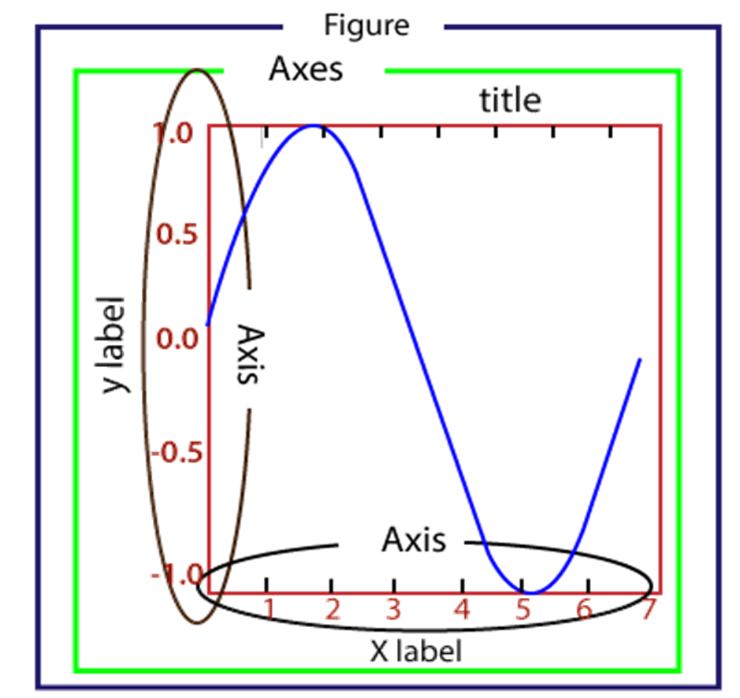
Parts of a Matplotlib chart
Figure: It is a canvas which may hold one or more axes (plots).
Axes: A Figure can contain several Axes. It consists of two or three (in the case of 3D) Axis objects. Each Axes is comprised of a title, an x-label, and a y-label.
Axis: Axis are the number of line like objects and responsible for generating the graph limits.
Artist: An artist is the all which we see on the graph like Text objects, Line2D objects, and collection objects. Most Artists are tied to Axes.

Slide 15
Installation
pip3 install matplotlib
Matplotlib requires a large number of dependencies:
Python
NumPy
setuptools
dateutil
pyparsing
libpng
pytz
FreeType
cycler
Six
user interface toolkits
tk
PyQt4
PyQt5
Pygtk
wxpython
pycairo
Tornado
Animation output files
_mpeg/avconv
ImageMagick
Pillow
LaTeX
GhostScript

Slide 16
Installation of Matplotlib using PyCharm
PyCharm - Select File > Settings > Python Interpreter and use the + symbol to install matplotlib.
import matplotlib.pyplot as plt
import numpy as np
import pandas as pd

Slide 17
Installation of Matplotlib using Data Bricks
%matplotlib inline
set_matplotlib_formats('png')
%config InlineBackend.figure_format = 'png’
import matplotlib.pyplot as plt
import numpy as np
import pandas as pd

Slide 18
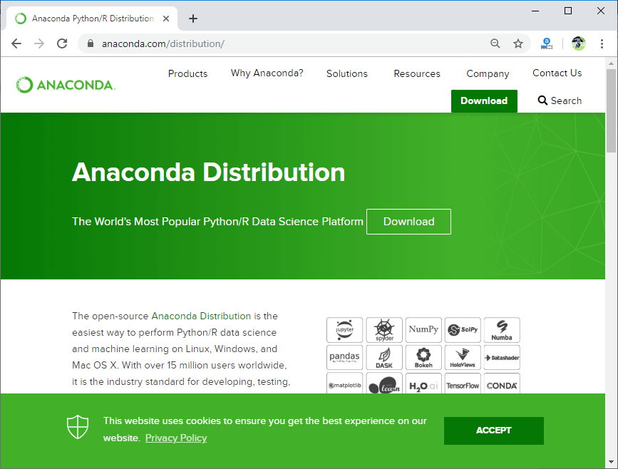
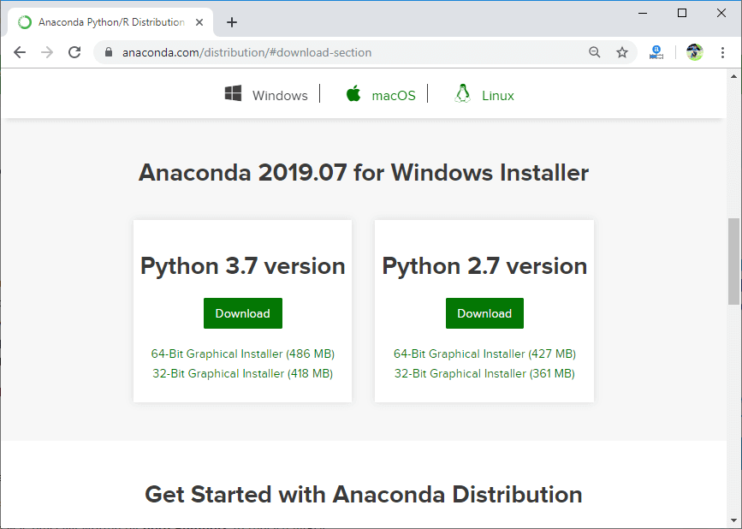
Installation of Matplotlib using Anaconda

Slide 19
Inbuilt functions for creating Plot
Plot Functions | Descriptions
Bar | Create a Bar Plot
Barh | Create a Horizontal bar Plot
Boxplot | Create a Box Plot
Hist | Create a Histogram Plot
Hist2D | Create a 2D Histogram Plot
Pie | Create a Pie Plot
Plot | Create a Line Plot
Polar | Create a Polar Plot
Scatter | Create a Scatter Plot of X vs Y
Stack plot | Create a Stacked Area Plot
Stem | Create a Stem Plot
Step | Create a Step Plot
Quiver | Create a Quiver Plot with 2D field of Arrows

Slide 20
Inbuilt function for Image & Figure
Image Functions | Descriptions
Imread | Read an image from a file into an array
Imsave | Save an array as in image file.
Imshow | Display an image on the axes.
Figure Functions | Descriptions
Figtext | Add text to figure.
Figure | Creates a new figure.
Show | Display a figure.
Savefig | Save the current figure.
Close | Close a figure window.

Slide 21
Inbuilt function for Axis
Axis Functions | Descriptions
Axes | Add axes to the figure.
Text | Add text to the axes.
Title | Set a title of the current axes.
Xlabel | Set the x axis label of the current axis.
Xlim | Get or set the x limits of the current axes.
Xscale | Set the scaling of the x-axis.
Xticks | Get or set the x-limits of the current tick locations and labels.
Ylabel | Set the y axis label of the current axis.
Ylim | Get or set the y-limits of the current axes.
Yscale | Set the scaling of the y-axis.
Yticks | Get or set the y-limits of the current tick locations and labels.

Slide 22
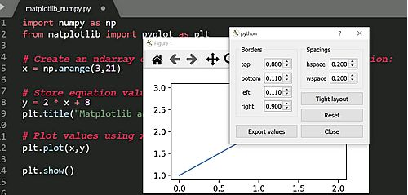
Matplotlib User interface with Menu, Data & Buttons
When matplotlib is used to create a plot, a User Interface (UI) and menu structure are generated.
The UI can be used to customize the plot, as well as to pan/zoom and toggle various elements.

Slide 23
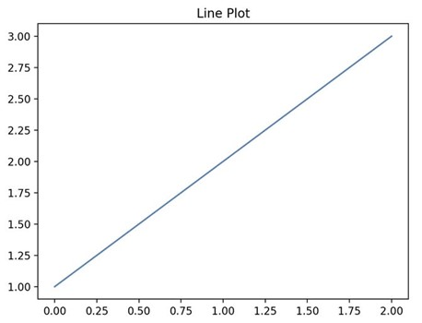
Matplotlib Line Plot
import matplotlib.pyplot as plt
# Plot some numbers:
plt.plot([1, 2, 3])
plt.title(”Line Plot”)
# Display the plot:
plt.show()

Slide 24
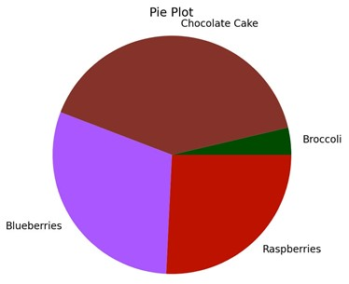
Matplotlib Pie Plot
import matplotlib.pyplot as plt
# Data labels, sizes, and colors are defined:
labels = 'Broccoli', 'Chocolate Cake', 'Blueberries', 'Raspberries'
sizes = [30, 330, 245, 210]
colors = ['green', 'brown', 'blue', 'red']
# Data is plotted:
plt.pie(sizes, labels=labels, colors=colors)
plt.axis('equal')
plt.title(“Pie Plot”)
plt.show()

Slide 25
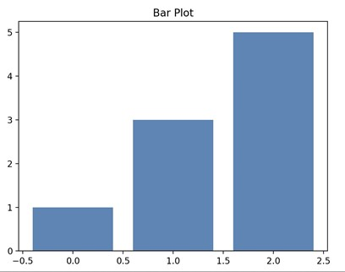
Matplotlib Bar Plot
import matplotlib.pyplot as plt
import numpy as np
# Create a Line2D instance with x and y data in sequences xdata, ydata:
# x data:
xdata=['A','B','C']
# y data:
ydata=[1,3,5]
plt.bar(range(len(xdata)),ydata)
plt.title(“Bar Plot”)
plt.show()

Slide 26
Matplotlib - Plotting a NumPy Array
import numpy as np
from matplotlib import pyplot as plt
# Create an ndarray on x axis using the numpy range() function:
x = np.arange(3,21)
# Store equation values on y axis:
y = 2 * x + 8
plt.title("NumPy Array Plot")
# Plot values using x,y coordinates:
plt.plot(x,y)
plt.show()

Slide 27
Matplotlib - Plotting a Pandas Data Frame
import numpy as np
import pandas as pd
import matplotlib.pyplot as plt
fig, ax = plt.subplots()
# Hide axes without removing it:
fig.patch.set_visible(False)
ax.axis('off')
ax.axis('tight')
# Create a numpy random array in a pandas dataframe with 10 rows, 4 columns:
df = pd.DataFrame(np.random.randn(10, 4), columns=list('ABCD'))
plt.title("Pandas Dataframe Plot")
ax.table(cellText=df.values, colLabels=df.columns, loc='center')
fig.tight_layout()
plt.show()

Slide 28
Basic Commands
import matplotlib.pyplot as plt
import numpy as np
Import pandas as pd
print(matplotlib.__version__)

Slide 29
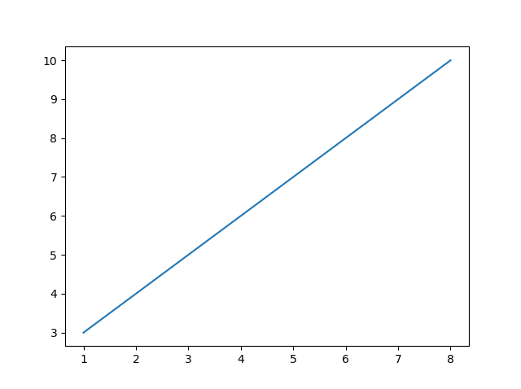
Basic Plotting Commands
import matplotlib.pyplot as plt
import numpy as np
Import pandas as pd
xpoints = np.array([0, 6])
ypoints = np.array([0, 250])
plt.plot(xpoints, ypoints)
plt.show()

Slide 30
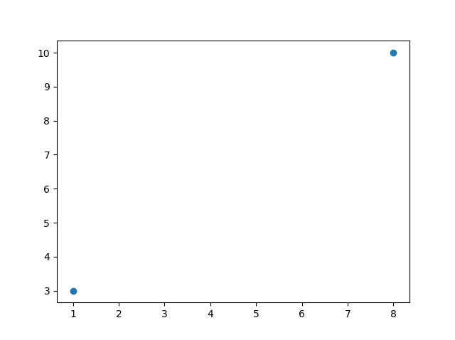
Basic Plotting Commands with “Markers” (o)
import matplotlib.pyplot as plt
import numpy as np
xpoints = np.array([1, 8])
ypoints = np.array([3, 10])
plt.plot(xpoints, ypoints, 'o')
plt.show()

Slide 31
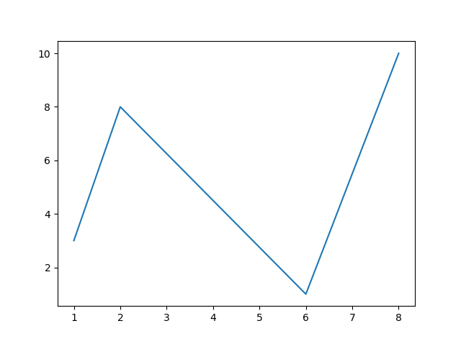
Basic Plotting Commands with multiple x & y values
import matplotlib.pyplot as plt
import numpy as np
xpoints = np.array([1, 2, 6, 8])
ypoints = np.array([3, 8, 1, 10])
plt.plot(xpoints, ypoints)
plt.show()

Slide 32
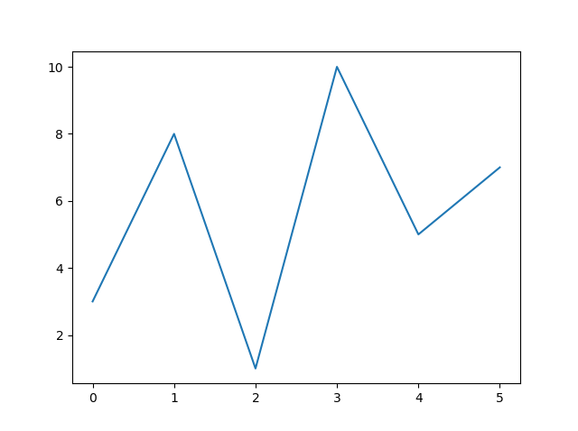
Basic Plotting Commands with default x values
import matplotlib.pyplot as plt
import numpy as np
ypoints = np.array([3, 8, 1, 10, 5, 7])
plt.plot(ypoints)
plt.show()

Slide 33
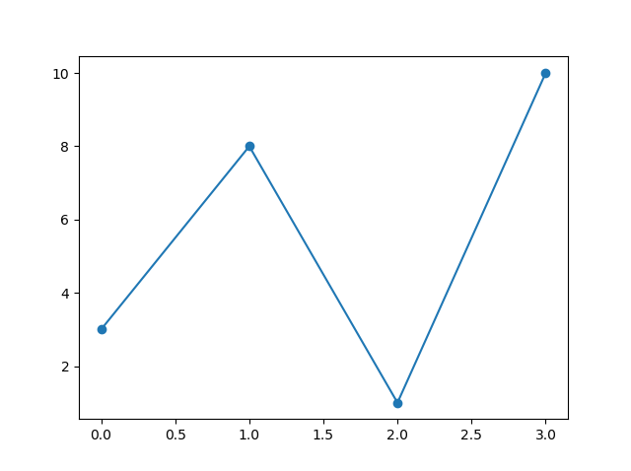
Basic Plotting Commands with “Marker” (o)
import matplotlib.pyplot as plt
import numpy as np
ypoints = np.array([3, 8, 1, 10])
plt.plot(ypoints, marker = 'o')
plt.show()

Slide 34
Marker reference
Marker | Description | Marker | Description
o | Circle | H | Hexagon
* | Star | h | Hexagon
. | Point | v | Triangle Down
, | Pixel | ^ | Triangle Up
x | X | > | Triangle Left
X | X filled | < | Triangle Right
+ | Plus | 1 | Tri up
P | Plus filled | 2 | Tri down
s | Square | 3 | Tri Left
D | Diamond | 4 | Tri Right
d | Diamond thin | | | Vine
p | Pentagon | _ | Hine

Slide 35
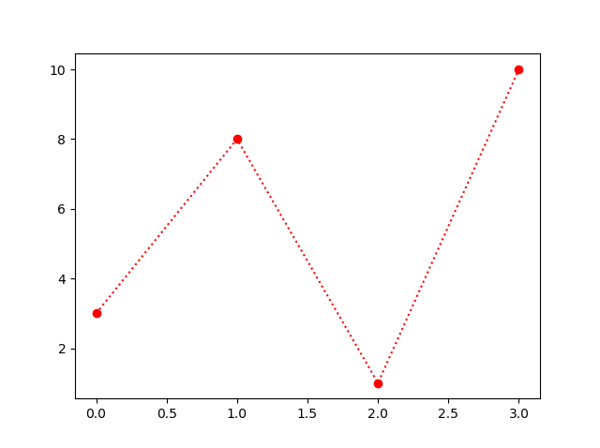
Basic Plotting Commands for formatting the figure
import matplotlib.pyplot as plt
import numpy as np
ypoints = np.array([3, 8, 1, 10])
plt.plot(ypoints, 'o:r')
plt.show()

Slide 36
Line reference & Colour reference
Line | Description | Colour | Description
_ | Solid Line | r | Red
: | Dotted Line | g | Green
-- | Dashed Line | b | Blue
-. | Dash & Dot line | c | Cyan
 |  | m | Magenta
 |  | y | Yellow
 |  | k | Black
 |  | w | White

Slide 37
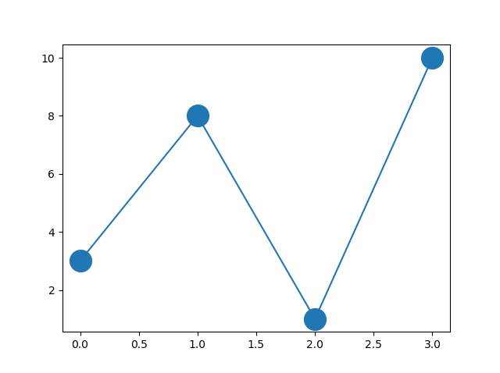
Basic Plotting Commands for formatting the Marker size
import matplotlib.pyplot as plt
import numpy as np
ypoints = np.array([3, 8, 1, 10])
plt.plot(ypoints, marker = 'o', ms = 20)
plt.show()

Slide 38
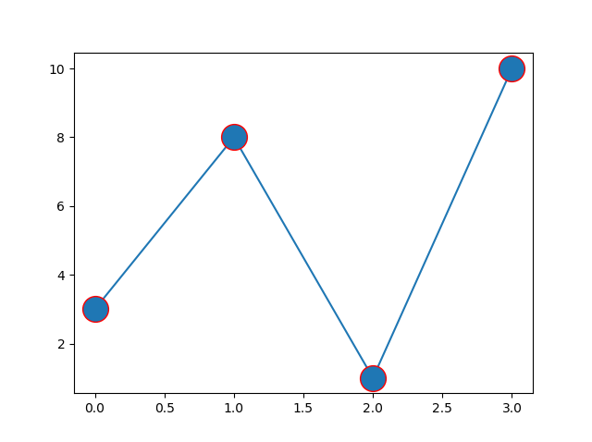
Basic Plotting Commands for formatting the Marker Color
import matplotlib.pyplot as plt
import numpy as np
ypoints = np.array([3, 8, 1, 10])
plt.plot(ypoints, marker = 'o', ms = 20, mec = 'r')
plt.show()

Slide 39
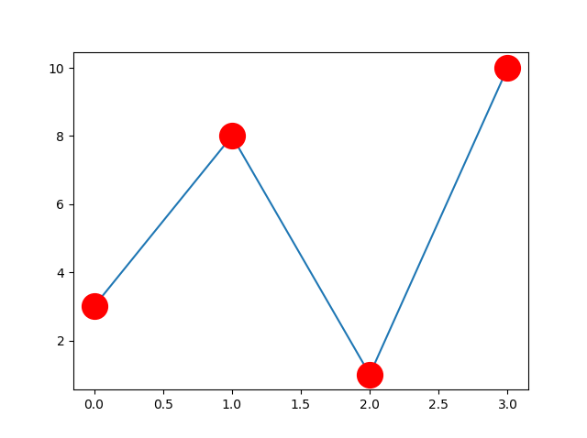
Basic Plotting Commands for formatting Marker face Color
import matplotlib.pyplot as plt
import numpy as np
ypoints = np.array([3, 8, 1, 10])
plt.plot(ypoints, marker = 'o', ms = 20, mfc = 'r')
plt.show()import matplotlib.pyplot as plt
import numpy as np
ypoints = np.array([3, 8, 1, 10])
plt.plot(ypoints, marker = 'o', ms = 20, mec = 'r')
plt.show()

Slide 40
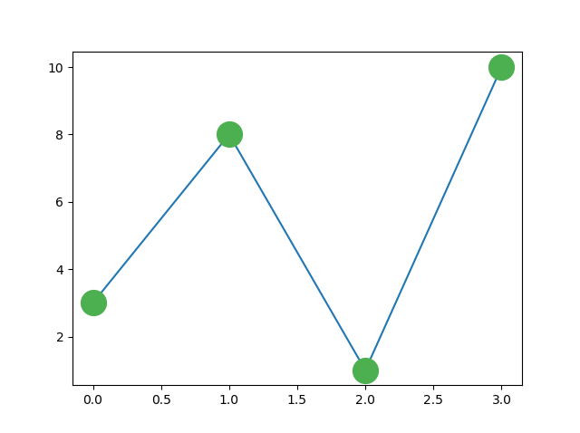
Basic Plotting Commands for formatting Marker face Color
import matplotlib.pyplot as plt
import numpy as np
ypoints = np.array([3, 8, 1, 10])
plt.plot(ypoints, marker = 'o', ms = 20, mfc = 'r')
plt.show()import matplotlib.pyplot as plt
import numpy as np
ypoints = np.array([3, 8, 1, 10])
plt.plot(ypoints, marker = 'o', ms = 20, mec = '#4CAF50', mfc = '#4CAF50’)
plt.show()

Slide 41
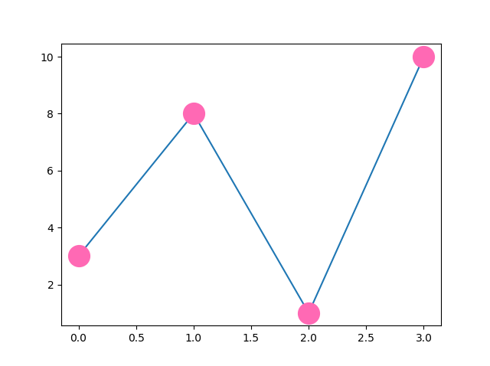
Basic Plotting Commands for formatting Marker face Color
import matplotlib.pyplot as plt
import numpy as np
ypoints = np.array([3, 8, 1, 10])
plt.plot(ypoints, marker = 'o', ms = 20, mfc = 'r')
plt.show()import matplotlib.pyplot as plt
import numpy as np
ypoints = np.array([3, 8, 1, 10])
plt.plot(ypoints, marker = 'o', ms = 20, mec = 'hotpink', mfc = 'hotpink')
plt.show()

Slide 42
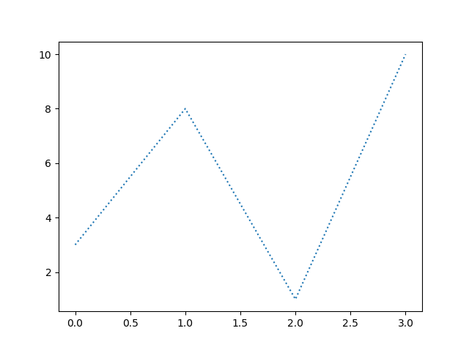
Basic Plotting Commands for formatting Line Style
import matplotlib.pyplot as plt
import numpy as np
ypoints = np.array([3, 8, 1, 10])
plt.plot(ypoints, linestyle = 'dotted')
plt.show()

Slide 43
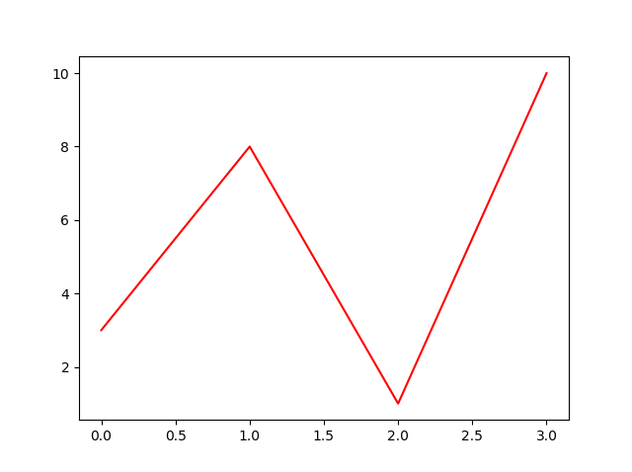
Basic Plotting Commands for formatting Line Style
import matplotlib.pyplot as plt
import numpy as np
ypoints = np.array([3, 8, 1, 10])
plt.plot(ypoints, color = 'r')
plt.show()

Slide 44
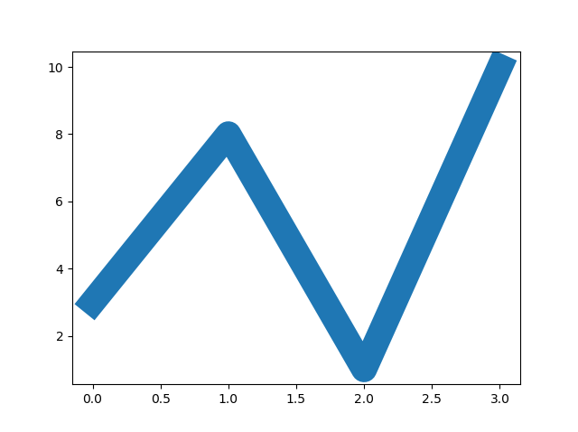
Basic Plotting Commands for formatting Line Width
import matplotlib.pyplot as plt
import numpy as np
ypoints = np.array([3, 8, 1, 10])
plt.plot(ypoints, linewidth = '20.5')
plt.show()

Slide 45
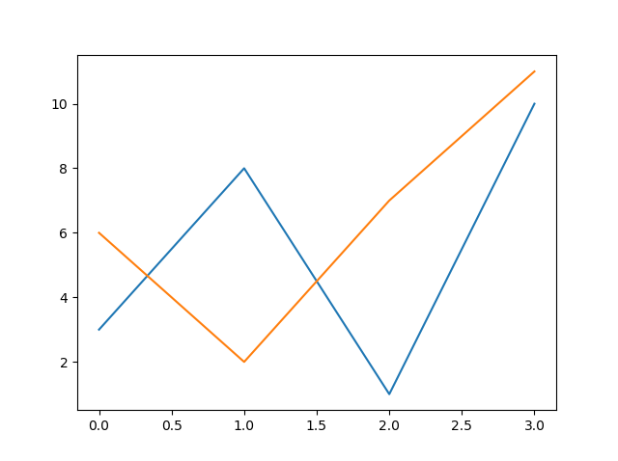
Basic Plotting Commands for formatting Multiple Line
import matplotlib.pyplot as plt
import numpy as np
y1 = np.array([3, 8, 1, 10])
y2 = np.array([6, 2, 7, 11])
plt.plot(y1)
plt.plot(y2)
plt.show()

Slide 46
Basic Plotting Commands for formatting Multiple Line
import matplotlib.pyplot as plt
import numpy as np
x1 = np.array([0, 1, 2, 3])
y1 = np.array([3, 8, 1, 10])
x2 = np.array([0, 1, 2, 3])
y2 = np.array([6, 2, 7, 11])
plt.plot(x1, y1, x2, y2)
plt.show()

Slide 47
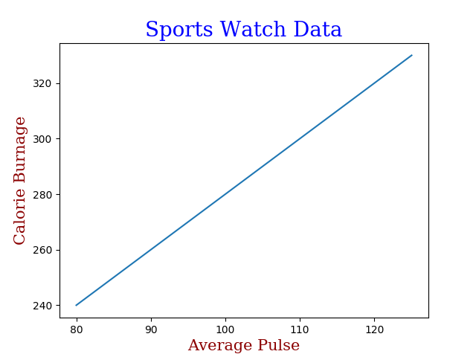
Basic Plotting Commands for Labels & Title
import numpy as np
import matplotlib.pyplot as plt
x = np.array([80, 85, 90, 95, 100, 105, 110, 115, 120, 125])
y = np.array([240, 250, 260, 270, 280, 290, 300, 310, 320, 330])
font1 = {'family':'serif','color':'blue','size':20}
font2 = {'family':'serif','color':'darkred','size':15}
plt.title("Sports Watch Data", fontdict = font1)
plt.xlabel("Average Pulse", fontdict = font2)
plt.ylabel("Calorie Burnage", fontdict = font2)
plt.plot(x, y)
plt.show()

Slide 48
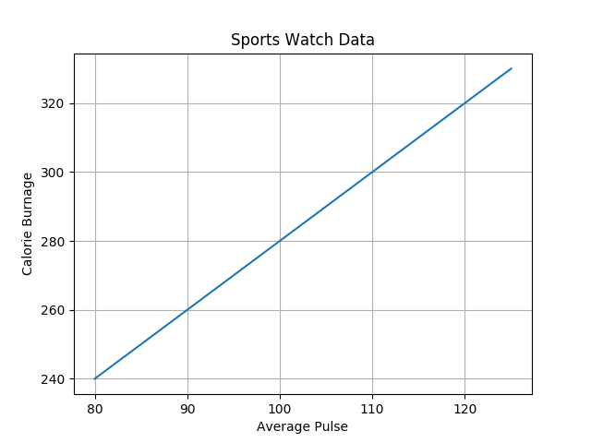
Basic Plotting Commands for formatting Grid
import numpy as np
import matplotlib.pyplot as plt
x = np.array([80, 85, 90, 95, 100, 105, 110, 115, 120, 125])
y = np.array([240, 250, 260, 270, 280, 290, 300, 310, 320, 330])
plt.title("Sports Watch Data")
plt.xlabel("Average Pulse")
plt.ylabel("Calorie Burnage")
plt.plot(x, y)
plt.grid()
plt.show()

Slide 49

Basic Plotting Commands for formatting Grid
import numpy as np
import matplotlib.pyplot as plt
x = np.array([80, 85, 90, 95, 100, 105, 110, 115, 120, 125])
y = np.array([240, 250, 260, 270, 280, 290, 300, 310, 320, 330])
plt.title("Sports Watch Data")
plt.xlabel("Average Pulse")
plt.ylabel("Calorie Burnage")
plt.plot(x, y)
plt.grid(axis = ‘x’)
plt.show()

Slide 50
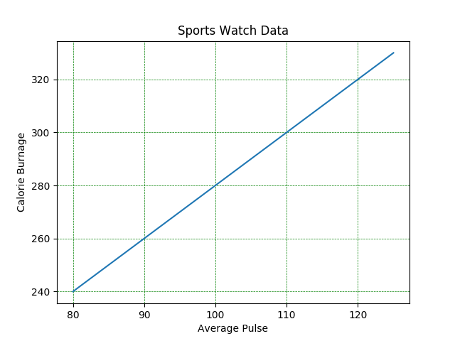
Basic Plotting Commands for formatting Grid
import numpy as np
import matplotlib.pyplot as plt
x = np.array([80, 85, 90, 95, 100, 105, 110, 115, 120, 125])
y = np.array([240, 250, 260, 270, 280, 290, 300, 310, 320, 330])
plt.title("Sports Watch Data")
plt.xlabel("Average Pulse")
plt.ylabel("Calorie Burnage")
plt.plot(x, y)
plt.grid(color = 'green', linestyle = '--', linewidth = 0.5)
plt.show()

Slide 51
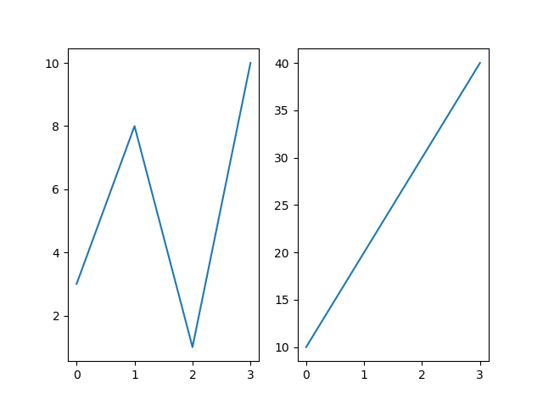
Basic Plotting Commands for displaying subplots
import matplotlib.pyplot as plt
import numpy as np
#plot 1:
x = np.array([0, 1, 2, 3])
y = np.array([3, 8, 1, 10])
plt.subplot(1, 2, 1)
plt.plot(x,y)
#plot 2:
x = np.array([0, 1, 2, 3])
y = np.array([10, 20, 30, 40])
plt.subplot(1, 2, 2)
plt.plot(x,y)
plt.show()

Slide 52
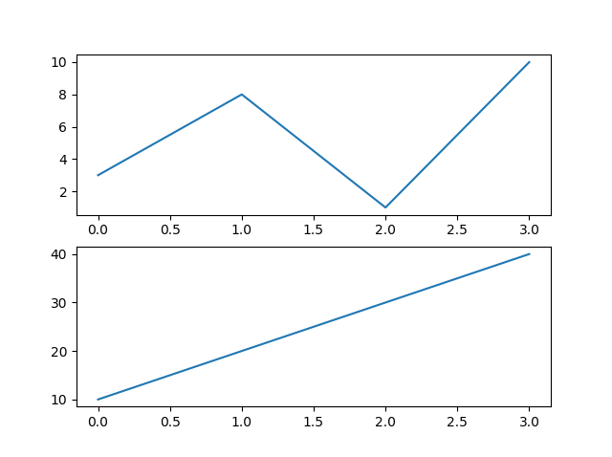
Basic Plotting Commands for displaying subplots
import matplotlib.pyplot as plt
import numpy as np
#plot 1:
x = np.array([0, 1, 2, 3])
y = np.array([3, 8, 1, 10])
plt.subplot(2, 1, 1)
plt.plot(x,y)
#plot 2:
x = np.array([0, 1, 2, 3])
y = np.array([10, 20, 30, 40])
plt.subplot(2, 1, 2)
plt.plot(x,y)
plt.show()

Slide 53
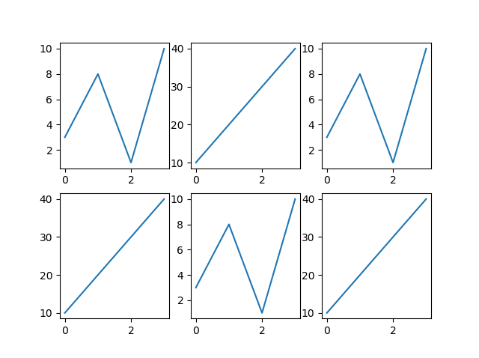
Basic Plotting Commands for displaying subplots
import matplotlib.pyplot as plt
import numpy as np
x = np.array([0, 1, 2, 3])
y = np.array([3, 8, 1, 10])
plt.subplot(2, 3, 1)
plt.plot(x,y)
x = np.array([0, 1, 2, 3])
y = np.array([10, 20, 30, 40])
plt.subplot(2, 3, 2)
plt.plot(x,y)
x = np.array([0, 1, 2, 3])
y = np.array([3, 8, 1, 10])
plt.subplot(2, 3, 3)
plt.plot(x,y)
x = np.array([0, 1, 2, 3])
y = np.array([10, 20, 30, 40])
plt.subplot(2, 3, 4)
plt.plot(x,y)
x = np.array([0, 1, 2, 3])
y = np.array([3, 8, 1, 10])
plt.subplot(2, 3, 5)
plt.plot(x,y)
x = np.array([0, 1, 2, 3])
y = np.array([10, 20, 30, 40])
plt.subplot(2, 3, 6)
plt.plot(x,y)
plt.show()

Slide 54
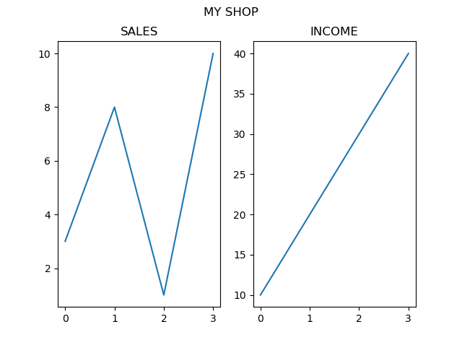
Basic Plotting Commands for formatting Subplots
import matplotlib.pyplot as plt
import numpy as np
#plot 1:
x = np.array([0, 1, 2, 3])
y = np.array([3, 8, 1, 10])
plt.subplot(1, 2, 1)
plt.plot(x,y)
plt.title("SALES")
#plot 2:
x = np.array([0, 1, 2, 3])
y = np.array([10, 20, 30, 40])
plt.subplot(1, 2, 2)
plt.plot(x,y)
plt.title("INCOME")
plt.suptitle("MY SHOP")
plt.show()

Slide 55
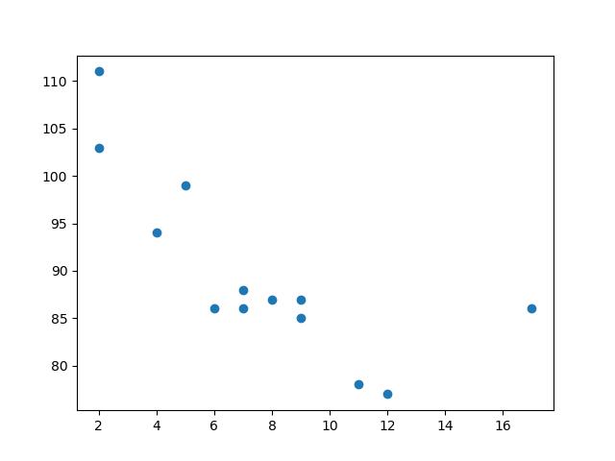
Basic Plotting Commands for Scatter Plots
import matplotlib.pyplot as plt
import numpy as np
x = np.array([5,7,8,7,2,17,2,9,4,11,12,9,6])
y = np.array([99,86,87,88,111,86,103,87,94,78,77,85,86])
plt.scatter(x, y)
plt.show()

Slide 56
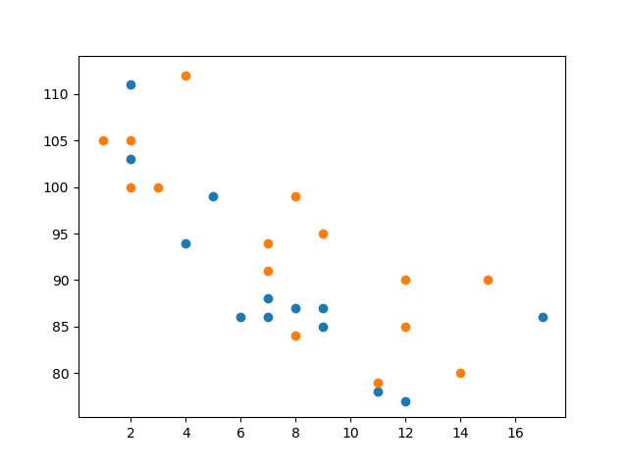
Basic Plotting Commands for Scatter Plots
import matplotlib.pyplot as plt
import numpy as np
#day one, the age and speed of 13 cars:
x = np.array([5,7,8,7,2,17,2,9,4,11,12,9,6])
y = np.array([99,86,87,88,111,86,103,87,94,78,77,85,86])
plt.scatter(x, y)
#day two, the age and speed of 15 cars:
x = np.array([2,2,8,1,15,8,12,9,7,3,11,4,7,14,12])
y = np.array([100,105,84,105,90,99,90,95,94,100,79,112,91,80,85])
plt.scatter(x, y)
plt.show()

Slide 57
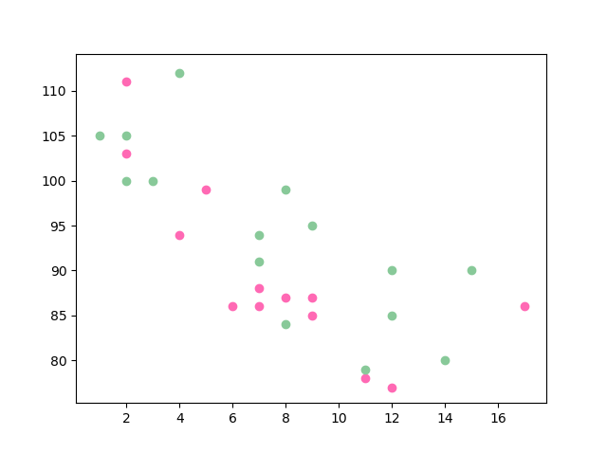
Basic Plotting Commands for Scatter Plots-color
import matplotlib.pyplot as plt
import numpy as np
x = np.array([5,7,8,7,2,17,2,9,4,11,12,9,6])
y = np.array([99,86,87,88,111,86,103,87,94,78,77,85,86])
plt.scatter(x, y, color = 'hotpink')
x = np.array([2,2,8,1,15,8,12,9,7,3,11,4,7,14,12])
y = np.array([100,105,84,105,90,99,90,95,94,100,79,112,91,80,85])
plt.scatter(x, y, color = '#88c999')
plt.show()

Slide 58
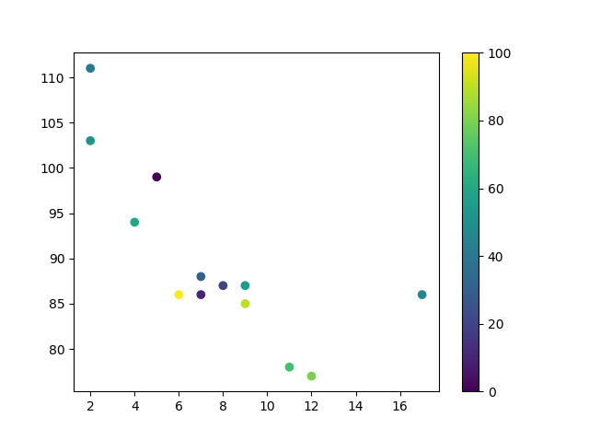
Basic Plotting Commands for Scatter Plots-Color Map
import matplotlib.pyplot as plt
import numpy as np
x = np.array([5,7,8,7,2,17,2,9,4,11,12,9,6])
y = np.array([99,86,87,88,111,86,103,87,94,78,77,85,86])
colors = np.array([0, 10, 20, 30, 40, 45, 50, 55, 60, 70, 80, 90, 100])
plt.scatter(x, y, c=colors, cmap='viridis')
plt.colorbar()
plt.show()

Slide 59
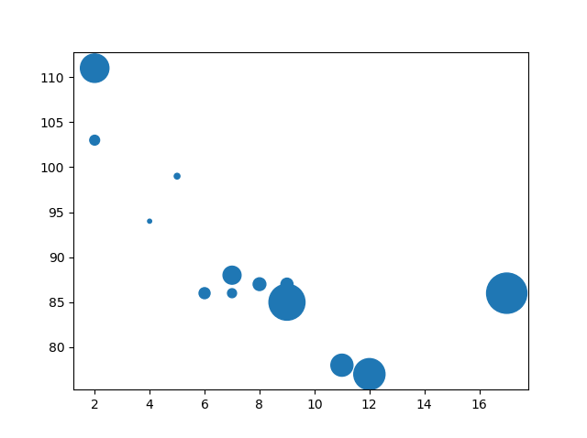
Basic Plotting Commands for Scatter Plots-Sizes
import matplotlib.pyplot as plt
import numpy as np
x = np.array([5,7,8,7,2,17,2,9,4,11,12,9,6])
y = np.array([99,86,87,88,111,86,103,87,94,78,77,85,86])
sizes = np.array([20,50,100,200,500,1000,60,90,10,300,600,800,75])
plt.scatter(x, y, s=sizes)
plt.show()

Slide 60
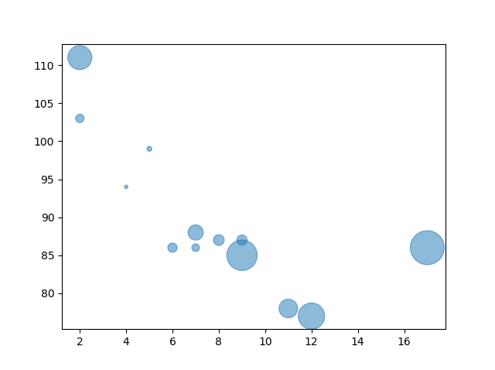
Basic Plotting Commands for Scatter Plots-Alpha
import matplotlib.pyplot as plt
import numpy as np
x = np.array([5,7,8,7,2,17,2,9,4,11,12,9,6])
y = np.array([99,86,87,88,111,86,103,87,94,78,77,85,86])
sizes = np.array([20,50,100,200,500,1000,60,90,10,300,600,800,75])
plt.scatter(x, y, s=sizes, alpha=0.5)
plt.show()

Slide 61
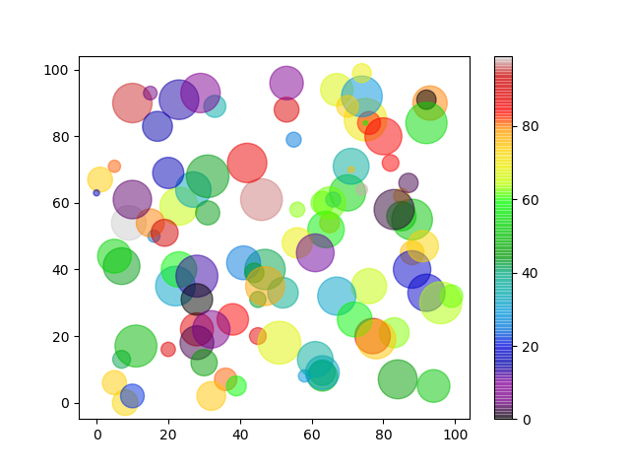
Basic Plotting Commands for Scatter Plots-Color Map
import matplotlib.pyplot as plt
import numpy as np
x = np.random.randint(100, size=(100))
y = np.random.randint(100, size=(100))
colors = np.random.randint(100, size=(100))
sizes = 10 * np.random.randint(100, size=(100))
plt.scatter(x, y, c=colors, s=sizes, alpha=0.5, cmap='nipy_spectral')
plt.colorbar()
plt.show()import matplotlib.pyplot as plt
import numpy as np
x = np.array([5,7,8,7,2,17,2,9,4,11,12,9,6])
y = np.array([99,86,87,88,111,86,103,87,94,78,77,85,86])
sizes = np.array([20,50,100,200,500,1000,60,90,10,300,600,800,75])
plt.scatter(x, y, s=sizes)
plt.show()

Slide 62
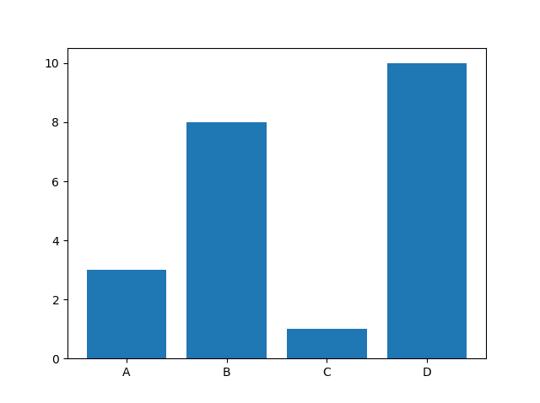
Basic Plotting Commands for Bar Plots
import matplotlib.pyplot as plt
import numpy as np
x = np.array(["A", "B", "C", "D"])
y = np.array([3, 8, 1, 10])
plt.bar(x,y)
plt.show()

Slide 63
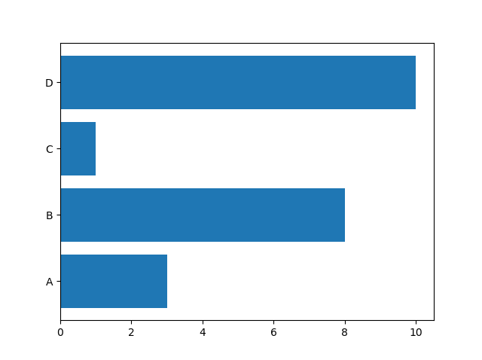
Basic Plotting Commands for Bar Plots - Horizontal
import matplotlib.pyplot as plt
import numpy as np
x = np.array(["A", "B", "C", "D"])
y = np.array([3, 8, 1, 10])
plt.barh(x, y)
plt.show()

Slide 64
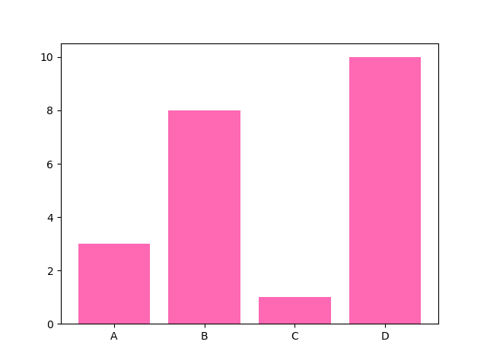
Basic Plotting Commands for Bar Plots - Color
import matplotlib.pyplot as plt
import numpy as np
x = np.array(["A", "B", "C", "D"])
y = np.array([3, 8, 1, 10])
plt.bar(x, y, color = "hotpink")
plt.show()

Slide 65
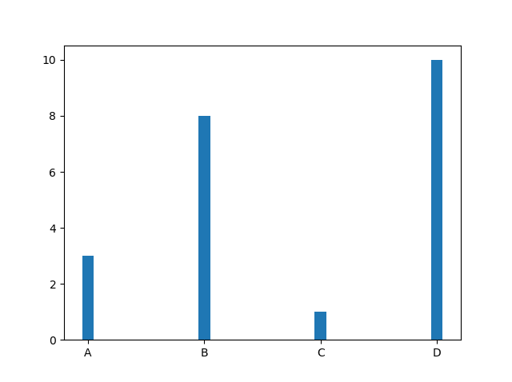
Basic Plotting Commands for Bar Plots - Width
import matplotlib.pyplot as plt
import numpy as np
x = np.array(["A", "B", "C", "D"])
y = np.array([3, 8, 1, 10])
plt.bar(x, y, width = 0.1)
plt.show()

Slide 66
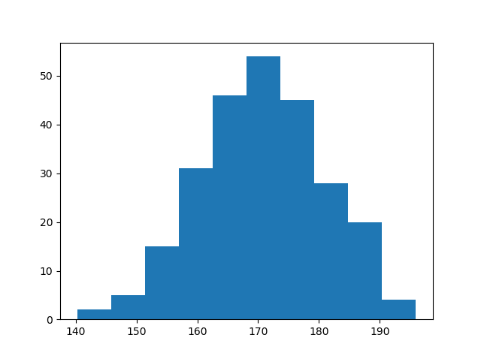
Basic Plotting Commands for Histogram plots
import matplotlib.pyplot as plt
import numpy as np
x = np.random.normal(170, 10, 250)
plt.hist(x)
plt.show()

Slide 67
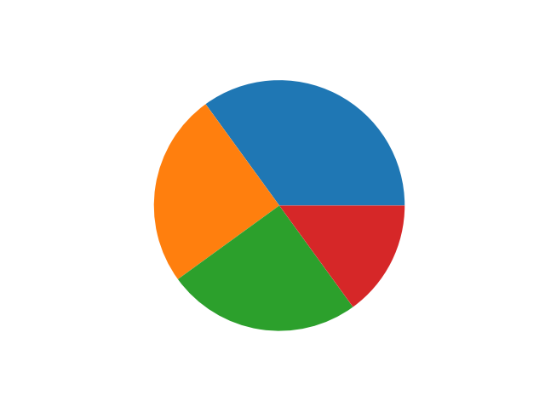
Basic Plotting Commands for Pie Charts
import matplotlib.pyplot as plt
import numpy as np
y = np.array([35, 25, 25, 15])
plt.pie(y)
plt.show()

Slide 68
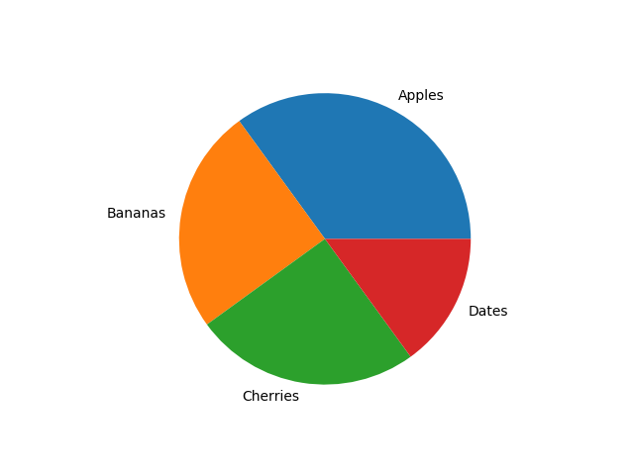
Basic Plotting Commands for Pie Charts - Labels
import matplotlib.pyplot as plt
import numpy as np
y = np.array([35, 25, 25, 15])
mylabels = ["Apples", "Bananas", "Cherries", "Dates"]
plt.pie(y, labels = mylabels)
plt.show()

Slide 69
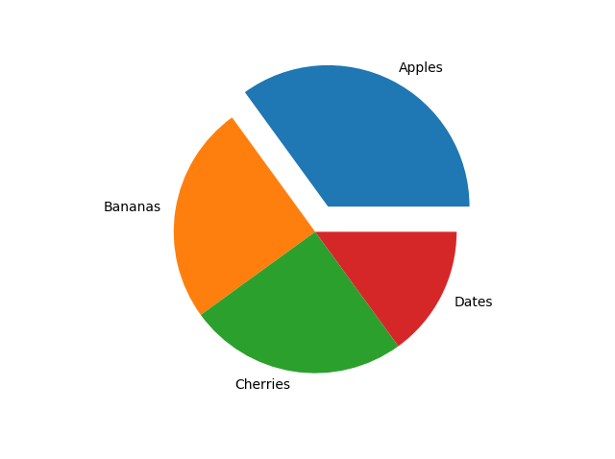
Basic Plotting Commands for Pie Charts - Explode
import matplotlib.pyplot as plt
import numpy as np
y = np.array([35, 25, 25, 15])
mylabels = ["Apples", "Bananas", "Cherries", "Dates"]
myexplode = [0.2, 0, 0, 0]
plt.pie(y, labels = mylabels, explode = myexplode)
plt.show()

Slide 70
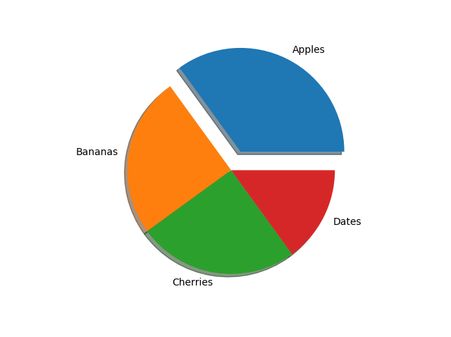
Basic Plotting Commands for Pie Charts - Shadow
import matplotlib.pyplot as plt
import numpy as np
y = np.array([35, 25, 25, 15])
mylabels = ["Apples", "Bananas", "Cherries", "Dates"]
myexplode = [0.2, 0, 0, 0]
plt.pie(y, labels = mylabels, explode = myexplode, shadow = True)
plt.show()

Slide 71

Basic Plotting Commands for Pie Charts - Color
import matplotlib.pyplot as plt
import numpy as np
y = np.array([35, 25, 25, 15])
mylabels = ["Apples", "Bananas", "Cherries", "Dates"]
mycolors = ["black", "hotpink", "b", "#4CAF50"]
plt.pie(y, labels = mylabels, colors = mycolors)
plt.show()

Slide 72

Basic Plotting Commands for Pie Charts - Legend
import matplotlib.pyplot as plt
import numpy as np
y = np.array([35, 25, 25, 15])
mylabels = ["Apples", "Bananas", "Cherries", "Dates"]
plt.pie(y, labels = mylabels)
plt.legend()
plt.show()

Slide 73

Basic Plotting Commands for Pie Charts - Header
import matplotlib.pyplot as plt
import numpy as np
y = np.array([35, 25, 25, 15])
mylabels = ["Apples", "Bananas", "Cherries", "Dates"]
plt.pie(y, labels = mylabels)
plt.legend(title = "Four Fruits:")
plt.show()

