Slide 1

GenAI Day9

Slide 2

Syllabus
Pre Training - Object-Oriented Programming (OOP)
Training
Classes, objects, inheritance, and encapsulation.
Hands-On: Create a class for a product catalog.
Post Training – Case Study: Implement an inventory management system using OOP concepts.

Slide 3


Seaborn
Seaborn is a simple, easy-to-use open-source data visualization Python library that has an easy-to-use interface for creating informative and aesthetically pleasing statistical graphics.
Seaborn is built on top of Matplotlib.
Matplotlib treats Figures and Axes as objects and focuses on how to draw them.
Seaborn has a dataset-oriented, declarative API that lets you treat a whole dataset as a single unit and focus on what elements in your plots mean than how to draw them.

Slide 4
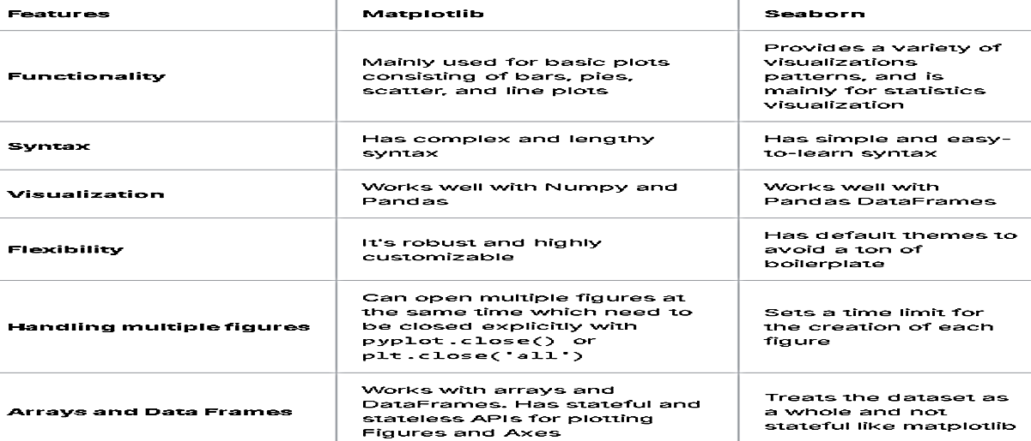
Matplotlib vs Seaborn

Slide 5
Features of Seaborn
Built in themes for styling matplotlib graphics
Visualizing univariate, bivariate and trivariate data
Fitting in and visualizing linear regression models
Plotting statistical time series data
Seaborn works well with NumPy arrays and Pandas data frames

Slide 6
Installing Seaborn
pip install seaborn
conda install seaborn
Dependencies to installing Seaborn
Python 2.7 or 3.4+
NumPy
SciPy
pandas
matplotlib

Slide 7
Seaborn – Importing Libraries
import numpy as np
import pandas as pd
import matplotlib.pyplot as plt
Import scipy as sp
import seaborn as sns

Slide 8
Seaborn – Importing Datasets - load_dataset()
# Importing sample datasets as Pandas DataFrames by de fault.
import seaborn as sb
df = sb.load_dataset('tips')
print df.head()
# get_dataset_names() displays the sample datasets in Seaborn library
print sb.get_dataset_names()

Slide 9
What is a Data Frame
Data Frame is an in-memory, tabular data structure that organizes data into a 2-dimensional table of rows and columns, similar to a spreadsheet or SQL table.
Each column holds values of a single datatype, while rows can contain a variety of datatypes
Every Data Frame contains a blueprint, known as a schema, that defines the name (label) and data type of each column.
In a distributed architecture, a Data Frame can span thousands of computers, thus making it possible to do analytics on big data.

Slide 10
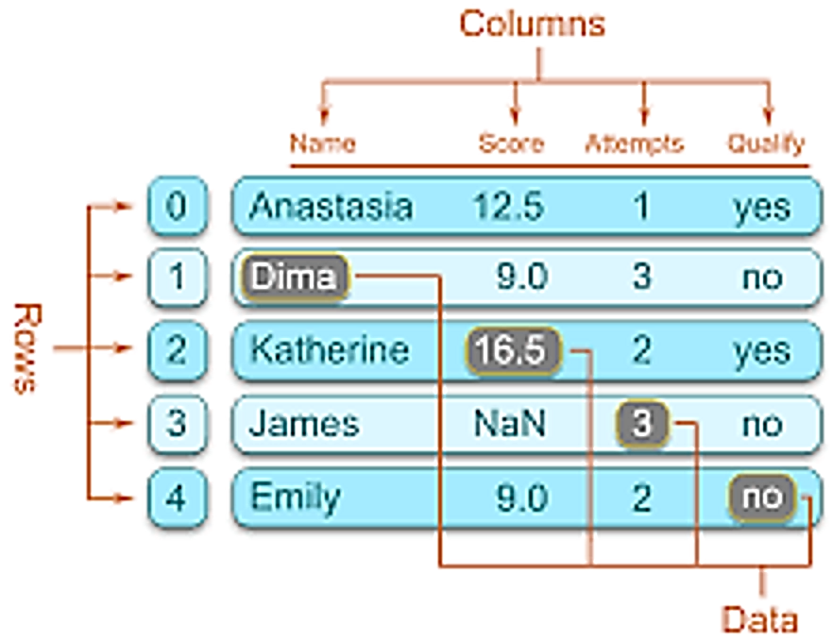
Data Frame

Slide 11
Data Frame

Slide 12
Aesthetics and Visualizations
Aesthetics means a set of principles concerned with the nature and appreciation of beauty, especially in art. Aesthetics fall into two groups, those that can represent continuous data and those that can’t.
Visualization is an art of representing huge volume of complex data in visually appealing and informative graphics.
Visualization allows easy interpretation and comprehension of complex data
Visualization helps in identifying patterns, relationships, and trends that might not be apparent through raw data alone.

Slide 13
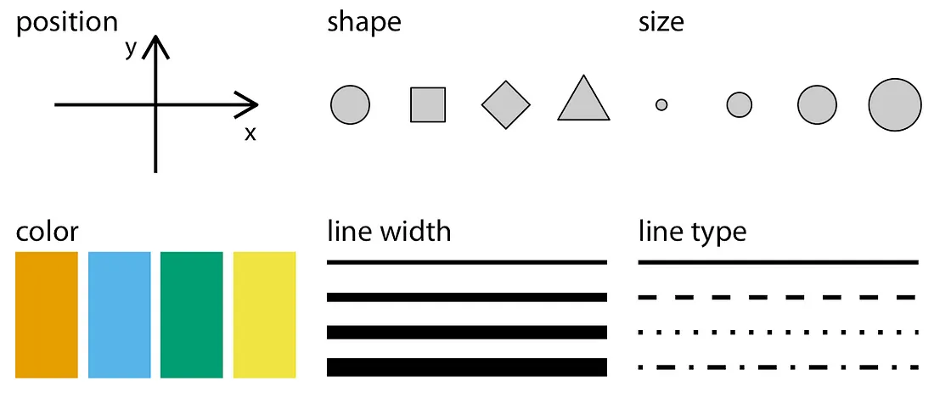
Aesthetics and Visualizations

Slide 14
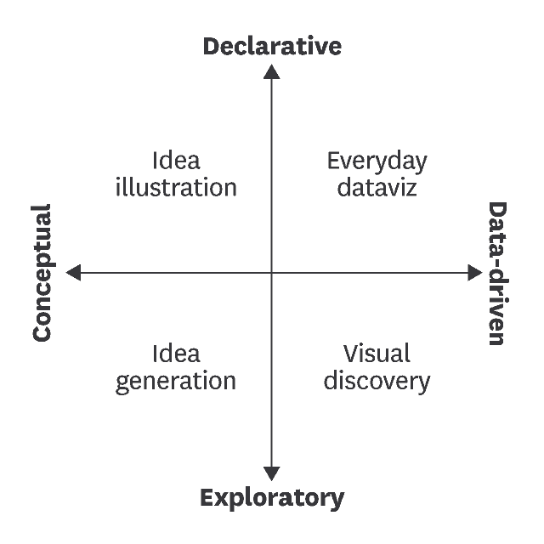
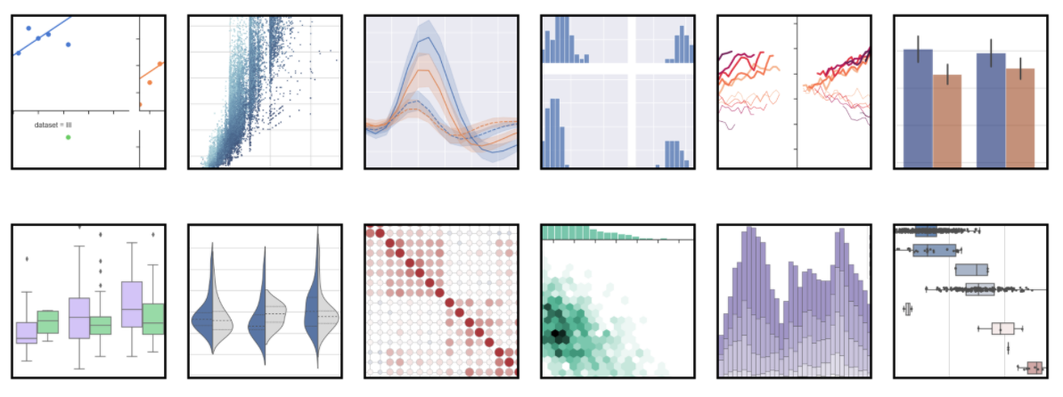
Aesthetics and Visualizations

Slide 15
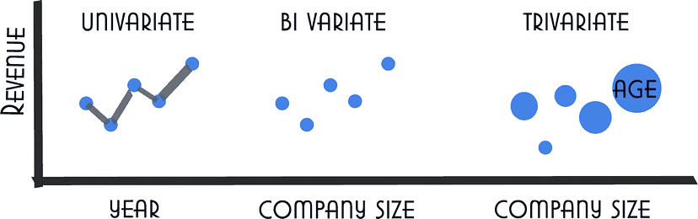
3 categories of Seaborn plots types
Seaborn provides three categories of plot types that can be used for data visualization and exploratory data analysis.
Univariate – x only (contains only one axis of information)
Bivariate – x and y (contains two axis of information)
Trivariate – x, y, z (contains three axis of information)

Slide 16
Categories of Seaborn Plots
Distribution plots: To visualize both types of distributions, i.e., univariate and bivariate distribution.
Relational plots: To visualize the relation between the two given variables.
Regression plots: To add an additional visual guide that will help to emphasize dataset patterns during the analysis of exploratory data.
Categorical plots: To visualize the categories of variables and how we can visualize them.
Multi-plot grids: To visualize multiple instances for the same plot with different subsets of a single dataset.
Matrix plots: To visualize a type of arrays of the scatterplots.

Slide 17
Types of Seaborn plots
scatterplot() - To visualize the relationship between two variables as scatter plots.
lineplot() - To visualize the trend of a variable over time as line plots.
histplot() - To visualize the distribution of a variable as histograms.
boxplot() - To visualize the distribution of a variable as box plots.
violinplot() – To visualize in detail the distribution of data as violin plots
heatmap() - To visualize the correlation between multiple variables as heatmaps.
pairplot() - To visualize the relationship between multiple variables as pairplots.
lmplot() – To visualize a line that represents a linear regression model with the data points on the given two-dimensional (2-D) space.

Slide 18
Types of Seaborn plots
Count() - To visualize the occurrence(counts) of the observation present in the categorical variable.

Slide 19
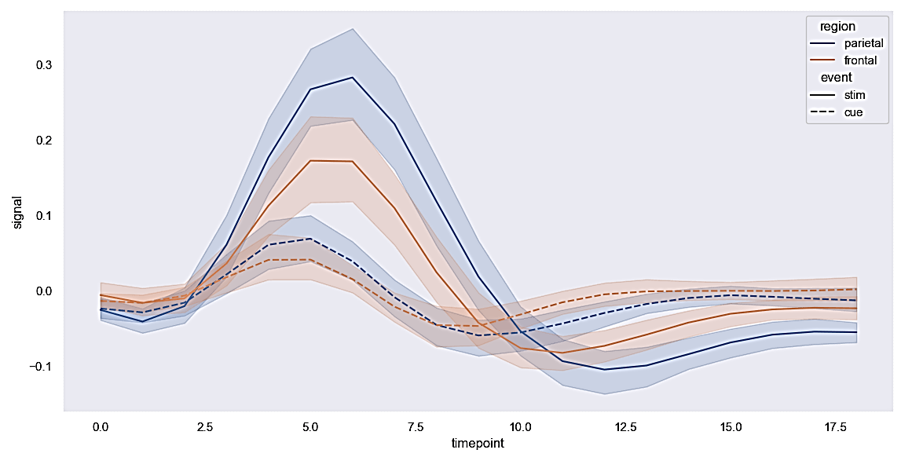
Line Plot
import seaborn as sns
import matplotlib.pyplot as plt
# Setting style with set() function
sns.set(style="dark")
# Using dataset() function to declare data type
FMR = sns.load_dataset("fmri")
sns.lineplot(x="timepoint",
y="signal",
hue="region",
style="event",
data=FMR) # using lineplot() function to create line plot
plt.show() # using show() function

Slide 20
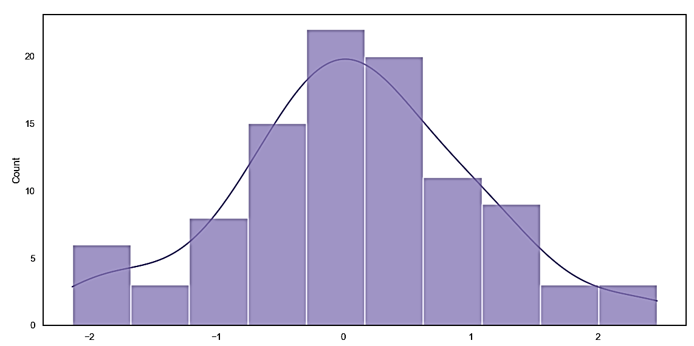
Line Plot
import numpy as np
import seaborn as sns
import matplotlib.pyplot as plt
# Selecting style for boxplot with set() function
sns.set(style="white")
# Generate a random univariate type distribution
ru = np.random.RandomState(10)
d = ru.normal(size=100)
# Plotting a simple histogram with kdeplot variation
sns.histplot(d, kde=True, color="m")
plot = sns.histplot(d, kde=True, color="m")
print(plot)
plt.show() # using show() function

Slide 21
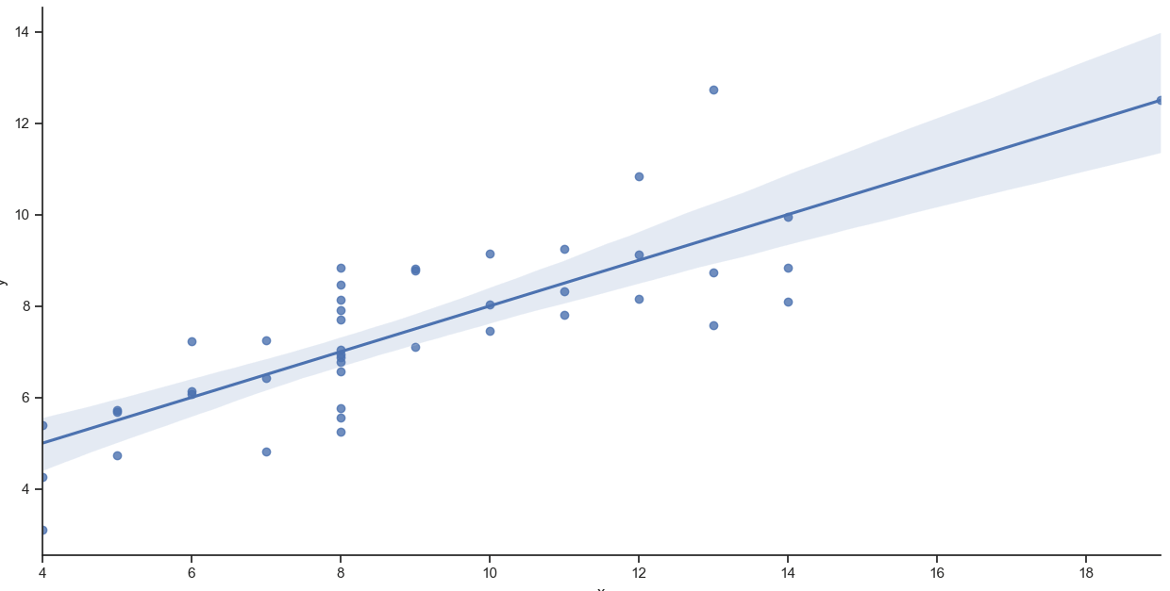
Lmplot
import seaborn as sns
import matplotlib.pyplot as plt
# Using set() function to set style
sns.set(style="ticks")
# Using dataset() function
ds = sns.load_dataset("anscombe")
# Showing results in the form of linear regression
sns.lmplot(x="x", y="y", data=ds)
plot = sns.lmplot(x="x", y="y", data=ds)
print(plot)
plt.show() # using show() function

Slide 22
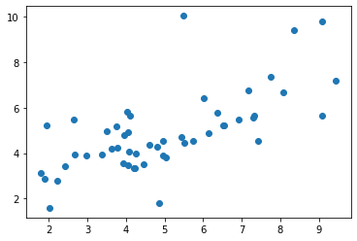
Scatter plot
import seaborn as sns
import matplotlib.pyplot as plt
df = sns.load_dataset('car_crashes')
print(df.head())
plt.scatter(df.speeding,df.alcohol)
plt.show()

Slide 23
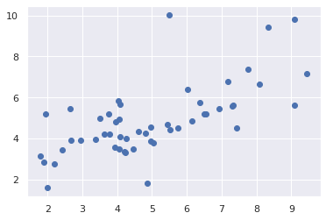
Scatter plot with settings
from matplotlib import pyplot as plt
import seaborn as sns
plt.scatter(df.speeding,df.alcohol)
sns.set()
plt.show()

Slide 24
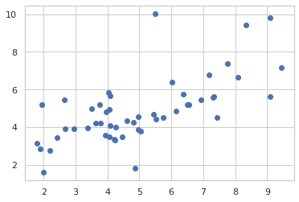
Scatter plot with style settings
from matplotlib import pyplot as plt
import seaborn as sns
plt.scatter(df.speeding,df.alcohol)
sns.set_style("whitegrid")
plt.show()
Style Settings
Dark grid
White grid
Dark
White
Ticks

Slide 25
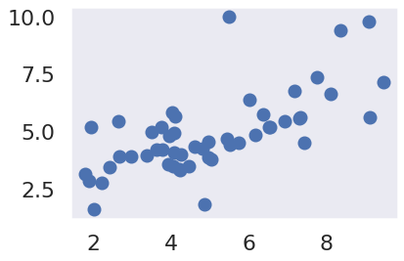
Scatter plot with scale settings
from matplotlib import pyplot as plt
import seaborn as sns
plt.scatter(df.speeding,df.alcohol)
sns.set_style("dark")
sns.set_context("notebook")
plt.show()
Scale Settings
Paper
Notebook (default)
Talk
Poster

Slide 26
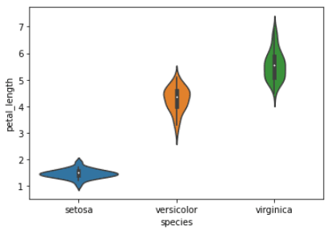
Violin plot graphically represents the density estimate, with wider parts indicating higher density, and the IQR and median are shown as a white dot and line within the violin.
import seaborn as sns
# load the iris dataset from Seaborn
iris = sns.load_dataset("iris")
# create a violin plot of petal length by species
sns.violinplot(x="species", y="petal_length", data=iris)
# display the plot
plt.show()

Slide 27
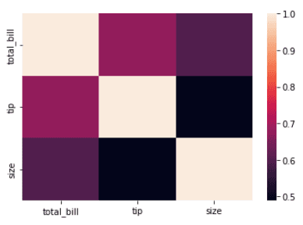
Heat Map plot, graphically represents data values as grades of colors in a two-dimensional space.
import seaborn as sns
import matplotlib.pyplot as plt
# Load the dataset
tips = sns.load_dataset('tips')
# Create a heatmap of the correlation between variables
corr = tips.corr()
sns.heatmap(corr)
# Show the plot
plt.show()

Slide 28
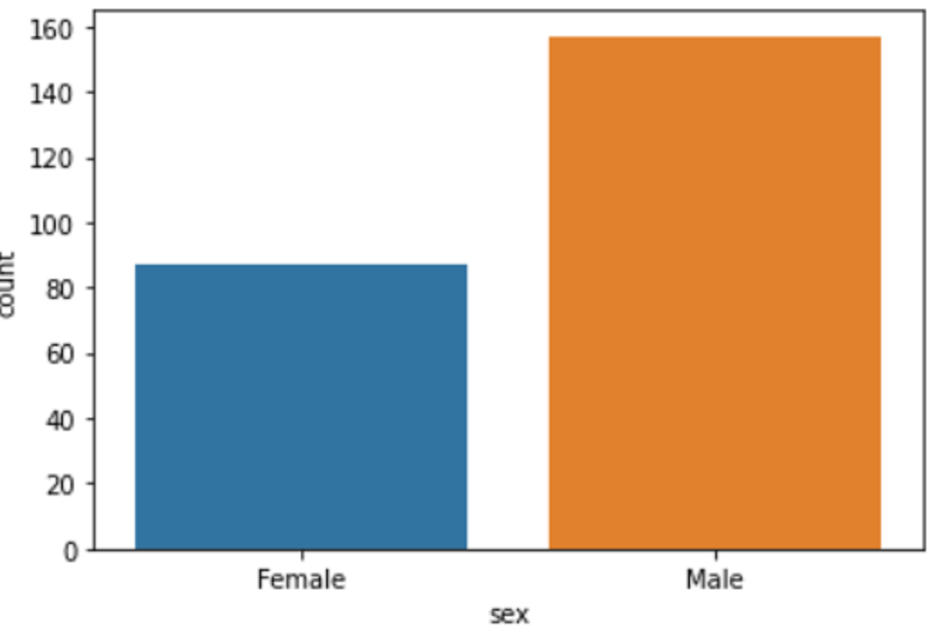
countplot
import matplotlib.pyplot as plt
import seaborn as sns
import pandas as pd
#loading the dataset 'tips'
df=pd.read_csv("/content/tips.csv")
#plotting the graph
sns.countplot(x='sex',data=df)
plt.show()

Slide 29
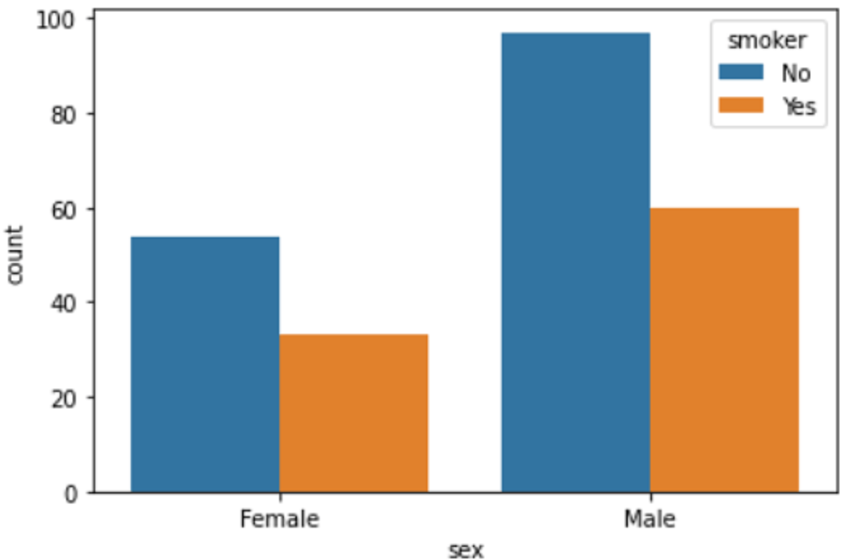
Countplot with Legend
import matplotlib.pyplot as plt
import seaborn as sns
import pandas as pd
#loading the dataset 'tips'
df=pd.read_csv("/content/tips.csv")
#plotting the graph
sns.countplot(x='sex',hue='smoker',data=df)
plt.show()

Slide 30
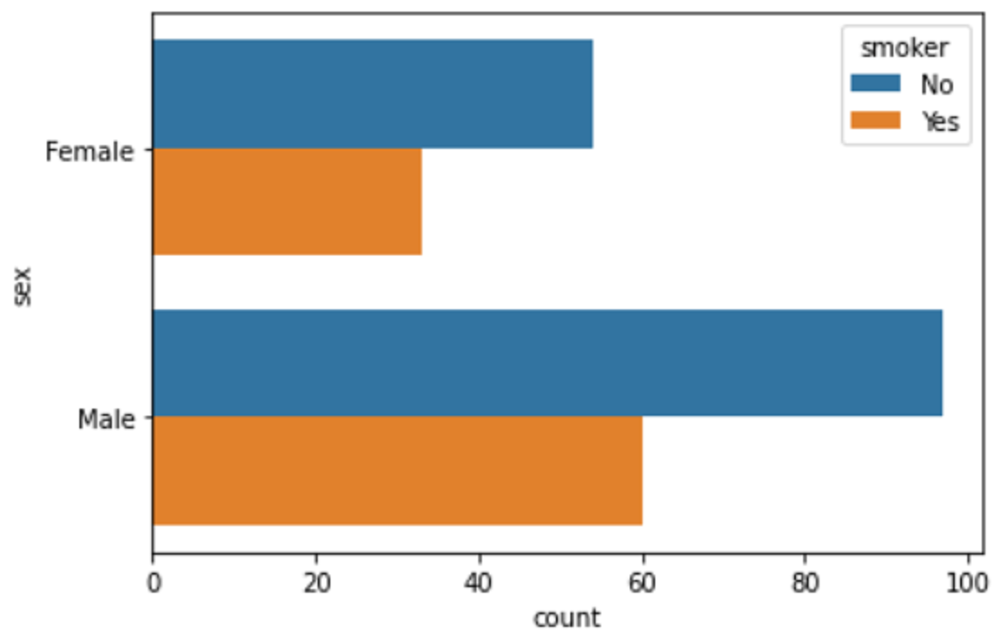
Horizontal Countplot with Legend
import matplotlib.pyplot as plt
import seaborn as sns
import pandas as pd
#loading the dataset 'tips'
df=pd.read_csv("/content/tips.csv")
#plotting the graph
sns.countplot(y='sex',hue='smoker',data=df)
plt.show()

Slide 31
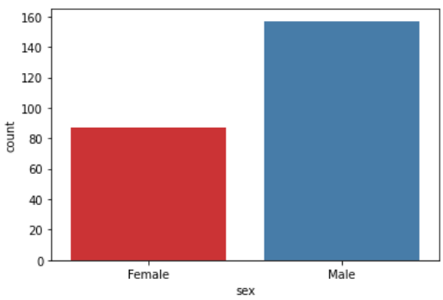
Colorized Countplot with Legend
import matplotlib.pyplot as plt
import seaborn as sns
import pandas as pd
#loading the dataset 'tips'
df=pd.read_csv("/content/tips.csv")
#plotting the graph
sns.countplot(x='sex', data=df, palette='Set1')
plt.show()

Slide 32
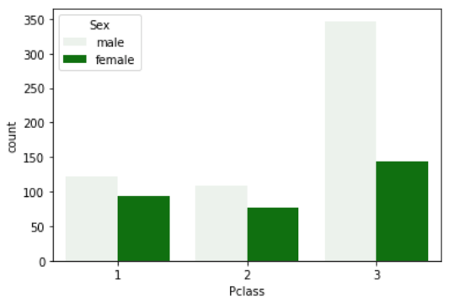
Colorized Countplot with Legend
import matplotlib.pyplot as plt
import seaborn as sns
import pandas as pd
#loading the dataset 'train'
df=pd.read_csv("/content/train.csv")
#plotting the graph
sns.countplot(x='Pclass',hue='Sex', data=df, color='green')
plt.show()

Slide 33
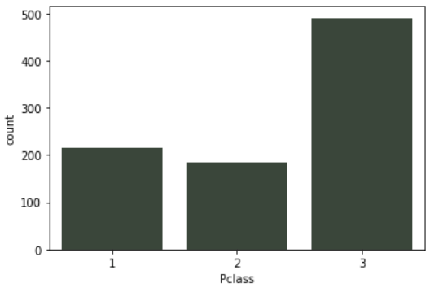
Colorized Countplot with Legend and Saturation
import matplotlib.pyplot as plt
import seaborn as sns
import pandas as pd
#loading the dataset 'train'
df=pd.read_csv("/content/train.csv")
#plotting the graph
sns.countplot(x='Pclass',data=df, color='green', saturation=0.1)
plt.show()

Slide 34
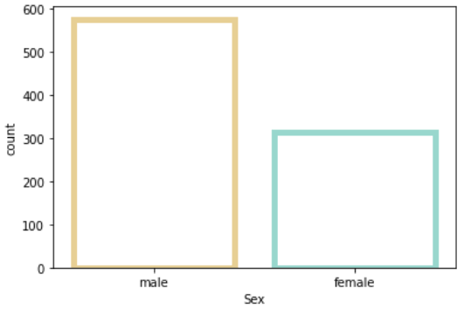
Countplot with Legend with Line width & Edge color
import matplotlib.pyplot as plt
import seaborn as sns
import pandas as pd
#loading the dataset 'train'
df=pd.read_csv("/content/train.csv")
sns.countplot(x='Sex', data=df, color="green", facecolor=(0,0,0,0), linewidth=5, edgecolor=sns.color_palette("BrBG",2))
plt.show()

