Slide 1

24-HOUR TECHNICAL HACKATHON
Lumenova: Reading Home Urine and Ovulation Test Strips with a Phone Camera
[Team name]
[Member 1]
[Member 2]
[Member 3]
[Member 4]
[Institution]
Organized by the ECE Department
Vidyavardhaka College of Engineering, Mysuru
Notes:
Introduce yourself. Lumenova is a free web app: you point your phone at a urine or ovulation test strip and it gives an objective, private reading with plain-language guidance. It is a screening and wellness aid, not a diagnostic device.

Slide 2
Problem Statement
Home test strips are still read by eye
01
Colour charts are hard to match
Lighting, colour vision and timing change what the eye sees.
02
Ovulation lines are hard to judge
Is the T line as dark as the C line? That guess is the result.
03
Results are thrown away
No trend over days, and no link to the menstrual cycle.
04
No next step, no privacy
Little guidance after a worrying result; most apps need an account.
ECE / VVCE, MYSURU
02 / 15
Notes:
Home urine and ovulation strips are cheap and sold everywhere, but people read them by eye. A 10-pad urine strip has dozens of similar shades, and the reading changes with lighting, colour vision and timing. On ovulation strips, the whole result is a judgement of whether the test line is as dark as the control line. Strips are thrown away, so trends are lost, and a worrying result rarely comes with a next step.

Slide 3
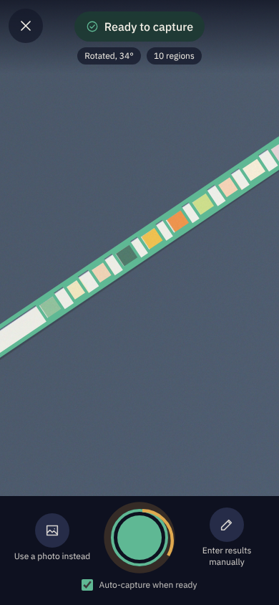
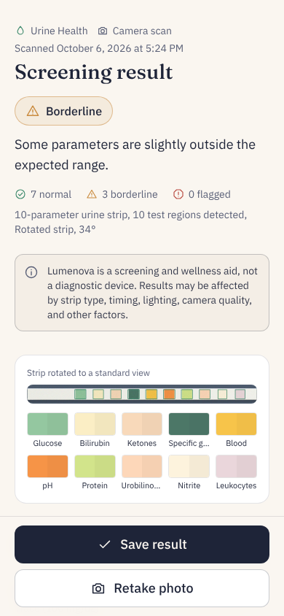
Proposed Solution
What is your solution?
Point a phone at the strip and get an objective reading of home urine and ovulation tests.
How does it help?
1. Live guidance frames the strip and captures it
2. AI finds the pads; colour science reads them
3. Plain-language result, never a diagnosis
4. Saved privately, with trends and a cycle calendar
What is the core idea?
Works in any phone browser. No app install, no account.
ECE / VVCE, MYSURU · Screens from the working prototype
03 / 15
Notes:
Lumenova turns the phone camera into an objective strip reader. The camera screen guides the user and captures automatically; here a 10-pad strip is detected at 34 degrees. The result screen shows the status with icon and text, counts per status, and the disclaimer on every result.

Slide 4

How It Works
One scan, six steps, mostly on the phone
01
02
03
04
05
06
Camera
Live guidance and auto-capture
Quality check
Rejects blur, glare, darkness
Find the pads
YOLO26s AI model (cloud), or on-device detector
Read
CIEDE2000 colour match; T/C line ratio
Result
Plain-language screening guidance
Save
Trends and calendar, on the phone
Only the photo goes to the AI model. Colour reading and storage stay on the phone, and the model can be switched off.
ECE / VVCE, MYSURU
04 / 15
Notes:
Step 3 is the only cloud step: the photo is sent to a YOLO26s model on Roboflow, which returns boxes around the pads. If it is off or offline, an on-device detector based on PCA does the same job. Colour reading, results and history never leave the phone.

Slide 5






Target Users
Built for women who test at home
Trying to conceive
Reliable ovulation readings and a predicted fertile window
Tracking cycle and wellness
Four-phase calendar and urine trends
Diabetes or kidney concerns
Regular home screening, with a history to show a doctor
Antenatal self-checks
Urine protein and glucose between visits, as a doctor advises
Rural, low-resource areas
Free, and runs in a basic smartphone browser
Community health workers
Consistent strip readings on field visits (future)
ECE / VVCE, MYSURU
05 / 15
Notes:
The main users are women who already use home strips: those trying to conceive, those tracking their cycle, people with diabetes or kidney concerns, and pregnant women doing self-checks their doctor recommends. Because it is free and browser-based, it also suits rural and low-resource settings. Community health workers are a future group.

Slide 6
Key Features
Nine things Lumenova does today
Urine strip reader
2 to 10 pads, at any angle
Ovulation (LH) reader
T/C ratio: Low, Rising or Peak
Live camera guidance
Auto-captures when the strip is ready
Quality gate
Says why a photo cannot be read
Test-kit check
Refuses pregnancy and COVID tests
Trends and history
Urine and LH graphs over time
Cycle calendar
Four phases and the next period
Nearby help
Clinics and pharmacies on a map, with directions
Privacy by design
No account; data stays on the phone
ECE / VVCE, MYSURU
06 / 15
Notes:
Every result shows what it means, what to do now, when to seek professional help and precautions, with the disclaimer. Status is shown with an icon and a word, never colour alone. There are also step-by-step test instructions, manual entry and a "use a photo instead" option.

Slide 7
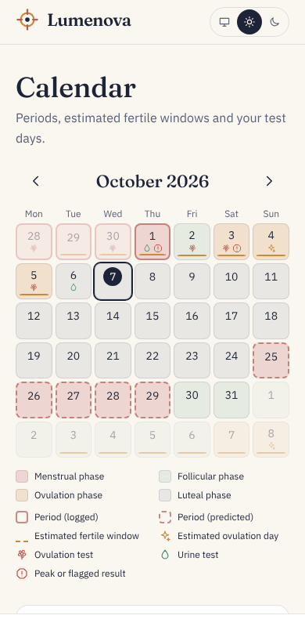
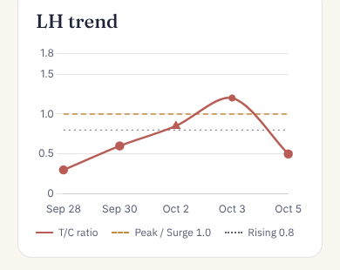
Tracking Over Time
Every test adds to a picture of the cycle
01
Four phases
predicted from logged periods
02
An LH Peak
moves the ovulation estimate
03
Urine trends
across screenings
ECE / VVCE, MYSURU · Screens from the working prototype, with sample data
07 / 15
Notes:
The calendar predicts all four phases from the period dates the user logs. Ovulation is placed 14 days before the next expected period; when an ovulation strip reads Peak, the estimate moves to the day after. The LH trend shows the T/C ratio crossing the 1.0 peak line.

Slide 8
Technology & Medium
A phone browser and a pharmacy strip
Layer | Technology
Front end | React 18, TypeScript, Vite, Tailwind CSS
Camera | WebRTC getUserMedia, HTML Canvas
Image analysis | Own TypeScript pipeline in a Web Worker: PCA, CIEDE2000, optical density
AI models | Two YOLO26s detectors trained on Roboflow (831 and 823 images)
Charts and maps | Chart.js; Leaflet with OpenStreetMap, Nominatim, Overpass
Storage | Browser localStorage, on the device only
Hosting and testing | GitHub Pages and Actions; Vitest and Playwright
ECE / VVCE, MYSURU · Medium: any smartphone with a camera and a modern browser
08 / 15
Notes:
Users need only a smartphone with a camera and a browser, plus standard strips from a pharmacy. There is no server or database: the site is static, the analysis runs in a Web Worker on the phone, and only the AI pad detection runs in the cloud on Roboflow.

Slide 9
AI Model Accuracy
Both models find the right parts of the photo
94.5%
98.8%
100%
Urine pad detector
mAP@50 over its 11 classes, on 49 unseen test images
Test-kit type detector
mAP@50 over 9 kit types, on 48 unseen test images
Ovulation tests found
Precision and recall in the test set; no errors seen in 48 images
This is detection accuracy, not clinical accuracy. Weakest class: nitrite (recall 66.7%). Colour readings still need a comparison with lab tests.
ECE / VVCE, MYSURU · Source: Roboflow model evaluations, version 1 of each model (YOLO26s)
09 / 15
Notes:
mAP at 50 means a detection counts when its box overlaps the true box by at least half. The urine model's headline figure in Roboflow is 86.7% because it averages in an empty "background" class that scores zero; over the 11 real classes it is 94.5%. Be clear that these numbers say the model finds the pads, not that the medical reading is correct. The next step is a comparison against lab urinalysis.

Slide 10
Innovation
What is new about Lumenova
No reader device
Uses the phone people already own, in a browser
Any angle, any background
PCA finds the strip; no calibration card needed
Self-calibrating colour
Each pad is white-balanced against the strip's own backing
Explainable hybrid AI
YOLO26s finds the pads; CIEDE2000 colour science reads them
Honest about uncertainty
Per-pad confidence, and "unreadable" instead of a guess
From result to care
A map of nearby clinics, hospitals and pharmacies
ECE / VVCE, MYSURU
10 / 15
Notes:
Clinical strip readers are separate machines. Lumenova runs in a phone browser, finds the strip at any angle, corrects the lighting using the strip's own white backing, and combines a trained detector with transparent colour science, so every reading can be explained. It also shows "unreadable" rather than guessing, and links a flagged result to nearby care.

Slide 11
Risks & Safeguards
Each known risk has a safeguard
Risk | How it is reduced
Wrong reading (light, blur, brand) | Quality gate, white balance, per-pad confidence, "unreadable"
Mistaken for a diagnosis | Non-diagnostic wording; disclaimer on every result
Colour reading not yet validated | Screening aid only; lab comparison study planned
Small training sets (about 830 images) | Collect varied images and retrain; on-device fallback
Privacy of health data | No account or server; photos never stored
Free third-party services fail | On-device fallback and clear error messages
Regulation | Stays a wellness aid; a diagnostic claim needs CDSCO approval
ECE / VVCE, MYSURU
11 / 15
Notes:
The biggest risk is a wrong reading being trusted. Lumenova refuses bad photos, shows a confidence for each pad, and says "unreadable" rather than guessing. The colour reading has not yet been compared with lab tests, so it is presented only as a screening aid. Any diagnostic claim would need approval from CDSCO, India's medical device regulator.

Slide 12

Expected Impact
Healthier choices, lower costs, less waste
Social
Economic
Environmental
Earlier visits when a result is flagged
Better women's health literacy
Private testing at home, with dignity
Reaches areas far from labs
Free app; tests cost only the strip
Fewer unnecessary trips and lost wages
Fewer ovulation strips wasted on misreads
Near-zero running cost at scale
No extra hardware to make or dispose of
Paperless records
Fewer journeys for routine checks
No always-on server
ECE / VVCE, MYSURU
12 / 15
Notes:
Socially, objective home screening can prompt a doctor visit sooner and improves understanding of women's health. Economically, the app is free and each test costs only a cheap strip. Environmentally, it reuses phones people already own instead of a dedicated reader device, and most processing happens on the phone.

Slide 13
Estimated Cost
The prototype cost ₹955 in test strips; the software was free
₹0
₹955
₹6.30
₹10–12
Software, AI training, hosting and maps (free tiers)
Strips: Keto-Diastix ₹315 (50), ovulation strips ₹590 (50), ovulation kit ₹50 (5)
Per urine test to the user (Keto-Diastix strip)
Per ovulation test to the user
Next stage (pilot year): about ₹22,000 to ₹1,67,000
Mostly a lab comparison study (about 200 samples), plus Roboflow's paid plan if data must be private. Estimates, not quotes.
ECE / VVCE, MYSURU · Strip prices are retail prices paid; other figures are estimates
13 / 15
Notes:
Every software tool and service has a free tier, so the only real spend was test strips: 315 rupees for 50 Keto-Diastix strips, 590 for 50 ovulation strips and 50 for a 5-test ovulation kit. For users the app is free, so each test costs only the strip. The pilot estimate is driven by a lab study comparing Lumenova's readings with laboratory urinalysis.

Slide 14
Future Scope
Next strip types
Support Keto-Diastix strips (glucose and ketones)
Clinical validation
Compare readings with laboratory urinalysis
Ways to expand
More training images, brands and languages
Future applications
Consistent strip readings for community health workers on field visits
Try it: rividyathasathakshi.github.io/demo
ECE / VVCE, MYSURU
14 / 15
Notes:
Invite questions. If there is time, open the link on a phone and scan a strip live. Next steps: add a layout for Keto-Diastix strips, run a comparison against lab urinalysis, and broaden the training data and languages.

Slide 15
THANK YOU
Questions? · rividyathasathakshi.github.io/demo
Lumenova is a screening and wellness aid, not a diagnostic device. Results may be affected by strip type, timing, lighting, camera quality, and other factors.
Notes:
Invite questions. If there is time, open the link on a phone and scan a strip live. Next steps: add a layout for Keto-Diastix strips, run a comparison against lab urinalysis, and broaden the training data and languages.

