Slide 1

Water Leakage Detection using IOT
By
Rivin Cheria
S4 B

Slide 2
OUTLINE
Relevance of the topic
Description
Objectives of the study
Existing and Proposed Systems
Block Diagram
Flow Sensor
Future Scope
Conclusion

Slide 3
RELEVANCE
With the growth of the world population, the demand of fresh water has increased causing serious problems in the field of water supply. Therefore, control of water has become a considerable issue today. Scientists, technicians, politicians, and generally, many other inhabitants of the planet become increasingly educated on the subject. The threat of pollution hovers over and limits water supplies. The shortage of this vital liquid requires great attention.

Slide 4
DESCRIPTION
Here we create an IOT framework to combine the electronicc devices and wifi medium.A main pipe from the tank is divided into 2 regions. One region is for the proper flow and other region is for showing a water leakage. Here we use 2 Flow sensor in which one is placed in the main pipe and the second one is placed is placed in the other end. An impulse is generated by inducing the coil on the mangnetic field in which we compares the 2 signals. If they have same value no leakage and if they different value there is a leakage and alert the users.

Slide 5
OBJECTIVES
This work focuses on the issue of distribution, more specifically, on the issue of “water leaks” in residential areas. Anyone who’s had a water heater, dishwasher or burst pipe disaster in their home knows how important early detection can be. Even those slow leaks that only cause mold damage require expenses to repair. The more water spilled (or splashed) the more money the repairs cost to residents. For this reason, it’s crucial to have some system installed in residences to detect water leaks.
Also Saving Pure water for For Future

Slide 6
EXISTING AND PROPOSED SYSTEMS
In the Exsisting system, we are unaware about the water leakage, and knows only when the tank is drained out completely or when we see any leakage. There can be situvation where it is difficult to find small leakages. This is will cause both the wastage of water as well as more consumption of power.
In this proposed system, IOT allowed water use monitoring and wastage control without awareness of humans
Assist users in detecting water leakage
Assist users in monitoring water flows through pipes
Aid users to monitor water use on a regular, monthly and yearly basis

Slide 7
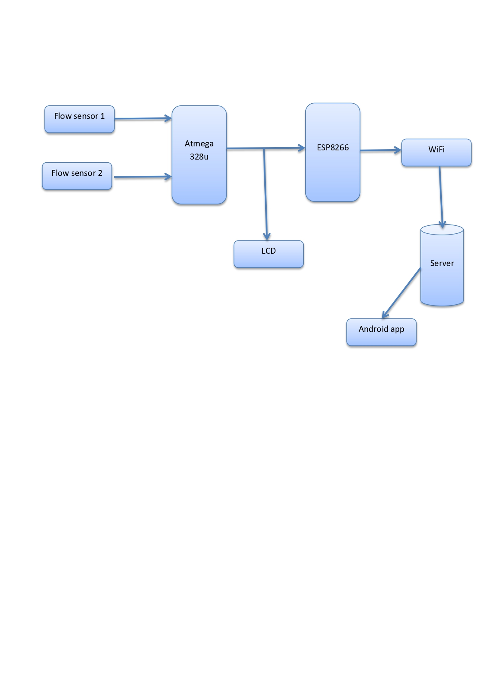
Block Diagram

Slide 8
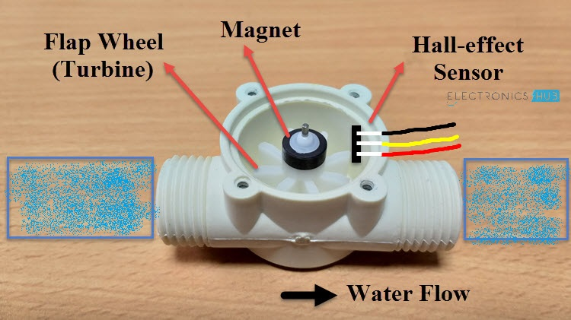
Flow Sensor

Slide 9
Future Scope
This mechanism can be improved with more sensors for large scale
Also in our system we are notifying to one or two users only but in future with the help of satellite we can give preference of number many user and notify only that user which is within the specified area range and near our system

Slide 10
Conclusion
The main goal of this project is to provide an autonomous system that prevents excessive water damage within a household. After working on this project, I better understand the difficulties people face when trying to create a product from scratch. The WLDS detects a water leak anywhere the user chooses to put it and alerts the user with a text message, in case of house vacancy.
Monitor amount of water flowed through
Very helful for residence,muncipalities etc

Slide 11
THANK YOU

