Slide 1


ENHANCING LIVES THROUGH INNOVATIVE TECHNOLOGY
VISION BEYOND SIGHT
Real-Time Object Detection and Speech Feedback System for Visually Impaired Individuals
TEAM MEMBERS
Tufan Layek (RA2411004010209)
Protyay Saha (RA2411004010196)
Adamya Srivastava (RA2411004010190)

Slide 2
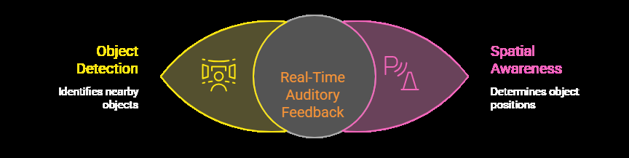
INTRODUCTION
Visually impaired individuals encounter significant obstacles in their daily lives, particularly when navigating unfamiliar environments. While traditional assistive technologies like white canes have been helpful, they offer limited information about the surroundings. Smart glasses, although more advanced, are often prohibitively expensive. Furthermore, many existing systems focus primarily on text recognition, neglecting the crucial aspect of real-time obstacle detection and spatial awareness.
Our proposed solution addresses these shortcomings by integrating object detection and spatial awareness into a text-to-speech system. This enhanced system provides real-time auditory feedback about nearby objects and their positions, enabling visually impaired users to navigate more safely and independently.

Slide 3
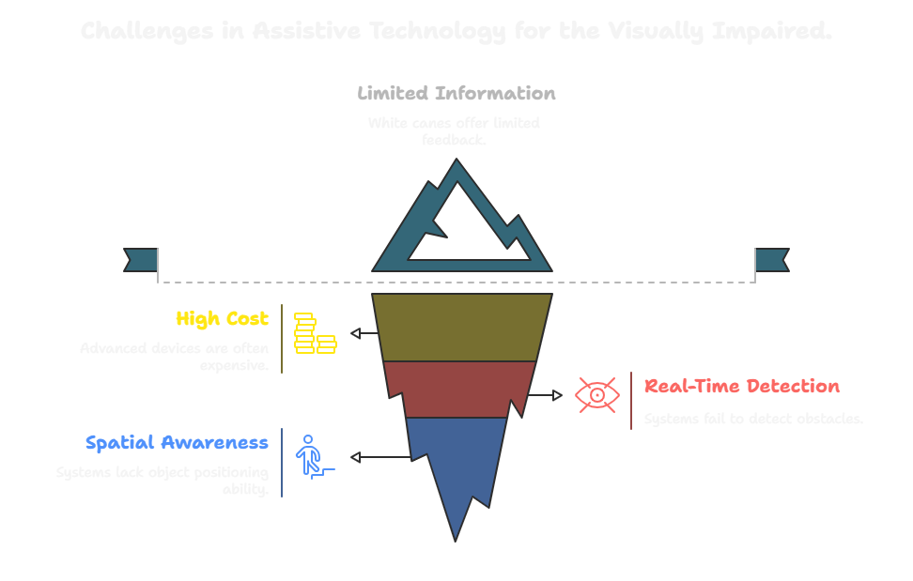
PROBLEM STATEMENT
The core problem lies in the lack of affordable and comprehensive assistive technologies that provide visually impaired individuals with real-time information about their surroundings.

Slide 4
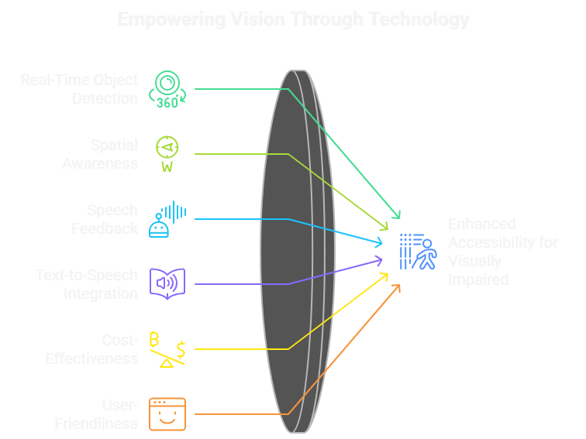
PROPOSED SOLUTION
Our proposed solution involves an enhanced text-to-speech model that incorporates object detection and spatial awareness capabilities. The system utilizes a camera to continuously scan the surroundings, detect nearby objects, and determine their relative position (left, right, or front). This information is then instantly converted into speech output, providing users with real-time alerts about obstacles and their positions.
“The system can be seamlessly integrated with Samsung Galaxy devices and Samsung’s AI ecosystem, allowing real-time visual data processing and voice feedback directly through a Samsung Galaxy smartphone, Galaxy Buds, or Galaxy Watch. This enables hands-free assistance for visually impaired users anywhere, without needing external hardware.”

Slide 5
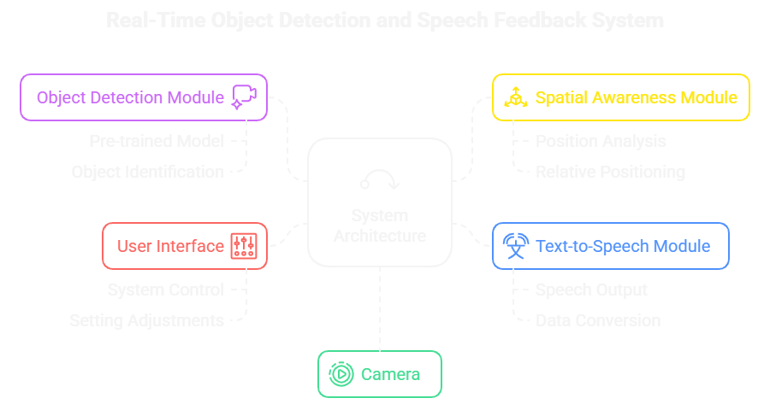
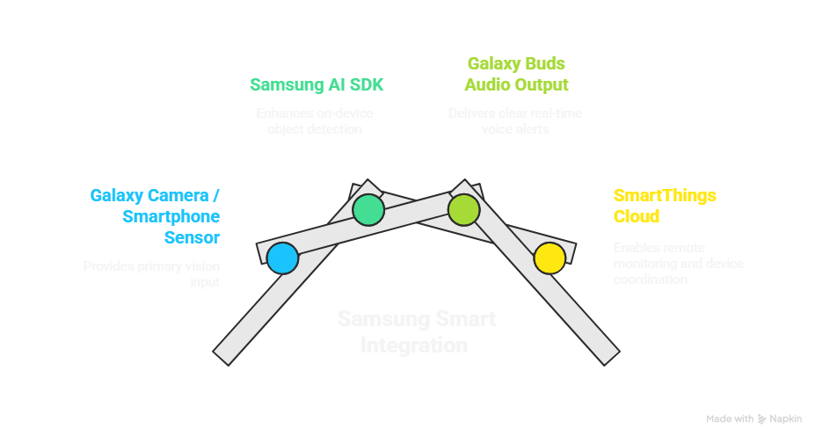
SYSTEM ARCHITECTURE

Slide 6
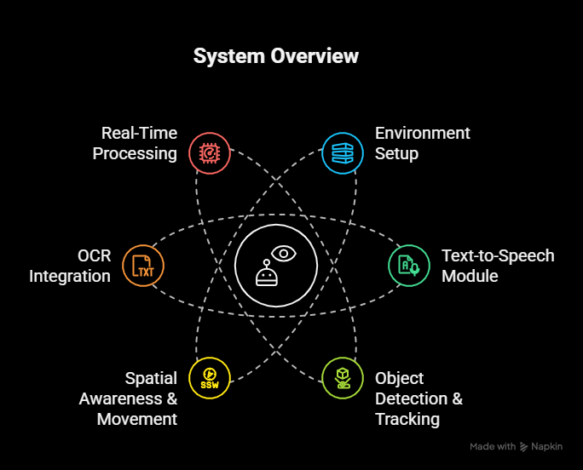
IMPLEMENTATION
Libraries & Models: YOLOv8 for object detection, OpenCV for video, Pytesseract for OCR, Pyttsx3 for TTS.
Object Detection: Camera captures live feed → YOLOv8 detects objects → bounding box size estimates distance (close/medium/far).
Tracking & Movement: Each object assigned ID → centroid tracked → direction & speed calculated → speech alerts given at intervals.
Text Reading (OCR): If a book is detected, text is extracted via Pytesseract and spoken aloud.
Speech Output: Non-blocking TTS thread converts detections into clear real-time audio feedback.
Performance: Runs ~30 FPS, real-time with visual + speech output.
“Samsung Galaxy smartphones with on-device AI acceleration (e.g., Exynos NPU) can run YOLOv8 in real time using Samsung Neural SDK, improving efficiency and reducing latency.”

Slide 7
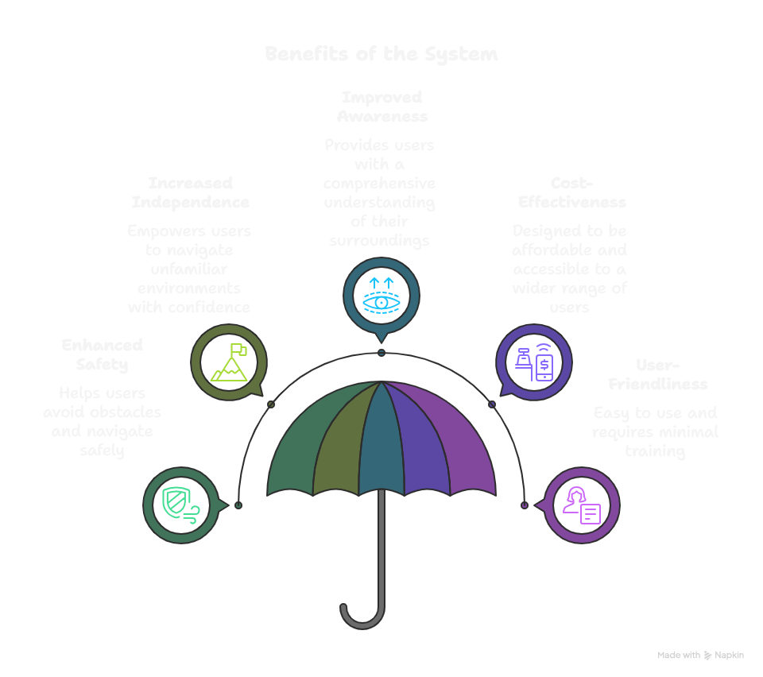

Slide 8
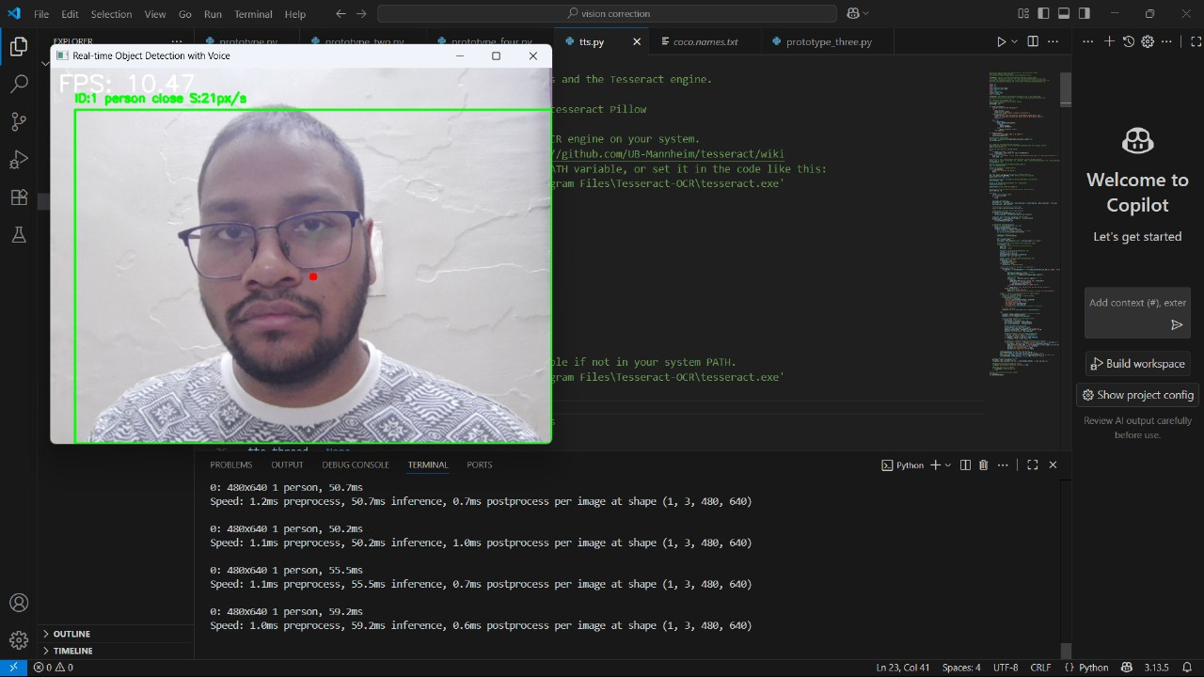
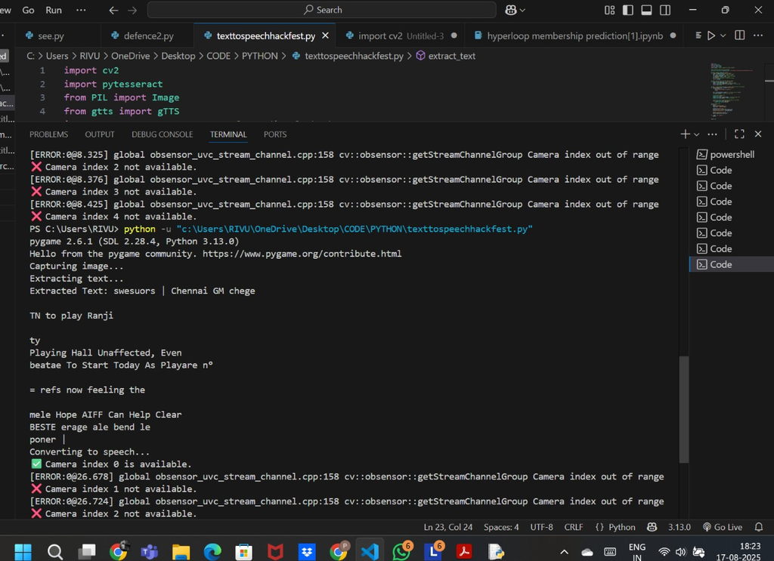
PROTOTYPE
Image recognition
Text to speech

Slide 9
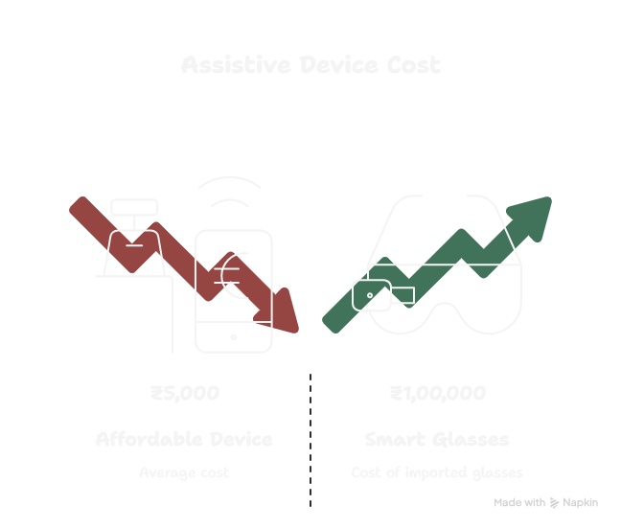
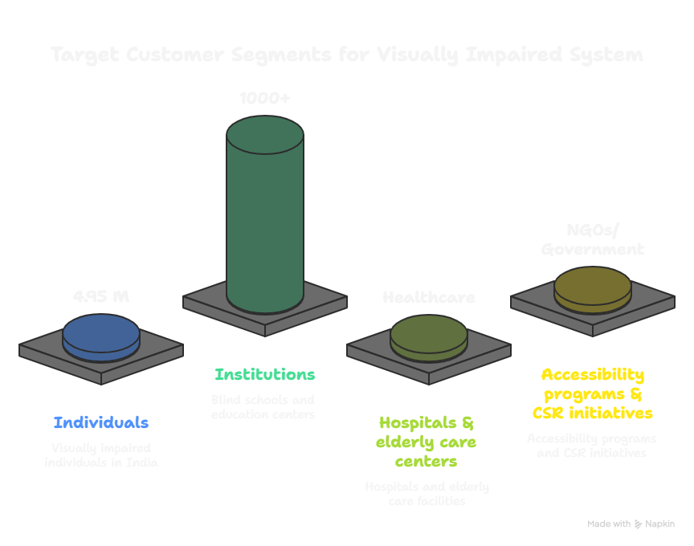
BUSINESS MODEL
“Can be deployed as a Samsung accessibility feature or SmartThings companion app, expanding Samsung’s inclusive technology offerings for differently-abled users.”
Value Proposition
2. Customer Segments

Slide 10
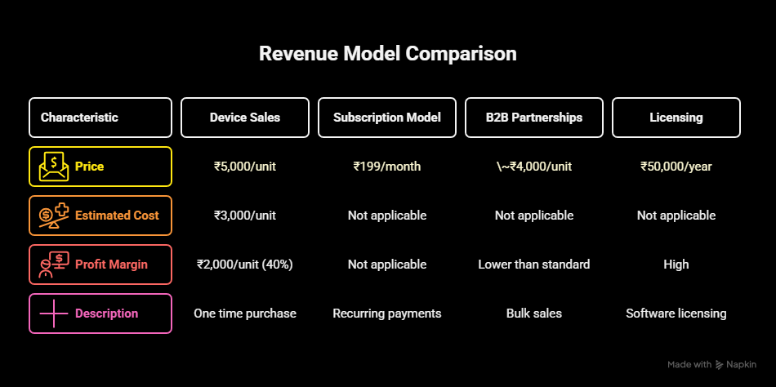
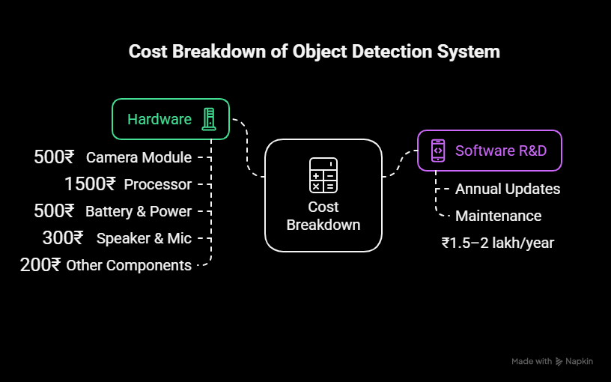
3. Revenue Streams
4. Key Resources (Cost Estimates)

Slide 11
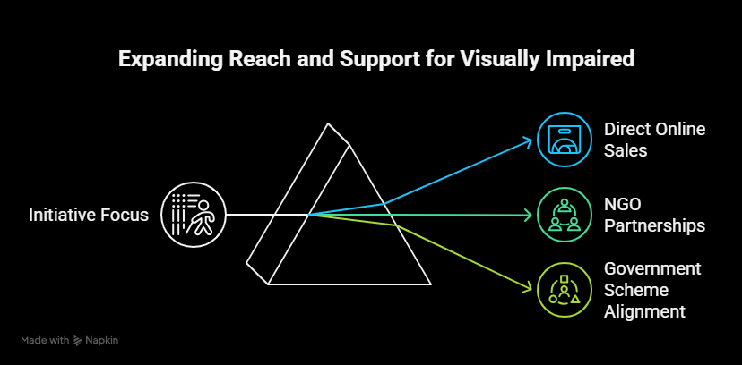
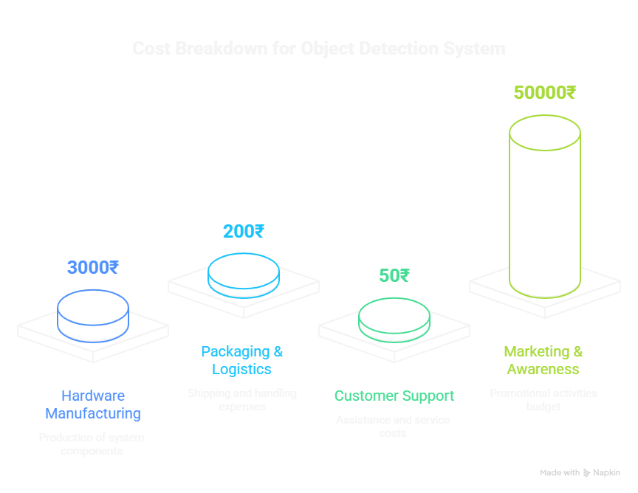
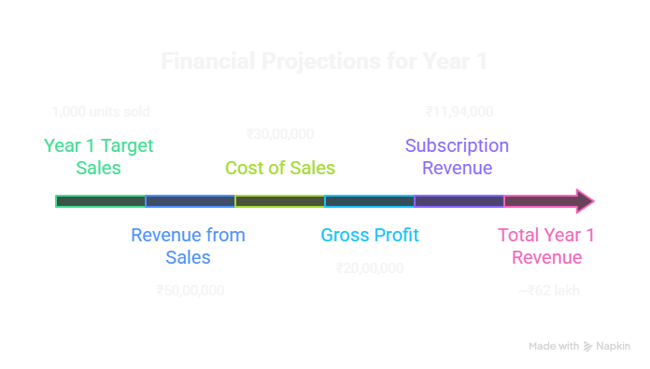
5. Distribution Channels
6. Cost Structure
7. Financial Projection (Example)
“Can be deployed as a Samsung accessibility feature or SmartThings companion app, expanding Samsung’s inclusive technology offerings for differently-abled users.”

Slide 12
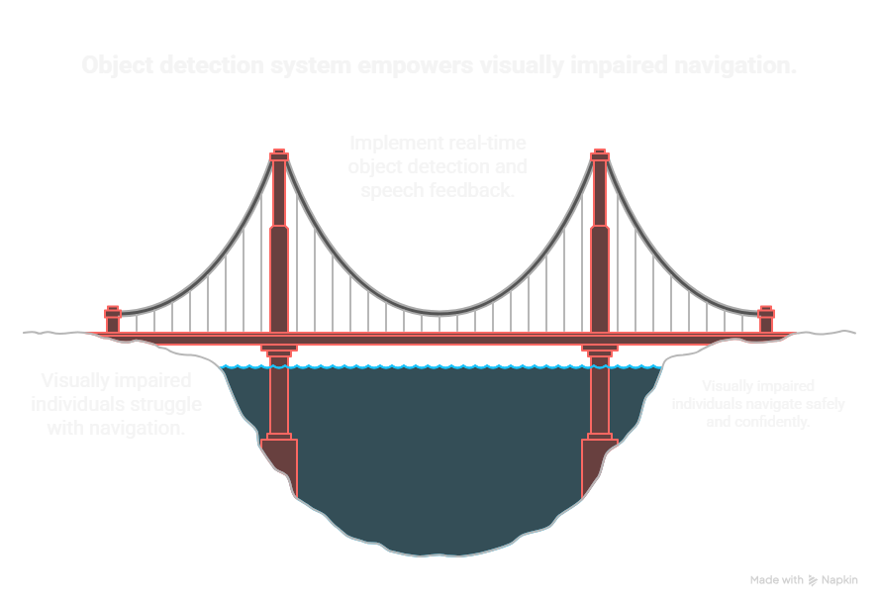
CONCLUSION
The proposed real-time object detection and speech feedback system empowers visually impaired individuals to navigate safely and independently through intelligent object recognition, spatial awareness, and voice guidance.
It is cost-effective, portable, and user-friendly, making it a strong alternative to existing assistive technologies.
By leveraging Samsung’s AI hardware, SmartThings connectivity, and Bixby voice technology, the solution aligns with Samsung’s vision of “Technology for Humanity,” enabling greater independence, confidence, and inclusivity for visually impaired users.

Slide 13
Thank You

