Slide 1

Student Name: -Kumbhar Dilip
College Name: - Indus University
Internship: - Cyber Security Internship
Organization: - DG Intern Hub
Week 7 Assignment: - VAPT (WEB APPLICATION TESTING WITH BURP SUITE)
SID: - dg/September/cyber/264
Mail: - dilipkumbhar.dginternshub@gmail.com
Task 7: - Theory + Practical

Slide 2
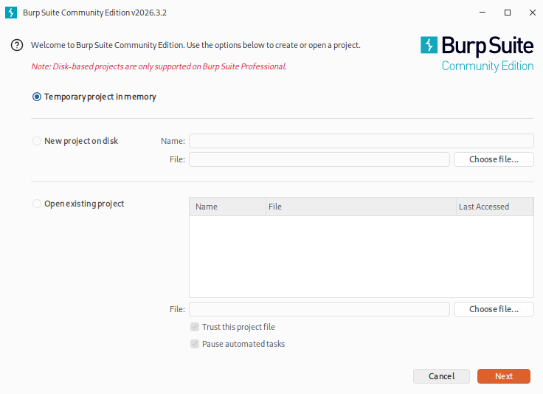
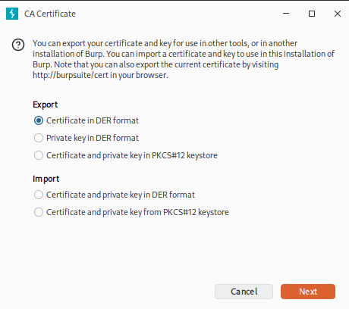
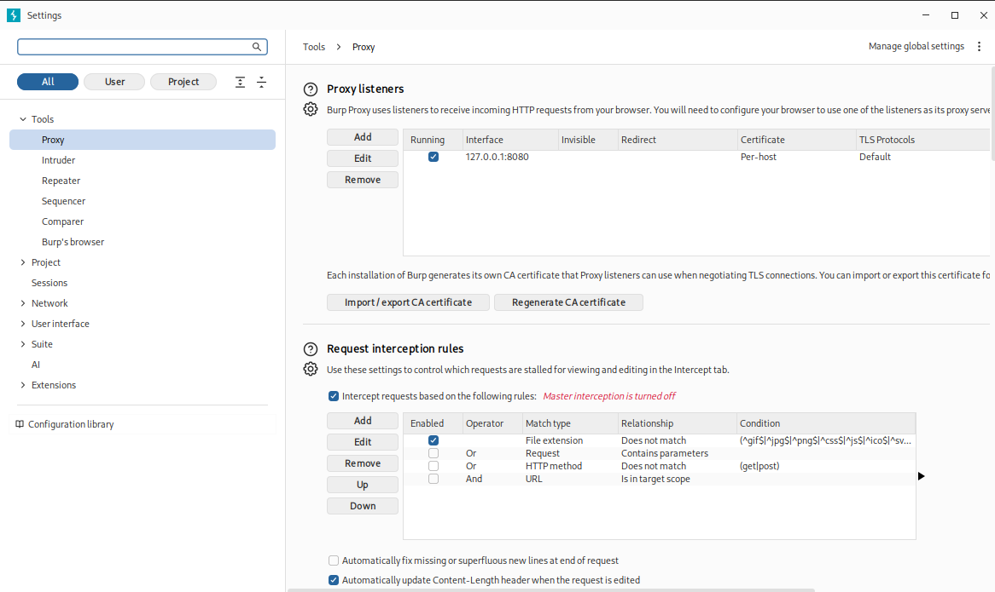
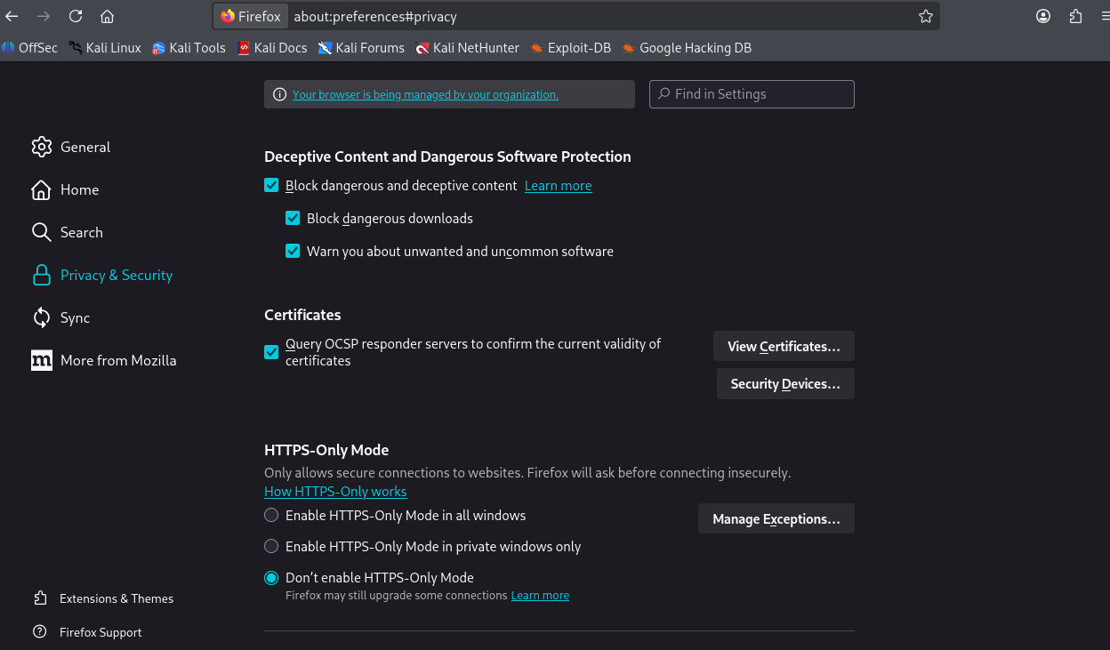
Task 22: Burp Suite Setup & Interception Install Burp Suite Community Edition
Open Burp Suite and select Temporary project in memory.
Go to Settings → Proxy and check that 127.0.0.1:8080 is running.
Configure Firefox to use the Burp proxy.
Download and import Burp’s CA certificate into Firefox.
Open Proxy → Intercept and turn interception on.

Slide 3
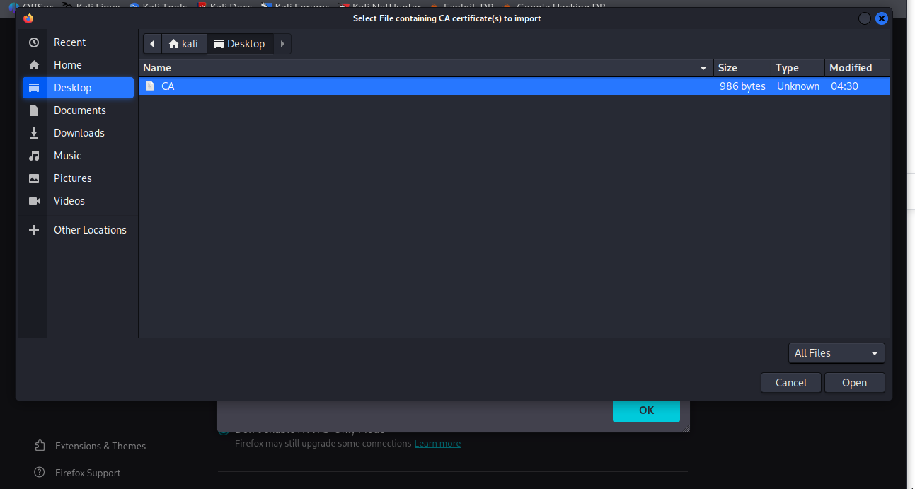
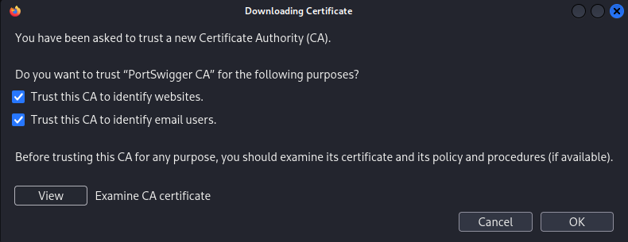
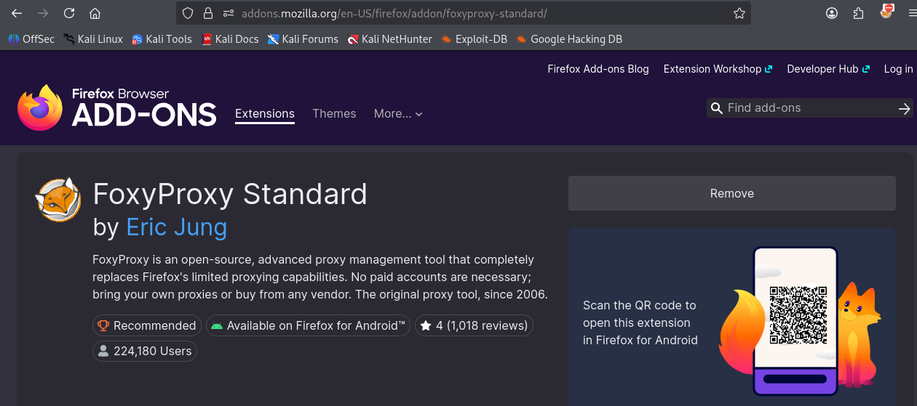
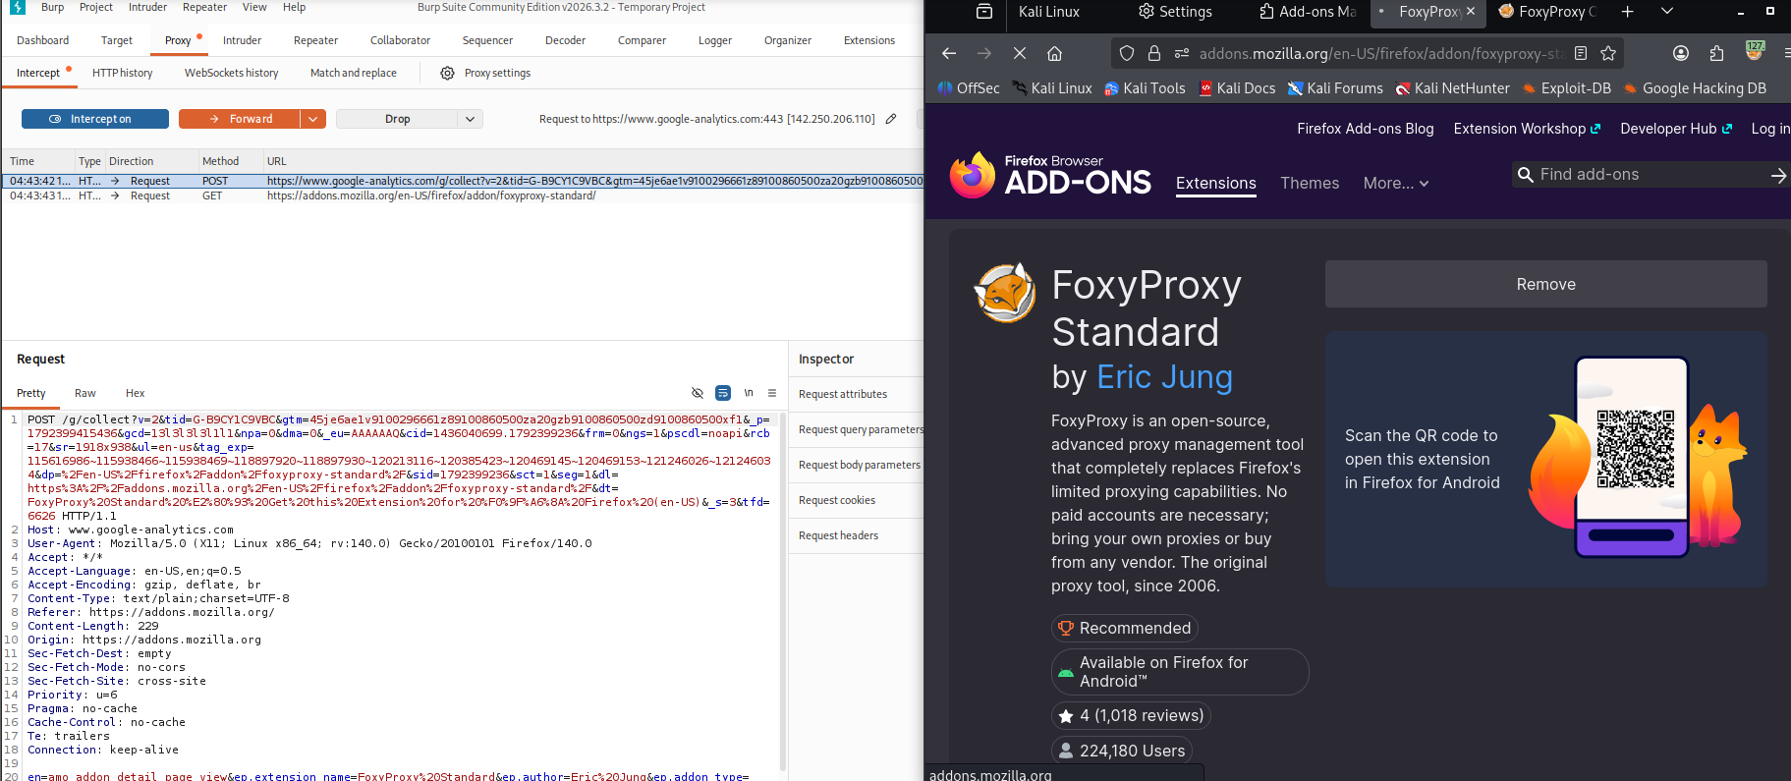
Visit a practice website and log in using a test account.
Analyze the captured request, including its method, URL, headers, and parameters.
Click Forward and check the server response in HTTP history.
Take screenshots of the captured request and response, hiding sensitive information.

Slide 4
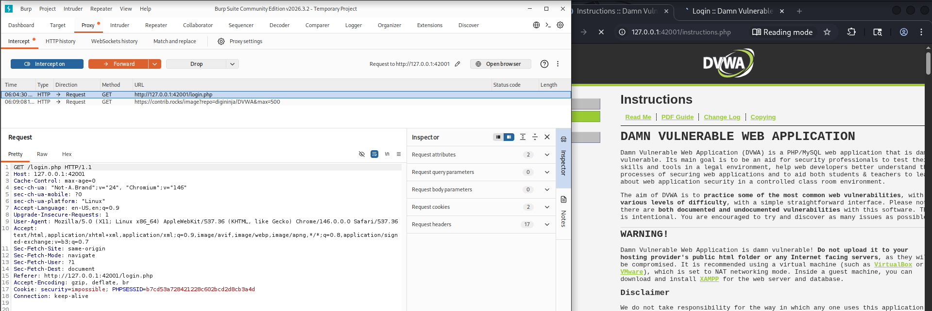
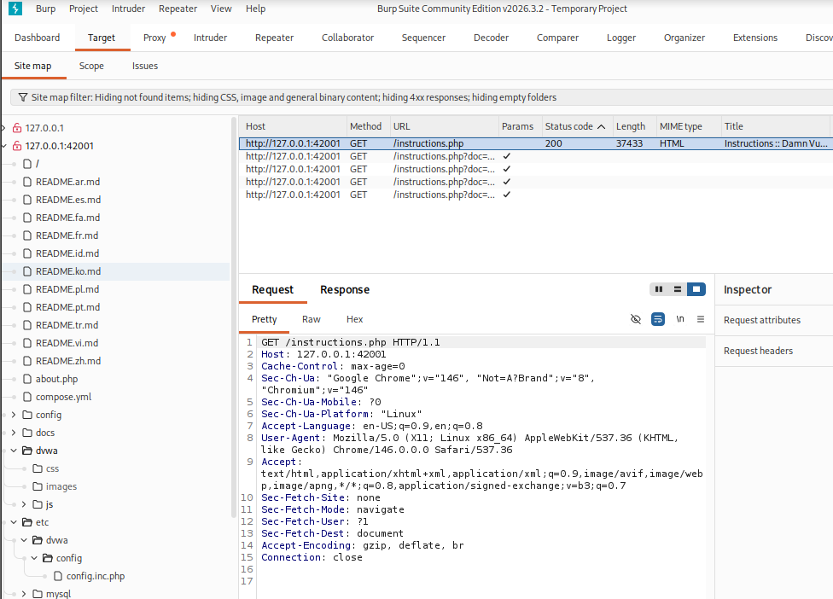
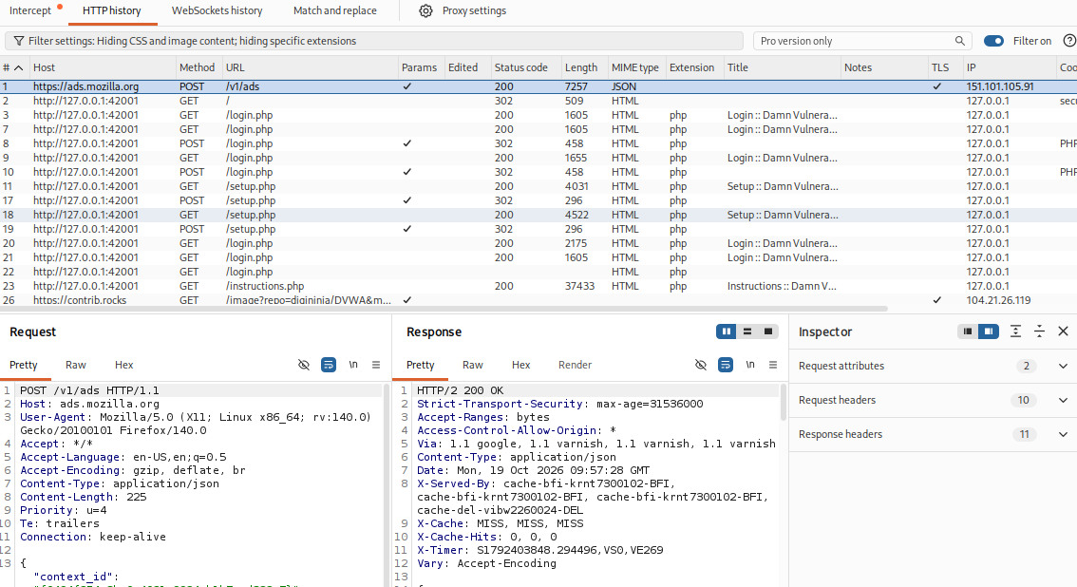
Task 23: Recon + Mapping Web Application Use Burp Proxy + Target Tab

Slide 5
Steps to Perform
Open Burp Suite and configure the browser proxy.
Open the DVWA application at http://127.0.0.1:42001/.
Browse the application and its available pages.
Go to Target → Site map and expand the target host.
Open Proxy → HTTP history to review requests and responses.
Identify endpoints, HTTP methods (GET/POST), and request parameters.
Record the findings in an attack-surface table.
Analysis
Burp Suite captures HTTP traffic and displays discovered endpoints in the site map. Login forms and request parameters identify areas for further security testing. The site map may not include pages that were not visited.
Result
The application's observed endpoints and HTTP methods were mapped, and potential security testing areas were identified.
Attack-Surface Table
Endpoint | Method | Purpose | Testing Focus
/login.php | GET/POST | User login | Authentication
/setup.php | GET/POST | Application setup | Access control
/instructions.php | GET | Instructions page | Access control
/instructions.php?doc=... | GET | Document-related request | Parameter validation

Slide 6
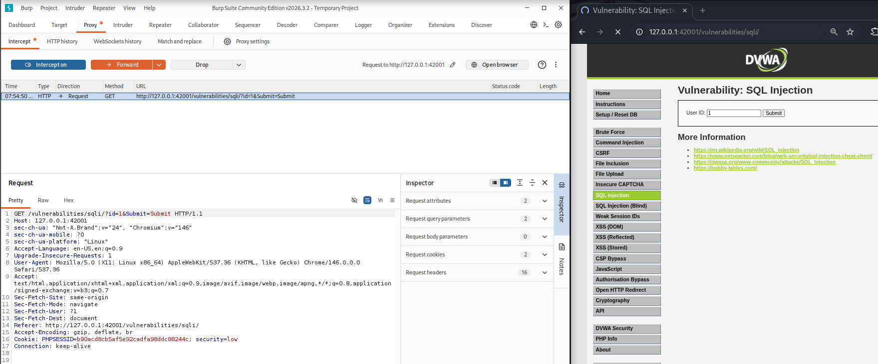
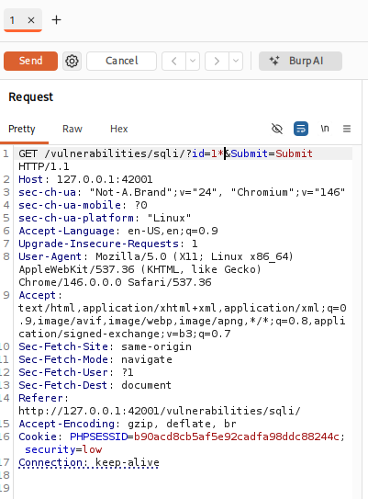
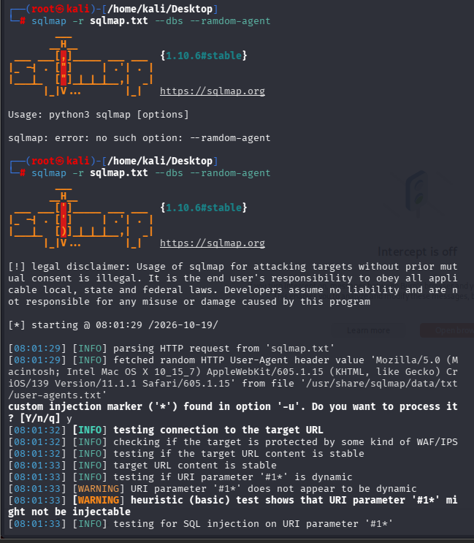
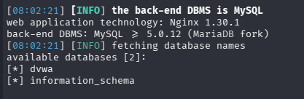
Task 24: Vulnerability Testing (Manual + Burp Tools)Use Burp tools like Repeater & Intruder:
SQL Injection
Open DVWA SQL Injection page.
Capture the GET request using Burp Suite.
Save the request as sqlmap.txt.
Test the request using sqlmap.
Identify the MySQL database.
Enumerate tables in the dvwa database.
Tables found: guestbook and users.
Dump the users table in the authorized lab.
Review the output files.

Slide 7
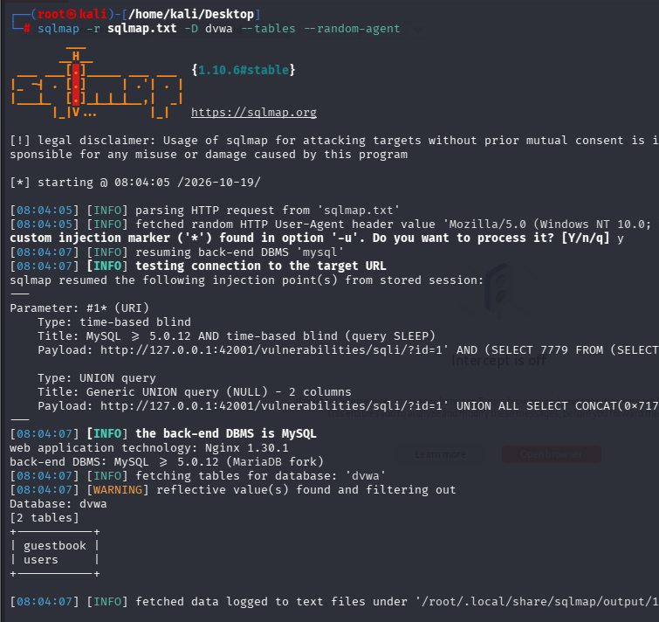
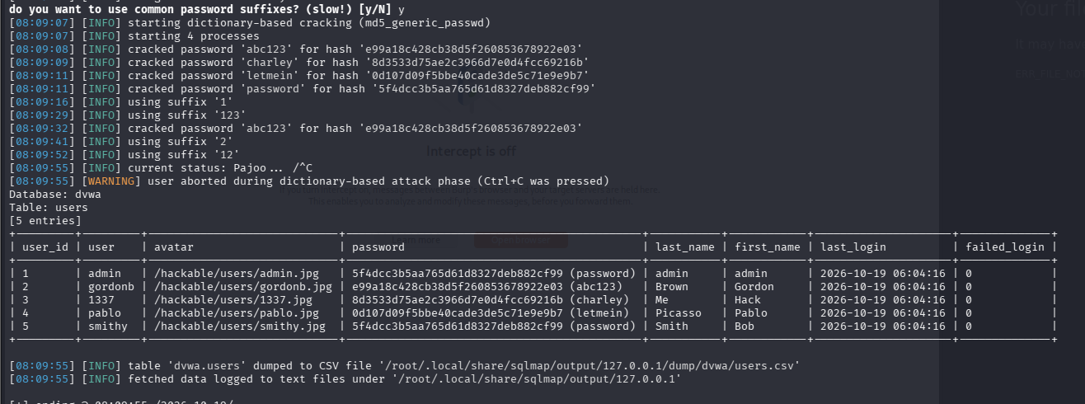
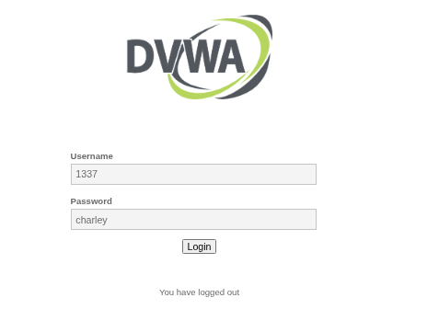
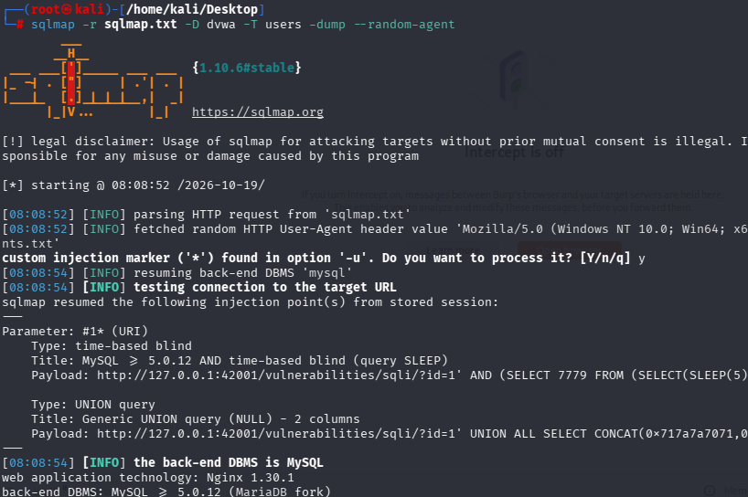

Slide 8
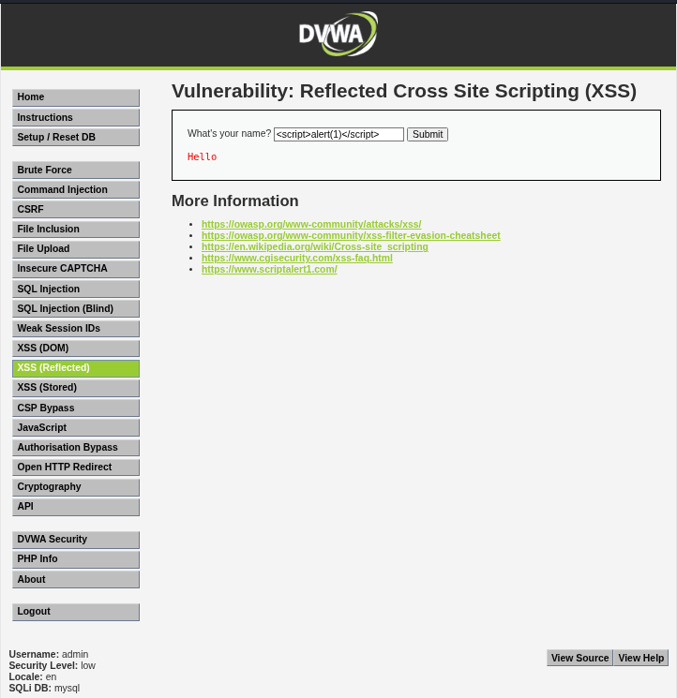
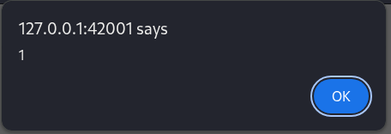
XSS (Cross-Site Scripting)
Find a search box or another input field.
In your authorized lab, test a harmless proof-of-concept payload such as <script>alert(1)</script>.
Observe whether the input is safely encoded or executed by the browser.
Determine whether the issue is reflected, stored, or DOM-based XSS.

Slide 9
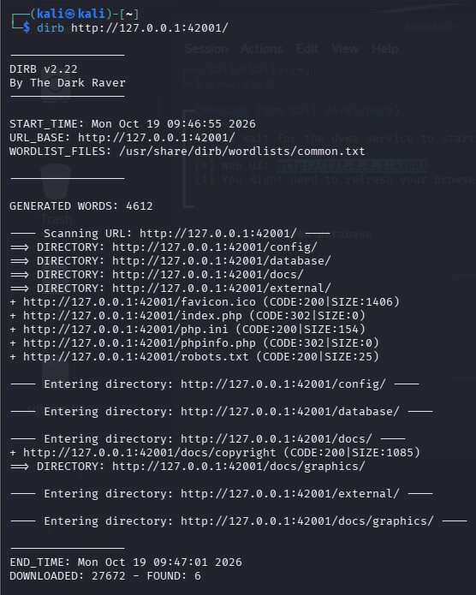
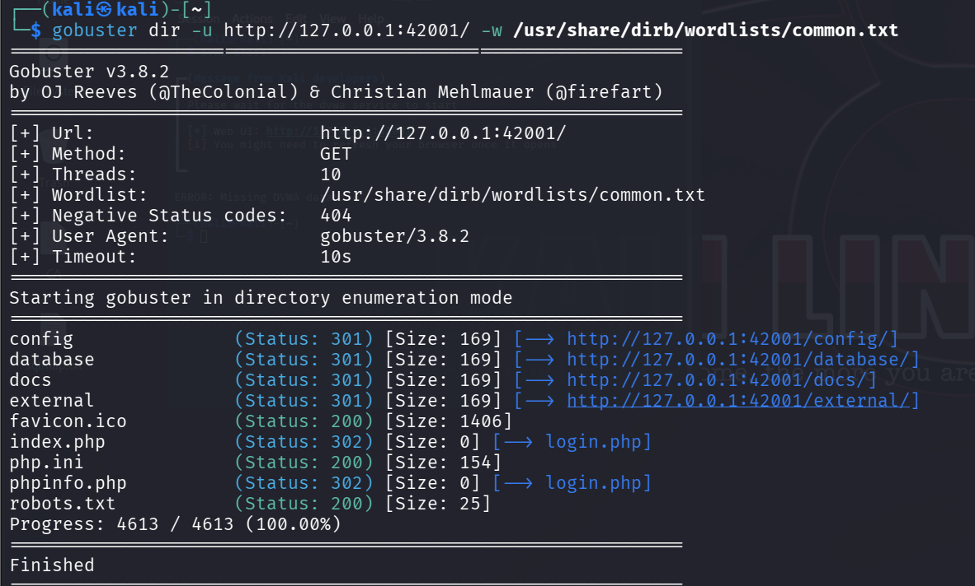
Task 25: Directory & Endpoint DiscoveryUse:
1. Scan using DIRB
Open the Kali Linux terminal and run:
bash
dirb http://127.0.0.1:42001/
dirb starts the directory scan.
http://127.0.0.1:42001/ is the target URL.
DIRB uses its default wordlist to find hidden directories and files.
Results found: config/, database/, docs/, external/, index.php, php.ini, phpinfo.php, and robots.txt.
2. Scan using Gobuster
Run the following command:
bash
gobuster dir -u http://127.0.0.1:42001/ -w /usr/share/dirb/wordlists/common.txt
gobuster dir starts directory enumeration.
-u specifies the target URL.
-w specifies the wordlist.
Gobuster checks the paths listed in the wordlist.

Slide 10


