Slide 1

Student Name: -Kumbhar Dilip
College Name: - Indus University
Internship: - Cyber Security Internship
Organization: - DG Intern Hub
Week 8 Assignment: - Advanced VAPT – Attack Chain & Full Exploitation Project
SID: - dg/September/cyber/264
Mail: - dilipkumbhar.dginternshub@gmail.com
Task 8: - Theory + Practical

Slide 2
Project Objective
What is Attack Chain Testing?
Attack chain testing means connecting multiple security weaknesses to understand how they could lead to a bigger security problem.
Identify entry points in the application.
Test authentication and access controls.
Analyse requests using Burp Suite.
Understand the combined security impact.
Recommend fixes to prevent attacks.
Objective:- Instead of finding isolated vulnerabilities, perform a complete attack chain by combining multiple weaknesses to demonstrate how a real attacker compromises a system.
Target: OWASP Juice Shop, DVWA, Metasploit
Tool: Burp Suite

Slide 3
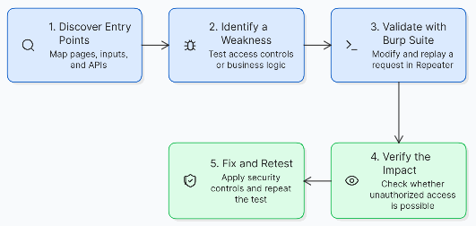
Attack Surface Mapping
Identify the application's entry points.
Login and Registration
Check authentication and input validation.
Input Fields and Parameters
Inspect search, profile, and request values.
APIs and Sessions
Review API endpoints, tokens, and permissions.
Tool: Burp Suite Proxy and Target Site map.
Attack Flow Diagram

Slide 4
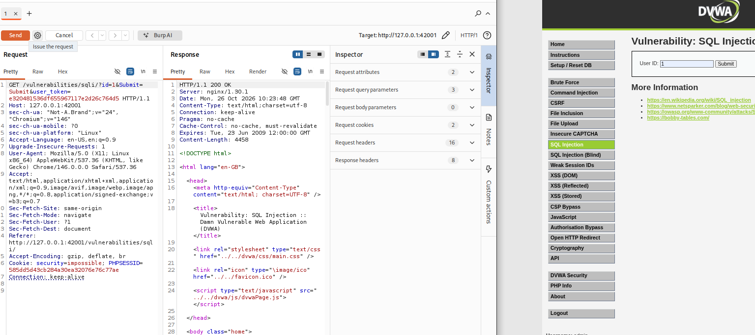
Key Vulnerabilities and Exploitation Steps:-
Vulnerabilities to investigate
Vulnerability | Simple explanation
IDOR | Accessing another user's data without permission.
Parameter Tampering | Changing request values to test server-side validation.
Business Logic Flaw | Using an application workflow in an unintended way.
Session Weakness | Improper handling or validation of sessions.
Testing steps using Burp Suite:
Log in to your authorized test application.
Capture a request in Proxy HTTP history.
Send the request to Repeater.
Change a test parameter or resource ID.
Compare the response with the expected result.
Save evidence if the weakness is confirmed.
Note: These are testing targets, not claims that every vulnerability exists in your application.

Slide 5
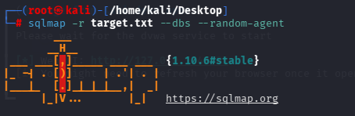
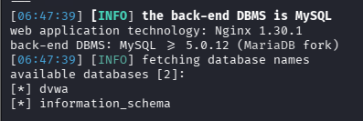
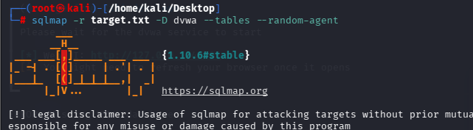
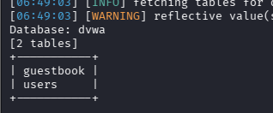
Final Impact and Risk Analysis
What could happen if vulnerabilities are chained together?
Data Exposure
Unauthorized access to private user information.
Account Compromise
Possible misuse of an account if authentication or authorization fails.
Business Risk
Privacy loss, financial damage, and reduced customer trust.
Severity: Low / Medium / High / Critical, depending on the verified impact and exploitability.

Slide 6
How to Fix the Vulnerabilities
Access Control: Check user permissions on every protected server-side request.
  Example:- if (user.role !== "admin") {
  return res.status(403).json({
  error: "Access denied"
  });
  }
IDOR: Verify resource ownership before returning or modifying data.
  Example of an IDOR vulnerability
  Request made by User A
  GET /api/profile/101
  The server returns User A's profile.
  Attack attempt
  GET /api/profile/102
  If the server returns User B's profile without checking ownership, an IDOR vulnerability exists.
  How it Fixed:-
  const profile = await db.profile.findFirst({
  where: {
  id: requestedId,
  userId: loggedInUser.id
  }
  });
  if (!profile) {
  return res.status(404).json({
  error: "Profile not found"
  });
  }
Session Security: A session identifies a logged-in user. If an attacker steals or abuses a session, they may be able to act as that user.
How to fix it:
Secure cookies: Use HttpOnly, Secure, and an appropriate SameSite setting.
Session rotation: Generate a new session ID after login and after important privilege changes.
Session expiration: Expire sessions after a suitable period of inactivity and enforce an absolute lifetime.
Logout: Invalidate the session on the server when the user logs out.
HTTPS: Protect session information while it travels between the browser and server.
app.use(session({
secret: process.env.SESSION_SECRET,
cookie: {
httpOnly: true,
secure: true,
sameSite: "lax",
maxAge: 30 * 60 * 1000
},
resave: false,
saveUninitialized: false
}));

Slide 7
Conclusion: Advanced VAPT
Advanced VAPT (Vulnerability Assessment and Penetration Testing) helps identify security weaknesses in a web application and understand how multiple vulnerabilities can combine to create serious security risks.
By identifying vulnerabilities, safely demonstrating their impact, and implementing appropriate security fixes, we can prevent unauthorized access, protect sensitive data, and improve the overall security of the application.
The main goal of Advanced VAPT is to find vulnerabilities before attackers exploit them, fix them effectively, and retest the application to ensure that it is secure.
References
OWASP Juice Shop – Vulnerable web application for security testing
https://owasp.org/www-project-juice-shop/
OWASP Top 10 – Common web application security risks
https://owasp.org/www-project-top-ten/
OWASP Web Security Testing Guide (WSTG) – Web application testing methods
https://owasp.org/www-project-web-security-testing-guide/
OWASP API Security Top 10 – API security risks and prevention
https://owasp.org/www-project-api-security/
PortSwigger Web Security Academy – Burp Suite tutorials and practical labs
https://portswigger.net/web-security
Burp Suite Documentation – Proxy, Repeater, and request analysis
https://portswigger.net/burp/documentation
Note: Practical testing and screenshots are based on my own authorized lab work for the DG Interns Hub Week 8 Advanced VAPT project.

Slide 8
