Slide 1
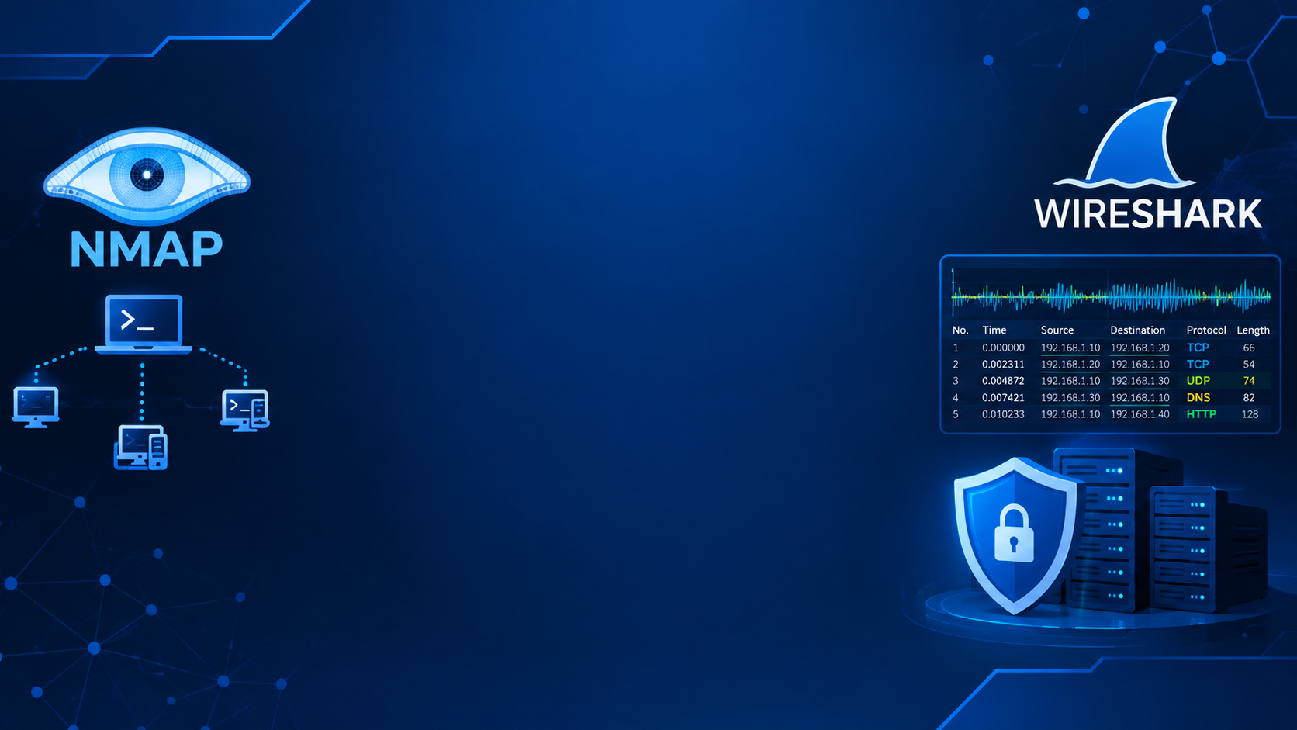
Student name: -kumbhar dilip
College name: - Indus university
Week 3 assignment: - advanced cybersecurity practical task
Sid: - dg/September/cyber/264
Mail: - dilipkumbhar.Dginternshub@gmail.Com
Task 2: - theory + practical
Required tools install/use the following:-
kali Linux / ubuntu / windows
- Nmap
- Wireshark
- VirtualBox or VMware
2–3 authorized VMs for the practical lab
Draw. io / diagrams.net for network topology
GitHub for project documentation and files

Slide 2
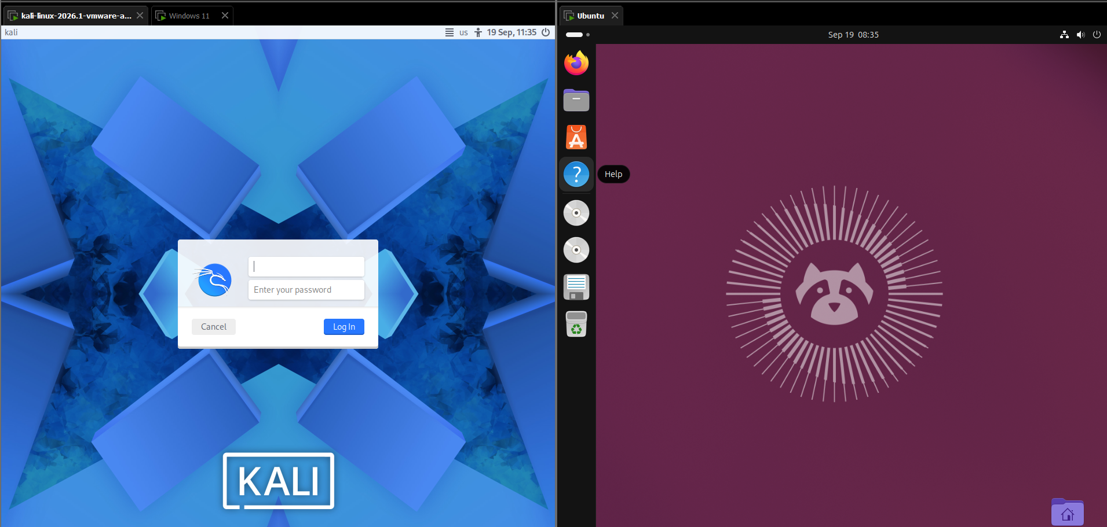
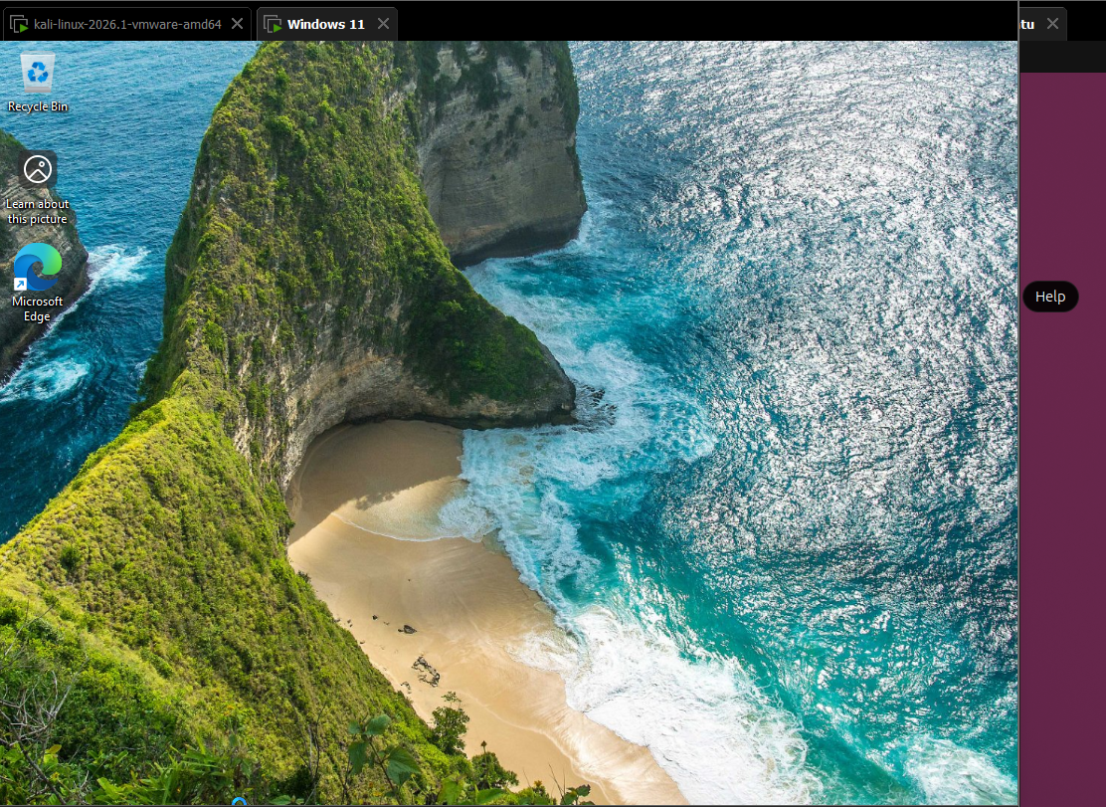
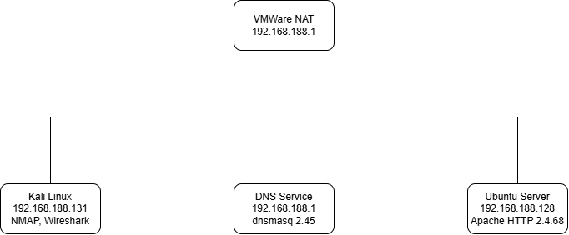
Objective Understand how a security analyst discovers devices and exposed network services.
Step 1: Start the Lab
Open VirtualBox.
Start:
Kali Linux
Ubuntu VM
Optional Windows VM

Slide 3
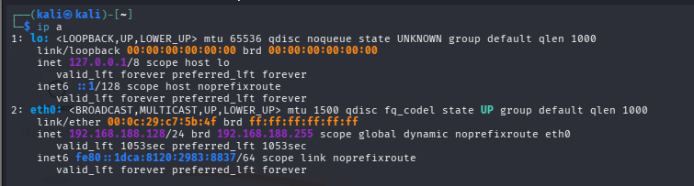
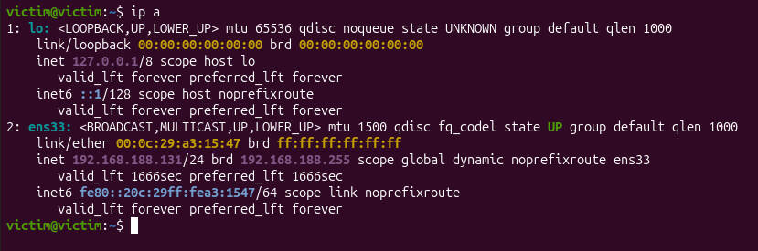
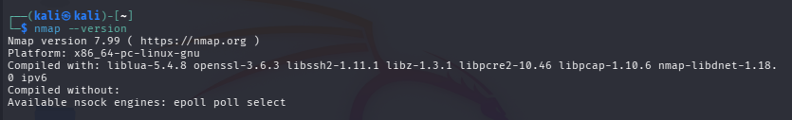
Step 2: Check Network Configuration
First identify the network details.
On Kali Linux
Open Terminal.
Run:
ip addr
This displays:
IP address :- 192.168.188.131/24
Subnet :- 255.255.255.0 (/24)
Network interface :- 192.168.188.0/24
Step 4: Verify Nmap Installation
On Kali:
nmap --version

Slide 4
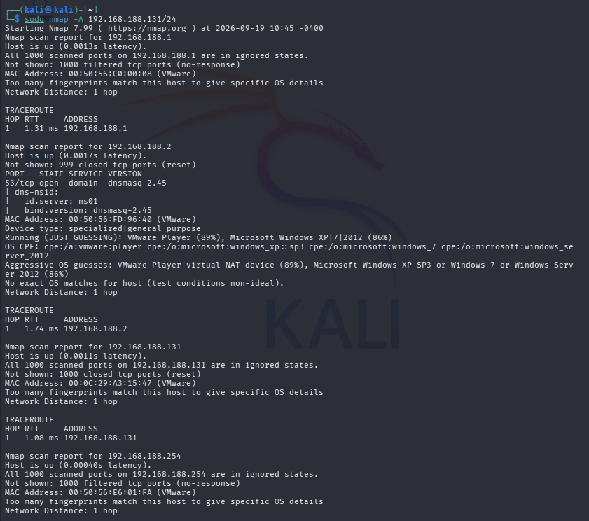
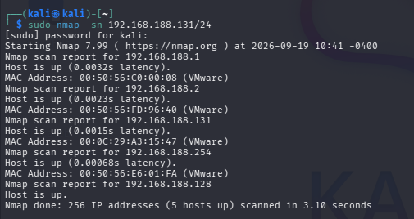
Step 5: Perform Host Discovery
Host discovery identifies active devices.
Command:
nmap -sn 192.168.188.131/24
Explanation:
-sn
Finds live hosts
Does not perform port scanning
Command:
nmap -A 192.168.188.131/24
Explanation:
-A
OS detection
Version detection
Script scanning
Traceroute

Slide 5
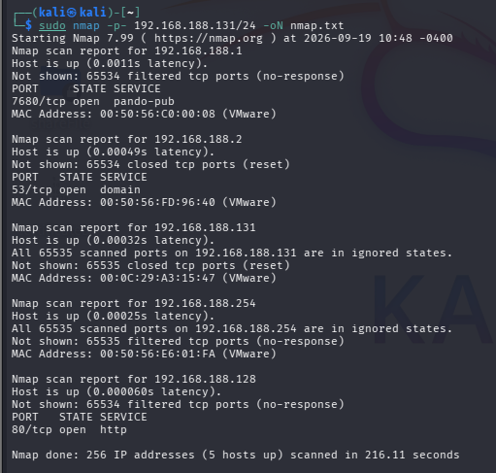
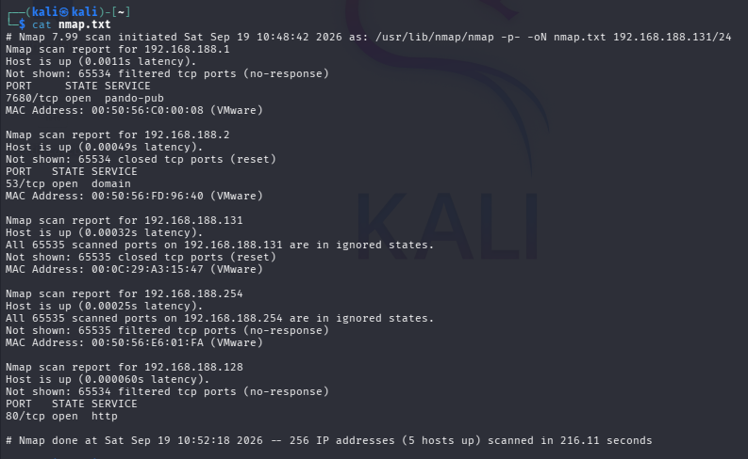
Step 6: Nmap Network Scanning and Port Enumeration
192.168.188.1 — TCP 7680 open (pando-pub)
192.168.188.2 — TCP 53 open (domain/DNS)
192.168.188.131 — no open TCP ports detected
192.168.188.254 — no open TCP ports detected
192.168.188.128 — TCP 80 open (HTTP)

Slide 6
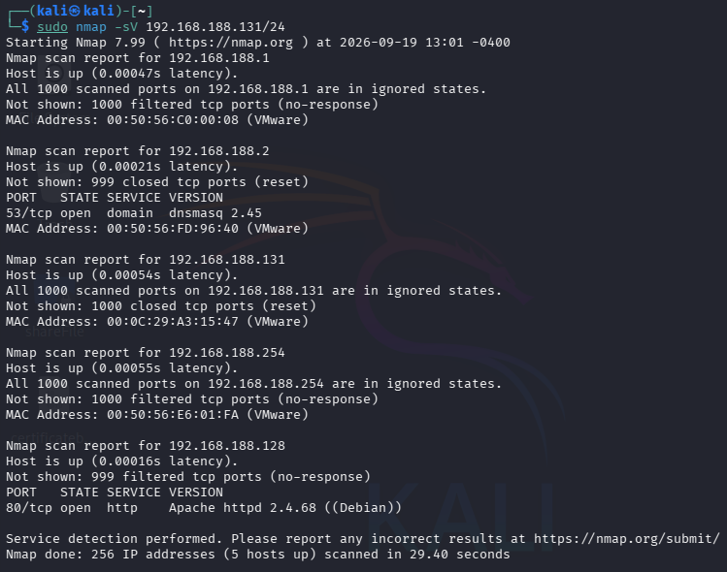
TASK 8 – Advanced Nmap Security Assessment
Objective Perform a more detailed assessment of your authorized lab machines.
Sudo nmap –sV <target-IP>
What service is running?
Ans. The scan shows DNS service (dnsmasq 2.45) running on TCP port 53 on 192.168.188.2.
Why is the service required?
Ans. DNS is required to translate domain names into IP addresses, allowing devices to access websites and other network services using names instead of IP addresses.
Is it necessary to expose it?
Ans. It should only be exposed to trusted clients that need DNS access. It does not need to be publicly accessible unless there is a specific requirement.
What could happen if the service is vulnerable?
Ans. An attacker could potentially intercept or manipulate DNS requests, obtain network information, or compromise the system, depending on the vulnerability.
How could it be secured?
Ans. Keep dnsmasq updated, restrict port 53 using a firewall, allow DNS requests only from trusted networks, disable unnecessary features, and monitor DNS activity regularly.

Slide 7
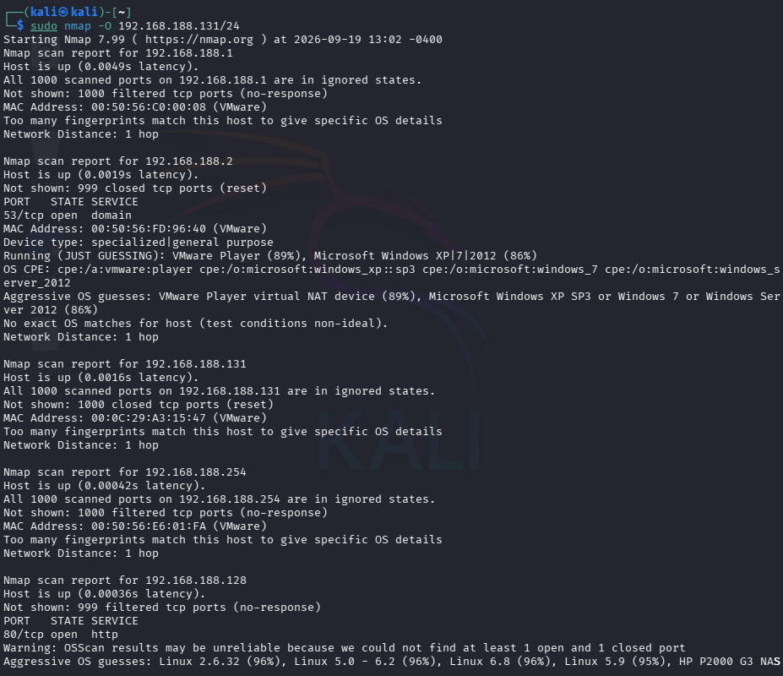
Sudo nmap -O <target-ip>
What service is running?
Ans. The scan shows DNS service (dnsmasq 2.45) running on TCP port 53 on 192.168.188.2.
Why is the service required?
Ans. DNS is required to translate domain names into IP addresses, allowing devices to access websites and other network services using names instead of IP addresses.
Is it necessary to expose it?
Ans. It should only be exposed to trusted clients that need DNS access. It does not need to be publicly accessible unless there is a specific requirement.
What could happen if the service is vulnerable?
Ans. An attacker could potentially intercept or manipulate DNS requests, obtain network information, or compromise the system, depending on the vulnerability.
How could it be secured?
Ans. Keep dnsmasq updated, restrict port 53 using a firewall, allow DNS requests only from trusted networks, disable unnecessary features, and monitor DNS activity regularly.

Slide 8
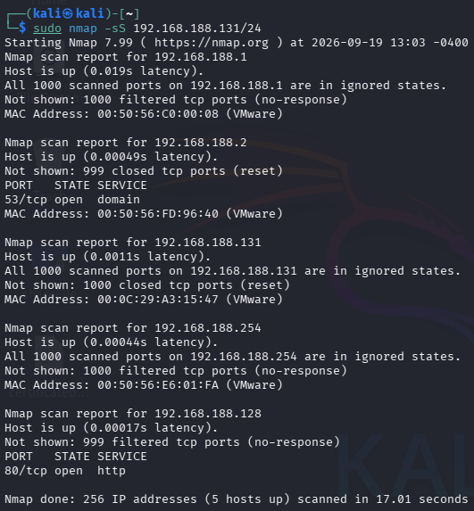
Sudo nmap -sS <target-ip>
What service is running?
Ans. The scan shows DNS service (dnsmasq 2.45) running on TCP port 53 on 192.168.188.2.
Why is the service required?
Ans. DNS is required to translate domain names into IP addresses, allowing devices to access websites and other network services using names instead of IP addresses.
Is it necessary to expose it?
Ans. It should only be exposed to trusted clients that need DNS access. It does not need to be publicly accessible unless there is a specific requirement.
What could happen if the service is vulnerable?
Ans. An attacker could potentially intercept or manipulate DNS requests, obtain network information, or compromise the system, depending on the vulnerability.
How could it be secured?
Ans. Keep dnsmasq updated, restrict port 53 using a firewall, allow DNS requests only from trusted networks, disable unnecessary features, and monitor DNS activity regularly.

Slide 9
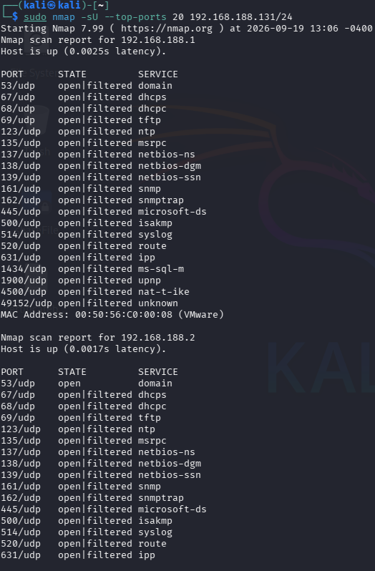
Sudo nmap -sU --top-ports 20 <target-ip>
1. What service is running?
Ans. The service running is DNS (Domain Name System) on UDP port 53. DNS converts website names like google.com into IP addresses.
2. Why is the service required?
Ans. DNS is required to help devices find servers using domain names instead of IP addresses.
It makes network communication easier and more user-friendly.
3. Is it necessary to expose it?
Ans. DNS only needs to be exposed if other devices or users need to use this DNS server.
If it is only for internal use, access should be limited to the internal network.
4. What could happen if the service is vulnerable?
Ans. An attacker could abuse a vulnerable DNS service to redirect users or gather network information.
Poorly secured DNS servers can also be misused for attacks such as DNS amplification.
5. How could it be secured?
Ans. Keep the DNS software updated and allow DNS requests only from trusted networks.
Disable unnecessary features, use firewall rules, and monitor DNS traffic for unusual activity.

Slide 10
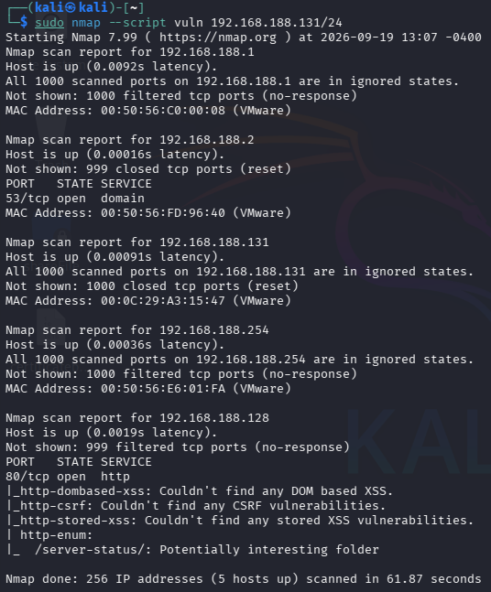
Sudo nmap --script vuln <target_IP>
1. What service is running?
Ans. The service running is HTTP (web server) on TCP port 80.
It provides a website or web application that users can access through a browser.
2. Why is the service required?
Ans. HTTP is required to make the website or web application available to users. It allows browsers and the web server to communicate and exchange web pages.
3. Is it necessary to expose it?
Ans. It should only be exposed if users need to access the web application. If it is an internal application, access should be limited to trusted users or networks.
4. What could happen if the service is vulnerable?
Ans. An attacker could exploit weaknesses in the web application to access or modify information.
The scan also found a potentially interesting /server-status/ folder, which should be checked and restricted if unnecessary.
5. How could it be secured?
Ans. Keep the web server and application updated and restrict access to sensitive pages such as /server-status/.
Use HTTPS, strong authentication, proper access controls, and regularly scan the application for vulnerabilities.

Slide 11
Final Nmap Security Assessment Table
Sr No. | IP Address | Port | Protocol | Service | Version | Risk | Observation
1 | 192.168.188.1 | No open ports | TCP | None | Not detected | Low | All 1000 TCP ports were filtered; likely VMware gateway or firewall-protected host.
2 | 192.168.188.1 | 53 | UDP | DNS | Not detected | Low | UDP scan showed open|filtered, indicating the service may be available but was not confirmed.
3 | 192.168.188.2 | 53 | TCP | DNS | dnsmasq 2.45 | Medium | DNS service detected and used for network name resolution.
4 | 192.168.188.2 | 53 | UDP | DNS | Not detected | Medium | UDP DNS service responded as open|filtered during the top-20 UDP scan.
5 | 192.168.188.2 | 67 | UDP | DHCP Server | Not detected | Medium | DHCP-related traffic appears available for network configuration.
6 | 192.168.188.2 | 68 | UDP | DHCP Client | Not detected | Low | Client-side DHCP service detected as open|filtered.
7 | 192.168.188.2 | 69 | UDP | TFTP | Not detected | Medium | TFTP service appears open|filtered and should be restricted if unused.
8 | 192.168.188.2 | 123 | UDP | NTP | Not detected | Low | Time synchronization service detected as open|filtered.
9 | 192.168.188.131 | No open ports | TCP | None | Not detected | Low | All scanned TCP ports were closed; no exposed services were found.
10 | 192.168.188.254 | No open ports | TCP | None | Not detected | Low | All TCP ports were filtered, indicating restricted access.
11 | 192.168.188.128 | 80 | TCP | HTTP | Apache httpd 2.4.68 (Debian) | Medium | Web server is accessible and running on Debian Linux.

Slide 12
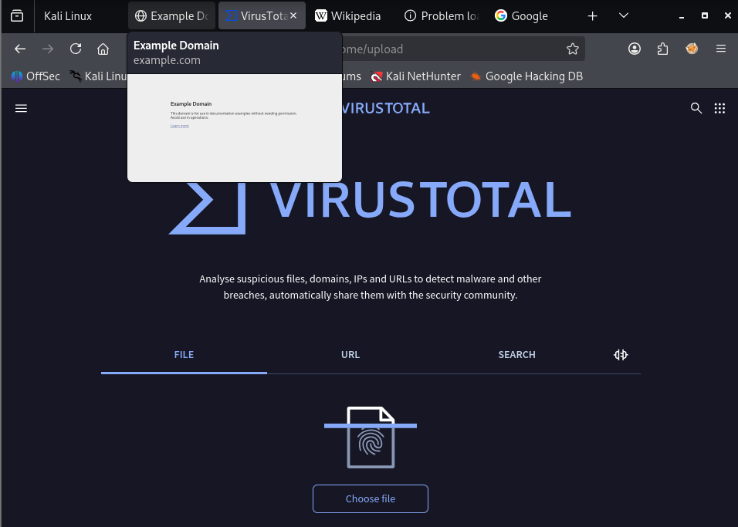
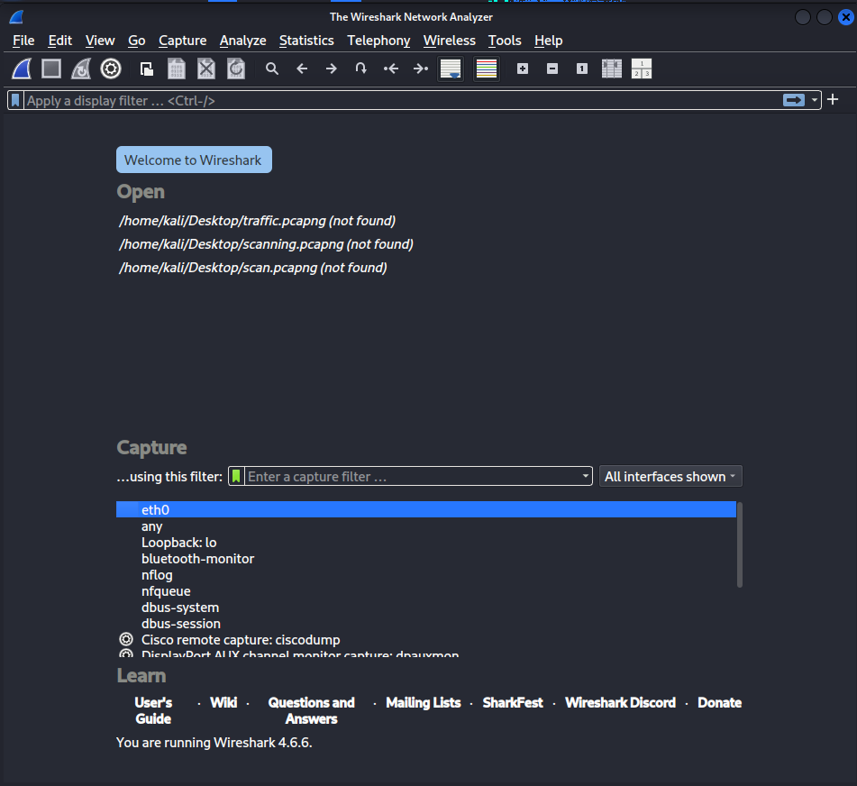
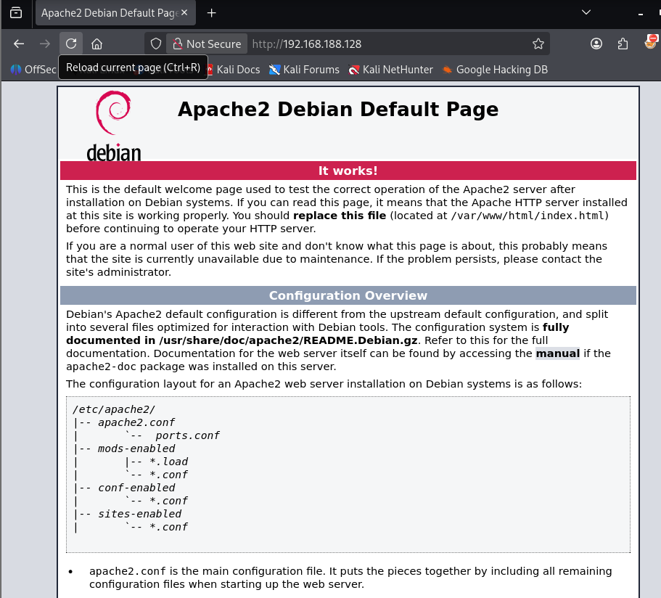
TASK 9 – Wireshark Network Traffic Capture
Objective Learn how a cybersecurity analyst captures and analyzes network packets.
Step 1: Identify Your Network Interface
Open Wireshark.
You will see a list of interfaces.
Examples:
eth0
ens33
wlan0
Ethernet
Step 2: Generate Normal Network Traffic
Generate different types of traffic so multiple protocols appear.
A. Access a Website
Open Firefox.
Visit:
example.com
wikipedia.org
This generates:
DNS
TCP
HTTP or HTTPS

Slide 13
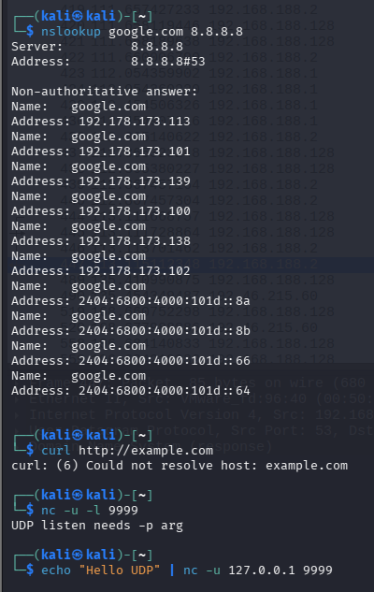
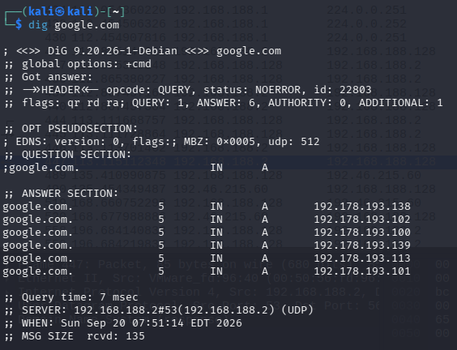
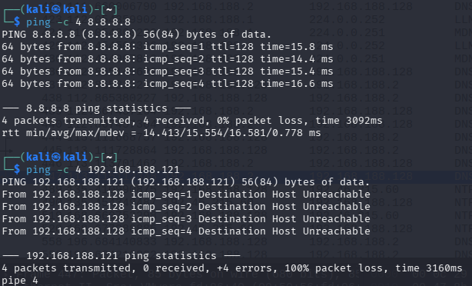
Step 3 : Generate DNS Requests
Open Terminal.
Run:
nslookup example.com
or
dig example.com
This creates DNS query packets.
Generate ICMP Traffic
Ping another authorized lab machine.
Example:
ping 192.168.188.128
Connect to a Local Service
If Apache is running on your Ubuntu VM:
Open:
http://localhost:8080

Slide 14
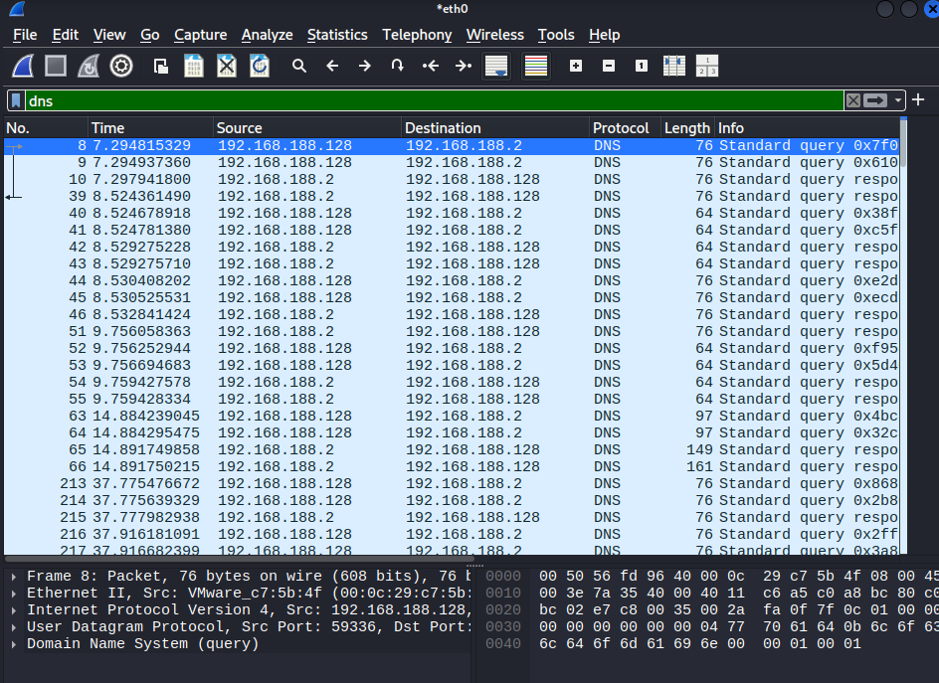
Step 4 : Capture Traffic for 5–10 Minutes
Allow Wireshark to capture packets for approximately:
5 minutes (minimum)
10 minutes (recommended)
After finishing:
Click the red Stop button.
Step 5: Save the Capture
Click:
File → Save As
Example filename:
task9_capture.pcapng
Step 6 : Analyze Important Protocols
Use the Display Filter bar.
DNS Filter
Type:
dns

Slide 15
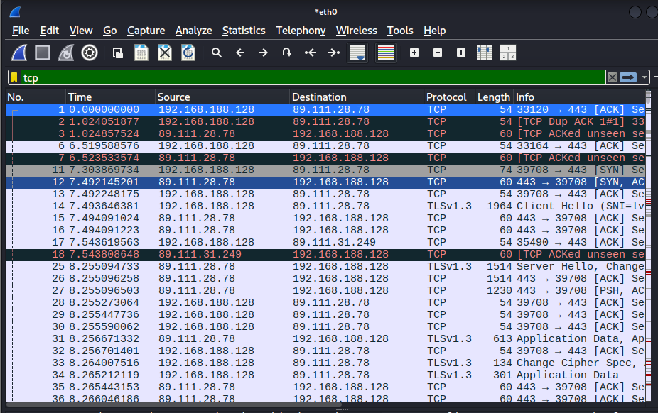
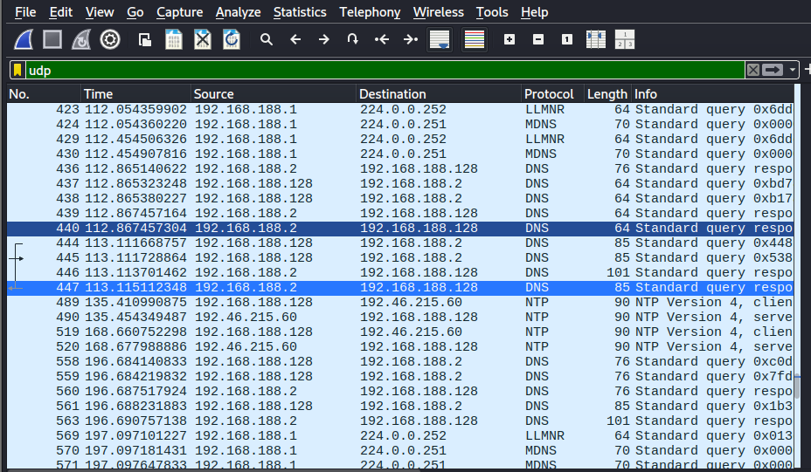
Step 7: TCP Filter
Type:
tcp
Step 8: UDP Filter
Type:
udp

Slide 16
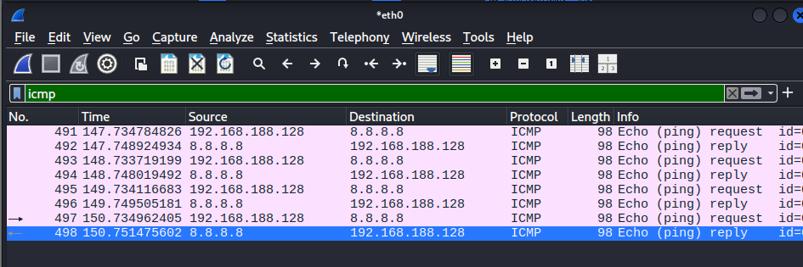
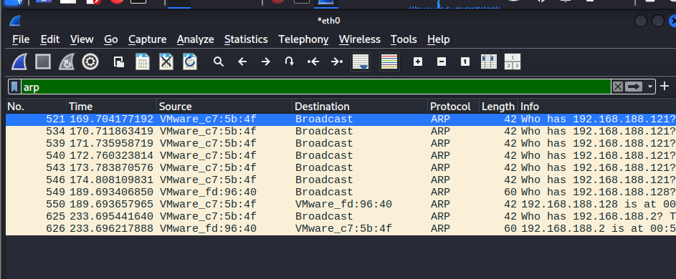
ICMP Filter
Type:
icmp
ARP Filter
Type:
arp

Slide 17
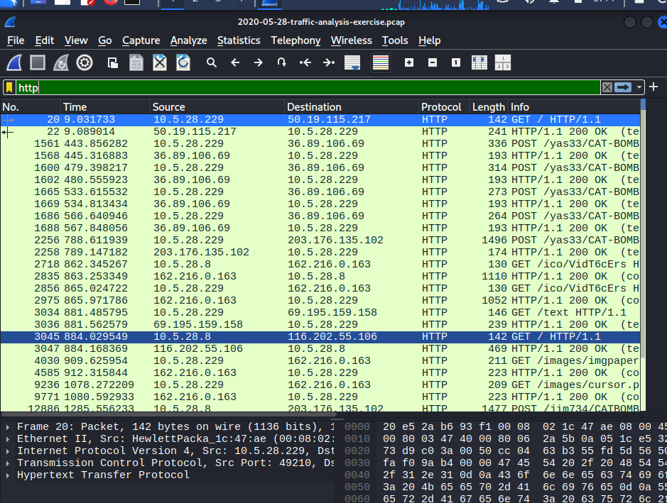
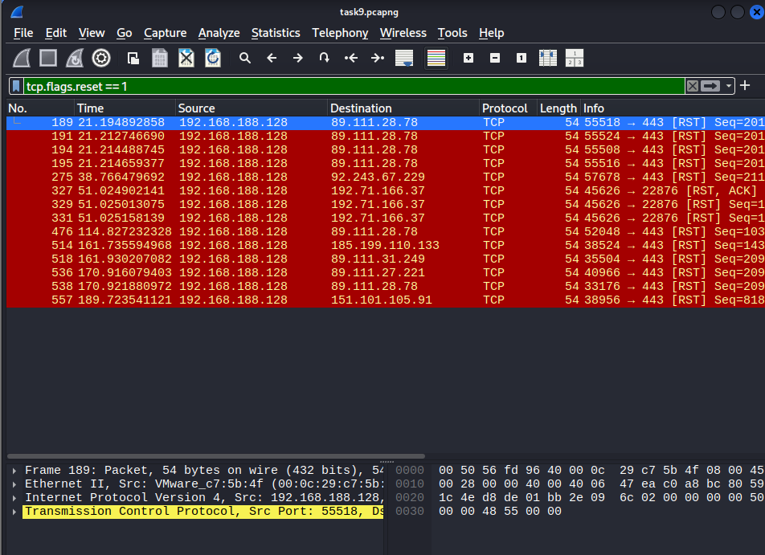
HTTP Filter
Type:
http
Investigate Special Filters
TCP Reset Packets
Filter:
tcp.flags.reset == 1

Slide 18
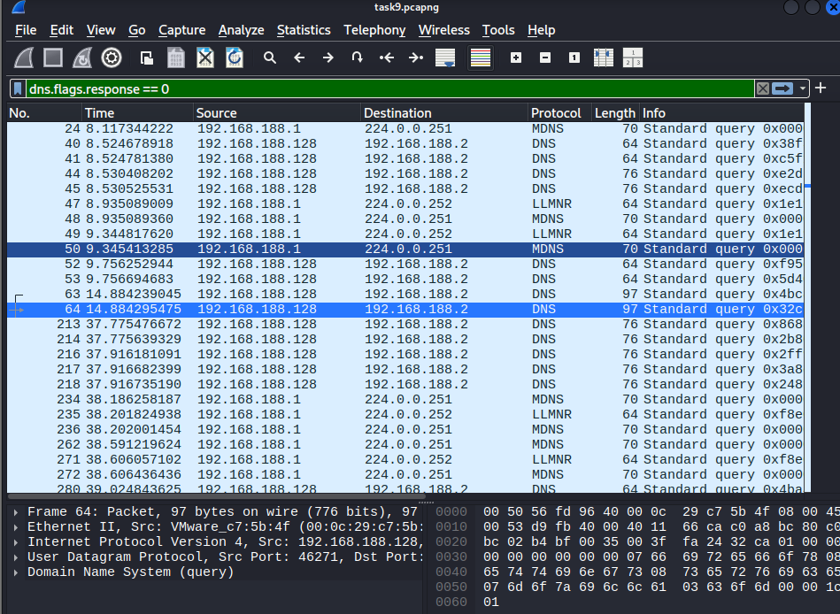
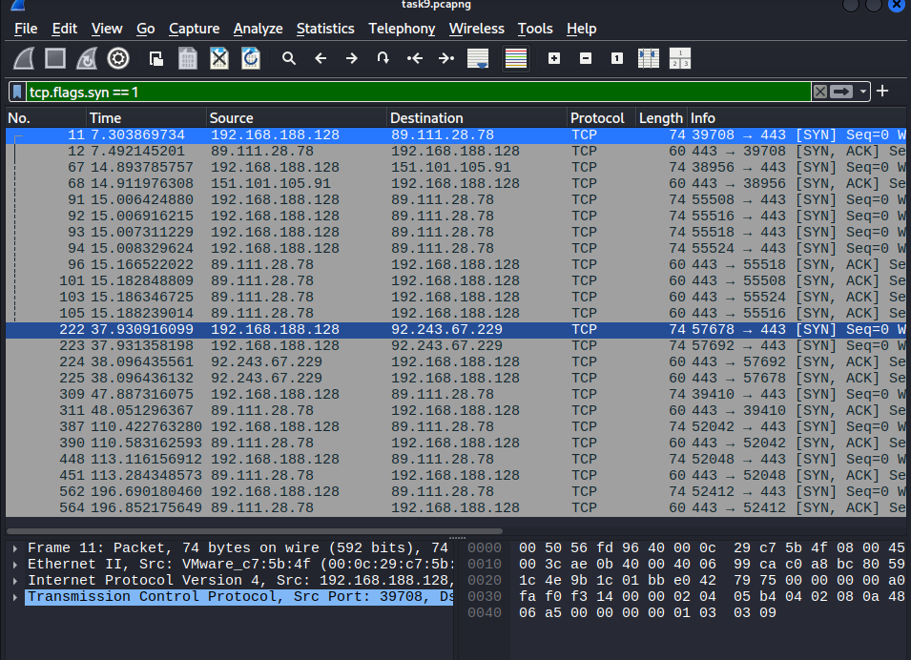
TCP Reset Packets
Filter:
tcp.flags.reset == 1
TCP SYN Packets
Filter:
tcp.flags.syn == 1

Slide 19
Timestamp | Source IP | Destination IP | Protocol | Source Port | Destination Port | Packet Information | Security Observation
7.294815329 | 192.168.188.128 | 192.168.188.2 | DNS | 59336 | 53 | Standard DNS Query (query 0x7f0) | Normal DNS request sent to the local DNS server for domain resolution.
7.294931800 | 192.168.188.2 | 192.168.188.128 | DNS | 53 | 59336 | Standard DNS Response | DNS server successfully returned a response to the client.
37.303869734 | 192.168.188.128 | 89.111.28.78 | TCP | 39708 | 443 | TCP SYN | A new TCP connection was initiated to an HTTPS server.
7.492145201 | 89.111.28.78 | 192.168.188.128 | TCP | 443 | 39708 | SYN-ACK | The remote server accepted the connection request, indicating a successful handshake.
7.493646381 | 192.168.188.128 | 89.111.28.78 | TLSv1.3 | 39708 | 443 | Client Hello (SNI) | A secure TLS handshake started for encrypted HTTPS communication.
8.255094733 | 89.111.28.78 | 192.168.188.128 | TLSv1.3 | 443 | 39708 | Server Hello | The server negotiated encryption successfully.
112.867457304 | 192.168.188.2 | 192.168.188.128 | DNS | 53 | 59336 | Standard DNS Response | The local DNS server completed another successful name resolution.
135.410990875 | 192.168.188.128 | 192.46.215.60 | NTP | 59336 | 123 | NTP Version 4 Client Request | The system synchronized its clock with an NTP server, which is normal system behavior.
135.454349487 | 192.46.215.60 | 192.168.188.128 | NTP | 123 | 59336 | NTP Version 4 Server Reply | The NTP server returned the correct time to the client.
147.734784826 | 192.168.188.128 | 8.8.8.8 | ICMP | — | — | Echo (Ping) Request | The host tested network connectivity with Google's DNS server.
147.748924934 | 8.8.8.8 | 192.168.188.128 | ICMP | — | — | Echo (Ping) Reply | The successful reply confirmed external network connectivity.
169.704177192 | VMware_c7:5b:4f | Broadcast | ARP | — | — | "Who has 192.168.188.121?" | The device attempted to discover the MAC address of another host on the LAN.
8.935089360 | 192.168.188.1 | 224.0.0.252 | LLMNR | — | 5355 | Standard Query | LLMNR requests were used for local hostname resolution on the network.
9.031733 | 10.5.28.229 | 50.19.115.217 | HTTP | 49210 | 80 | HTTP GET / HTTP/1.1 | A standard web page request was captured over unencrypted HTTP.
9.089014 | 50.19.115.217 | 10.5.28.229 | HTTP | 80 | 49210 | HTTP/1.1 200 OK | The web server successfully returned the requested webpage.

Slide 20
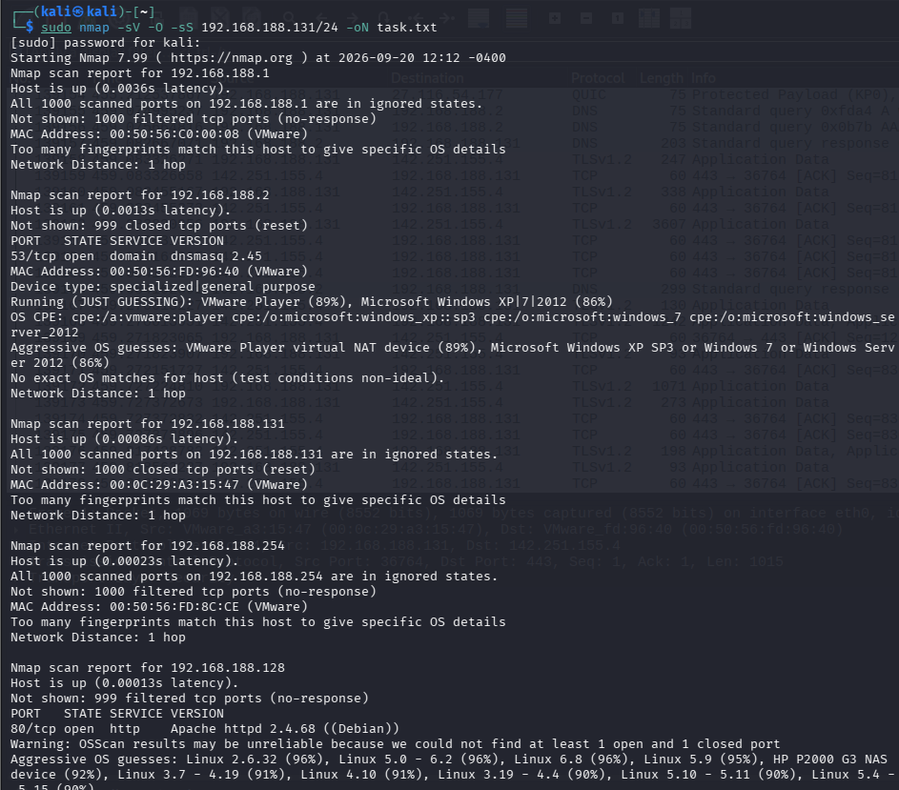
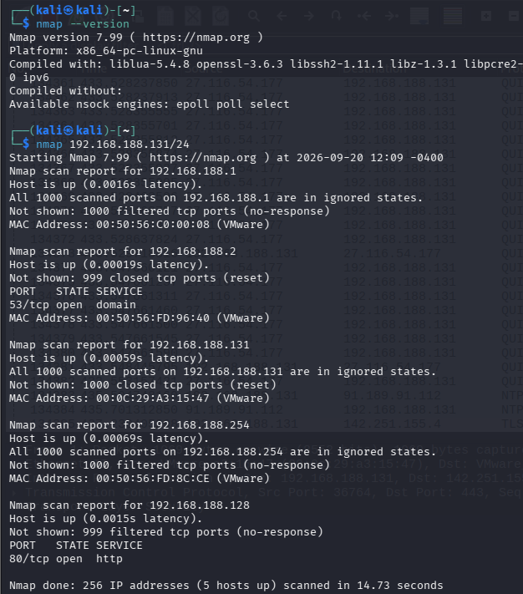
TASK 10 – Nmap + Wireshark Investigation
Objective Understand what an Nmap scan looks like at the packet level.
Step 1: Start Your Lab
Check your IP:
ip addr
target: 192.168.188.131
Step 2: Run Nmap While Capturing
Open another Terminal.
Run the SYN scan.
sudo nmap -sV -O -sS 192.168.188.131/24 -oN task.txt

Slide 21
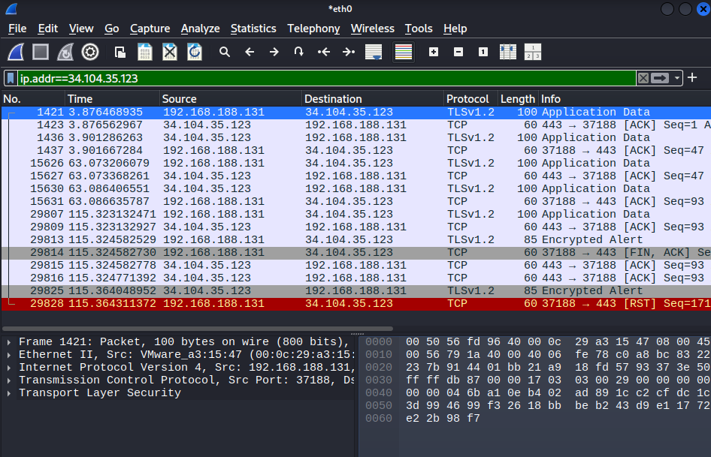
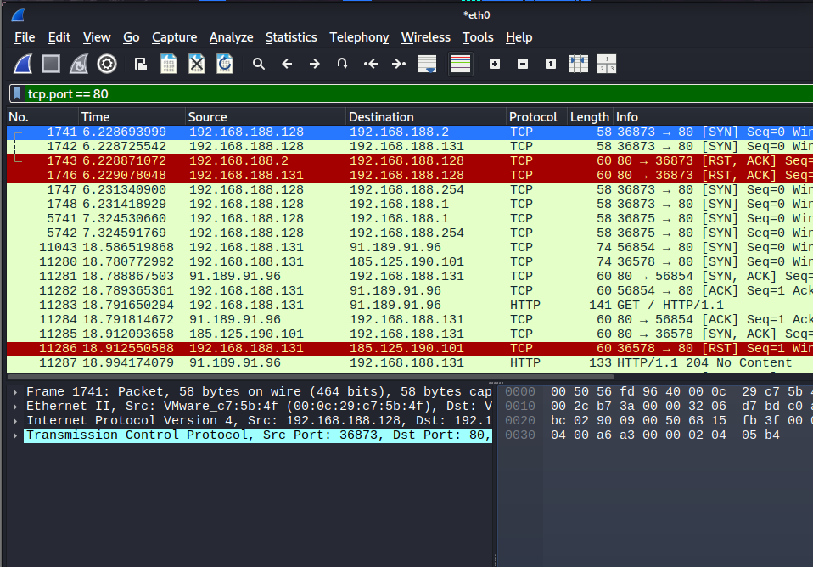
Step 3: Open Wireshark
Open Wireshark.
Select the correct interface (eth0).
Click Start Capturing.
Do not stop the capture yet.
Step 4: Filter the Scan Traffic
The SYN scan creates TCP packets.
Filter: ip.addr==34.104.35.123
Step 5: Find SYN Packets
Filter: tcp.port==80

Slide 22
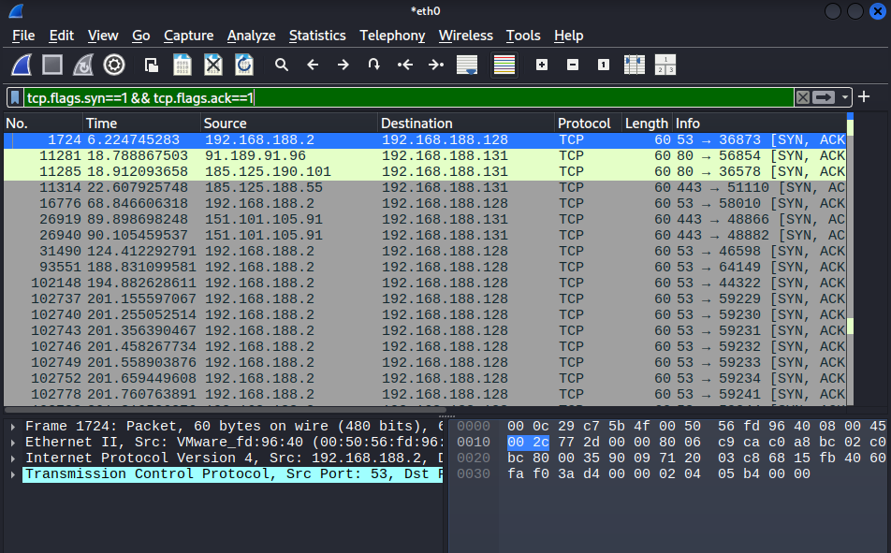
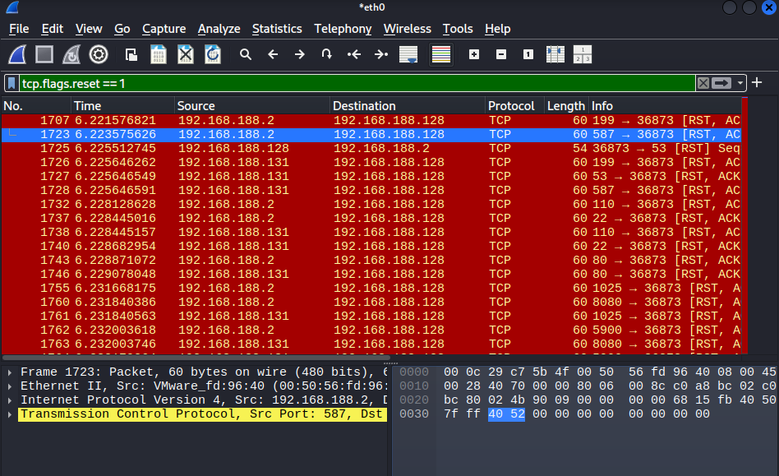
Step 7: Find SYN/ACK Responses
Use:
tcp.flags.syn==1 && tcp.flags.ack==1
Step 8: Find RST Packets
Filter:
tcp.flags.reset==1

Slide 23
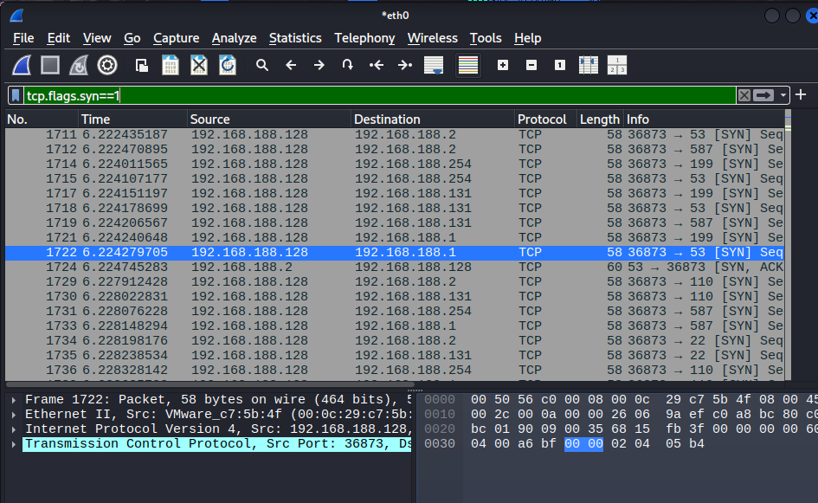
Step 9: Find RST Packets
Filter:
tcp.flags.syn==1

Slide 24
1. SYN Packets Analysis
Filter used:
tcp.flags.syn==1
Actual Evidence
Observation
The scanning host (192.168.188.128) sent SYN packets to multiple destination ports.
Ports scanned included 53, 80, 22, 110, 587, and 199.
This confirms that Nmap attempted connections without completing the TCP handshake.
Packet No. | Timestamp | Source IP | Target IP | Destination Port | TCP Flag
1722 | 6.224279705 | 192.168.188.128 | 192.168.188.1 | 53 | SYN
1724 | 6.224745283 | 192.168.188.2 | 192.168.188.128 | 53 | SYN, ACK
1741 | 6.228693999 | 192.168.188.128 | 192.168.188.2 | 80 | SYN
2. SYN/ACK Response Analysis
Filter used:
tcp.flags.syn==1 && tcp.flags.ack==1
Actual Evidence
Observation
A SYN/ACK indicates that the destination port accepted the connection request.
Port 53 responded from 192.168.188.2, matching Nmap's DNS result.
Port 80 also returned SYN/ACK responses, confirming the web service was reachable.
Packet No. | Timestamp | Source IP | Target IP | Source Port | TCP Flag
1724 | 6.224745283 | 192.168.188.2 | 192.168.188.128 | 53 | SYN, ACK
11281 | 18.788867503 | 91.189.91.96 | 192.168.188.131 | 80 | SYN, ACK
11285 | 18.912093658 | 185.125.190.101 | 192.168.188.131 | 80 | SYN, ACK

Slide 25
3. RST Response Analysis
Filter used:
tcp.flags.reset==1
Actual Evidence
Observation
Several RST packets appeared immediately after connection attempts.
This is expected behavior for an Nmap SYN scan because Nmap resets the connection instead of completing it.
RST packets from other ports also indicate that some scanned ports were closed.
4. Destination Ports Observed
The SYN scan attempted connections to multiple ports.
Observation
Nmap rapidly tested several common service ports.
Only ports 53 and 80 showed successful responses.
Packet No. | Timestamp | Source IP | Target IP | Source Port | TCP Flag
1707 | 6.221576821 | 192.168.188.2 | 192.168.188.128 | 199 | RST, ACK
1723 | 6.223575626 | 192.168.188.2 | 192.168.188.128 | 587 | RST, ACK
1725 | 6.225512745 | 192.168.188.128 | 192.168.188.2 | 53 | RST
1746 | 6.229078048 | 192.168.188.131 | 192.168.188.128 | 80 | RST, ACK
Port | Service
53 | DNS
80 | HTTP
22 | SSH
110 | POP3
587 | SMTP Submission
1025 | Dynamic Port

Slide 26
Source and Target IP Analysis
Observation
Most scan traffic originated from the scanning machine (192.168.188.128).
Responses came from the scanned hosts depending on port status.
TCP Flags Analysis
Observation
These flags clearly show how a TCP SYN scan works:
Nmap sends SYN.
Open ports reply with SYN/ACK.
Nmap immediately sends RST instead of completing the handshake.
Number of Connection Attempts
From the Wireshark capture:
Item | Value
Scanning Host | 192.168.188.128
DNS Target | 192.168.188.2
Web Target | 192.168.188.131
Additional External Hosts | 91.189.91.96, 185.125.190.101
TCP Flag | Meaning | Evidence
SYN | Start a TCP connection | Packets 1722, 1741
SYN, ACK | Open port accepted the request | Packet 1724
RST | Connection reset by Nmap | Packet 1725
RST, ACK | Closed port rejected the connection | Packet 1707
Packet Type | Observation
SYN Packets | Multiple connection attempts were observed across common ports.
SYN/ACK Responses | Received mainly from ports 53 and 80.
RST Responses | Several reset packets appeared after successful or rejected connection attempts.

Slide 27
Nmap vs Wireshark Comparison
Nmap Result | Wireshark Evidence | Interpretation
Port 53 detected open | SYN → SYN/ACK (Packet 1724) | DNS service is reachable.
Port 80 detected open | SYN → SYN/ACK | Apache web service is reachable.
Port 199 closed | SYN → RST, ACK (Packet 1707) | The port is not accepting connections.
Port 587 closed | SYN → RST, ACK (Packet 1723) | SMTP Submission port rejected the request.
Port 22 no successful response | SYN with no completed handshake | The port is closed or filtered.
Filtered hosts (192.168.188.1, 192.168.188.254) | No expected response | Firewall or packet filtering likely blocked the scan.

Slide 28
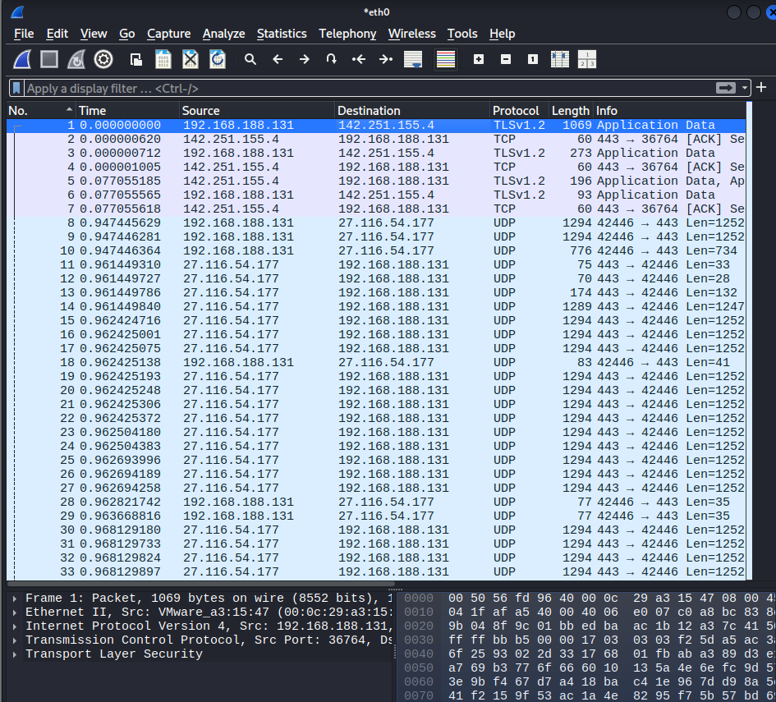
TASK 11 – Advanced Network Traffic Investigation
Objective Investigate network traffic from your own lab capture or a legitimate cybersecurity training ".pcap/.pcapng" file.
Step 1: Open the Capture File
Open Wireshark.
Click File → Open.
Select your capture file (task9.pcapng or task10_scan.pcapng).
The packet list will appear.

Slide 29
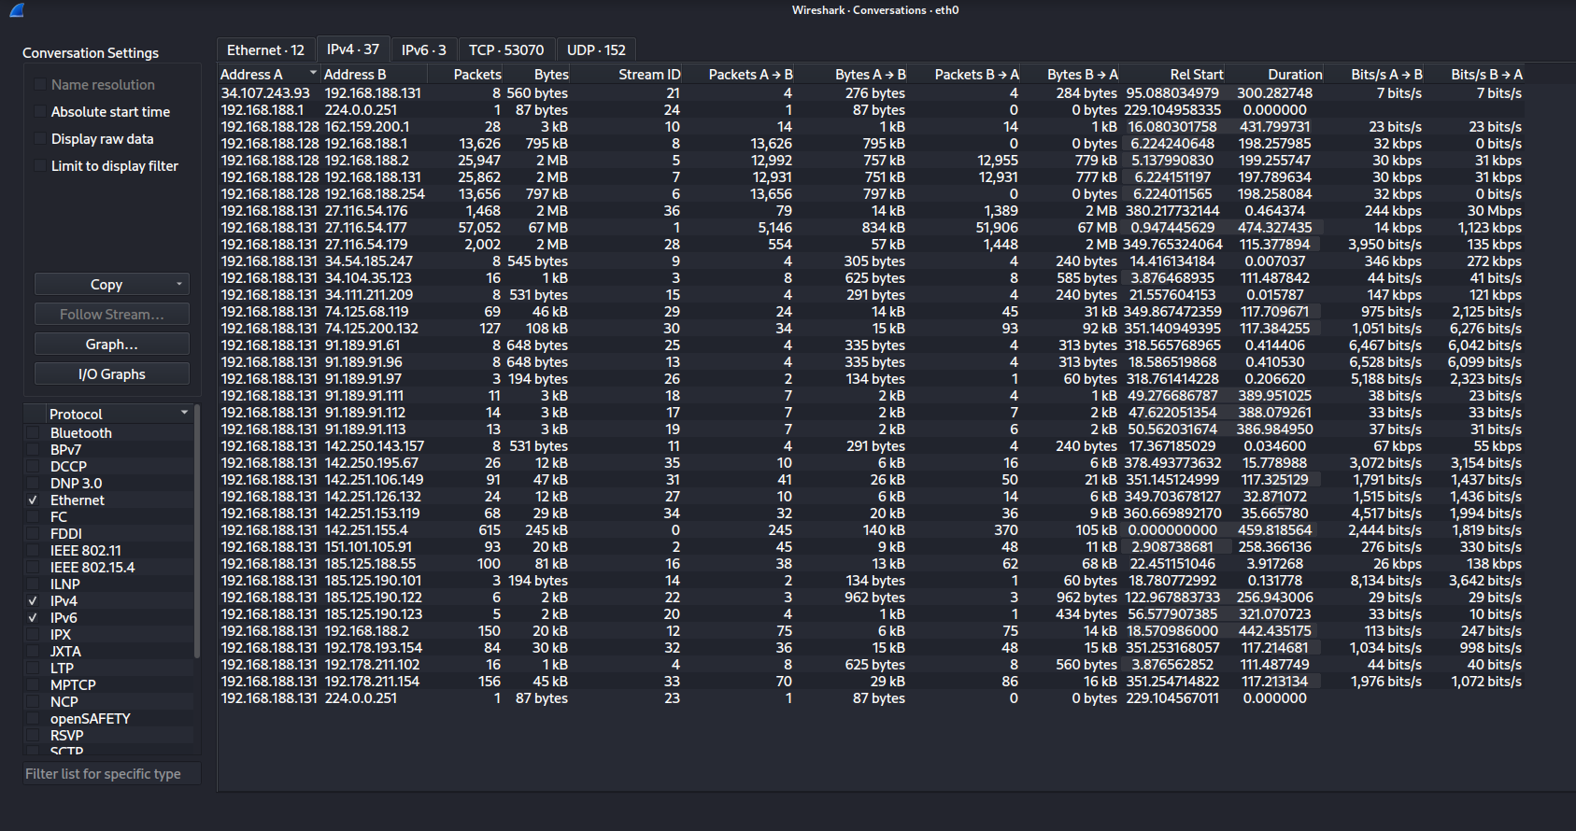
Step 2: Find the Top Communicating Hosts
Wireshark provides conversation statistics.
Go to:
Statistics → Conversations → IPv4
Record
Most active source IP
Most active destination IP
Number of packets exchanged

Slide 30
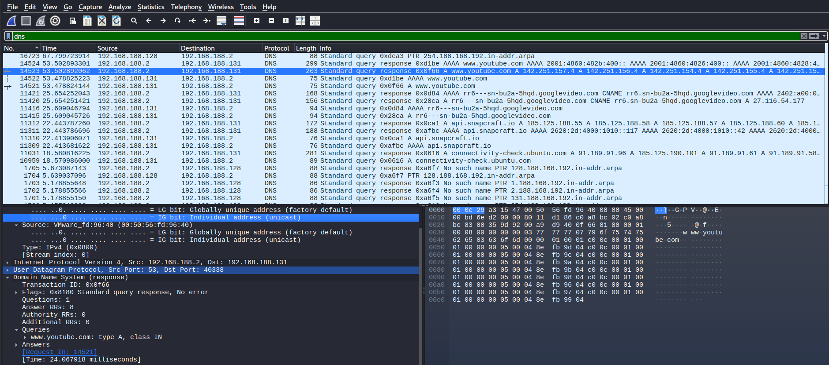
Step 3: Investigate DNS Traffic
In the filter bar type:
dns
Look for:
DNS Queries
DNS Responses
Domain Names
Query Types
Click a DNS packet.
Expand:
Domain Name System
Queries
Example:
google.com
example.com
Find Query Types
Common values:
Type | Meaning
A | IPv4 Address
AAAA | IPv6 Address
PTR | Reverse Lookup
MX | Mail Server

Slide 31
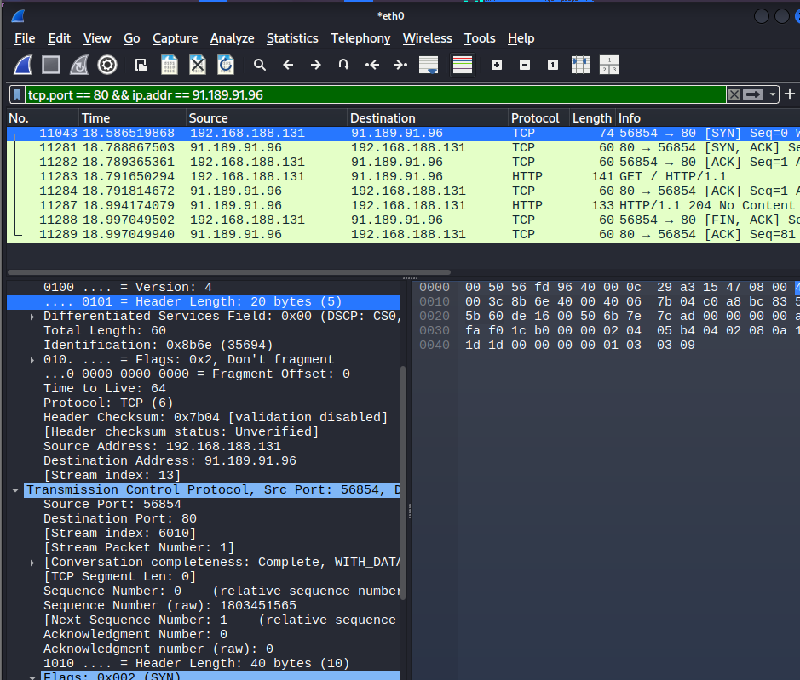
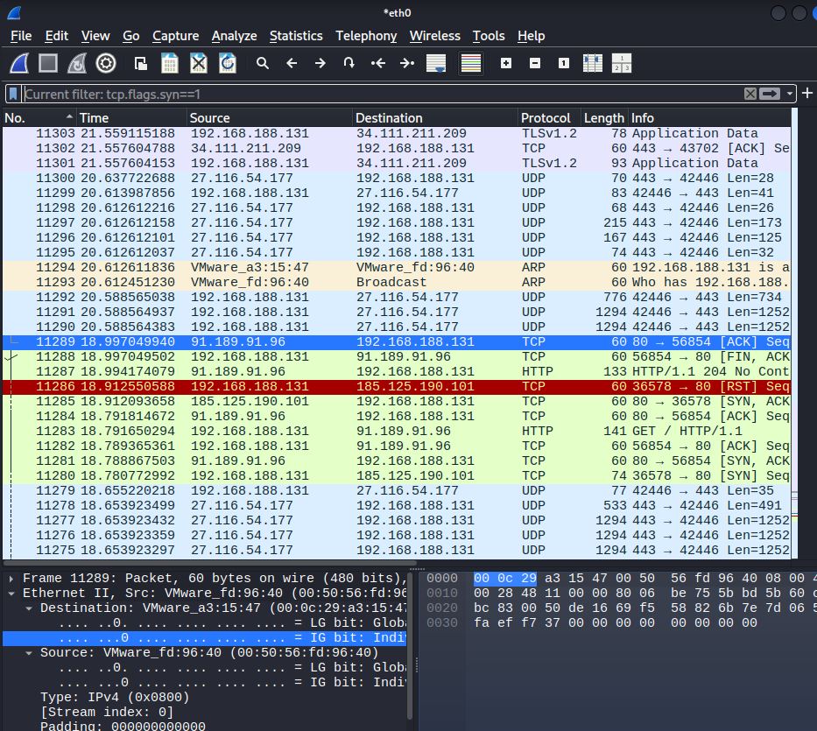
Step 4: Investigate TCP Traffic
Find SYN Packets
Filter:
tcp.port == 80 && ip.addr == 91.189.91.96
Find SYN Packets
Filter:
tcp.flags.syn==1

Slide 32
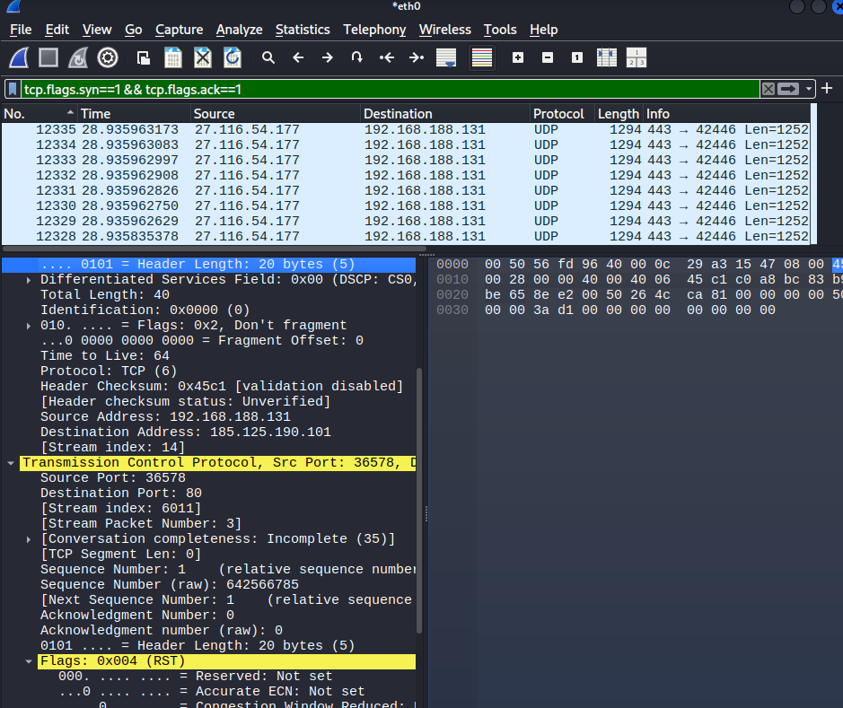
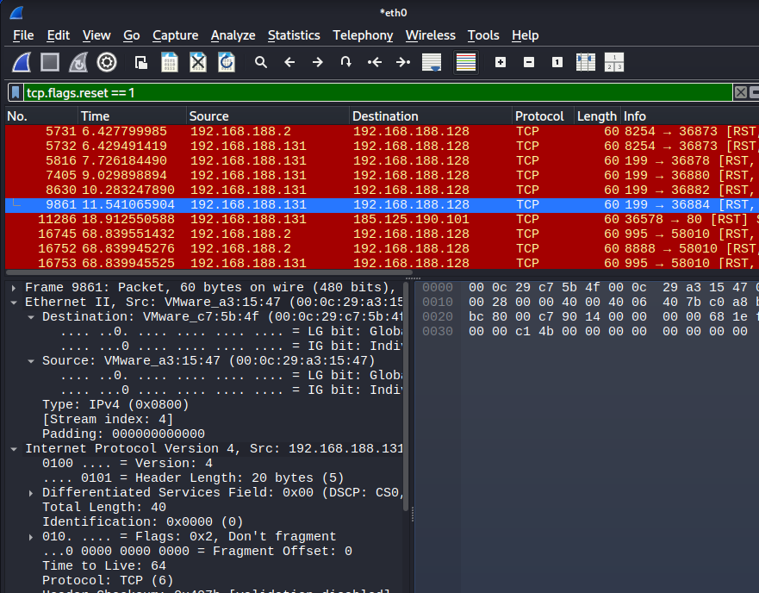
Find SYN/ACK Responses
Filter:
tcp.flags.syn==1 && tcp.flags.ack==1
Find RST Packets
Filter:
tcp.flags.reset==1

Slide 33
Step 5: Check for Repeated Connection Attempts
Use:
tcp.flags.syn==1
Look for:
Same source IP
Same destination IP
Multiple SYN packets
Example:
Repeated attempts may simply be:
Normal browsing
Service discovery
Nmap scanning
Source | Target | Port
192.168.188.128 | 192.168.188.2 | 53
192.168.188.128 | 192.168.188.131 | 80
192.168.188.128 | 192.168.188.131 | 22

Slide 34
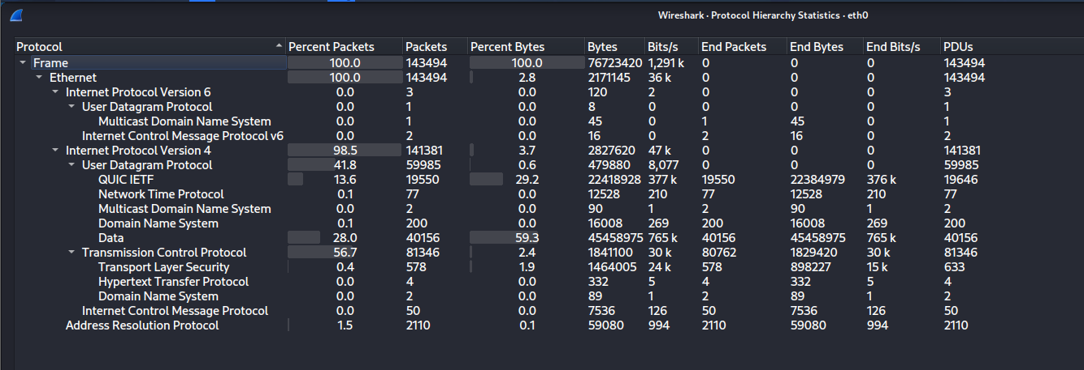
Step 6: Look for Suspicious Indicators
Repeated connection attempts: 192.168.188.128 shows multiple connections on different high-numbered ports.
Unusual ports: Ports such as 35234, 38668, and 54083 should be verified.
Unexpected protocols: UDP traffic on port 123 (NTP) should be checked to confirm it is legitimate.
Abnormal DNS requests: 192.168.188.2:53 generates DNS traffic; verify the requested domains if unusual.
Large amounts of traffic: 27.116.54.177:443 has about 67 MB of traffic and should be reviewed.
Unexpected systems: External IPs such as 27.116.54.176 and 142.251.106.149 should be verified against expected services.

Slide 35
Investigation Table
Time | Source IP | Destination IP | Port | Protocol | Observation | Security Significance
18.5865 | 192.168.188.131 | 91.189.91.96 | 80 | TCP | SYN packet sent to web server. | Normal connection request to a website.
18.7888 | 91.189.91.96 | 192.168.188.131 | 80 | TCP | SYN/ACK response received. | The web server accepted the connection.
18.7916 | 192.168.188.131 | 91.189.91.96 | 80 | HTTP | HTTP GET request sent. | User accessed a webpage.
18.9941 | 91.189.91.96 | 192.168.188.131 | 80 | HTTP | HTTP 204 No Content received. | Normal server response.
22.4438 | 192.168.188.131 | 192.168.188.2 | 53 | DNS | DNS query for api.snapcraft.io. | Normal domain name lookup.
53.4788 | 192.168.188.131 | 192.168.188.2 | 53 | DNS | DNS query for www.youtube.com. | Normal DNS request before accessing YouTube.
53.5029 | 192.168.188.2 | 192.168.188.131 | 53 | DNS | DNS response returned multiple IP addresses. | Successful DNS resolution.
115.3643 | 192.168.188.131 | 34.104.35.123 | 443 | TCP | TCP RST packet sent. | Connection was intentionally closed.

Slide 36
TASK 12 Vulnerability Assessment Table (Actual Lab Findings)
Objective Use the information gathered from Tasks 7–11 to perform a basic vulnerability/security assessment of your lab.
Step 3: Assign Risk
Use simple reasoning.
Risk | Meaning
Critical | Immediate serious danger
High | Major security risk
Medium | Needs improvement
Low | Minor issue or good practice
Step 1: Collect Previous Results
Step 2: Identify Security Findings
Sr No. | Finding | Evidence | Risk | Potential Impact | Recommendation
1 | HTTP service exposed on Port 80 | Nmap detected Apache httpd 2.4.68 on 192.168.188.128. Wireshark captured HTTP traffic. | Medium | Unencrypted web traffic could expose information if sensitive data is transmitted. | Use HTTPS, keep Apache updated, and restrict unnecessary access.
2 | /server-status directory exposed | nmap --script vuln found the /server-status page. | Medium | The page may reveal server information useful for attackers. | Disable or restrict /server-status to administrators only.
3 | DNS service accessible on Port 53 | Nmap detected dnsmasq 2.45 on 192.168.188.2. | Medium | If misconfigured, DNS could be abused for information gathering or misuse. | Limit DNS access to trusted devices and keep dnsmasq updated.
4 | HTTP used instead of encrypted HTTPS | Wireshark captured HTTP GET requests and responses. | Medium | Data sent over HTTP can be viewed by others on the network. | Redirect HTTP traffic to HTTPS and use TLS certificates.
5 | Multiple connection attempts observed | Wireshark showed repeated SYN packets during Nmap scanning. | Low | Repeated connection attempts could indicate scanning activity and should be monitored. | Monitor connection attempts and configure firewall rules where appropriate.

Slide 37
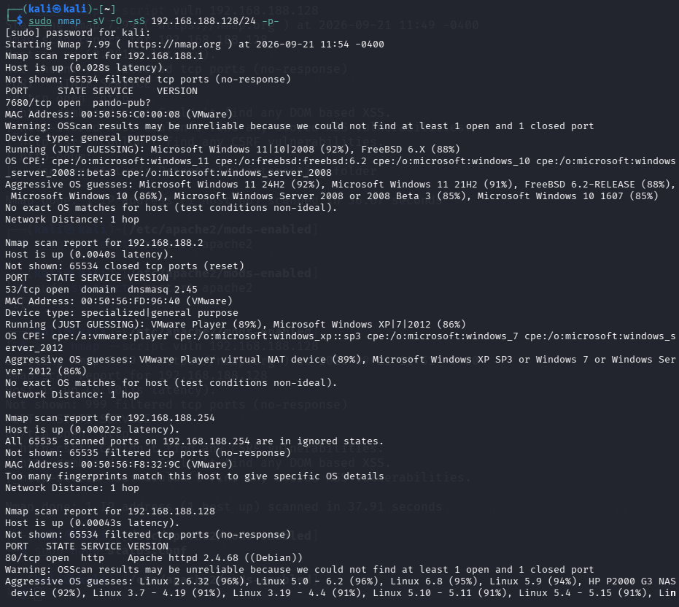
TASK 13 – Security Hardening & Before/After Testing
Objective Fix security issues identified in your authorized lab and demonstrate the improvement.
Tools Used
Nmap
Apache Web Server
UFW Firewall
Step 1 – Run the Before Scan
Before making any changes, scan the target machine.
Command
sudo nmap -sV 192.168.188.128

Slide 38
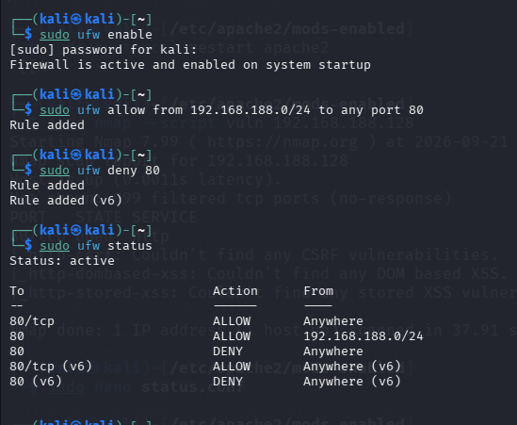
Security Improvement 1 – Restrict HTTP Access
Security Issue
The web server was accessible on Port 80.
Why Fix It?
Anyone on the network could access the web service.
Action Taken
Allow only the local network to access Port 80.
Enable UFW
sudo ufw enable
Allow only the local subnet:
sudo ufw allow from 192.168.188.0/24 to any port 80
Deny other access:
sudo ufw deny 80
Check firewall:
sudo ufw status

Slide 39

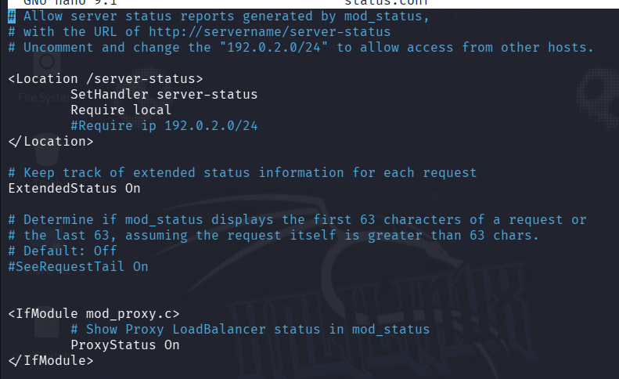

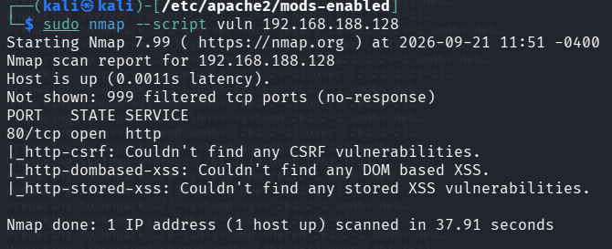

Security Improvement 2 – Disable Apache Server Status
Security Issue
Nmap found:
Why Fix It?
It may reveal server information.
Open Apache Configuration
sudo nano /etc/apache2/mods-enabled/status.conf
Find:
  <Location /server-status>
  Change it to:
  <Location /server-status>
  Require local
  </Location>
Save:
Ctrl + x
Enter
Restart Apache:
sudo systemctl restart apache2
Verify
Run:
sudo nmap --script vuln 192.168.188.128

Slide 40



Security Improvement 3 – Update Installed Packages
Security Issue
Your scan detected:
Apache httpd 2.4.68
Even when software is current, regular updates are an important hardening practice.
Update Packages
sudo apt update
Upgrade:
sudo apt upgrade -y
Check Apache version:
apache2 -v

Slide 41
Five Professional Recommendations
Use HTTPS: Enable HTTPS instead of HTTP to protect data transmitted between users and the server.
Configure firewall rules: Block unnecessary services and ports through proper firewall settings to reduce security risks.
Keep software updated: Regularly update the operating system, applications, and server software to fix known security vulnerabilities.
Restrict sensitive pages: Disable or limit access to sensitive pages, such as /server-status, so that important server information is not exposed.
Monitor network activity: Regularly monitor network traffic using tools such as Wireshark or SIEM solutions to detect unusual or suspicious activity.
Project Summary
During this project, I conducted a complete network security assessment. I started by using Nmap to discover devices and identify open services on the network. I then captured and analyzed network traffic to understand the communication and identify potential security issues.
After assessing the vulnerabilities, I applied appropriate security hardening measures to improve the overall security of the system. Finally, I performed before-and-after testing to verify that the security improvements were effective.
Overall, this project helped me understand the practical process of identifying, analyzing, and reducing network security risks.

