Slide 1

Student name: -Kumbhar Dilip
College name: - Indus University
Week 4 assignment: - Cyber Security Internship
Sid: - dg/september/cyber/264
Mail: - dilipkumbhar.dginternshub@gmail.Com
Task 4: - Theory + Practical

Slide 2
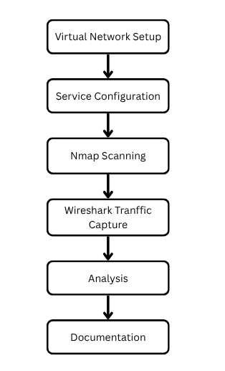
Project Overview: -
This project is a practical network security laboratory designed to understand the basics of network configuration, service identification, network scanning, and traffic analysis.
The lab uses multiple virtual machines connected through the same virtual network. Kali Linux is used as the security-testing machine, while a Windows or Linux machine acts as the target. A web server such as Apache or Nginx is installed on the target machine.
All testing should be performed only on the user's own isolated lab network or systems for which they have permission.
The project demonstrates the complete workflow

Slide 3
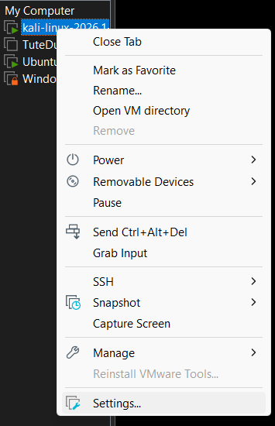
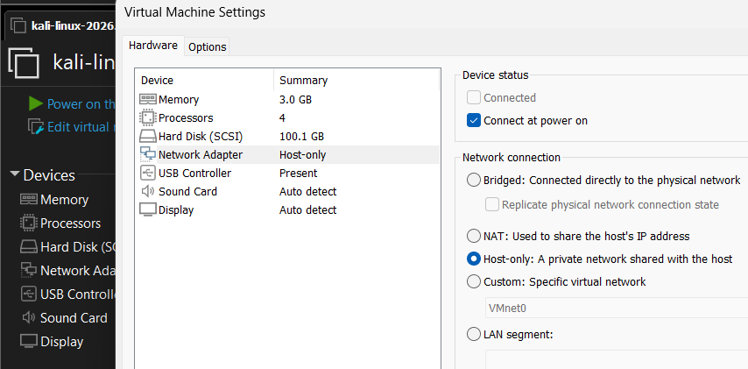
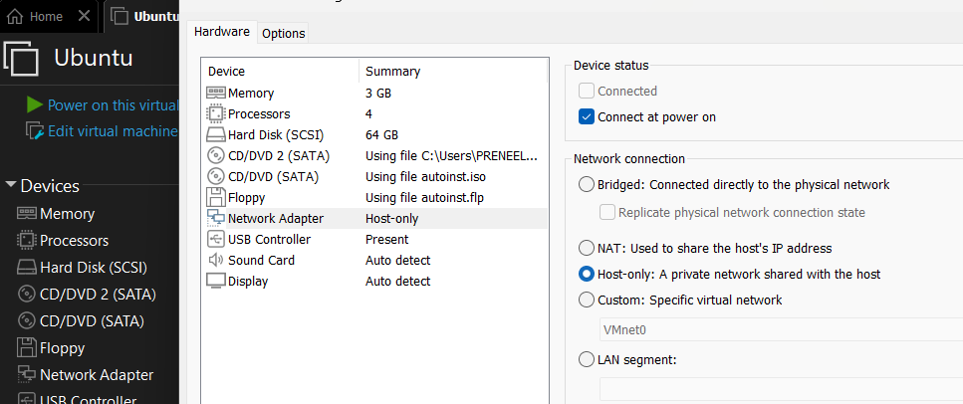
Task 1 – Setup Basic Network in VMware
Step 1: Open VMware Workstation
Kali Linux VM (Attacker)
Ubuntu Server/Windows VM (Target)
Step 2: Configure the Network Adapter
Select Kali Linux or Ubuntu.
Click Edit Virtual Machine Settings.
Select Network Adapter.
Choose NAT (or Host-Only).
Click OK.

Slide 4
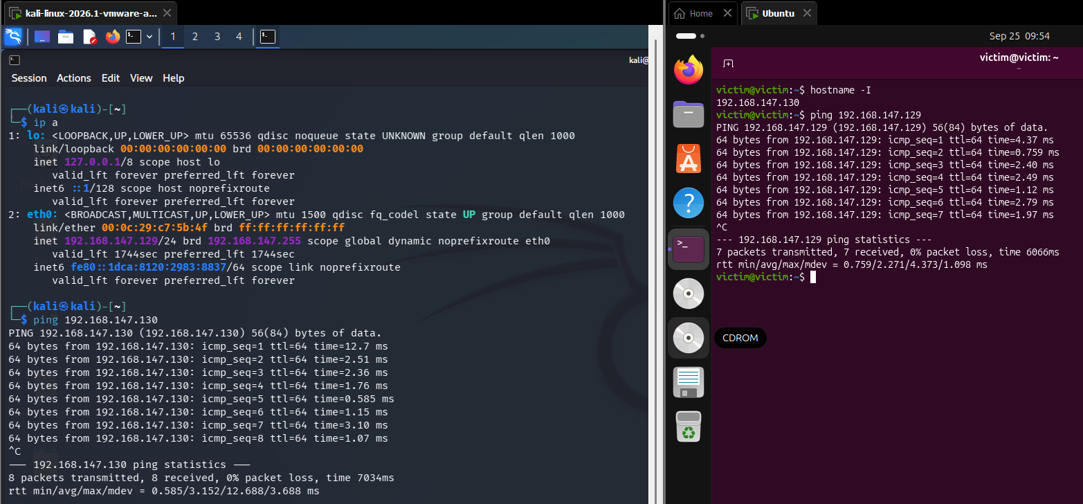
Step 3: Start Both Machines
Power on:
Kali Linux
Ubuntu Server (or Windows)
Step 4: Check the IP Address
Kali Linux
Open Terminal and run:
ip a
Ubuntu
Open Terminal and run:
hostname -I
Step 5: Verify Both Are on the Same Network
Compare the IP addresses.
Step 6: Test Connectivity
From Kali, ping the Ubuntu machine.
ping 192.168.188.128
Step 7: Test from Ubuntu (Optional)
Ping Kali.
ping 192.168.188.131
Machine | Example IP
Kali | 192.168.147.129
Ubuntu | 192.168.147.130

Slide 5

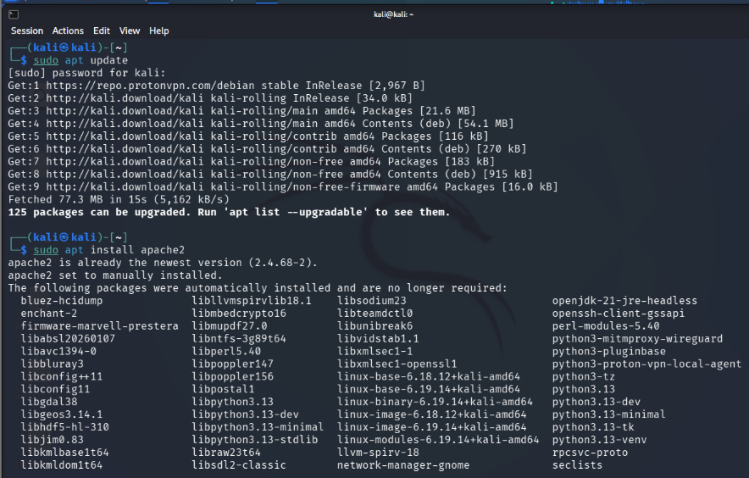
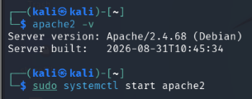

Task 2 – Install & Configure Services
Part A – Install Apache Web Server
Step 1: Open Terminal on Kali.
Step 2: Update Packages
Run:
sudo apt update
Step 3: Install Apache
Run:
sudo apt install apache2 -y
Part B – Start and Enable Apache
Step 4: Start the Service
Run:
sudo systemctl start apache2
Step 5: Enable Apache at Boot
Run:
sudo systemctl enable apache2
Step 6: Check Service Status
Run:
sudo systemctl status apache2

Slide 6
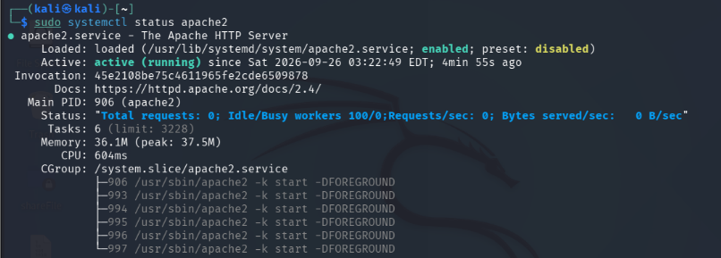
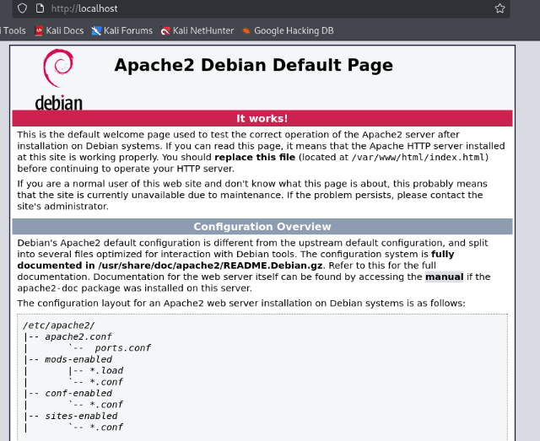

Step 6: Check Service Status
Run:
sudo systemctl status apache2
Part C – Test the Web Server
Step 7: Test on kali
Open Firefox on Ubuntu and visit:
http://localhost
Part D – Verify Port 80
On Kali run:
sudo ss -tuln | grep 80

Slide 7
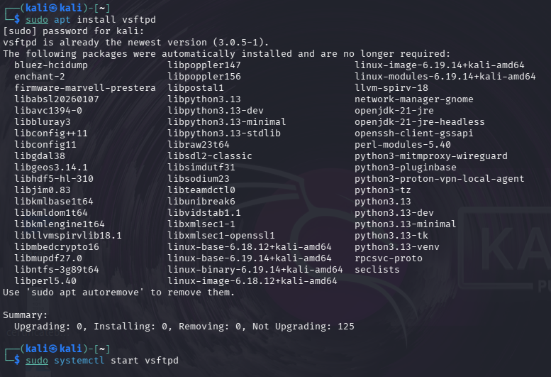
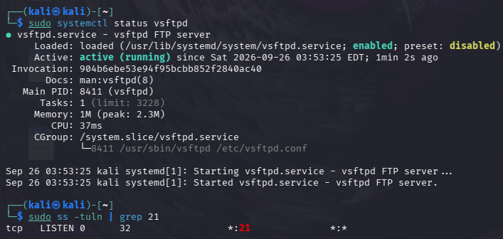
Optional – Install FTP Server (vsftpd)
If you want bonus marks, install an FTP server.
Step 1: Install
sudo apt install vsftpd -y
Step 2: Start FTP
sudo systemctl start vsftpd
Step 3: Enable at Boot
sudo systemctl enable vsftpd
Step 4: Check Status
sudo systemctl status vsftpd
Verify FTP Port
Run:
sudo ss -tuln | grep 21

Slide 8
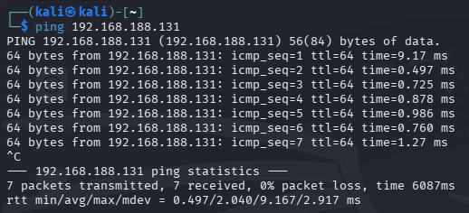
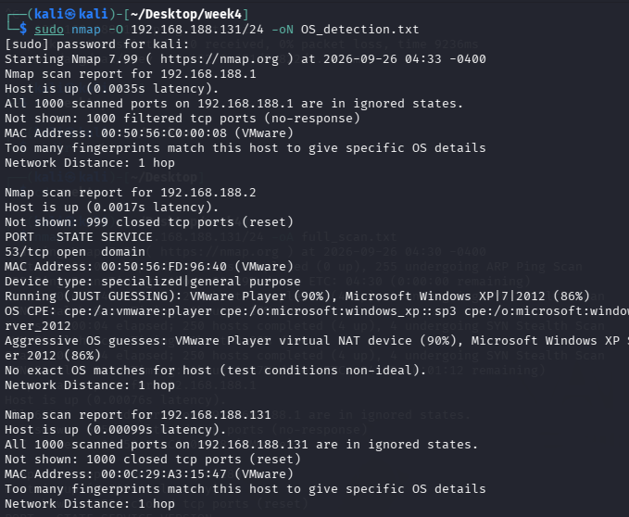
Task 3: Network Scanning (Nmap)
Lab Details
Machine | Role | Example IP
Kali Linux | Attacker | 192.168.188.131
Ubuntu Server | Target | 192.168.188.128
Step 1: Verify the Target is Reachable
On Kali, open Terminal and run:
ping 192.168.188.128
Step 2: Detect Operating Systems
Your screenshot uses Nmap's OS detection option:
sudo nmap -O 192.168.188.131/24 –oN OS_detection.txt

Slide 9
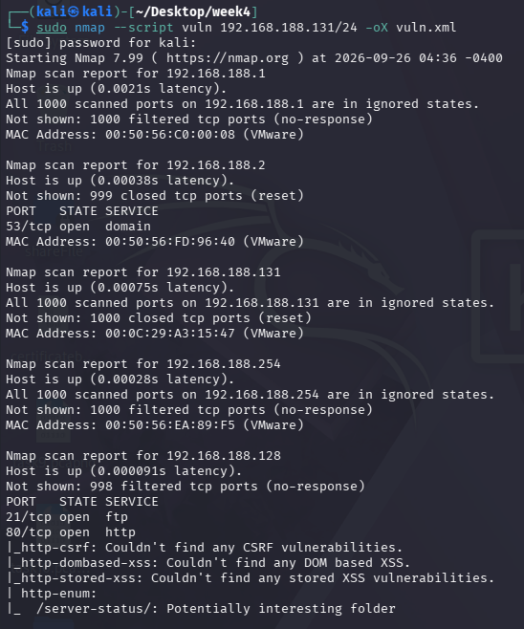
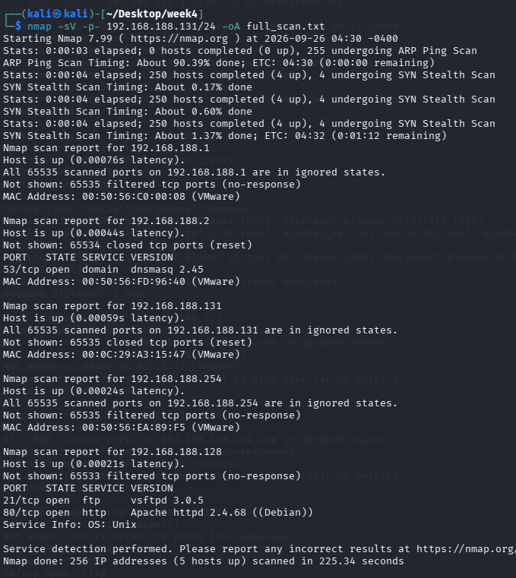
Step 3 :Perform service/version detection
Your right-hand screenshot uses:
nmap -sV -p- 192.168.188.131/24 -oA full-scan
Output files
The -oA option creates:
full-scan.nmap
full-scan.xml
full-scan.gnmap
Step 4 :Run vulnerability NSE scripts
Your left screenshot uses:
sudo nmap --script vuln 192.168.188.131/24 -oX vuln.xml

Slide 10
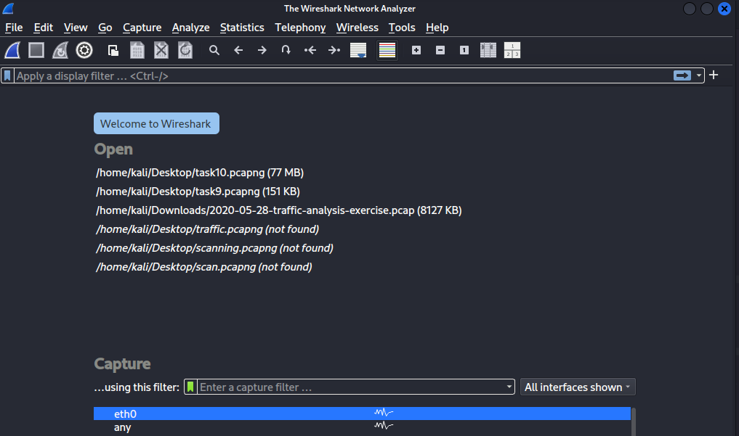
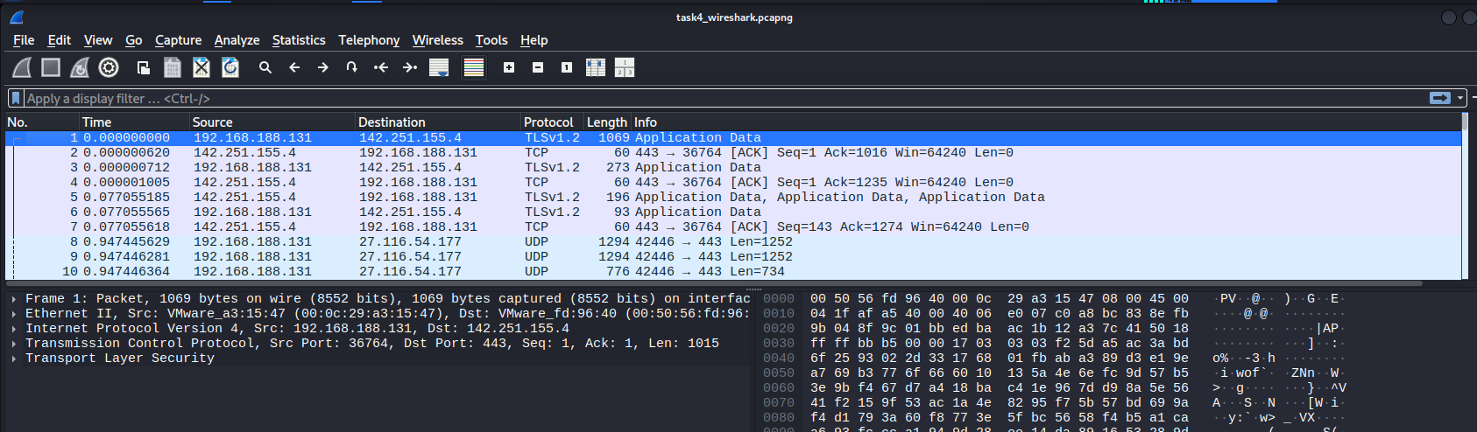
Task 4: Traffic Analysis (Wireshark)
Step 1: Open Wireshark
Open Wireshark in Kali.
You will see network interfaces like eth0 or ens33.
Select the interface connected to your VMware network.
Double-click the interface to start capturing.
Step 2: Start Capturing
Step 3: Generate Traffic
While Wireshark is capturing, generate some network activity.
A. HTTP Traffic
On Kali, open Firefox and visit:
http://localhost

Slide 11
References: -
Nmap Official Documentation → https://nmap.org/docs.html
Wireshark Official Documentation → https://www.wireshark.org/docs/relnotes/
Apache HTTP Server Documentation → https://httpd.apache.org/docs/
Ubuntu Documentation → https://ubuntu.com/desktop/docs/en/latest/
Kali Linux Documentation → https://www.kali.org/docs/

Slide 12

Thank
You

