Slide 1


Student Name: -Kumbhar Dilip
College Name: - Indus University
Internship :- Cyber Security Internship
Organization :- DG Intern Hub
Week 5 Assignment: - VAPT Tools – Practical Learning
SID: - dg/september/cyber/264
Mail: - dilipkumbhar.dginternshub@gmail.com
Task 5: - Theory + Practical
Sr. No. | Slide Title | Main Points
1 | Week 5 – VAPT Practical | Name, Internship Details
2 | What is VAPT? | Vulnerability Assessment, Penetration Testing, Purpose, Authorized Testing
3 | Tools Used | Nmap, Nikto, Burp Suite
4 | Nmap Results | -sS, -sV, -A, Scan Results, Screenshot
5 | Nikto Results | Scan, Findings, Vulnerabilities, Screenshot
6 | Burp Suite | Proxy, HTTP Request, Headers, Cookies, Screenshot
7 | Findings & Conclusion | Key Findings, Recommendations, Learning Outcomes, Conclusion

Slide 2
What is VAPT?
VAPT stands for Vulnerability Assessment and Penetration Testing. It is a security process used to find and understand weaknesses in a computer system, website, application, or network.
1. Vulnerability Assessment
Vulnerability Assessment is the process of finding security weaknesses in a system.
For example,
Software is outdated.
Weak passwords are being used.
Unnecessary ports or services are open.
2. Penetration Testing
Penetration Testing (Pen Testing) goes one step further.
Here, an authorized security tester tries to safely exploit identified weaknesses to determine how serious they really are and what an attacker could potentially do.
3. Purpose of VAPT
Find security weaknesses
Understand the risk associated with those weaknesses
Check whether vulnerabilities can actually be exploited
Help the organization fix the problems
Improve the overall security of systems and applications
Reduce the chances of real attackers successfully compromising the system
4. Authorized testing
Authorized testing means you have permission from the owner of the system to perform security testing.

Slide 3
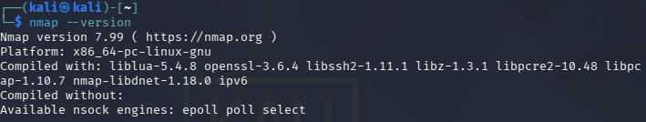
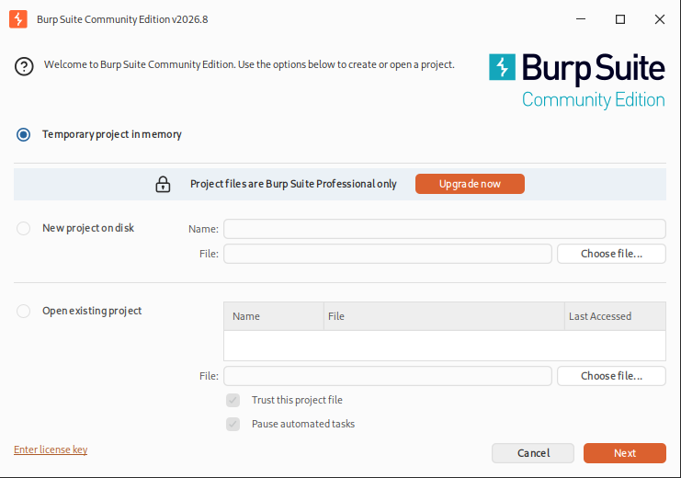
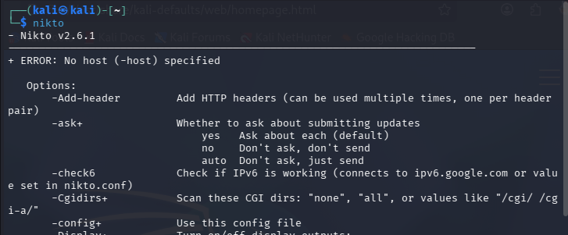
1. Prepare Kali Linux
Open Terminal:
sudo apt update
Install the required tools:
sudo apt install nmap nikto burpsuite -y
Check installation:
nmap --version
nikto -Version
For Burp Suite:
burpsuite

Slide 4
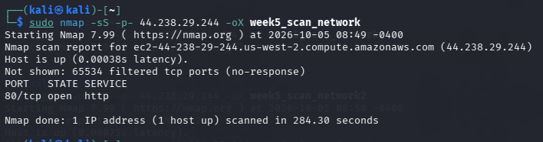
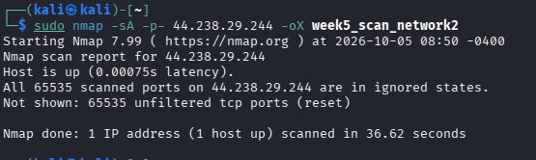
Nmap – Network Scanning
Target:
testaspnet.vulnweb.com
Scan 1 – SYN Scan
Nmap Aggressive Scan
Run:
nmap -A testaspnet.vulnweb.com
-A enables several detection features, including:
OS detection
Service/version detection
Default NSE scripts
Traceroute

Slide 5
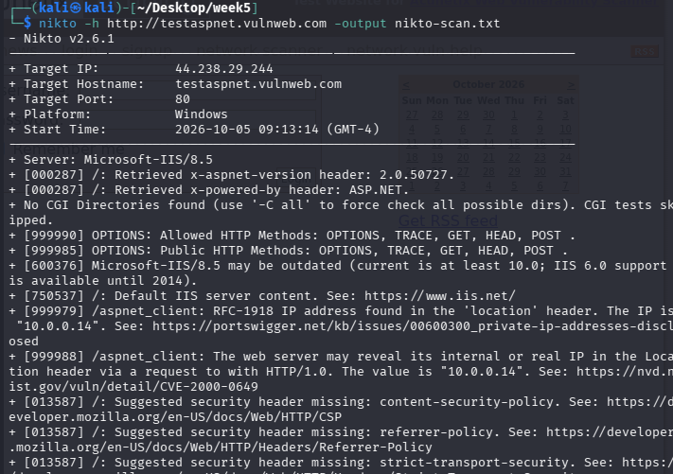
Nikto – Web Vulnerability Scan
Start Nikto:
nikto -h http://testaspnet.vulnweb.com
Nikto checks the web server for things such as:
Interesting files/directories
Server configuration issues
Missing security headers
Known web-server issues
Potentially exposed information

Slide 6
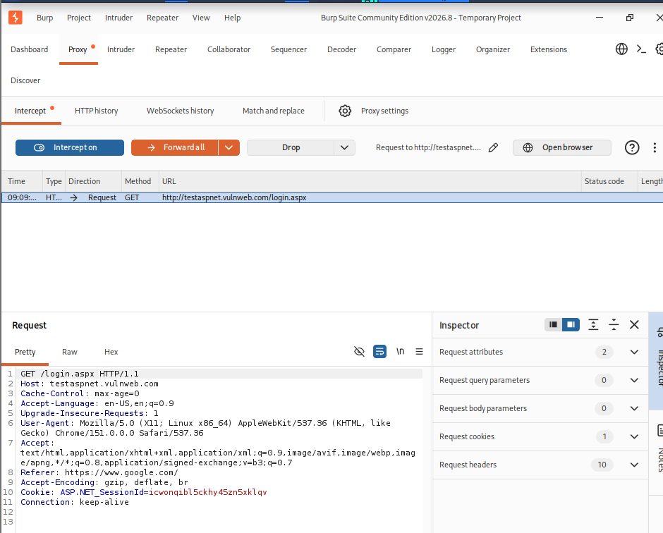
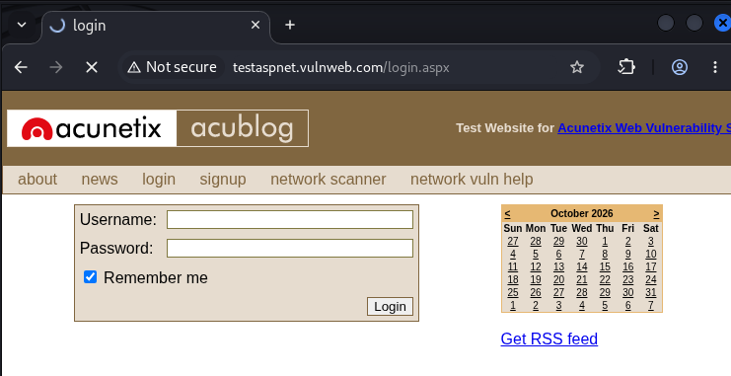
Burp Suite
Now perform the third part.
Start Burp:
burpsuite
Choose:
Temporary Project → Next → Use Burp Defaults → Start Burp
Configure Burp Suite Browser
I opened Burp Suite and used its built-in browser, so I did not need to configure Firefox manually.
In Burp Suite, I checked:
Proxy → Proxy settings
The proxy listener was running on:
127.0.0.1:8080
I then opened Burp's built-in browser and visited:
http://testaspnet.vulnweb.com
I looked at the following parts of the request:
Method: Shows what action the browser is requesting, such as GET or POST.
Path/URL: Shows which page or resource is being requested.
Host: Shows the website being contacted.
Headers: Provide extra information about the browser and request.
Cookies: Can contain information used to maintain a session.
Capture HTTP Requests
I went to:
Proxy → Intercept
Turned Intercept ON.
I visited different pages on the authorized training website. Burp Suite captured the HTTP requests sent by the browser.

Slide 7
Find at Least 3 Issues
This is the most important part of your mini-project.
You should combine information from:
Nmap + Nikto + Burp Suite
Create a Findings Table
Your report can contain this:
Important: Change the table according to your real scan results.
ID | Tool | Finding | Evidence | Risk | Recommendation
F-01 | Nmap | Open web service | Port 80 | Medium | Restrict and secure unnecessary services
F-02 | Nikto | Actual Nikto finding | Nikto output | Based on finding | Apply appropriate configuration fix
F-03 | Burp | HTTP/request security observation | Captured request | Based on observation | Use secure configuration and HTTPS where applicable

Slide 8
Recommendations
Examples:
Remove unnecessary services.
Keep software updated.
Configure web-server security properly.
Use HTTPS for web communication.
Apply appropriate HTTP security headers.
Monitor web-server logs.
Follow least-privilege principles.
Learning / Challenges
Write what you learned:
Basic network scanning
Service enumeration
Web vulnerability scanning
HTTP request analysis
Headers and cookies
Security findings
Report preparation
Conclusion
Example:
This practical helped me understand the basic workflow of Vulnerability Assessment and Penetration Testing. I used Nmap to identify available services, Nikto to inspect the web server for security-related findings, and Burp Suite to understand HTTP requests and responses. I learned that scanning results should be analyzed carefully instead of simply copying tool output. The practical also improved my understanding of attack surface, web security, and security recommendations. All testing was performed only against the authorized training environment.

Slide 9


