Slide 1

Student Name: -Kumbhar Dilip
College Name: - Indus University
Internship: - Cyber Security Internship
Organization: - DG Intern Hub
Week 6 Assignment: - Web Security & Vulnerability Testing (VAPT Basics)
SID: - dg/September/cyber/264
Mail: - dilipkumbhar.dginternshub@gmail.com
Task 6: - Theory + Practical

Slide 2
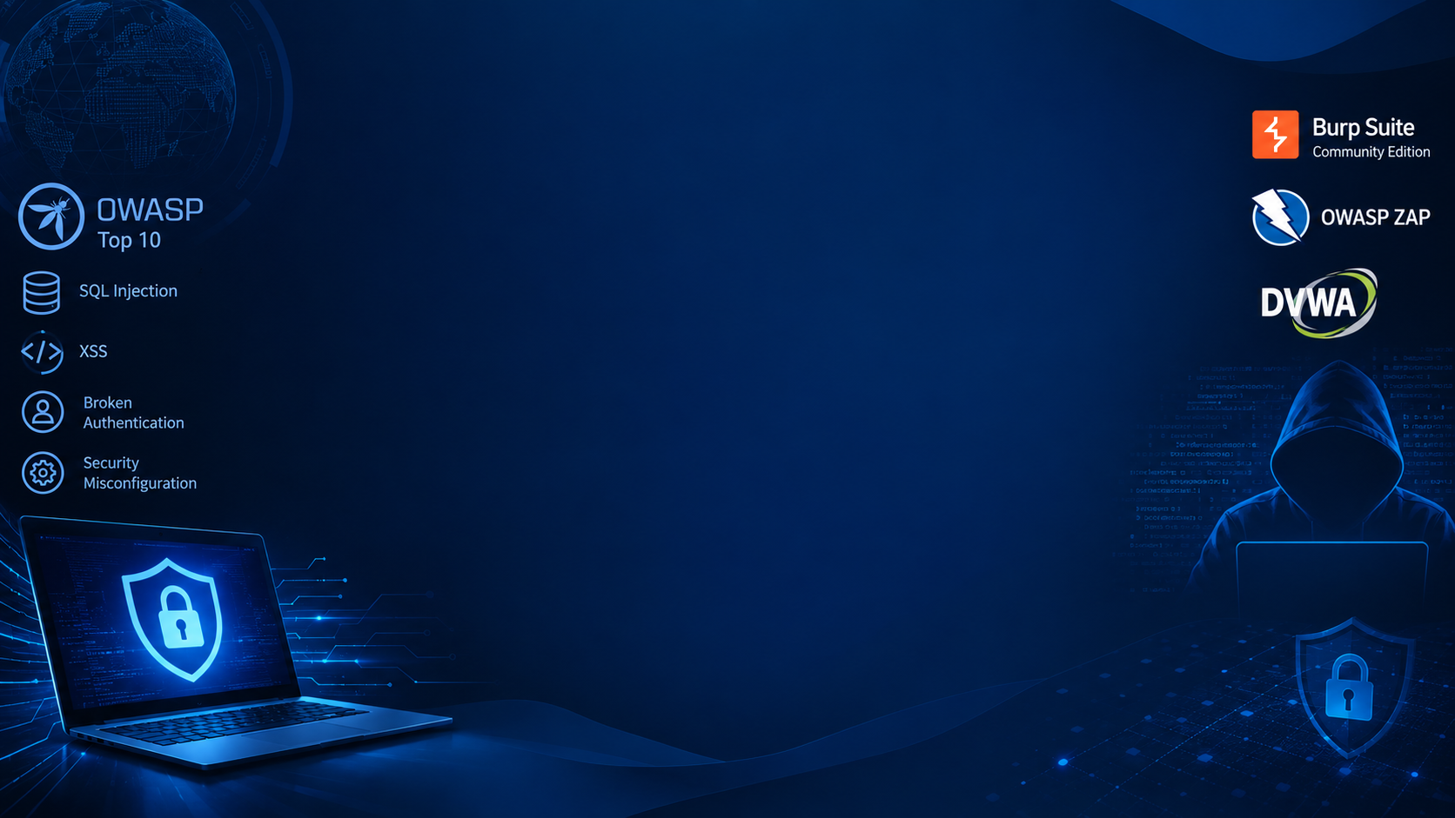
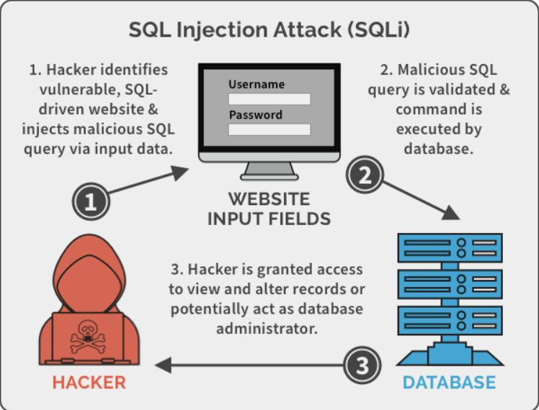
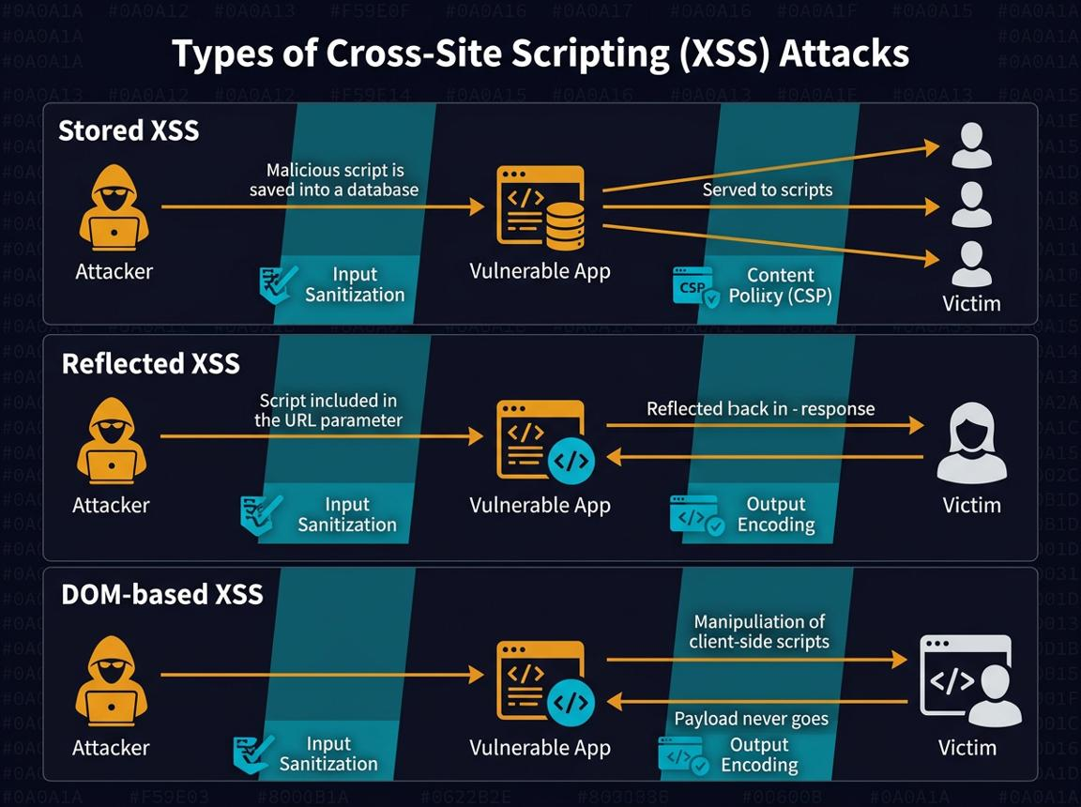
Task 1: Study OWASP TOP 10
OWASP Top 10 is a widely used awareness resource that describes major web application security risks. Your task specifically focuses on four vulnerabilities.
1. SQL Injection (SQLi)
Meaning: Untrusted input changes the intended SQL database query.
Example impact: Unauthorized access to database records.
Prevention: Parameterized queries, input validation, least-privilege database accounts.
Testing: Use DVWA's SQL Injection module in a local lab.
2. Cross-Site Scripting (XSS)
Meaning: An application allows untrusted content to execute as script in a browser.
Reflected XSS: The input is reflected in the immediate response.
Stored XSS: The malicious content is saved and later shown to users.
Prevention: Context-aware output encoding, safe templating, and appropriate sanitization.

Slide 3
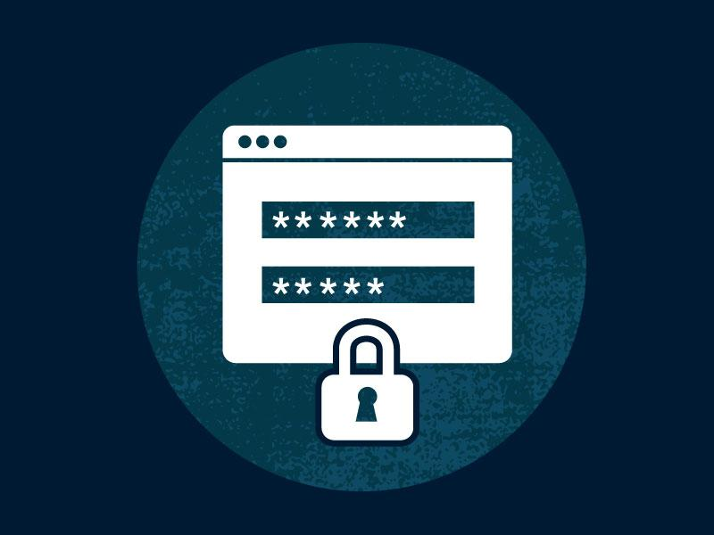
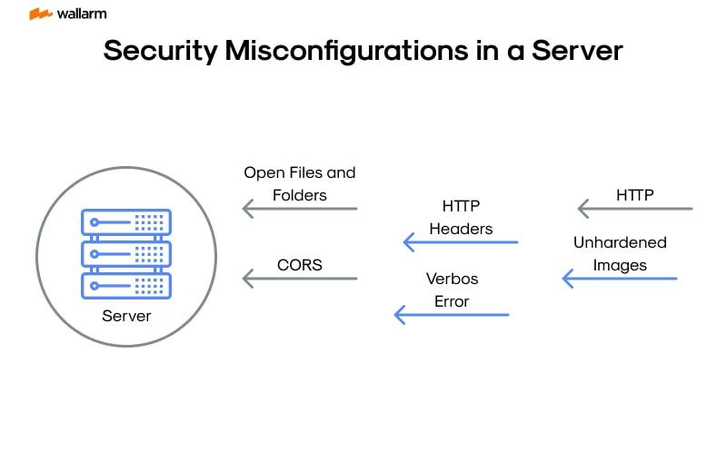
3. Broken Authentication
Meaning: Weak login, session management, or authentication controls allow account compromise.
Examples: Weak passwords, insecure session handling, missing protections against repeated login attempts.
Prevention: Multi-factor authentication, secure session cookies, login throttling, and strong password controls.
4. Security Misconfiguration
Meaning: Systems or applications have insecure settings.
Examples: Debug mode enabled, default credentials, directory listing enabled, excessive error details.
Prevention: Secure configuration baselines, patching, removing defaults, and regular configuration reviews.

Slide 4
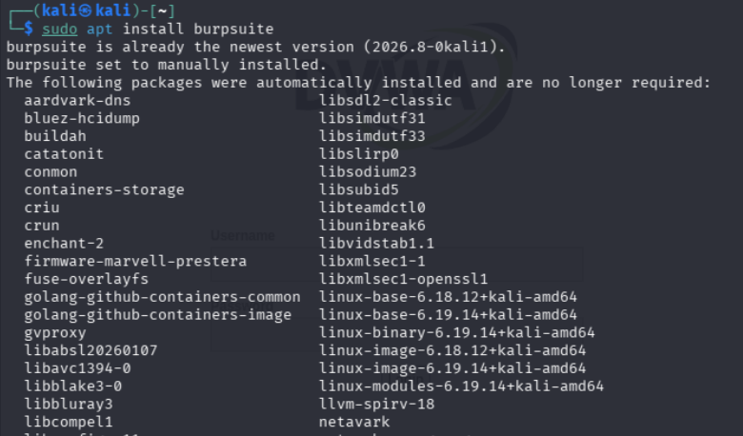
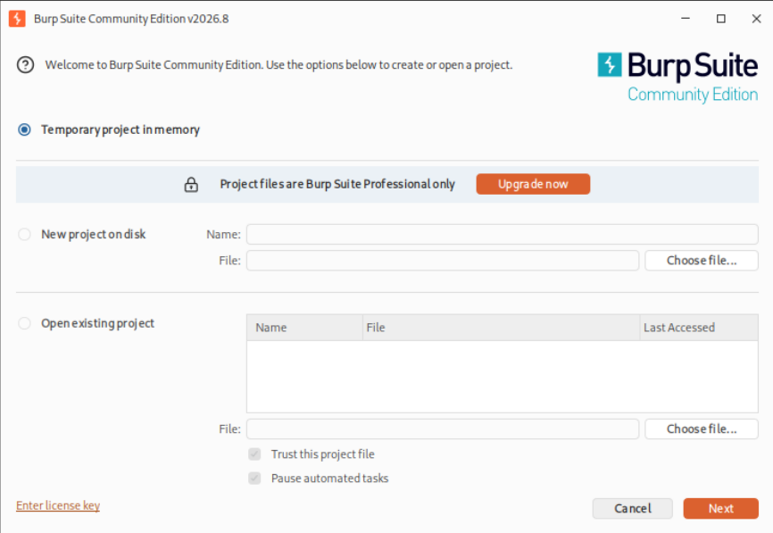
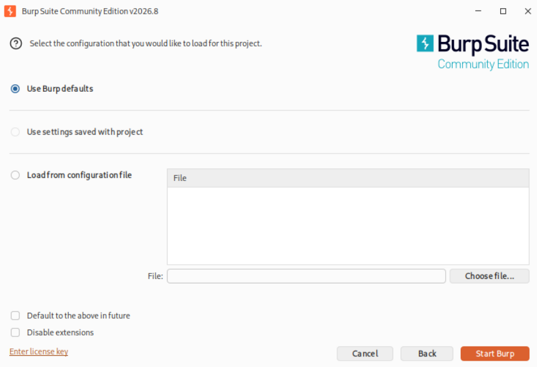
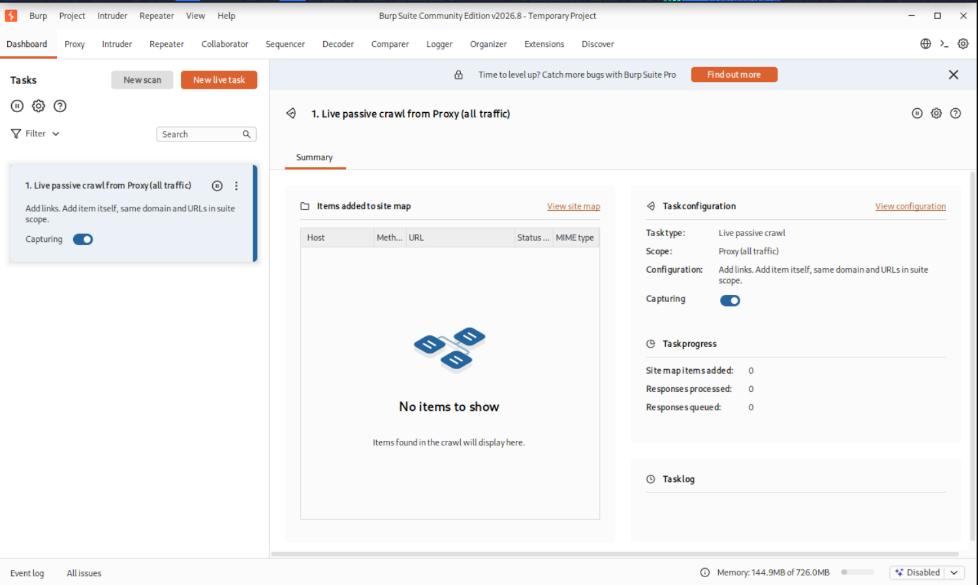
Task 2: Install & Setup Tools
1. Install Burp Suite using the Kali Linux terminal.
2. Launch Burp Suite Community Edition and select temporary project.
3. Choose default configuration settings and start Burp Suite.
4. Open the Dashboard to view available tasks.

Slide 5
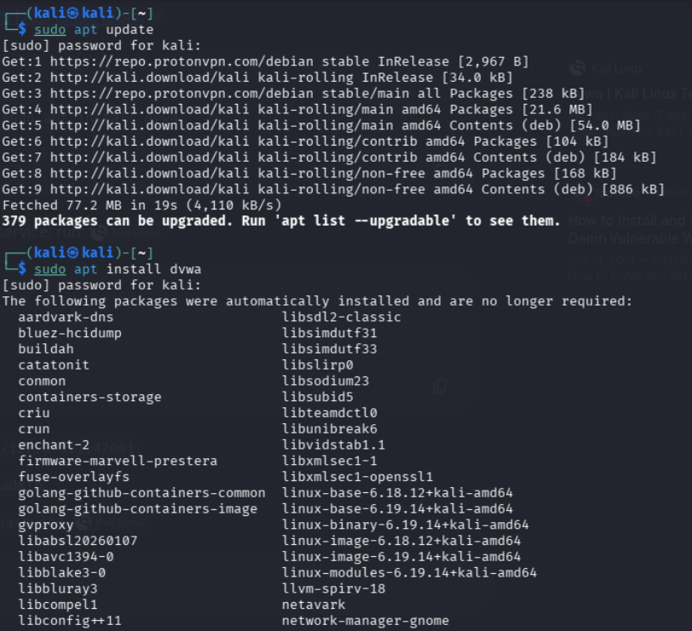
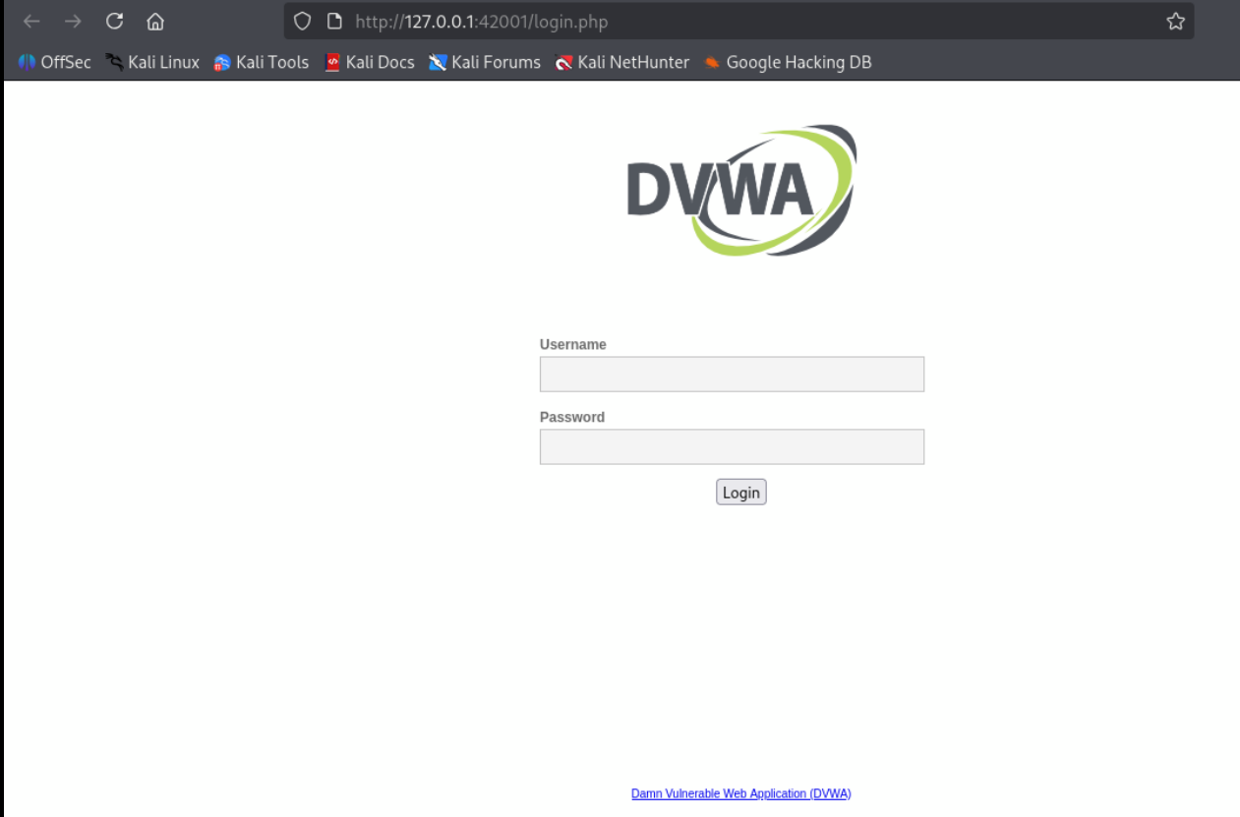
Steps 2: Install DVWA
Open the Kali Linux terminal.
Update the package list using:
bash
sudo apt update
Install DVWA using:
bash
sudo apt install dvwa
Wait for the installation process to complete.
Steps 1: DVWA Login
Open the DVWA web application in the browser.
Enter the username and password.
Click Login to access the application.

Slide 6
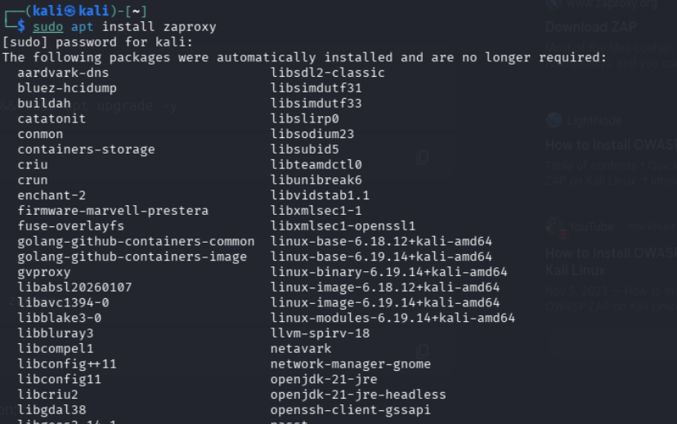
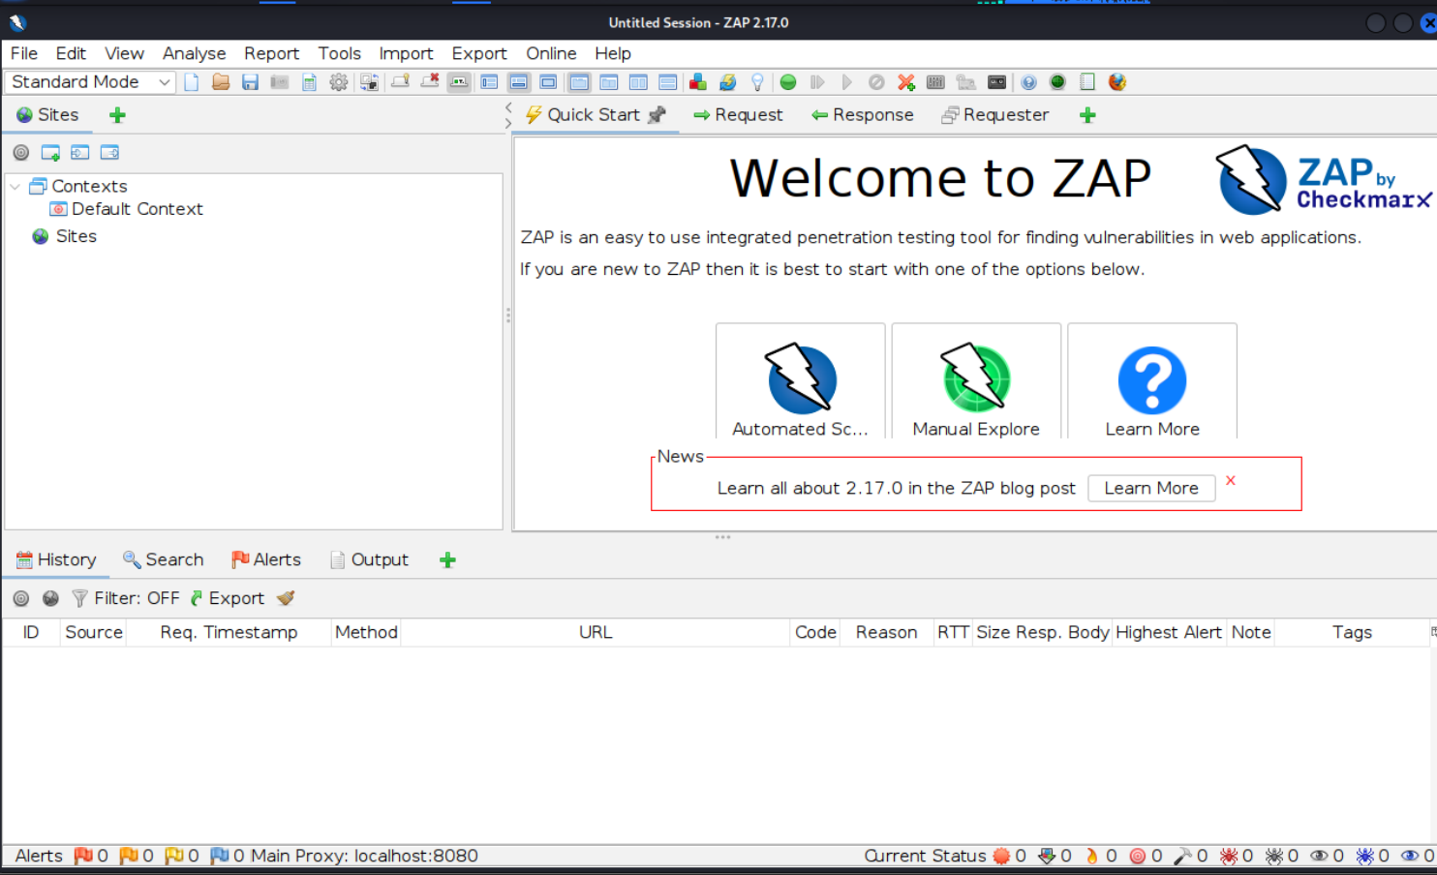
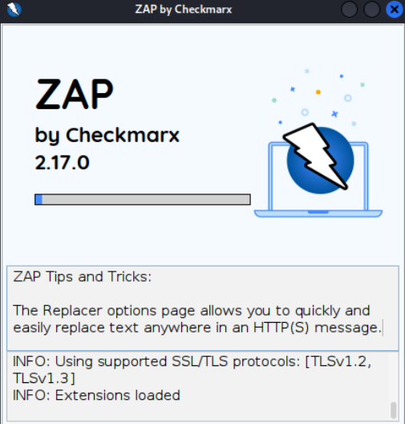
Updated Kali Linux packages.
Installed OWASP ZAP using apt.
Launched ZAP successfully.
Verified the ZAP interface.

Slide 7
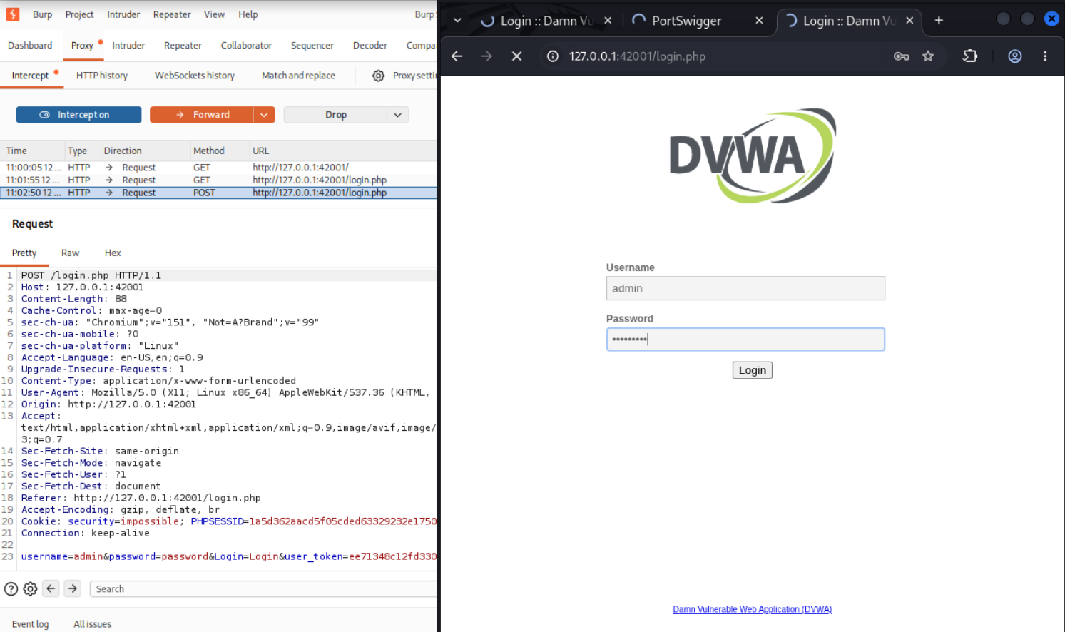
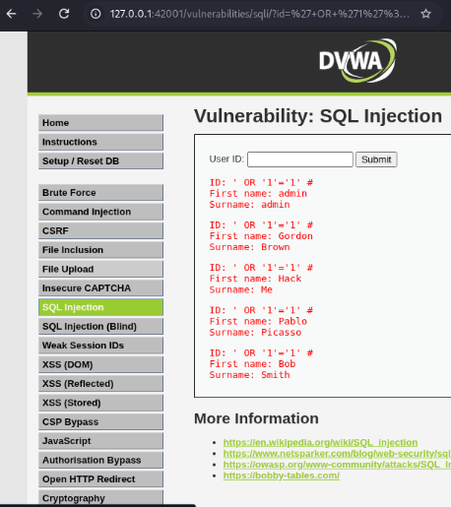
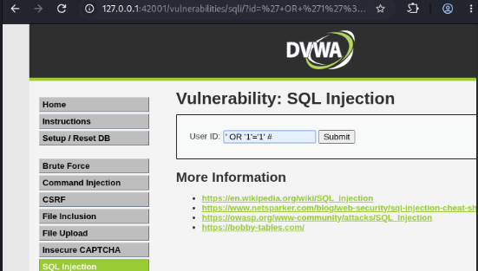
Task 3: Perform Testing (DVWA)
Log in to DVWA using valid credentials.
Intercept and inspect login requests using Burp Suite.
Navigate to the SQL Injection vulnerability module.
Enter the SQL injection payload into User ID.
Submit the payload and observe returned user records.
Analyse unauthorized database access and query manipulation risks.
Recommend prepared statements and proper input validation.

Slide 8
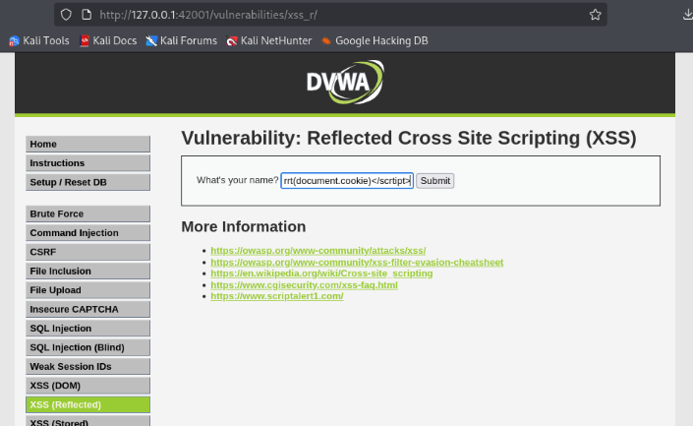
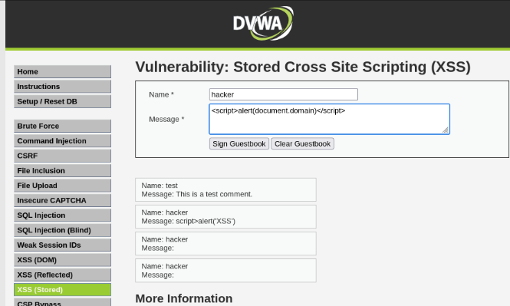
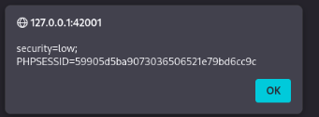
Open DVWA and select Stored XSS vulnerability.
Enter username and JavaScript payload in fields.
Submit guestbook entry and observe stored message.
Select Reflected XSS and enter test payload.
Submit input and observe reflected response behaviour.
Observe alert displaying document cookie information.
Verify session cookie and low security setting.

Slide 9
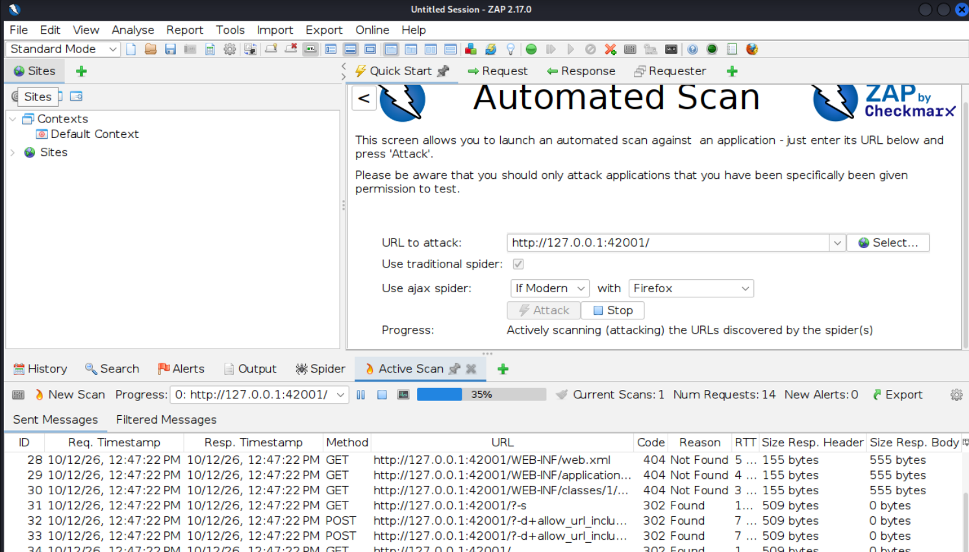
Task 4: Scan Using OWASP ZAP
Open OWASP ZAP and launch the application.
Start DVWA or an authorized test website.
Select Automated Scan from Quick Start.
Enter the target website URL in the field.
Click Attack to begin automated scanning.
Wait until the scan process completes.
Open Alerts to identify security vulnerabilities.
Review vulnerability severity, evidence, and affected URLs.
Click Report and select report generation.
Export the scan report and save it.

Slide 10
Task 4: Scan Using OWASP ZAP
Open OWASP ZAP and launch the application.
Start DVWA or an authorized test website.
Select Automated Scan from Quick Start.
Enter the target website URL in the field.
Click Attack to begin automated scanning.
Wait until the scan process completes.
Open Alerts to identify security vulnerabilities.
Review vulnerability severity, evidence, and affected URLs.
Click Report and select report generation.
Export the scan report and save it.

Slide 11
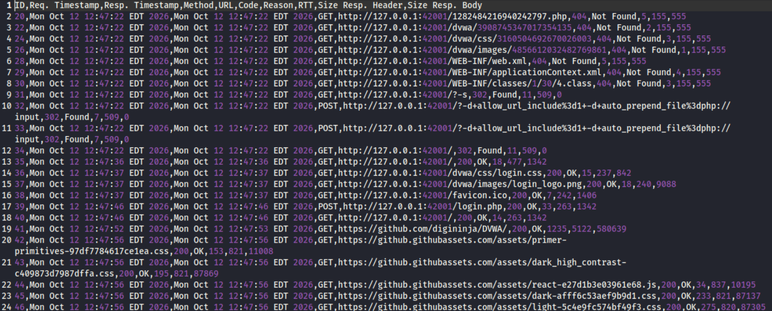
Report

Slide 12


