Slide 1
Cell annotation using machine learning

Slide 2

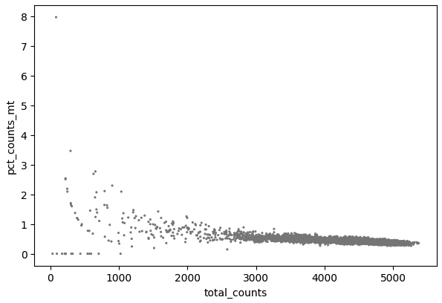
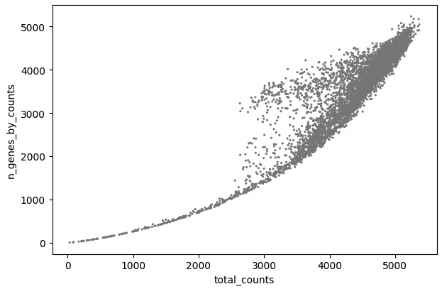
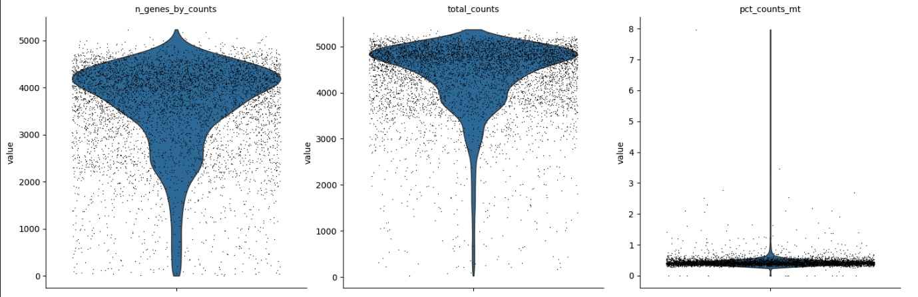
Whole embryo
Data load
Data visualization

Slide 3
WHOLE EMBRYO
Data normalization
Log transformation
Data standardization
Data filtering :
Min genes
Min cells
Max mitochondrial genes percentage
Identifying highly variable genes
Data regression
Total_counts
mitochondrial genes percentage

Slide 4
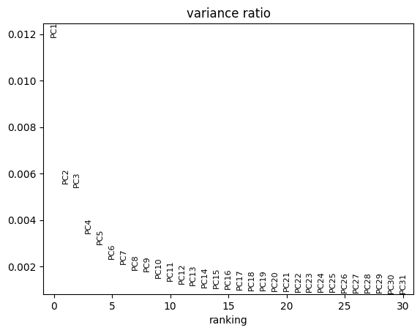
Whole EMBRYo
PCA FEATURE SELECTION
DATA SHUFFLING
K-FOLD VALIDATION
K_list = [3, 5, 7] – classifier count
L_list = [2, 3, 4] – majority needed

Slide 5
WHOLE EMBRYO
classifier1 = SVC(kernel='rbf', C=1.0, gamma='scale’)
classifier2 = RandomForestClassifier(n_estimators=100, max_depth=None, max_features="sqrt")
classifier3 = KNeighborsClassifier(n_neighbors=10)
classifier4 = GradientBoostingClassifier(n_estimators=20, max_depth=5, learning_rate=1)
classifier5 = LogisticRegression(penalty='l2', solver='lbfgs', max_iter=5000)
classifier6 = RandomForestClassifier(n_estimators=200, max_depth=10, max_features="log2")
classifier7 = GradientBoostingClassifier(n_estimators=50, max_depth=3, learning_rate=0.5)

Slide 6



Whole EMBRYO

Slide 7
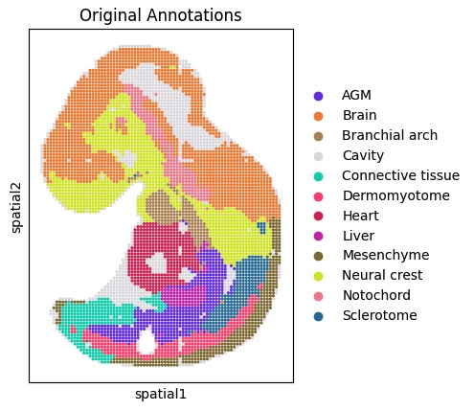
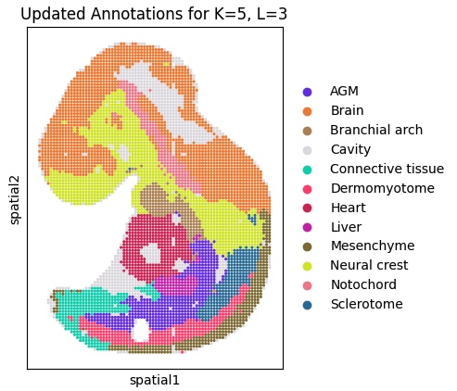


WHOLE EMBRYO

Slide 8
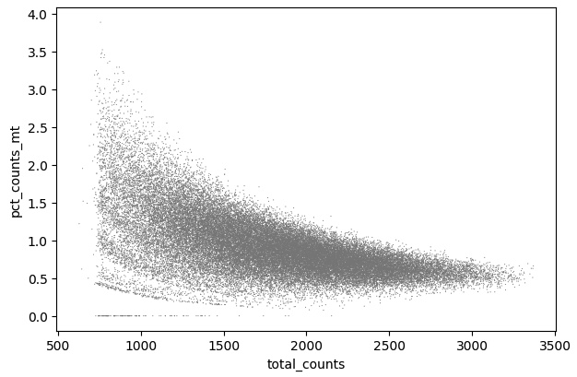
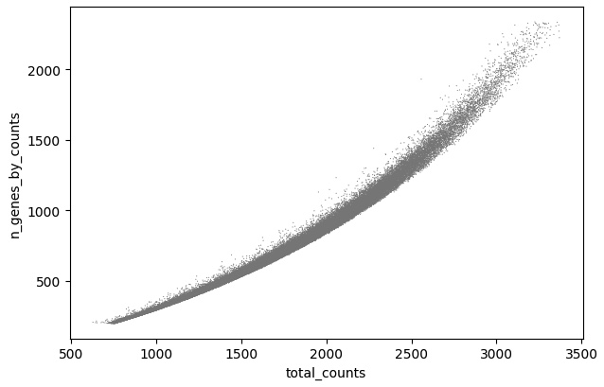
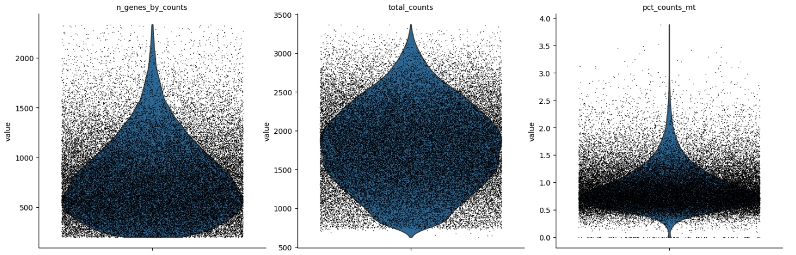
BRAIN embryo
Data load
Data visualization

Slide 9
BRAIN EMBRYO
Data normalization
Log transformation
Data standardization
Data filtering :
Min genes
Min cells
Max mitochondrial genes percentage
Max number of genes
Identifying highly variable genes
Data regression
Total_counts
mitochondrial genes percentage

Slide 10
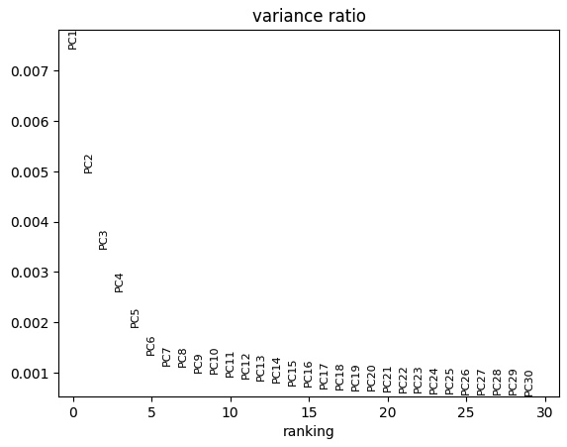
BRAIN EMBRYo
PCA FEATURE SELECTION
DATA SHUFFLING
K-FOLD VALIDATION
K_list = [3, 5, 7] – classifier count
L_list = [2, 3, 4] – majority needed

Slide 11
BRAIN EMBRYO
classifier1 = SVC(kernel='rbf', C=1.0, gamma='scale’)
classifier2 = RandomForestClassifier(n_estimators=100, max_depth=None, max_features="sqrt")
classifier3 = RandomForestClassifier(n_estimators=200, max_depth=None, max_features="sqrt")
classifier4 = RandomForestClassifier(n_estimators=100, max_depth=10, max_features="sqrt")
classifier5 = RandomForestClassifier(n_estimators=200, max_depth=None, max_features="log2")
classifier6 = RandomForestClassifier(n_estimators=100, max_depth=None, max_features="log2")
classifier7 = RandomForestClassifier(n_estimators=200, max_depth=10, max_features="log2")

Slide 12



BRAIN EMBRYO

Slide 13
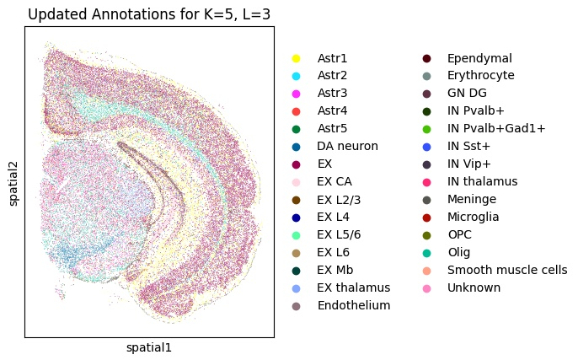
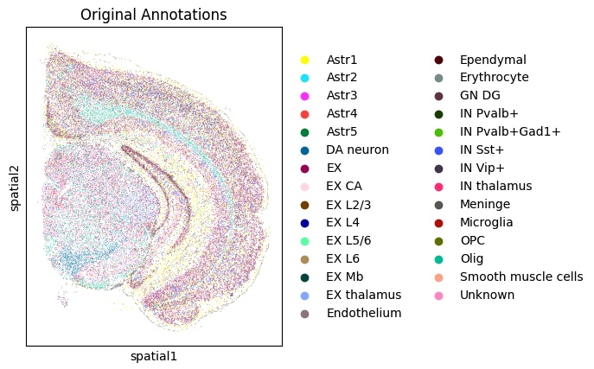
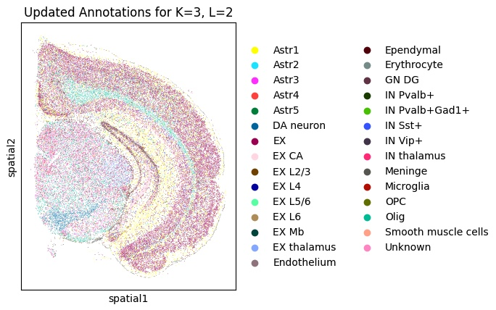

BRAIN EMBRYO

Slide 14
ThANK YOU FOR your ATTENTION
Raša Stojanović
Dejan Drašković

