Slide 1
Cardio Health Analysis using Machine Learning

Slide 2
This is final data science internship Project on machine learning.
The Cardio dataset is about various record of patients, the prediction analysis is to know those among the patient that has heart disease.

Slide 3
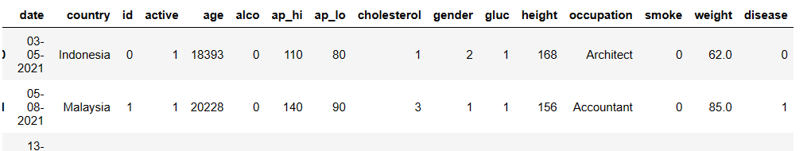
The Cardio dataset is about various record of patients, the prediction analysis is to know those among the patient has heart disease.
Among each record, there are factors like 'date', 'country', 'id', 'active', 'age', 'alco', 'ap_hi', 'ap_lo',
'cholesterol', 'gender', 'gluc', 'height', 'occupation', 'smoke',
'weight', 'disease'],
.

Slide 4
In this cardio records , there are major factors which are the independent and dependent variable, After the dataset was cleaned,
(EDA) was performed to get some insight on this factors recorded, and to also know the correlation and anomalies in the variables.

Slide 5
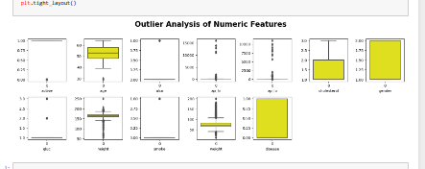
EDA By Visualization

Slide 6
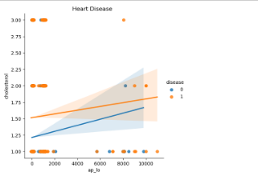
EDA By Visualization

Slide 7
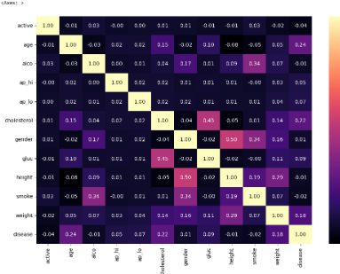
EDA By Visualization

Slide 8
independent variables was selected, dependent variable was also selected, disease was a target variable, models was created in order to compare each them and get
the most accuracy for the patient's analysis, models was trained and tested

Slide 9
Precission, Accuracy and F1 score obtained.
Logistic Regression Accuracy : 72.27%
Logistic Regression F1 score: 71.05%
KNeighbor Accuracy : 65.33%
KNeighbor F1 score: 64.66%
Decision Tree Accuracy : 63.58%
Decision Tree F1 score: 63.10%
Random Forest Accuracy : 70.74%
Random Forest F1 score: 70.67%
xgb Accuracy : 73.69%
xgb F1 score: 72.69%

Slide 10
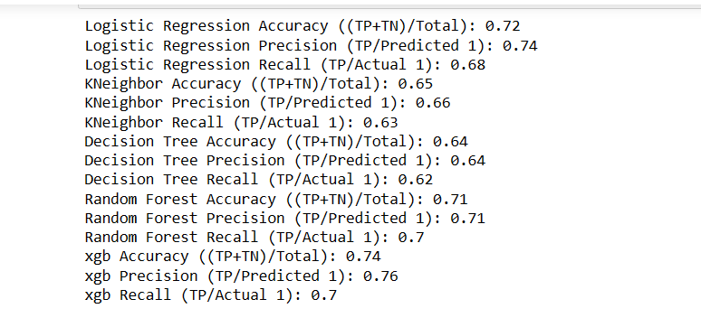

Slide 11
The result of confusion matrix
True Positive (TP) is 5413,
False Negative (FN) is 1575,
False Positive (FP) is 2109
True Negative (TN) is 4903

Slide 12
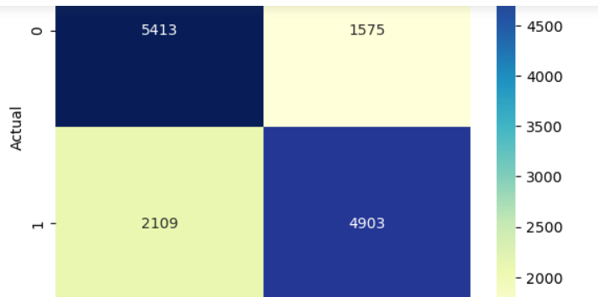
Visualization with Confusion matrix

Slide 13
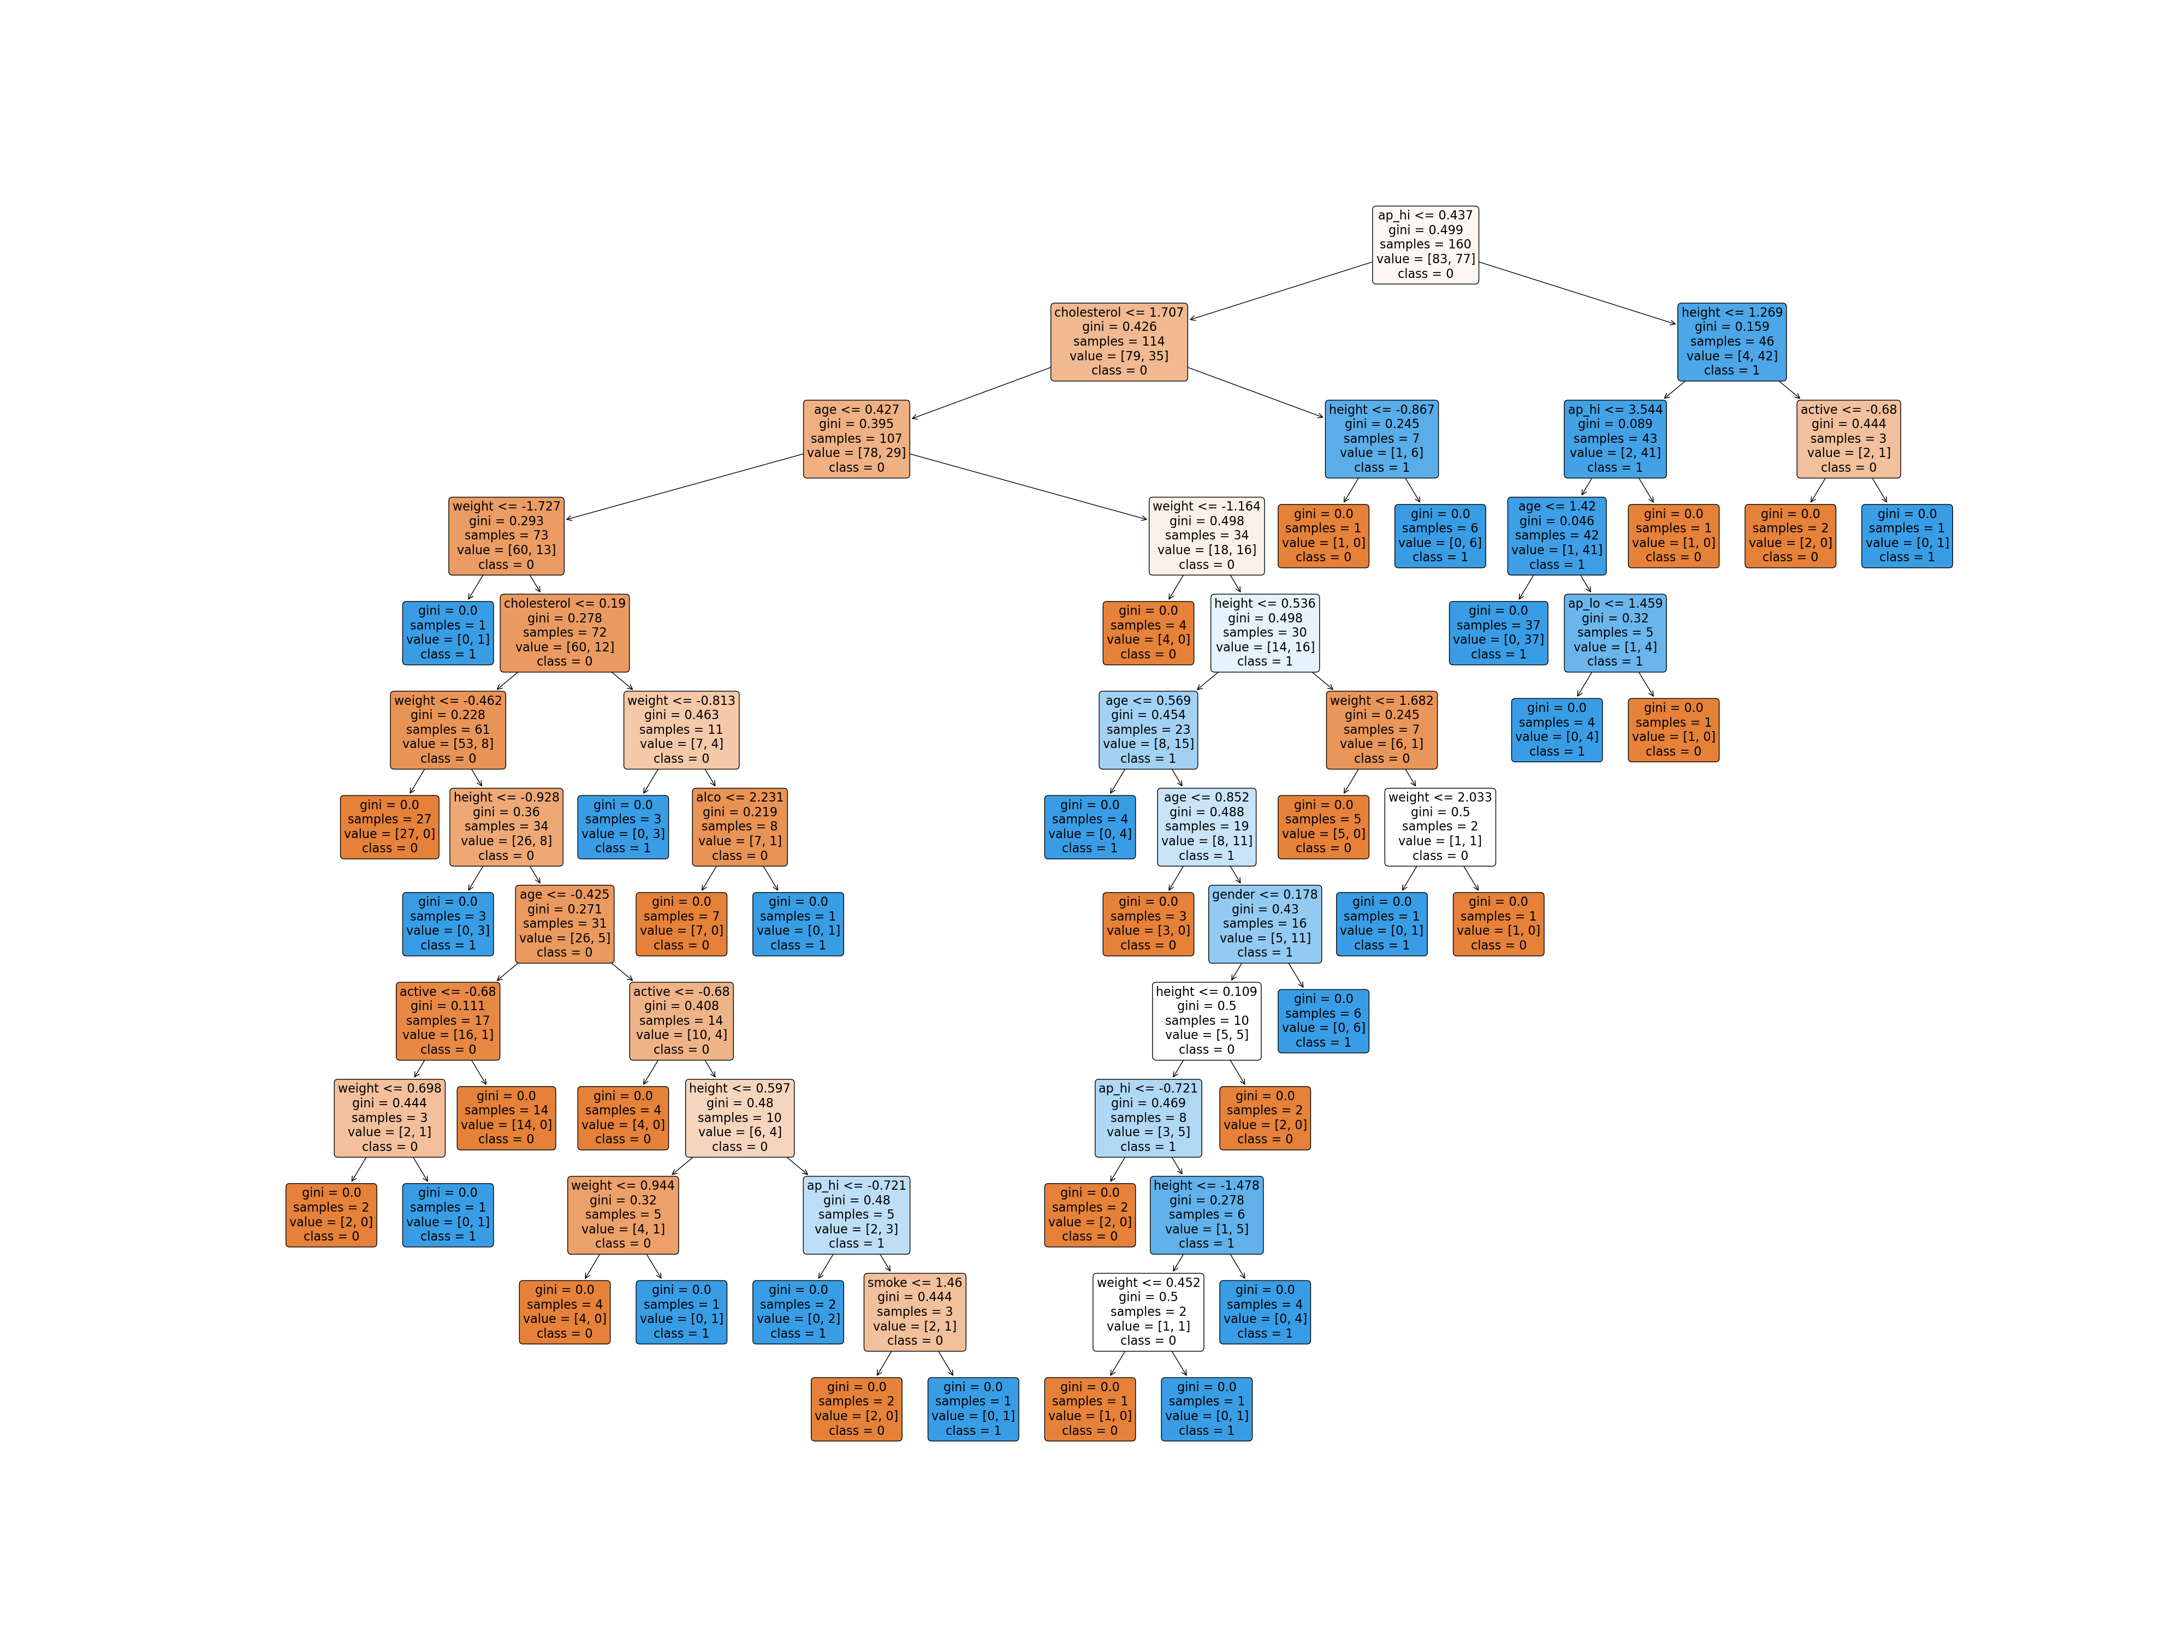
The visualization with decision tree
then decision tree , the GINI was about 4%
and sample about 1%

Slide 14
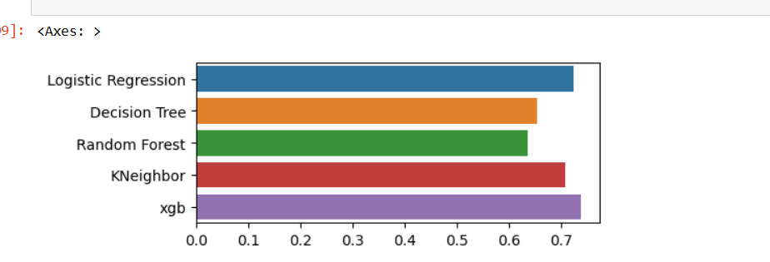
Comparing model performance visual

Slide 15
Conclusion
In this prediction analysis, the models used are showing a good percentage of accuracy and precision, which indicate the prediction
is accurate in this dataset. there is high number of True positive, numbers of patient with cardio disease.

