Slide 1
s
Data Science Certification Internship Project
Loan Prediction

Slide 2

A large portion of a retail bank’s profits come from the interests incurred on home loans.
But this is incumbent upon the timely payments of premiums of the loans by the clients. If the client defaults on the loan repayment, then the bank incurs a huge loss.
It is thus very important for banks to choose its clients carefully.
This project is about loan prediction to identify creditworthiness of borrowers,

Slide 3
The dataset comprises of 5000 rows and 17 columns.
I imported the dataset and done some data cleaning with some function, assessing the dataset using isnull(),isna(),duplicated,etc.
I done explanatory analysis and visualization using histogram, heatmap,crosstab,boxplot etc.

Slide 4

I converted catagorical data into numerical data
When categorical data is correctly transformed into numerical data, it allows machine learning algorithms to effectively process.
The three alogrithm suitable for this kind of prediction, which i uses was decision tree, logistic regressionand support vector machine.
In my decision tree , I used a few sample (250)rows of datafrom my dataset to be clearer and also used the full dataset.

Slide 5
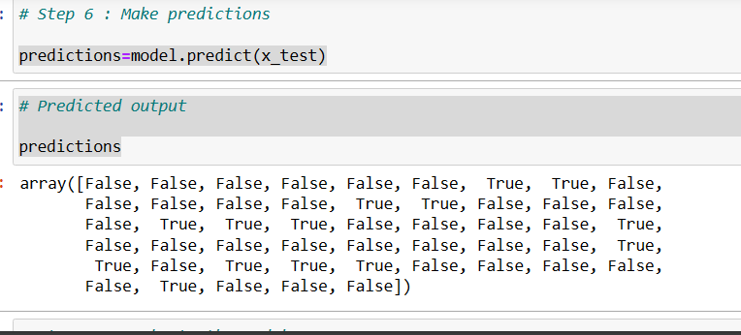
prediction and accuracy

Slide 6
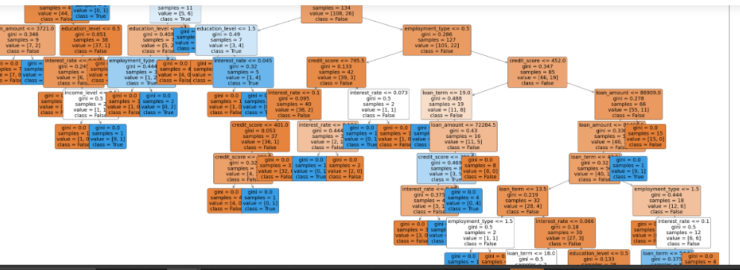

Slide 7
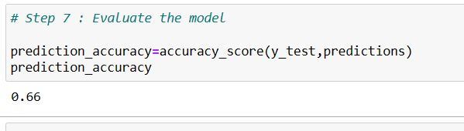

Slide 8
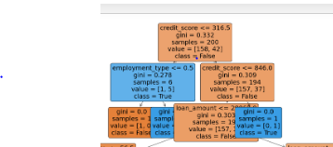
Show that it is not just credit score and employment_type that affects loan defaulter and non_default but other factor which you can in this decision tree model that are in this dataset and the gini

Slide 9
Logistic regression
Using Logistic regression show clear picture about this prediction of creditworthiness, using label encoding we represented false and true with 0 and 1 which also mean defaulter and non_defaulter

Slide 10
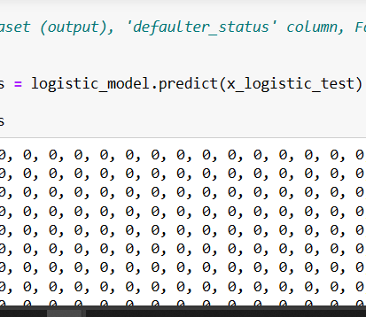
prediction and accuracy score

Slide 11
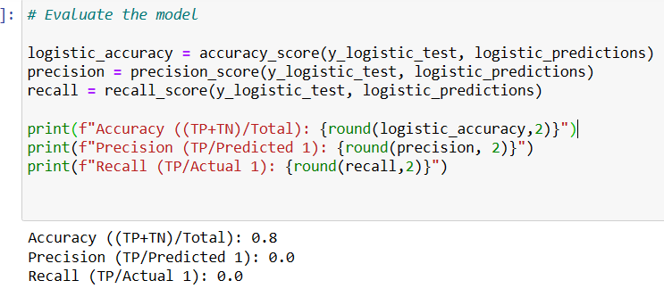

Slide 12
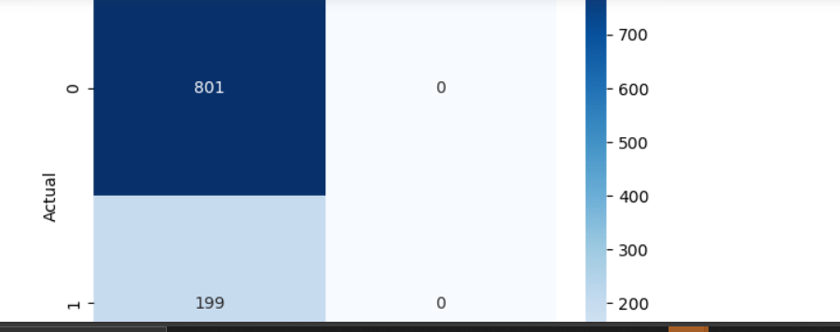
And comfusion matrix as

Slide 13
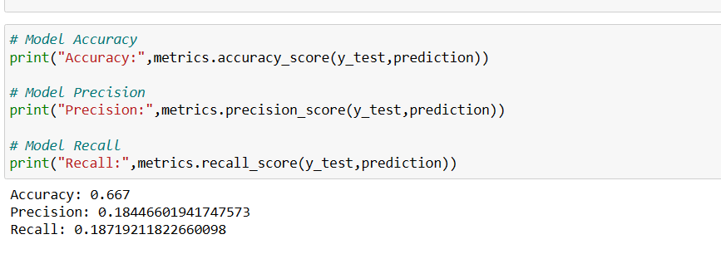
SVM
Using SVM to obtain high accuracy of the prediction

Slide 14
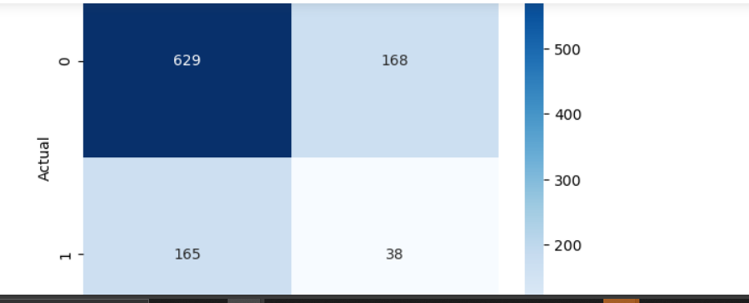
SVM
Using SVM to obtain high accuracy of the prediction

