Slide 1
Data Science Certification Internship Project
Real_Estate

Slide 2

In the real estate industry, accurate property valuation plays a crucial role in making informed buying and selling decisions. Property owners, investors, and real estate professionals rely on accurate and reliable valuation estimates to determine fair market prices, negotiate deals, and assess investment opportunities
This real estate analysis was carried out in PowerBI and Excel with dashboard on both
This dataset contains all the required detail such as block, flat model, flat area, resale price etc.

Slide 3
First I started by data cleaning, to ensure that the dataset is okay for analysis.
In powerbi, I did some data modeling and I use dax to do some data calculation and made some data visualization. building a good dashboard for more clear analysis.

Slide 4
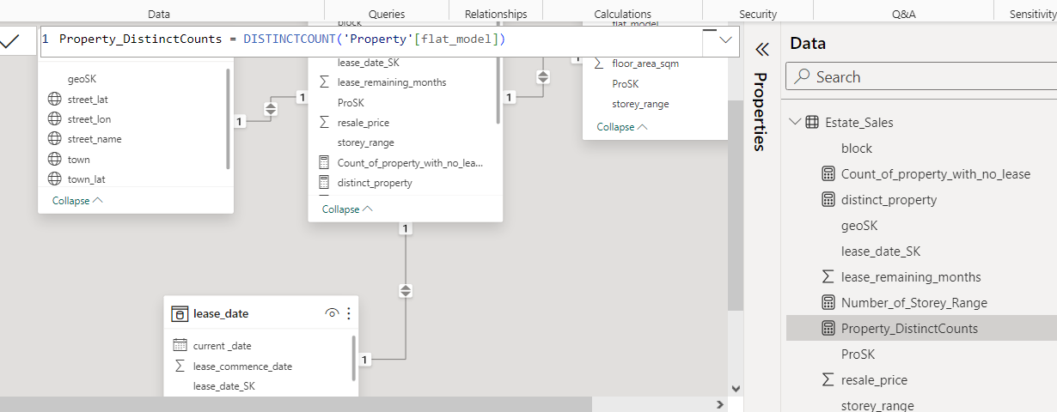

Slide 5
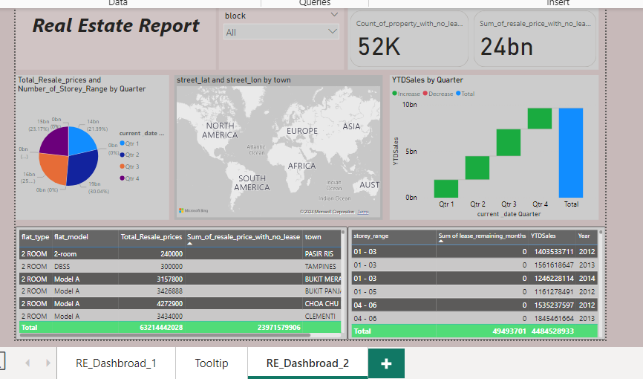

Slide 6
Using Exporatory analysis tool to get the total resale_price and average and the trend line of different property and their geographical region
Using KPI chart in power bi visual tool tool to visualize our target resale_price.

Slide 7
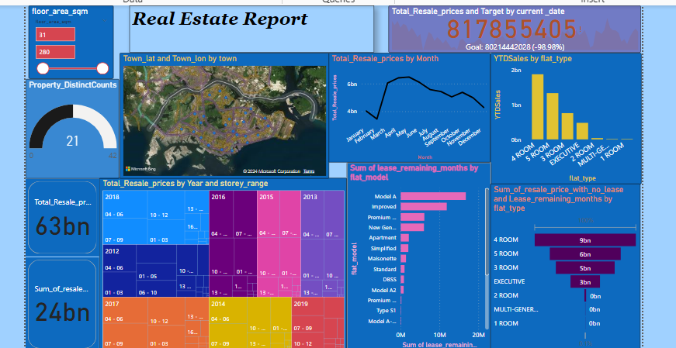

Slide 8
Then in excel I started by data descriptive analysis, which I obtain the descriptive analysis each variable of the dataset,
And second, I did the exporatory analysis , using pivot table and some excel function calculation,
Using some visualization tool like pivot table, I was able to obtain some insight on some datasets that does not have lease remaining, and some geographical region

Slide 9
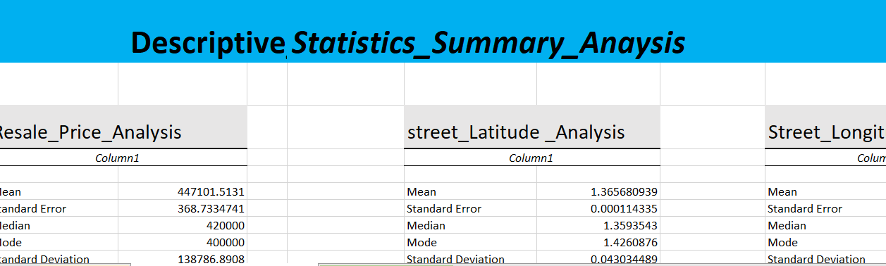

Slide 10
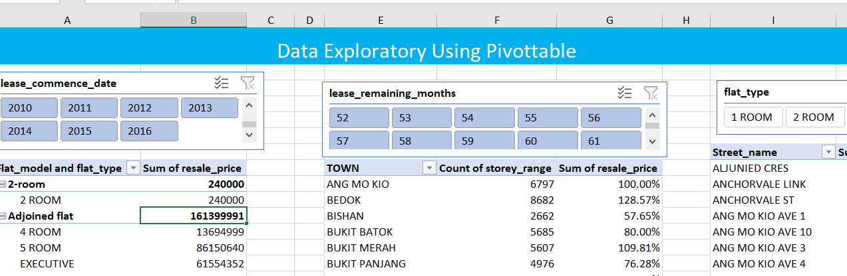

Slide 11
