Slide 1
“WellBot: An NLP-powered Health-care and Mental Health Support Chatbot”
Riya Jomy Kannampuzha: rkannampuzha (SUID : 303601108)
Rinkal Mistry: rkmistry (SUID: 809590547)
Jincy John: jijohn (SUID: 318032982 )
Anoushka Mergoju: amergoju (SUID: 328542442)
Sree Durga Phanidhar Manikonda (SUID : 396944482)

Slide 2
Introduction
Welcome to our NLP project, introducing WellBot, your trusted companion in health and mental wellness. In today's fast-paced world, accessing healthcare and mental health support can be challenging, but WellBot aims to change that.
Utilizing Natural Language Processing (NLP) technology, WellBot engages in conversations with users, providing immediate advice on health and mental wellness matters.
With WellBot, users can communicate their concerns or emotional states, and the chatbot intelligently comprehends their needs. Our project goal is clear: to leverage NLP techniques to break down barriers in accessing healthcare and mental health support.

Slide 3
Solution
Imagine having a reliable healthcare and mental wellness companion right at your fingertips. That's what 'WellBot' offers. In a world where seeking support can feel daunting, 'WellBot' streamlines the process through personalized conversations.
Here's the key: WellBot engages users in open discussions about their health concerns. Using cutting-edge technology, it provides tailored advice for both physical and mental health issues. For common symptoms, WellBot offers immediate support and guidance. However, if it detects any serious conditions, it promptly recommends seeking professional medical help.
With WellBot, there's no need to wait for appointments or feel embarrassed about discussing sensitive topics. It's like having a knowledgeable friend by your side, ready to offer assistance whenever you need it.

Slide 4
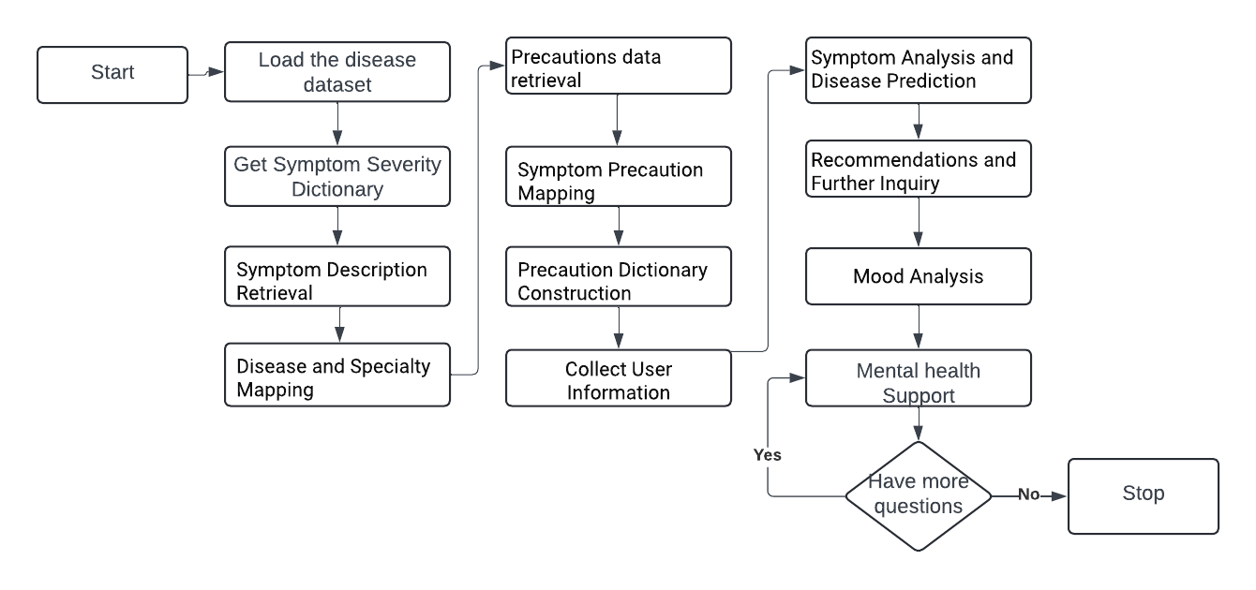
Methodology

Slide 5
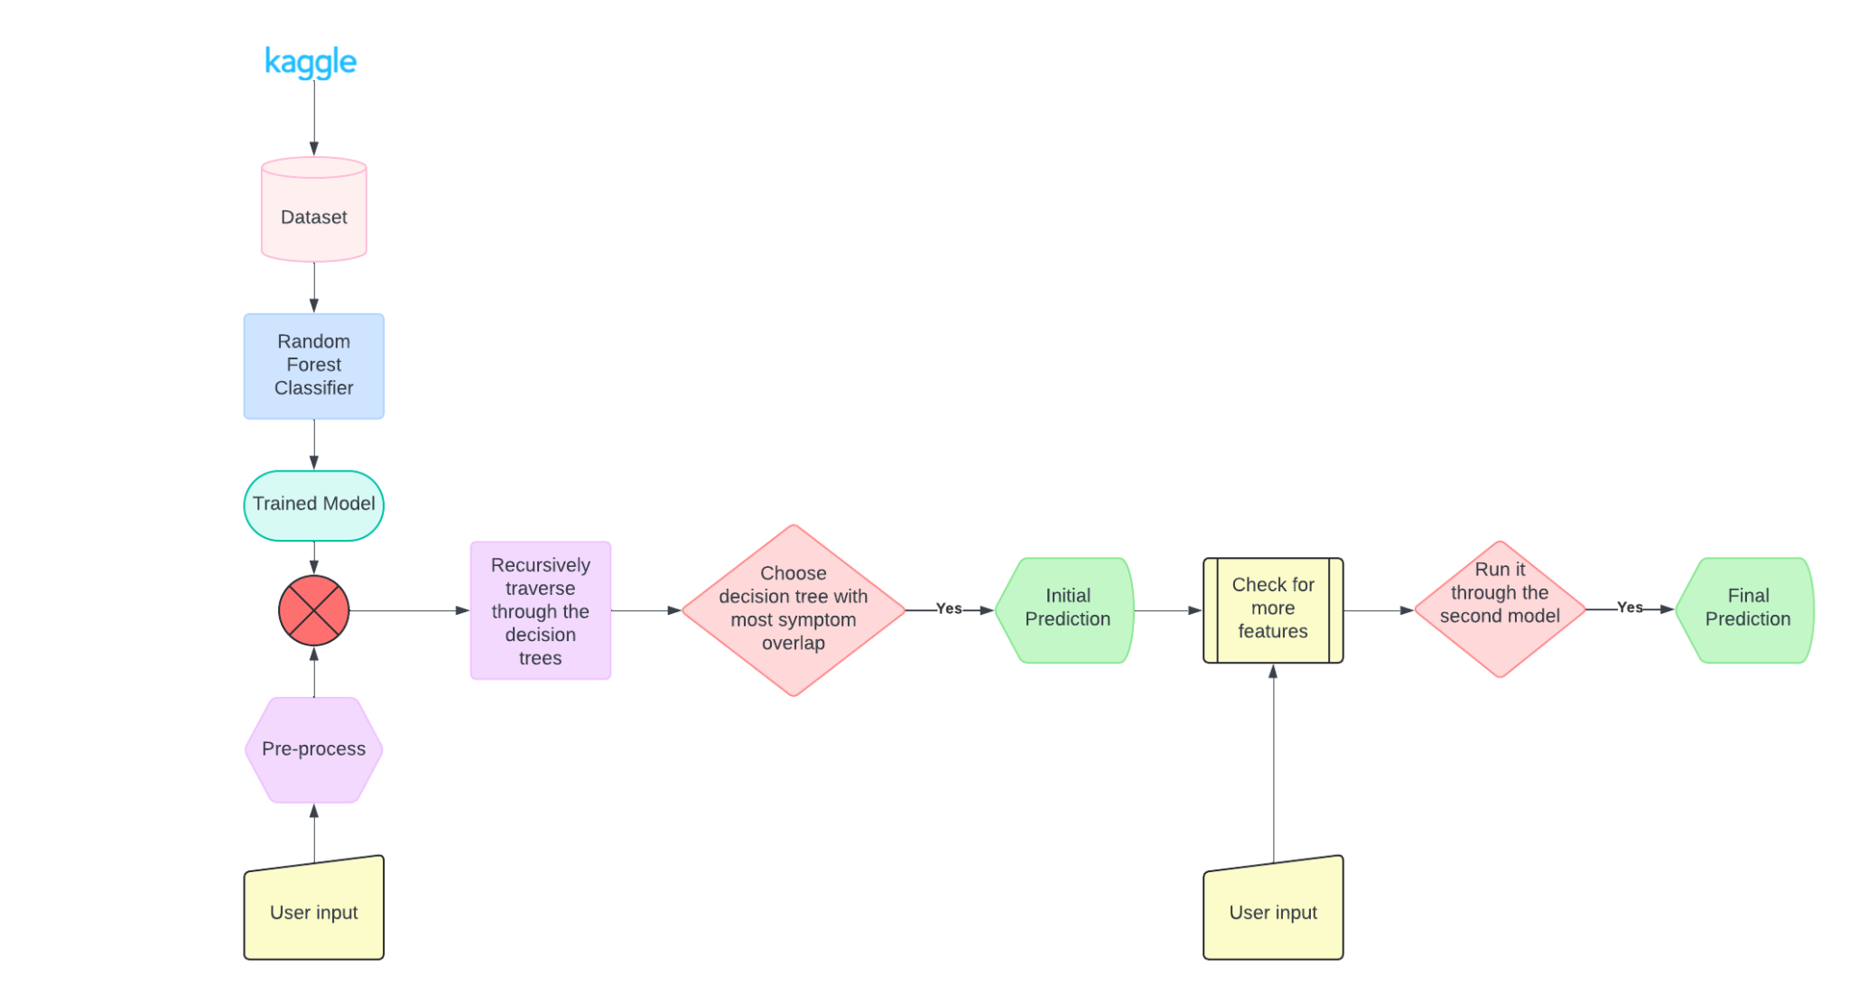
Disease Prediction
Dataset: Disease Symptom Prediction competition from Kaggle.
Ensemble Learning Approach: Utilize Random Forest classifier for symptom tracking.
User Input Processing: Gather 3-4 user symptoms and preprocess them to match dataset.
Decision Tree Traversal: Traverse through Random Forest decision trees to identify matching nodes for user symptoms, constructing a dictionary of matched symptoms and their parent nodes.
Symptom Confirmation and Prediction: Confirm additional symptoms related to matched disease, incorporate them into the input, and conduct a second prediction with updated vectors. Present prediction results, now enriched with confirmed symptoms.

Slide 6
Disease Description/Severity
Data Sources: Our system utilizes three CSV files: "symptoms_description.csv," "symptom_precaution.csv," and "symptom_severity.csv." These files contain disease details crucial for symptom-based classification, enriched descriptions, and severity data.
Implementation Overview: Our system efficiently matches user-reported symptoms with diseases, leveraging indexing and pattern matching techniques. It provides tailored advice and severity assessments, enhancing users' understanding of their health concerns.
Symptom Matching: By employing data indexing and pattern matching, our system accurately identifies diseases based on user-reported symptoms.
Severity Assessment: Utilizing severity data from "symptom_severity.csv," our system calculates severity scores, aiding in disease seriousness assessment and decision-making.
Formula : (sum*days)/(len(exp)+1)>13

Slide 7
Doctor Recommendation
User Input: When a user shares their symptoms with the chatbot, the platform captures this input for analysis.
Data Lookup: Our tool refers to the "symptoms_description" file, which organizes data into symptom, disease, and doctor specialty columns.
Symptom Matching: The platform matches the user's symptoms with those listed in the dataset, ensuring accurate identification of potential diseases.
Specialty Consideration: Taking into account the specialty associated with each disease, the interface determines the relevant medical expertise required.
Doctor Retrieval: Using the identified specialty, the tool retrieves doctor information from the "doctors.csv" file which being obtained from website named “www.zocdoc.com”, ensuring a match between user needs and available expertise.
Recommendation Process: Finally, the chatbot suggests a doctor to the user along with a link to the doctor's online portal, making it easier for the user to schedule an appointment.

Slide 8
Mental Health Chatbot
Our mental health support chatbot is an integration of a mood analyzer with an FAQ system that provides nuanced support and resources for mental health concerns.
By leveraging a dataset from Kaggle with over 500 mental health related questions and answers, our wellness bot builds on a Linear SVC model for text classification. It is trained on TF-IDF vectorizer question data, learning to associate specific patterns and terms with corresponding intents. By utilizing an interactive chat interface, the bot prompts the user for their query and based on their intent, it retrieves a corresponding answer from dataset.
The integrated mood analyzer preprocesses mood-related user inputs using Logistic Regression to assess emotional states. It evaluates textual data based upon a trained model that utilizes another Kaggle dataset (i.e., Mental Health Corpus which includes over 27000 labelled sentences on depression and anxiety) to identify patterns indicating positive or negative emotional states, enhancing the chatbot response accuracy.
Upon receiving queries, the system predicts the mood, fetching appropriate responses for offering coping strategies and mental health tips for either positive/negative mood.

Slide 9
Analysis
Mood Analyzer Experimental Analysis: After testing our mood-related mental health corpus data against Logistic Regression and Random Forest; the prior seemed to be a better fitting model since it accommodated the sparseness of the data better. The FAQ dataset could not be used in this model due to it being an non-labeled dataset and it was determined that a supervised learning approach would work better for our mood classification model.
Disease Predictor Experimental Analysis : In our experimental analysis of disease prediction, we found that the Random Forest Classifier surpassed the Decision Tree Classifier in performance. While the Decision Tree Classifier displayed notable bias, overfitting, and a lack of generalization, the Random Forest Classifier offered superior accuracy and generalization. Particularly noteworthy is our dataset's high dimensionality, with over 140 features. In this complex environment, the Random Forest algorithm excelled in capturing the finer details in the dataset, leading to more robust predictions.

Slide 10
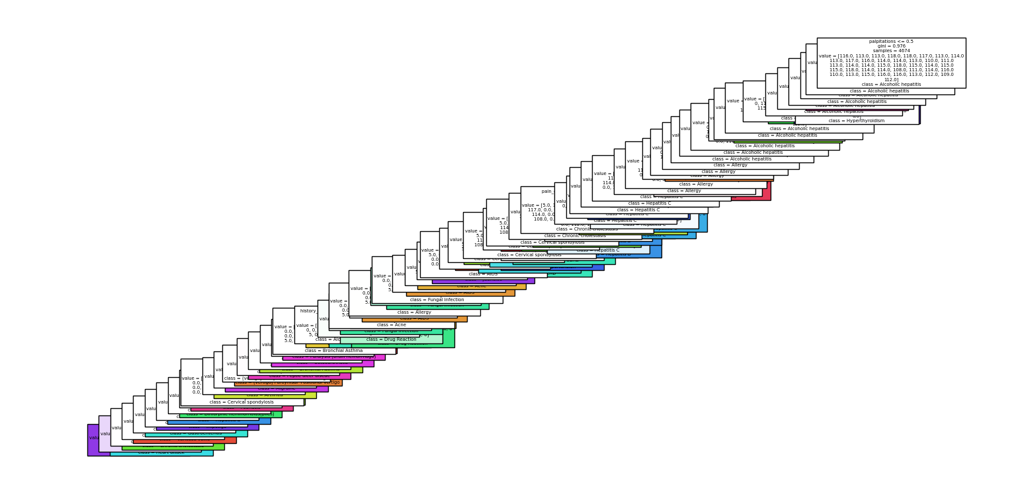
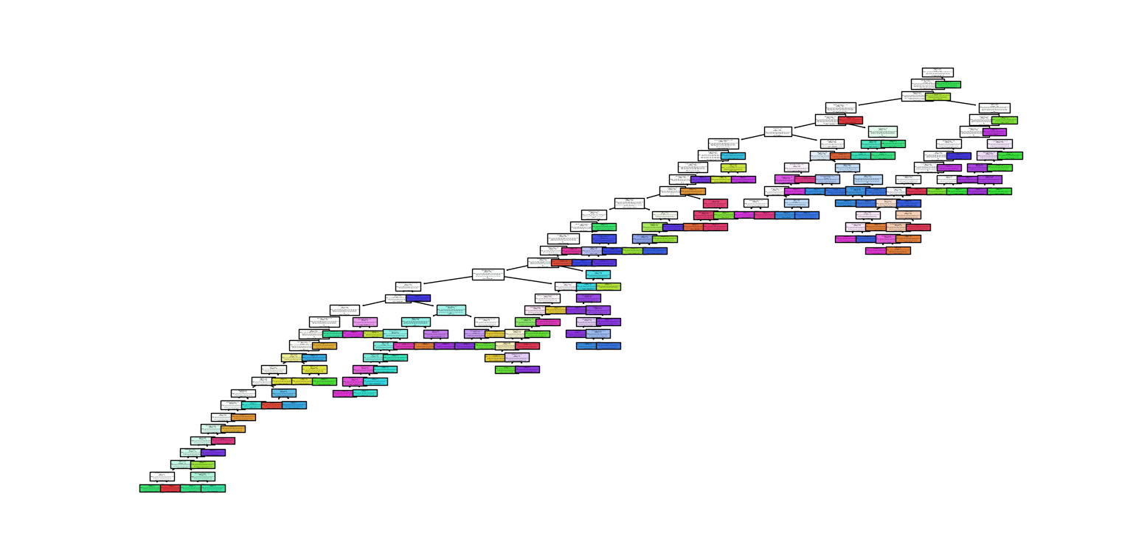
Decision Tree Classifier vs Random Forest Classifier

Slide 11
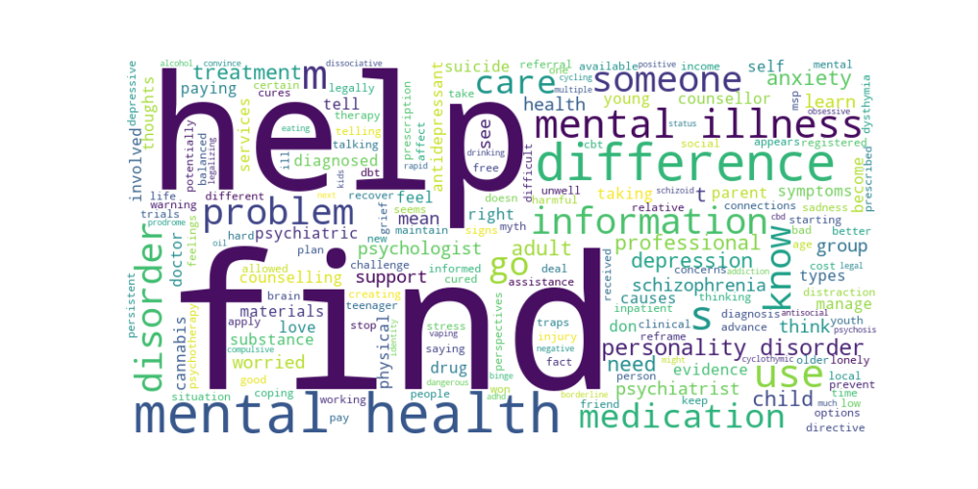
FAQ Mental Health Chatbot

Slide 12
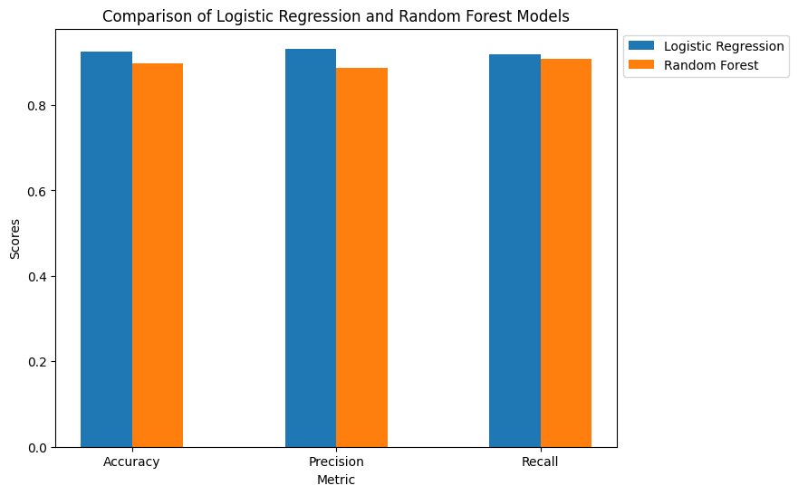
Results
Mood Analyzer Model Performance: The Logistic Regression model is 3.78% more accurate, has 5.26% higher precision, and 2.07% higher recall than Random Forest.

Slide 13
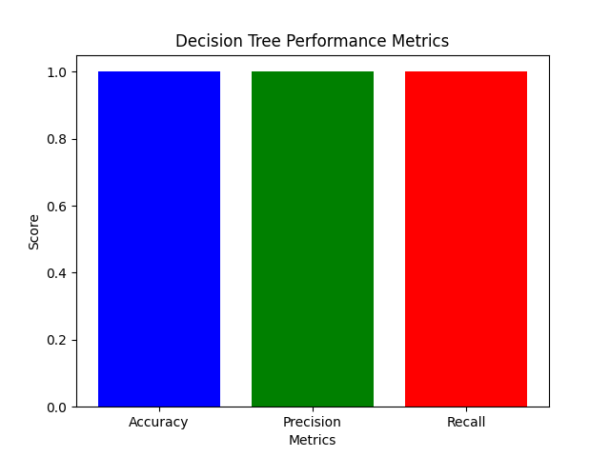
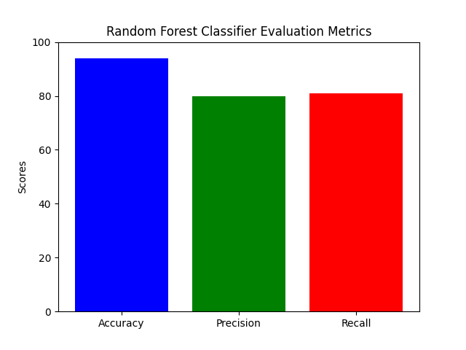
Results - Disease prediction

Slide 14
Live Demo
Sample Prompts
Symptoms - congestion, chest pain, runny nose, chills - Common Cold
Symptoms - itching, skin rash, red spots, fever - Chicken Pox
User: I feel alright, thanks!
User: Yes, I do
User: How do I improve my physical strength?
User: How do I get in touch with a support group?
User: I've been feeling a little lonely, how can I get better?
User: Any other suggestions?
User: How do I improve my mental health?

