Slide 1
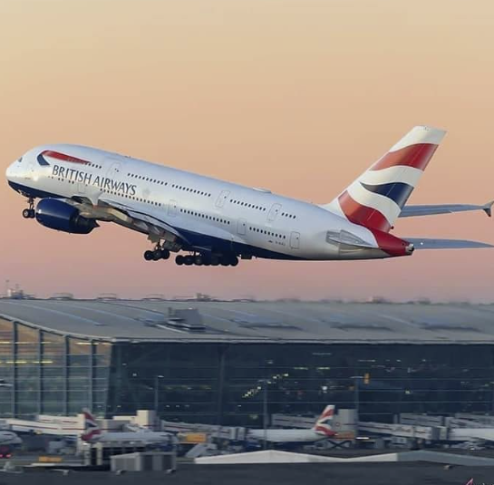
British Airways
Review Analysis

Slide 2
Analysis method used
Sentimental Analysis
Topic Modelling
Word Cloud

Slide 3
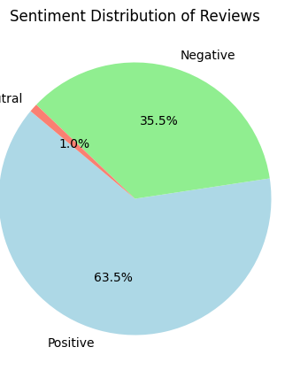
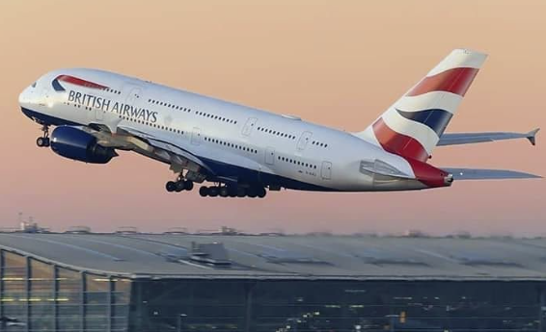
Sentimental Analysis
Insights
Positive : 63.5%
Negative: 35.5%
Neutral: 1.0%

Slide 4
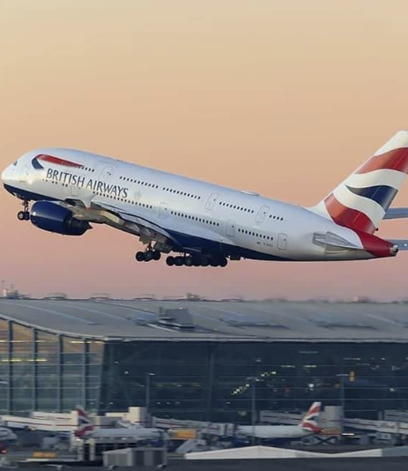
Topic Modelling Insights
Topic 0 seems to focus on customer service interactions, with words like "said," "people," "attendant," "going," and "asking." This suggests conversations or comments about interactions with airline staff.
Topic 1 involves aspects of seating and class, with words like "class," "business," "seats," "british," "seat," "airways," "row," "service," "boeing," and "world." This topic might be reflecting passengers' experiences or opinions about seating arrangements and comfort during their flights.
Topic 2 includes a mix of terms related to seating again ("seat," "seats"), travel classes ("business," "class," "economy"), and general travel ("passengers," "cabin," "crew," "check"). It could indicate discussions about different travel classes and the associated amenities or services.
Topic 3 seems to be geographically focused, with references to "London," "airways," and "us," and possibly the customer service experience ("service," "hours," "customer," "airport"). This might capture conversations about specific routes or the experience at particular airports.
Topic 4 contains positive descriptors ("good," "food," "service") and mentions of "crew," "time," "cabin," "club," "lounge," "London," and "drinks." This topic might represent positive feedback about the onboard experience, including food and lounge services.

Slide 5
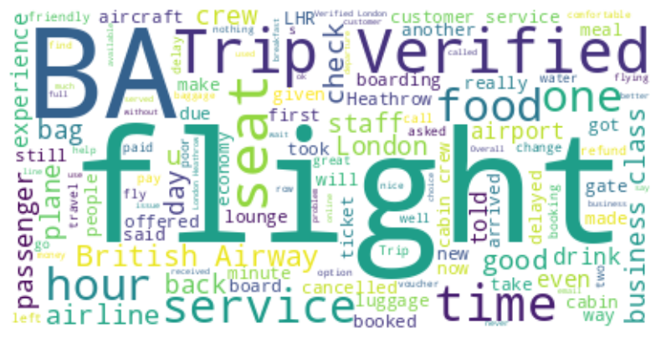
Word Cloud Insights

Slide 6
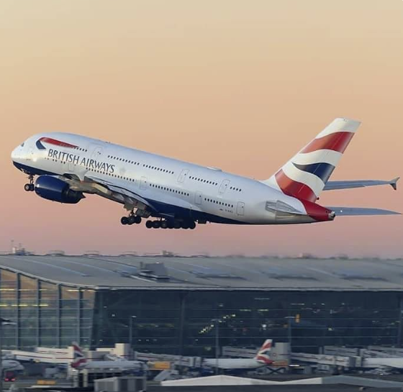
Predictive Analytics for customer bookings
A Machine Learning Approach to Enhancing Business Strategies

Slide 7
Overview
Dataset
Dataset contains 50000 customer interaction
14 feature variables including demographics, sales_channels and trip_details
Target variable: Customer_bookings
Objective: Unveil key drivers affecting customer booking decisions.
Scope: Utilization of historical data to predict booking behavior and
identify actionable insights.

Slide 8
Model selection rationale
Chose RandomForest for its robustness and interpretability.
Transitioned to XGBoost to leverage its gradient boosting framework, optimizing for imbalanced classes.

Slide 9
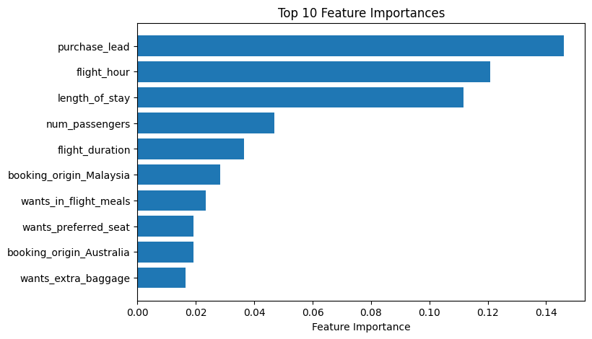
Insights (Random Forest classifier)
Its clear from the graph that top 5 features affecting the completion of booking the flight are:
Purchase_lead
flight_hour
length of stay
num_passengers
light duration

Slide 10
Random Forest Model Performance
Accuracy & Precision:
Achieved an overall accuracy of 85.46%, indicating strong predictive capabilities.
Precision for non-bookings is high at 87%, reducing the risk of false marketing engagement.
Recall & F1-Score:
Recall for bookings is at 13%, indicating room for improvement in capturing all potential bookings.
F1-score for bookings stands at 0.21, suggesting a need for a more balanced precision-recall trade-off.

Slide 11
XGBoost Model Enhancement
Refined Recall:
The recall for bookings has improved significantly to 76%, demonstrating the model's enhanced sensitivity to actual bookings.
We now capture a higher proportion of booking opportunities, vital for targeted marketing campaigns.
Precision & F1-Score:
Precision for bookings is at 30%, a trade-off against the increased recall rate.
F1-Score improvement to 0.43 confirms better balance in model performance metrics.
Classification Report Comparison:
Insert a table or graphic comparing the RandomForest and XGBoost classification reports.
Discussion Text:
"While the precision has dipped, the increased recall for class 1 (booked) from 13% to 76% with XGBoost signifies our enhanced ability to detect more genuine booking instances, a valuable shift for business strategy."
Balanced Accuracy Highlight:
"The cross-validated balanced accuracy of 88.47% with XGBoost indicates a reliable performance across both booking and non-booking classes when factoring in the class imbalance.

