Slide 1
Category review: Chips
June 2020
Retail Analytics
Brand note: If client logo is not required, use alternate title page layout right click slide thumbnail > Layout > Title

Slide 2
Notes:
To view Privacy video explaining how important data privacy is to Quantium, please click here: https://www.youtube.com/watch?v=Zq1QDAkoRzU
or here Q:\Company Reference\Brand & Design\Brand videos\Q Privacy.mp4
At Quantium, we believe that data is the behavioural footprint of humanity and that it has to be treated with the utmost care and responsibility.
Histories, attitudes, indeed lives are stored within it in ways that aren’t always apparent – and that’s what makes its potential so powerful.
To work with it responsibly, sensitively, we set ourselves the highest data privacy protection and governance standards.
We have spent 17 years perfecting privacy-by-design and secure-by-design principles. Central to this is not holding any personally identifiable information about people –
we neither receive it, and put the necessary protections in place to be unable to decipher it.
Every aspect of handling data is safeguarded: from its de-identification, to its encryption – data security is paramount and of the highest grade.
We pride ourselves on gaining the trust of iconic organisations around the world through years of securely working with their data,
and in turn the trust that builds with their stakeholders.

Slide 3
Executive summary
Mainstream Young Singles/couples and Mainstream retirees are prime targets for marketing campaigns due to their high contribution to sales.
Family oriented segments (particularly older families – Budget) are key demographics, likely due to large household size and hence, larger purchases.
New Families represent a lower spend category, possibly due to smaller family sizes or different purchasing priorities.
The difference in spending between premium levels within the same life stage suggests that mainstream customers tend to spend more on chips than their budget or premium counterparts.
01
Customer Analysis
The mainstream Young Singles/couples had the highest total spend on chips amount to $157,621; indicating their significant contribution to the chip category. Mainstream retirees followed closely with the total spend of $155,677.
The most purchased pack size was 175g accounting to 123692 quantity purchased.
The Brand Kettle led the total sales of $400k and brands like doritos, inspite of having multiple variations still managed a total sales of $25K.
Brands like Tyrrels and twisties showed a strong affinity within specific customer segments with sales figure.
02
Chips sales Analysis

Slide 4
01
Customer Analytics

Slide 5
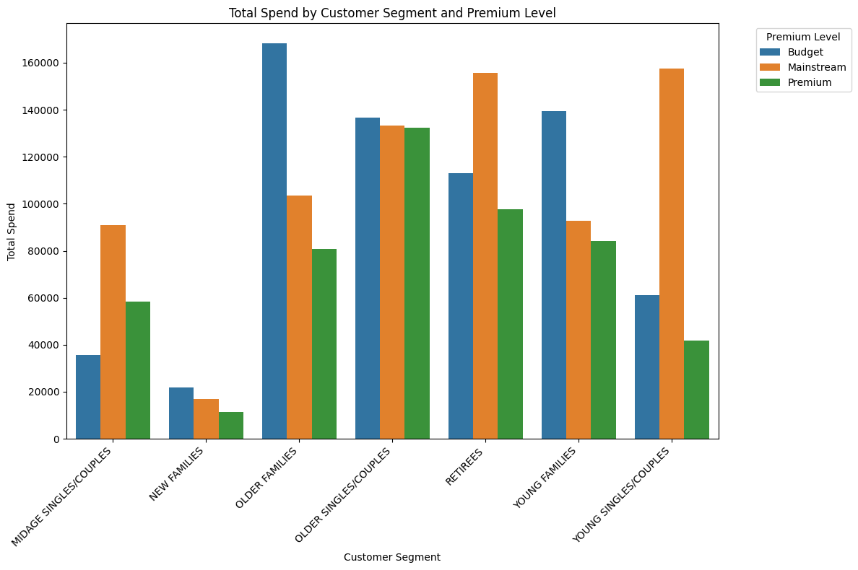
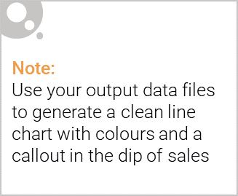

Slide 6

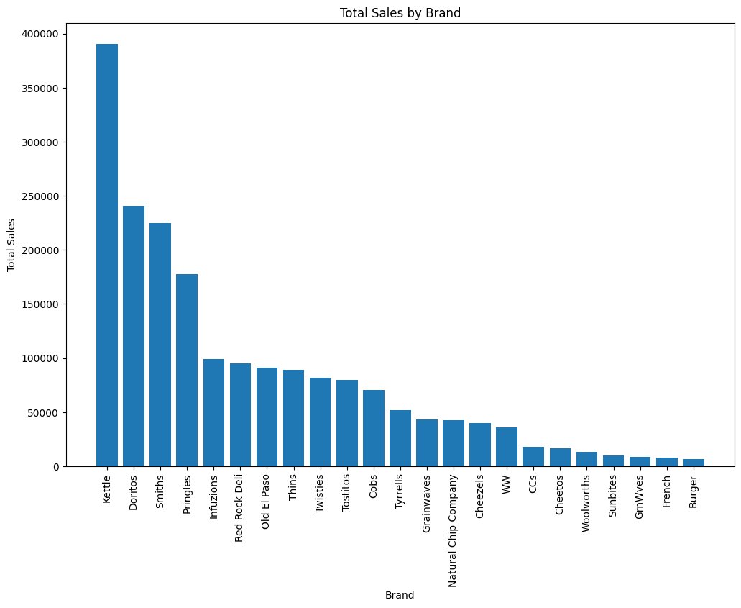
Total sales vs Brand

Slide 7
02
Trial store performance

Slide 8
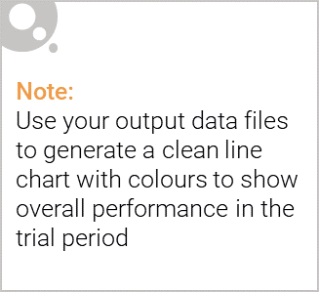
What is trial store and control store?
The concepts of "trial stores" and "control stores" are used in retail analytics to evaluate the effectiveness of various business strategies, such as promotional campaigns, store layout changes, or any other significant alterations intended to influence customer behavior and store performance
Trial Stores
Trial stores are the stores that have been selected to undergo a specific change or test. This could involve implementing a new marketing strategy, changing the store layout, introducing new products, or any other modification aimed at improving store performance. The main goal with trial stores is to see how these changes affect key performance indicators (KPIs) such as sales, customer traffic, and transaction sizes.
Control Stores
Control stores are carefully selected stores that are not subject to the trial changes but are otherwise similar to the trial stores in key aspects such as location, store size, customer demographics, and pre-trial performance. The idea is that any significant differences in performance between the trial and control stores during the trial period can be attributed to the trial itself, as all other factors are assumed to be equal or similar.

Slide 9
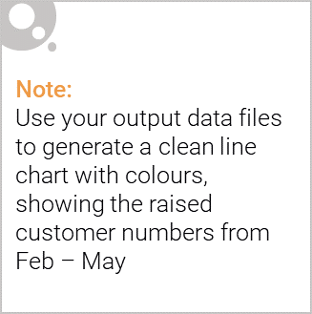
METHODOLOGY OVERVIEW: EXECUTION OF TRIAL VS CONTROL STORE ANALYSIS
Trial and Control Store Selection:
Trial Stores: Stores 77, 86, and 88 were selected for implementing trial changes aimed at enhancing store performance.
Control Stores: For each trial store, a control store was chosen based on pre-trial performance metrics, including total sales revenue, the total number of customers, and average transactions per customer, ensuring a like-for-like comparison.
Pre-Trial Data Analysis:
Analyzed historical data to establish a baseline of performance for both trial and control stores, ensuring the trial's effects are measured against a comparable backdrop.
A/B Testing Execution:
Trial Period: February 2019 to April 2019.
Conducted statistical tests (t-tests) to compare performance metrics (total sales, customer counts, and transaction volumes) between each trial store and its respective control store during the trial period.
The significance level was set at 0.05 to determine statistically significant differences.
Key Metrics Analyzed:
Total Sales Revenue: The aggregate revenue generated from all transactions.
Total Number of Customers: The count of unique customers visiting the store.
Average Transactions Per Customer: The average number of transactions conducted by each customer.

Slide 10
FINDINGS:
Store 77 showed significant improvements in performance metrics during the trial, indicating the trial's success.
Stores 86 and 88 did not exhibit statistically significant differences, suggesting the trial changes did not significantly impact these stores.

Slide 11
