Slide 1
Student Performance — Exploratory Data Analysis
Presented by Riya Manoj

Slide 2
Introduction
What is EDA?
Exploratory Data Analysis (EDA) is the process of analyzing datasets to summarize their main characteristics.
It uses statistical techniques and visualization to uncover patterns ,detect anomalies and test assumptions.
Purpose of EDA
To understand the structure and quality of data.
To identify relationship between variables.
To generate insights that guide further analysis or modeling.

Slide 3
Problem Statement
To study student performance in subjects like Math, Reading, and Writing.
To analyze how demographic and social factors (gender, parental education, lunch type, test preparation) influence scores.
To provide meaningful insights that can support future predictive modeling.

Slide 4
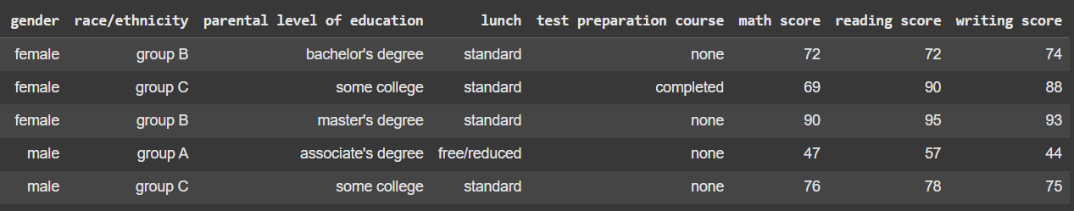
About the Dataset
- ~1000 rows, 8 columns
- Numeric: math, reading, writing scores
- Categorical: gender, parental education, lunch, test preparation course, race

Slide 5
Workflow
Data Acquisition
Data Cleaning
Univariate Analysis
Bivariate Analysis
Multivariate Analysis
Insights & Conclusion

Slide 6
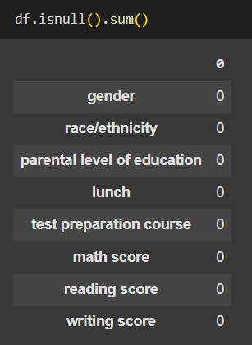
Data Cleaning
- Verified dataset structure
using info()
- Checked for missing values
none found
- Verified data consistency
(no duplicates)
- No major cleaning required

Slide 7
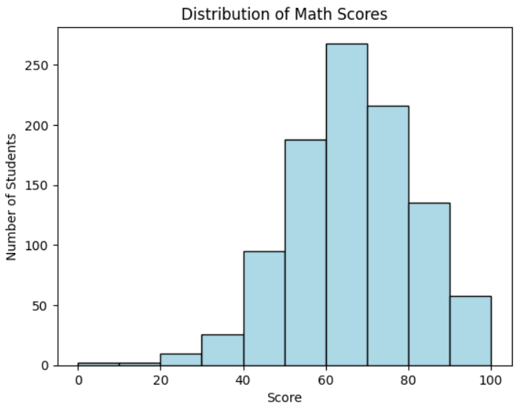
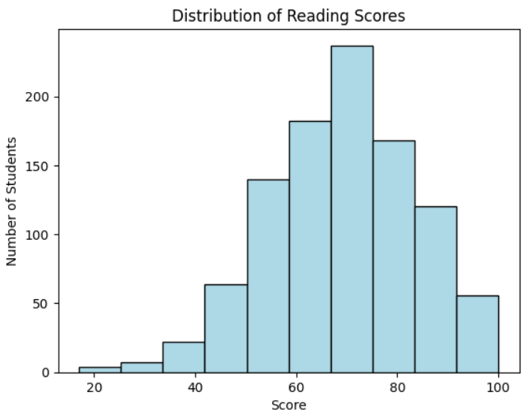
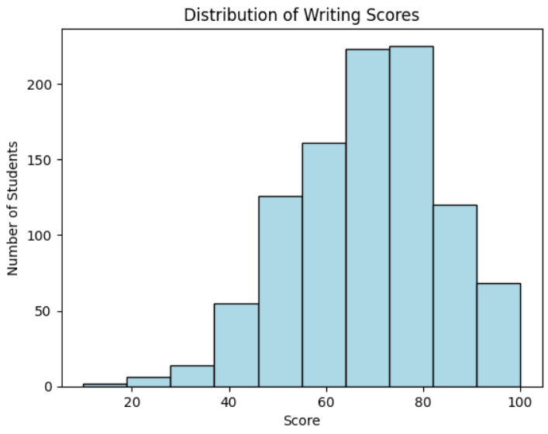
Distribution of Scores
- Most scores between 60–80
- Few extreme outliers
- Balanced distributions

Slide 8
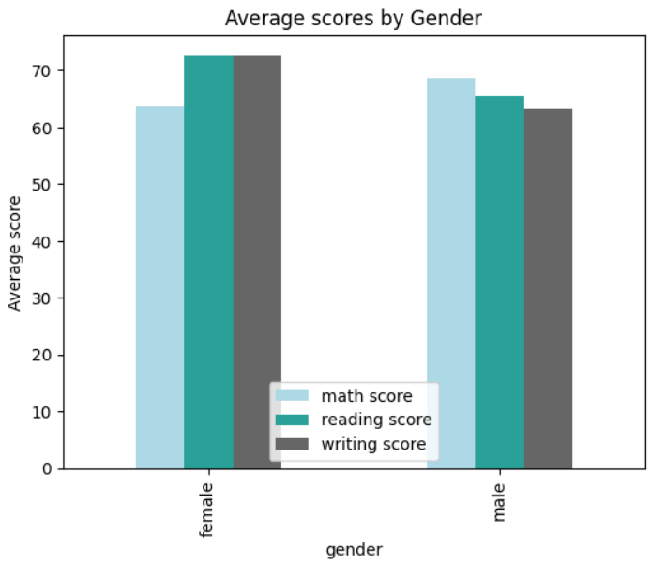
Gender and Performance
- Females: better in
reading & writing
- Males: slightly
better in math
- Differences small

Slide 9
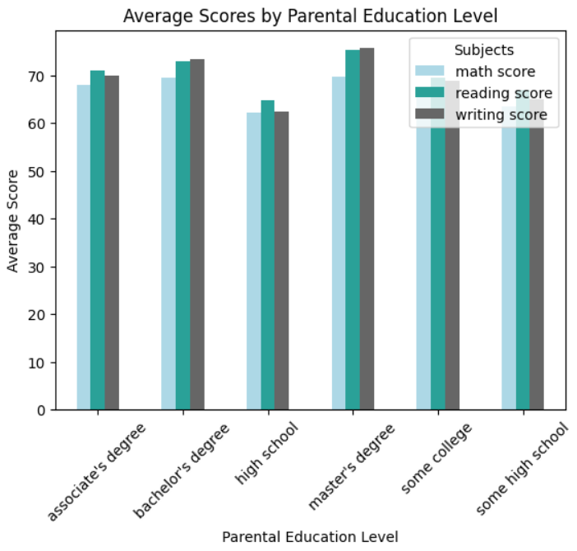
Parental Education Level
- Higher education level → higher scores
- Clear positive correlation

Slide 10
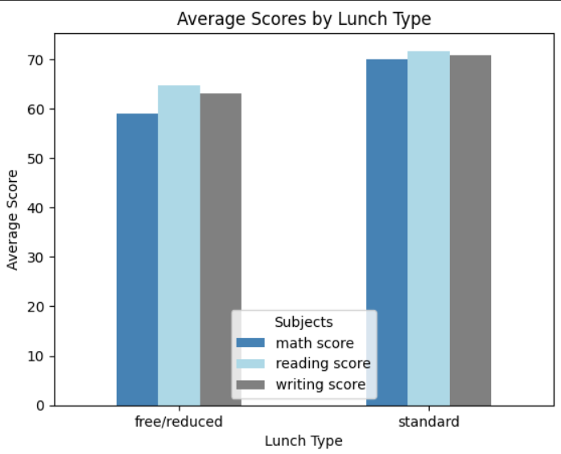
Lunch Type
- Standard lunch → higher performance
- Free/reduced lunch → relatively lower scores

Slide 11
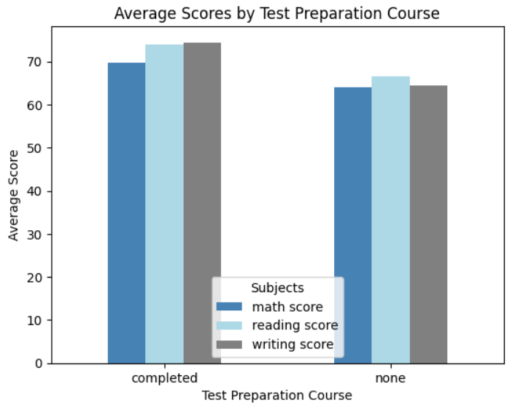
Test Preparation Course
- Completed test prep → higher scores
- Preparation has clear positive effect

Slide 12
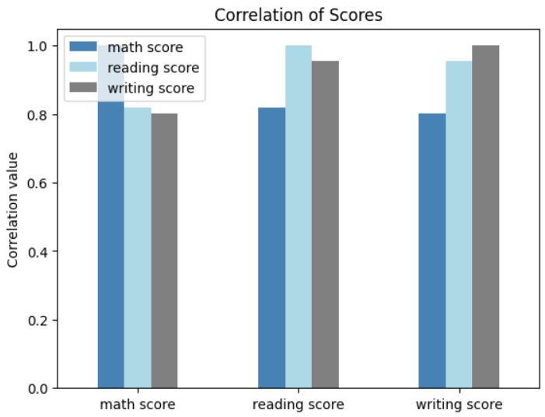
Correlation Between Subjects
- Math, Reading, Writing strongly correlated
- Doing well in one subject → likely to do well in others

Slide 13
Key Insights
Test preparation course ->Students who completed it showed consistently higher scores
Parental education->Higher parental education levels correlate with better student performance across all subjects.
Lunch type->Students with a standard lunch performed better than those with free/reduced lunch, suggesting resource or nutrition impact.
Gender trends->Females outperformed in reading & writing, while males had a slight advantage in math.
Score relationships->Strong positive correlation among math, reading, and writing scores.

Slide 14
Tools Used
Python Libraries - Pandas, NumPy, Matplotlib
Platform – Google Colab
Dataset source -Kaggle

Slide 15
Conclusion
EDA provided a clear understanding of the dataset through cleaning, exploration, and visualization
Analysis showed that gender, parental education, lunch type, and test preparation significantly affect student performance
Strong correlations were observed among math, reading and writing scores
EDA proved essential for extracting insights and preparing the data for further modeling

Slide 16
Thank You

