Slide 1
Automobile Dataset Analysis using NumPy
Presented by: Riya Manoj

Slide 2
Introduction
NumPy is a powerful open-source Python library for numerical and scientific computing.
Useful for handling large arrays and mathematical operations.
Forms the foundation for data science and Machine Learning libraries like Pandas and TensorFlow.
Project goal: Apply NumPy on the automobile dataset to clean data and analyze horsepower.

Slide 3
Problem Statement
Horsepower values were stored as strings, not numbers.
Needed to analyze cars with respect to horsepower and mpg.
Challenge: connect numerical horsepower with car names for insights.

Slide 4
Proposed Solution
Used pandas to load dataset and identify missing values.
Replaced missing horsepower values with mean (data cleaning).
Converted horsepower into NumPy array for operations.
Applied slicing and sorting to extract insights.

Slide 5
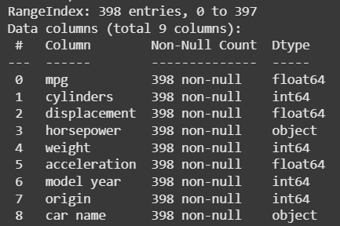
Dataset Overview
Dataset: Auto MPG , 398 rows, 9 columns.
Key attributes: mpg, horsepower, car name.
Issue: horsepower column had non-numeric values.

Slide 6
Tools Used
Python (programming language)
NumPy (numerical operations, slicing, sorting)
pandas (data cleaning and dataset handling)
Google Colab (implementation environment)

Slide 7
Implementation
Step 1: Loaded dataset and checked info.
Step 2: Converted non numeric horsepower column to numeric.
Step 3: Handled missing horsepower values with mean.
Step 4: Converted horsepower column into NumPy array.
Step 5: Performed slicing to view specific ranges.
Step 6: Sorted horsepower to find top 5 cars.

Slide 8
Insights
Missing horsepower values were successfully replaced.
Cars with higher horsepower generally had lower mpg.
Top 5 cars by horsepower identified (e.g., Pontiac grand prix , Pontiac Catalina, Buick estate wagon).
Data cleaning made analysis possible.
Note: The dataset is historical, so high-horsepower cars identified (Pontiac, Buick , etc.)were considered powerful in that era, but may not match today’s high-performance standards

Slide 9
Conclusion
NumPy simplified numerical processing and array handling.
Preprocessing improved dataset quality and accuracy.
Analysis provided real-world insights into automobile performance.
Project highlighted the importance of data cleaning + NumPy operations in data analytics.

Slide 10
References
Auto MPG Dataset -Kaggle
NumPy Official Documentation.
pandas Official Documentation.

Slide 11
Thank You

