Slide 1
Pandas Assignment – Iris Dataset
Data Exploration & Analysis using Pandas
Prepared by: Riya Manoj

Slide 2
Introduction
What is Pandas?
- Python library for data manipulation and analysis.
Purpose of this Assignment:
- Learn Pandas operations.
- Explore the Iris dataset, a classic dataset used in ML.

Slide 3
Dataset Overview
- Iris dataset contains flower measurements.
- Features: SepalLengthCm, SepalWidthCm, PetalLengthCm, PetalWidthCm
- Target: Species (Setosa, Versicolor, Virginica)
- 150 rows total
- Checked missing values and duplicates.

Slide 4
Tools Used
- Python – Programming language
- Pandas – Data manipulation & exploration
- Matplotlib – For visualizations
- Google Colab – Coding environment

Slide 5
Data Loading & Inspection
- Loaded dataset with pd.read_csv()
- Previewed with head() and tail()
- Checked shape, dtypes, unique values, and describe()

Slide 6
Data Quality Checks
- Missing values check → None
- Duplicates check → Used df.duplicated().sum()
- Descriptive statistics with df.describe()

Slide 7
Data Selection & Filtering
- Column selection: df['Species’], df[['SepalLengthCm','PetalLengthCm']]
- Row selection: iloc[], loc[]
- Filtering examples:
df[df['SepalLengthCm']>5.0]
df[df['Species']=='Iris-setosa']

Slide 8
Sorting Data
- Sort by column:
df.sort_values('SepalLengthCm')
- Sort by multiple columns:
df.sort_values(['Species','PetalLengthCm'], ascending=[True,False])

Slide 9
Creating New Columns
- New column SepalRatio = SepalLengthCm / SepalWidthCm
- New column SepalDouble = SepalLengthCm * 2 using apply()

Slide 10
Grouping & Aggregation
- Mean SepalLengthCm by species:
df.groupby('Species')['SepalLengthCm'].mean()
- Multiple aggregations:
df.groupby('Species').agg({'SepalLengthCm':'mean','PetalLengthCm':'max'})

Slide 11
Data Exploration
- Unique values in Species: df['Species'].unique()
- Count of each species: df['Species'].value_counts()
- Correlation: df.corr()

Slide 12
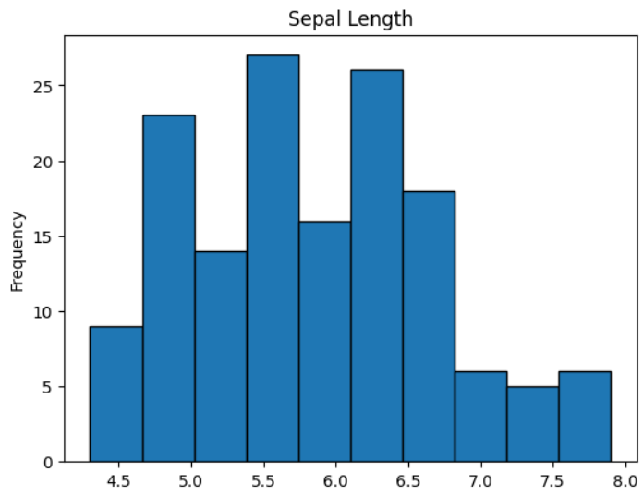
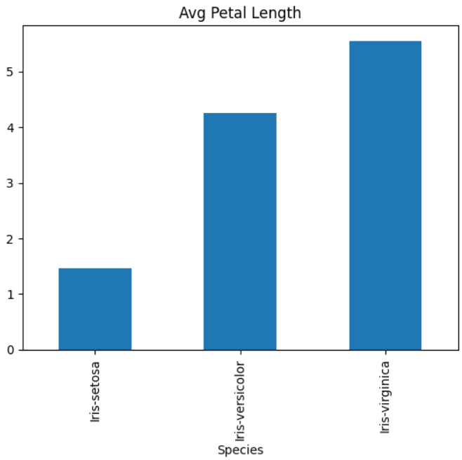
Visualization
- Histogram of Sepal Length:
- Bar chart of Avg Petal Length by species:

Slide 13
Conclusion
- Pandas is powerful for data inspection, cleaning, and analysis.
- Key learning outcomes:
1. Data loading and quality checks
2. Selection, filtering, sorting
3. Feature engineering
4. Grouping, aggregation, correlation
5. Visualizations with Pandas
- Outcome: Hands-on experience exploring Iris dataset with Pandas

