Slide 1
Airport Ground-Crew Coordination
A Multi-Agent Routing System
PRESENTED TO :
Ms. Pooja G
Riya Solanki
BL.EN.U4CSE23065

Slide 2
Introduction to the Problem
Multiple ground-service vehicles operate simultaneously at an airport
1
Vehicles travel between depots, taxiways and aircraft gates
2
Shared paths can create conflicts between vehicles
3
Gates are limited shared resources
4
Different service vehicles may have different priorities
5
Dynamic events can require vehicles to replan their routes
6
Goal: Find efficient routes while minimizing conflicts, waiting time, and overall completion time.

Slide 3
PEAS & Environment Properties
PEAS Component | Description
Performance | Minimize travel distance, waiting time, conflicts and makespan
Environment | Airport grid with obstacles, gates, depot and service areas
Actuators | Move, wait, follow a route, service, return, replan, update priority, and redirect
Sensors | Position, destination, gate availability, reservations, priorities and events
Environment Properties
Multi-Agent
Dynamic
Discrete
Sequential
Deterministic

Slide 4
Multi-Agent System Architecture
Airport Environment
Each service agent
Perceive
Read the environment state
Position, destination, gate availability, status and message (wait or replan)
Coordinator Agent
Decide
Plan route (Cooperative A* or GBFS)
Fuel
Agent
Baggage
Agent
Catering
Agent
Maintenance
Agent
Act
Move and perform service
Airport Environment
Different service roles, one shared environment
Perceive, Decide, Act loop

Slide 5
Workflow: From Input to Performance Comparison
1
2
3
4
5
Input Environment and Agent Assignments
Scenario Selection
Algorithm Selection (Cooperative A* or GBFS)
Route Planning
Agent Coordination and Conflict Checking
6
7
8
Simulation Execution
Metrics Collection
Performance Comparison
Scenarios supported:
Normal Operation
Gate Unavailable
Emergency Priority
Unreachable Goal

Slide 6
Search Techniques: Cooperative A* vs GBFS
Cooperative A*
Greedy Best-First Search (GBFS)
Cost + heuristic search
Heuristic-only search
Evaluation: f(n) = g(n) + h(n)
Evaluation: f(n) = h(n)
Weighs cost so far and estimated remaining cost
Expands the node that looks closest to the goal
Routes planned under the simulation's constraints
Routes planned under the simulation's constraints
Optimal multi-agent coordination not claimed
Optimal route not guaranteed
Algorithm | Evaluation Function | Uses Path Cost g(n) | Node Priority
Cooperative A* | f(n) = g(n) + h(n) | Yes | Cost so far + remaining estimate
Greedy Best-First Search (GBFS) | f(n) = h(n) | No | Estimated remaining cost

Slide 7
Cooperative Routing and Conflict Handling
Candidate Route
Vertex Conflict
Edge-Swap Conflict
Two vehicles cannot occupy the same location at the same time.
Two vehicles cannot swap positions through the same edge in opposite directions at the same time.
Reservation Table
Vertex Conflict Check
Edge-Swap Conflict Check
Conceptual grid example
B
Vehicles A and B both claim the highlighted cell at the same time step
Gate / Resource Reservation
1
A
The Reservation Table rejects the second claim
2
Safe Route
B is routed to wait, so the conflict is avoided
3
Execute / Replan

Slide 8
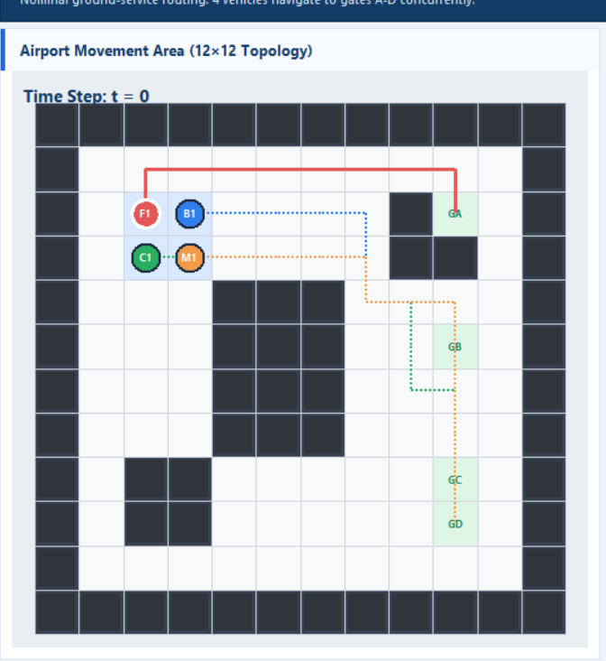
Simulation Execution
Latest GUI screenshot to be inserted
(dashboard with the four scenarios and two algorithms)
1
Initialize Agents
2
Assign Destinations
3
Plan Routes
4
Reserve Shared Resources
5
Execute Movement
Tracked metrics
6
Monitor Conflicts / Events
Total Distance
Waiting Time
Makespan
Conflicts Detected
Nodes Expanded
Planning Runtime
7
Replan When Required
Completed / No-Path
8
Complete Service

Slide 9
Demonstration Scenarios
Four scenarios
1
2
3
4
Normal Operation
Gate Unavailable
Emergency Priority
Unreachable Goal
Ground-service agents travel to their assigned gates under normal conditions.
Gate B becomes unavailable, and the affected agent is redirected to Gate D before its route is replanned.
FUEL01 receives emergency priority at simulation time step 5, and the fleet replans to accommodate the priority change.
The system identifies a destination that cannot be reached because of the obstacles in the environment.
Same scenarios for both algorithms
A* and GBFS are each run on all four scenarios; results follow.

Slide 10
Results: A* vs GBFS
Recorded results for all four scenarios:
Scenario | Algorithm | Distance | Waiting | Makespan | Conflicts | Nodes | Runtime (ms) | Done / No-path
Normal Operation | A* | 84 | 1 | 28 | 0 | 154 | 1.12 | 4 / 0
 | GBFS | 84 | 1 | 28 | 0 | 93 | 1.24 | 4 / 0
Gate Unavailable | A* | 68 | 1 | 29 | 0 | 126 | 1.03 | 3 / 0
 | GBFS | 68 | 1 | 29 | 0 | 77 | 1.19 | 3 / 0
Emergency Priority | A* | 94 | 1 | 34 | 0 | 389 | 1.98 | 4 / 0
 | GBFS | 96 | 1 | 36 | 0 | 348 | 1.84 | 4 / 0
Unreachable Goal | A* | 18 | 0 | 21 | 0 | 32 | 0.35 | 1 / 1
 | GBFS | 18 | 0 | 21 | 0 | 20 | 0.35 | 1 / 1
Zero conflicts in all scenarios
Emergency Priority
Both algorithms recorded 0 conflicts. In Unreachable Goal, 1 vehicle completed and 1 had no path.
A*: distance 94, makespan 34. GBFS: distance 96, makespan 36.

Slide 11
Conclusion
1
Developed a multi-agent system for airport ground-service routing and coordination.
2
Agents replan for Gate Unavailable and Emergency Priority events; the system identifies an Unreachable Goal.
3
Cooperative A* and GBFS were compared across all four scenarios.
4
Trade-off: GBFS expanded fewer nodes; Cooperative A* recorded lower distance (94 vs 96) and makespan (34 vs 36) in Emergency Priority.
5
Both recorded zero conflicts; the results do not show either algorithm is universally better.
6
Future work: larger airport grids, more agents, repeated dynamic events, improved replanning, additional benchmarking.

Slide 12
THANK YOU
Questions?

