Slide 1

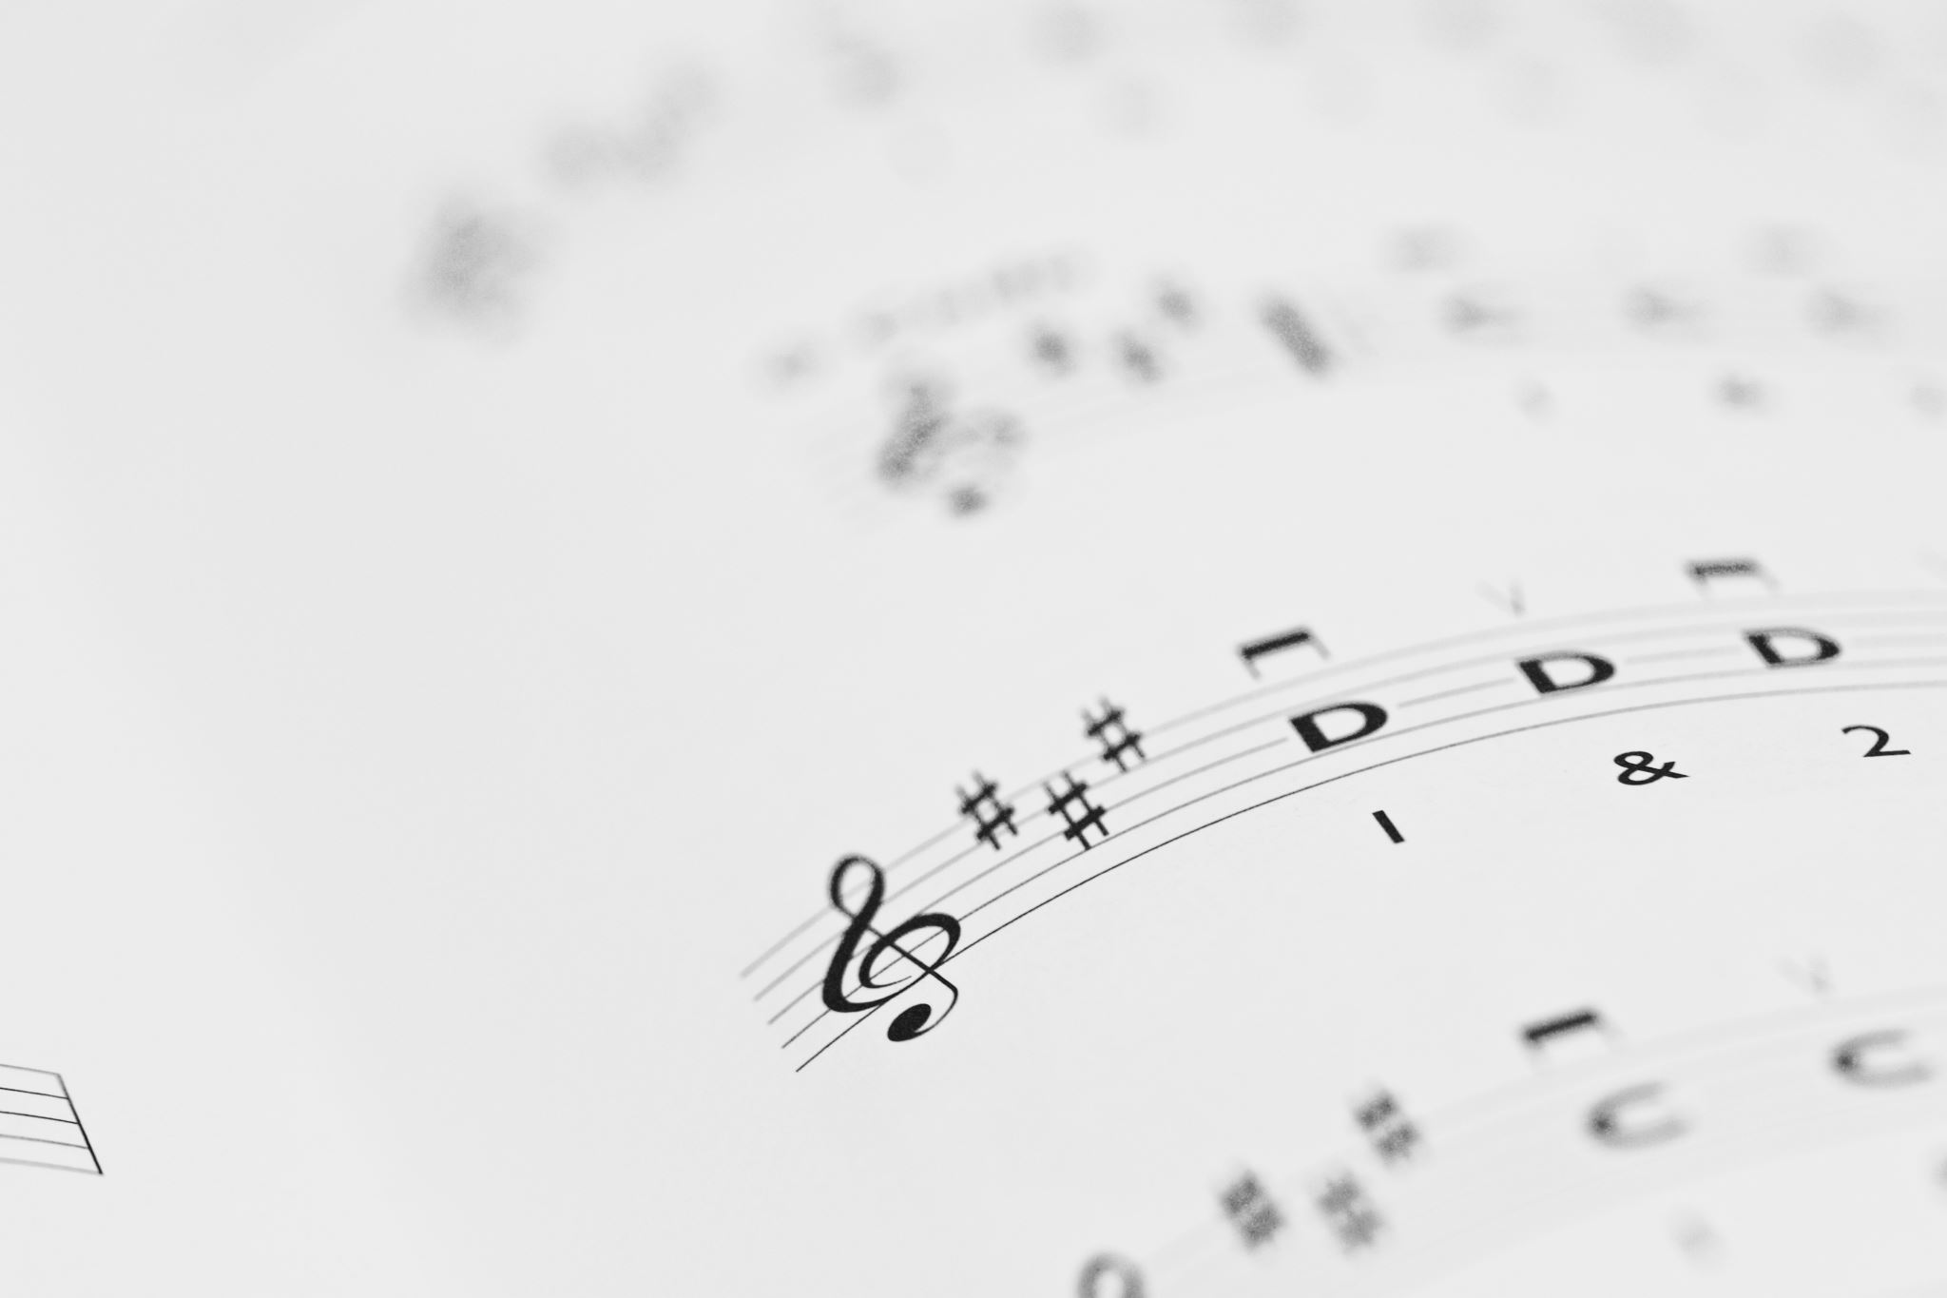
Melody Generation
Riya & Darshil

Slide 2
Outlines
Introduction
Basic concepts of Music like what is melody and midi note
Dataset used
Model used in Training .
LSTM Architecture.
Steps to create project
Output

Slide 3
Introduction
A melody generation project involves using computer algorithms or artificial intelligence to create a musical melody. The goal of such a project could be to generate a new melody that sounds pleasant and harmonious, or to create a melody that fits a particular genre or style of music.
The project typically involves collecting a dataset of existing melodies, which can be used to train machine learning models or neural networks. These models can then be used to generate new melodies based on the patterns and structures they have learned from the dataset.
For the dataset here we use folk song data which is in .krn format . So we preprocess it using music21 library and then convert it into MIDI Numbers .

Slide 4
What is Melody
Melody is a tune, voice or line, is a linear succession of musical tones that the listener perceives as a single entity.
Melody is a sequence of combination of note and rest.
Note is addition of pitch and Duration
note = Pitch+Duration.
Pitch is always indicates that how High/ Low a note is . If we have high frequency the have high pitch and if we have low frequency then low pitch .

Slide 5
Pitch
It represents the vibration frequency of the vocal cords during the sound productions (like vowels, for example).
Sounds are higher or lower in pitch according to the frequency of vibration of the sound waves producing them

Slide 6
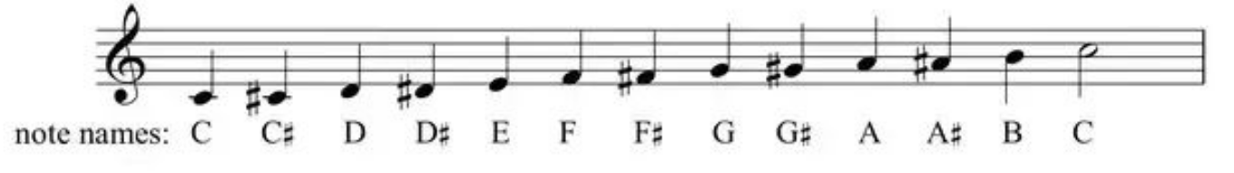
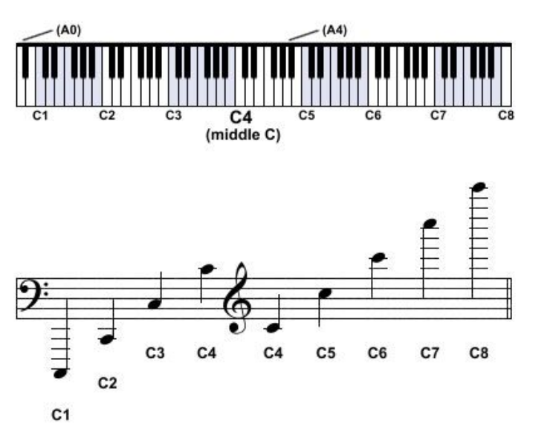
Here we have 2 same Note name but both have different frequency so we can not identify by note-name so we use another way .
Scientific pitch notation = note name + octave

Slide 7
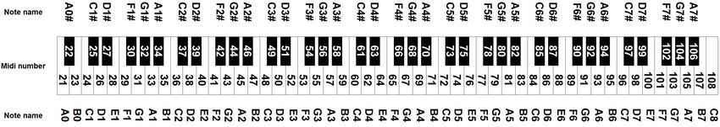
MIDI note notation
midi is a protocol to play , edit and record music
Map note to numbers – c4=60
below image is MIDI note notation which is all note name with MIDI numbers.

Slide 8
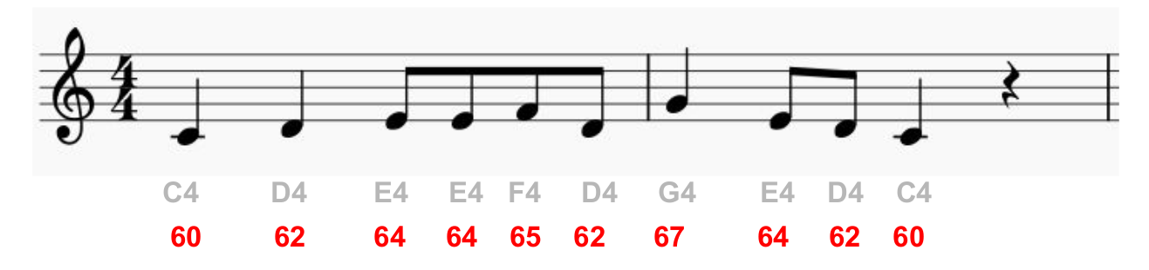
Melody with MIDI numbers

Slide 9
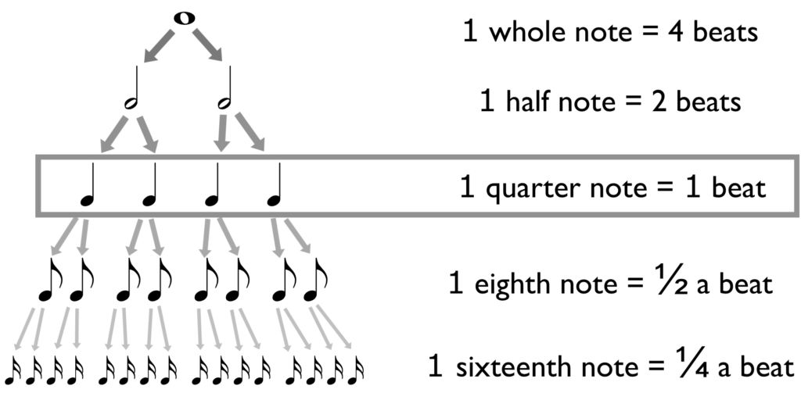
Note values

Slide 10
What is MIDI Notes
MIDI : Musical instrument Digital interface
MIDI is protocols which allows electronic instruments and other digital musical tools to communicate with each other .
MIDI itself does not make sound, it is just a series of messages like "note on," "note off," "note/pitch," "pitchbend," and many more.
These messages are interpreted by a MIDI instrument to produce sound.
A MIDI instrument can be a piece of hardware (electronic keyboard, synthesizer) or part of a software environment

Slide 11
LSTM
LSTM stands for Long Short-Term Memory, and it is a type of recurrent neural network architecture that is designed to address the problem of vanishing gradients that can occur in traditional recurrent neural networks.
LSTMs are particularly effective for processing sequential data, such as speech, video, and natural language text.
The LSTM architecture includes a series of memory cells that can store information over time, as well as three types of gates that control the flow of information into and out of the cells.
These gates include an input gate, an output gate, and a forget gate.

Slide 12
LSTM Gates
The gates are controlled by sigmoid activation functions, which allow the model to learn how to selectively let information in and out of the memory cells.
Input Gate : The input gate determines which information to let into the cell,
Forget gate : the forget gate determines which information to discard from the cell
Output gate : output gate determines which information to output from the cell.
In addition to the memory cells and gates, LSTMs also include a cell state that is passed along from one time step to the next, allowing the model to maintain a long-term memory of the input sequence.

Slide 13
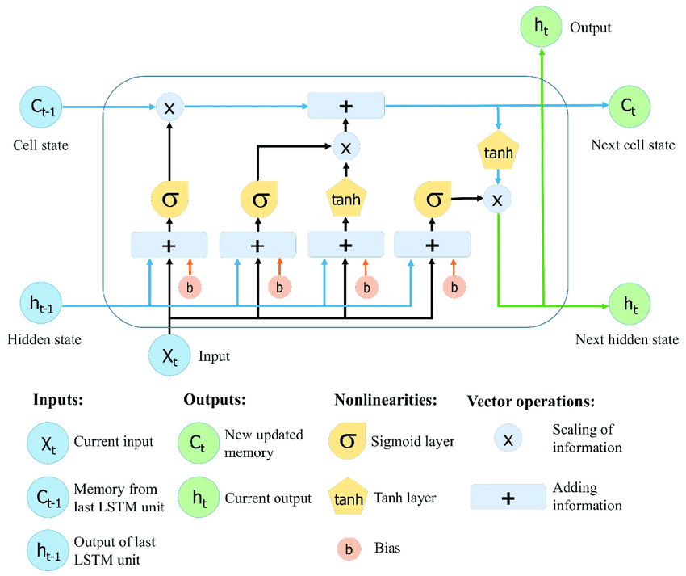
LSTM Architecture

Slide 14
Database Used: ESAC Folksong Databases (Deutschl dataset-erk folder)
Model Architecture: LSTM
Tool used : Musescore (for check generated melodies )
Important Library used : Tensorflow , music21

Slide 15
Steps of preprocessing on krn Data
Load a folk songs in .krn format using music21 library
filter out the songs that have non acceptable durations
Transpose songs to Cmaj/Cmin
Encode songs (i.e.encoding for symbolic music in .krn format to MIDI numbers) & saved to text files.
Merge all text files to one.
Create mapping of that MIDI number to create vocabulary for the training json formate.
Provided targets & inputs to train LSTM to generate melody and save training model.
Fed a seed of melody to model.h5 to generate melody
Saved melody to midi & run midi using MuseScore4.

Slide 16
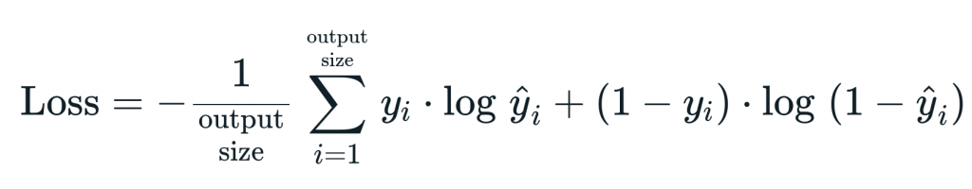
Loss function and optimizer used
Loss function used :sparse_categorical_crossentropy
Formula of loss function :
Optimizer used : Adam
Adam is the best optimizers. If one wants to train the neural network in less time and more efficiently than Adam is the optimizer. For sparse data use the optimizers with dynamic learning rate.
We have take learning rate 0.001 and train model with 50 epochs got the around 90% accuracy.

Slide 17
Input given to predict model .
Input_size : (1, 64 , 34)
1 : batch_size
64 :sequence length
34 : vocubalary size

Slide 18
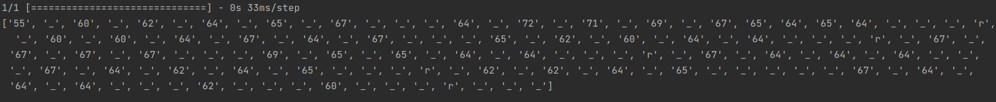
Output
Here we provided seed(piece of melody), no. of steps(500), max. sequence length(64), temperature (0.7). First created melody n saved as ‘mel.midi’ file. Then run it through MuseScore4.
Input : "55 _ 60 _ 62 _ 64 _ 65 _ 67 _ _ _ 64 _ 72 _"
Output :

Slide 19
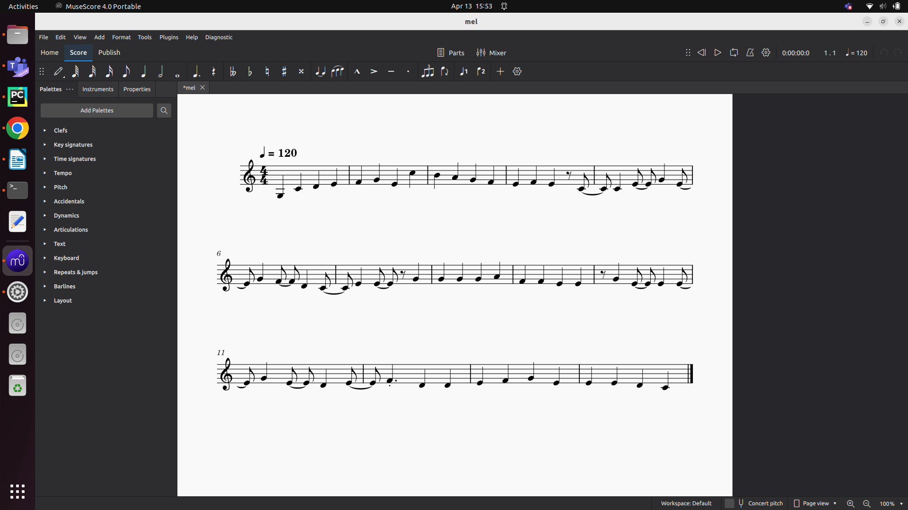

Slide 20
Thank you …

