Slide 1
Dynamic Traffic Signal Monitoring & Controller System
Prepared By
RIYA Patel(18iT100)
Dhruvi Patel(18it083)
GUIDED BY:
PROF.SANDIP PATEL
Prof. Harsh patel

Slide 2
Objective
a traffic signal monitoring & controlling system based on Internet of Things (IoT) using an Arduino to avoid undesirable effects such as delays, and traffic jams.

Slide 3
Outline:
Project Overview
Limitation
Innovation in project
Diagram
Components required
Proposed work
Application
Test Cases
Learning Outcome
Future scope
References

Slide 4
Why this?
As we are interested to do the project on internet of things(IOT) and eager to learn about it.
How it works?
What are the specification of it?
What the limitation of board? And so on.

Slide 5
PROJECT OVERVIEW
Nowadays, it is obvious that the volume of traﬃcs is rapidly growing on roads worldwide.
This result aﬀects directly to economies, human health, and environment because of huge traﬃc congestion
By this way, Intelligent Transportation Systems (ITS) have been developed to deal with these emergent problems

Slide 6
Limitation
IR sensor sometimes may absorb normal light also.
IR sensor work only for fewer distance(Approx 1.5-2cm)
Should arrange in accurate manner otherwise they may not detect the traffic density.

Slide 7
Innovation in Project
As we are going to innovate in this project that time is dynamically change according to the density sensed by the sensor at which lane the traffic is more.

Slide 8
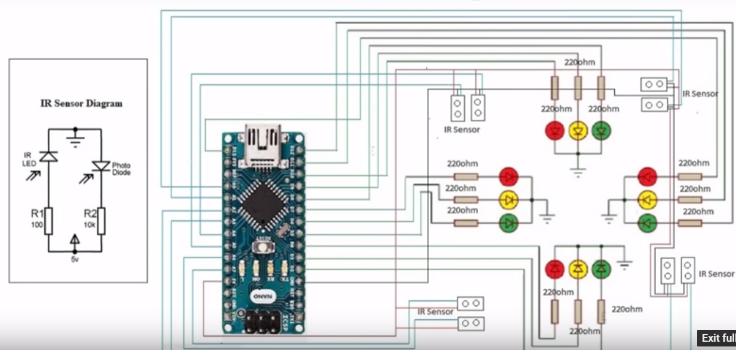
Diagram of project

Slide 9
Components Required:
4XLED(red, green, yellow)
Power Supply(5V-12V)
IR Sensor(Module)
Arduino Mega 2560
Connecting Wires
4XResistors(220 ohm)

Slide 10
Arduino Mega 2560
It is a microcontroller board.
It is an open source computing platform and has an environment for developing software for the Arduino board.
It take input from the switches or sensor and control the output.

Slide 11
IR Sensor
Used for the object detection using which the system gets an input of the traffic density.
Traffic density is measured as “Low, Green, Red”.
The system which adjusts and varies the traffic signal duration for that particular way.

Slide 12
Application
Traffic control signals provide for an orderly movement of traffic.
They help in reducing the frequency of an accident of some special nature i.e. of right angles accidents.
They intercept heavy traffic to allow other traffic to cross the road intersection safety.

Slide 13
Test Cases
Case-01: If the density is high, automatically the time of the light decrease at that direction and the congestion is low.
Case-02: If the density is high at the two sides of the road then the moderate equal time period is given to both that direction.
Case-03: If the traffic is not then the normal timing is followed.

Slide 14
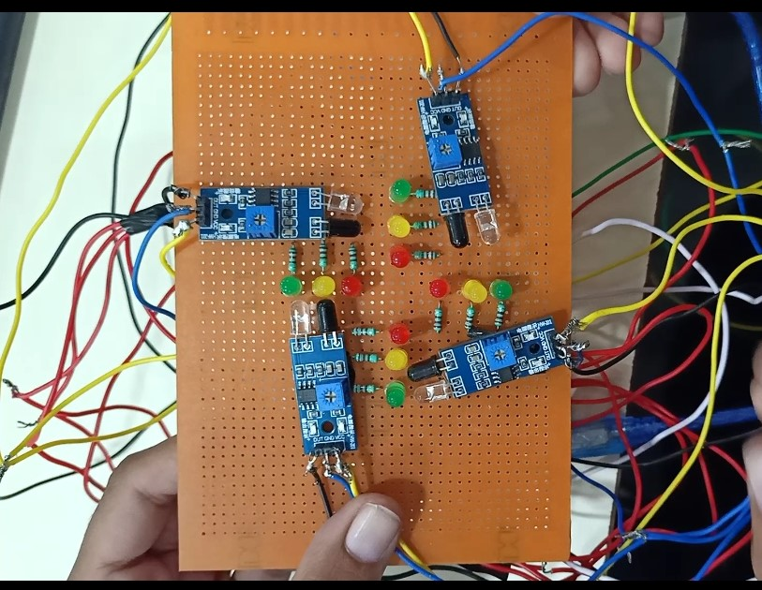
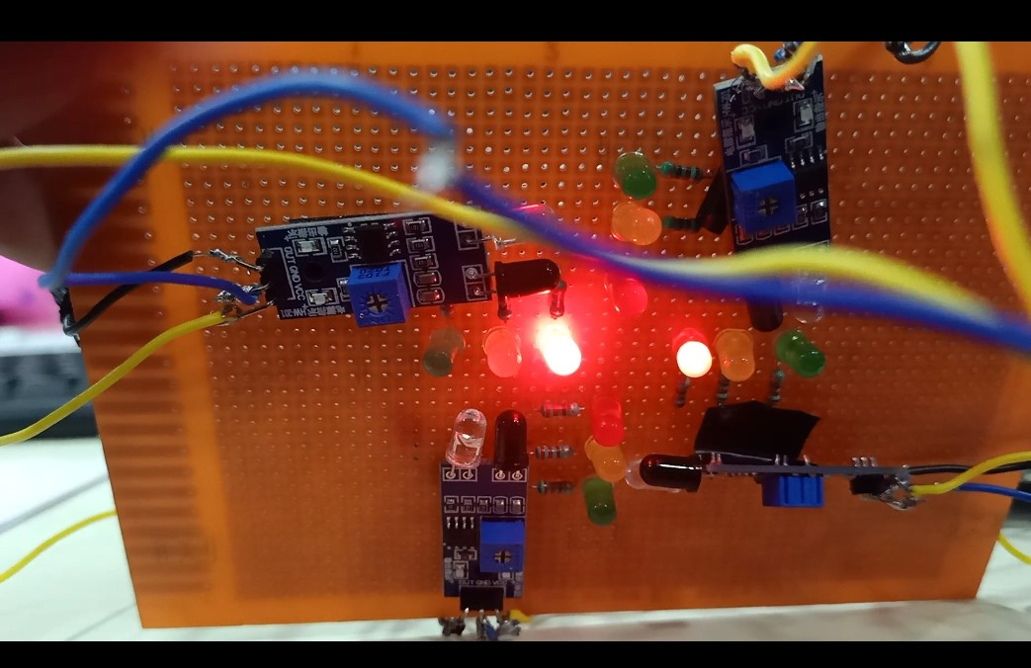
snapshots

Slide 15
Division of responsibility
Connections of Arduino and IR Sensors.
Connections of IR Sensors and LED.
Coding.

Slide 16
Learning Outcome:
Here we Learned about the Arduino board and functionalities of the board.
Learned about the IR sensor.
Learned about how to implement the traffic lights in the PCB board and connect to the Arduino.

Slide 17
Future scope
To detect the emergency vehicle using an ultrasonic sensor.
Implemented dynamically in real world.
Also, try to use camera for security purpose.

Slide 18
References
https://www.ijraset.com/fileserve.php?FID=4535
https://www.researchgate.net/publication/327781916_ADAPTIVE_TRAFFIC_LIGHT_CYCLE_TIME_CONTROLLER_USING_MICROCONTROLLERS_AND_CROWDSOURCE_DATA_OF_GOOGLE_APIs_FOR_DEVELOPING_COUNTRIES
https://www.researchgate.net/publication/324537810_An_Iot_Based_Traffic_Signal_Monitoring_and_Controlling_System_Using_Density_Measure_of_Vehicles
https://pdfs.semanticscholar.org/e747/4ef21d4a4b5cbfc8f0d2e5f565c3b7d7468a.pdf
https://www.embedded-computing.com/guest-blogs/iot-based-smart-traffic-signal-monitoring-using-vehicle-count
https://sci-hub.tw/https://ieeexplore.ieee.org/document/8463825

Slide 19
Thank you

