Slide 1
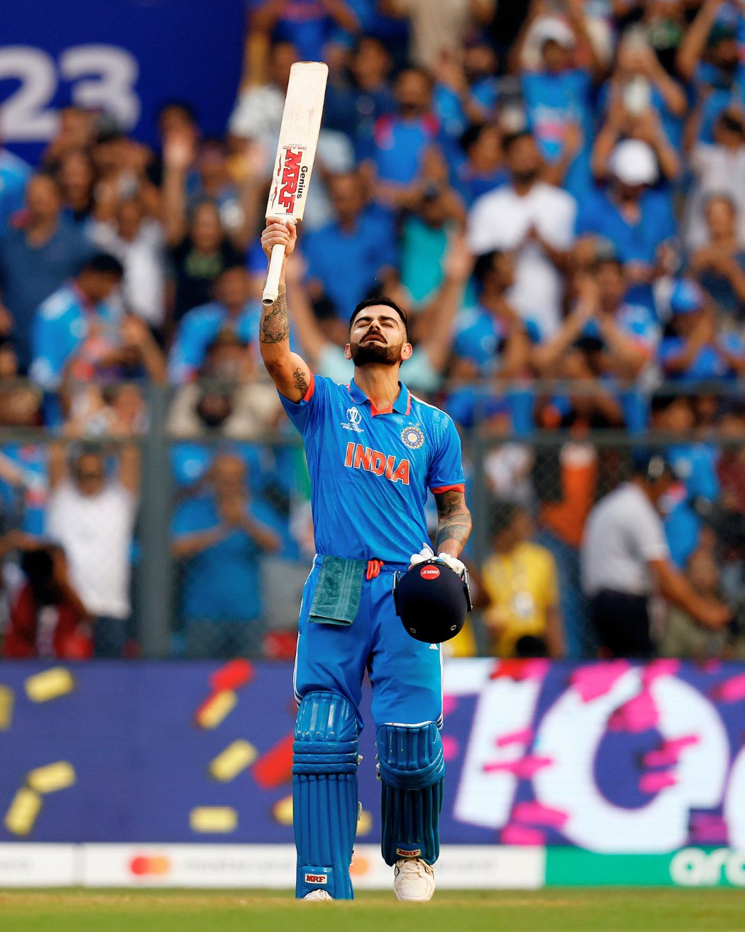
VIRAT KOHLI PERFORMANCE ANALYSIS
Presented by – 1) Rahul Pandey 23030141047
2) Riya Kumari 23030141053

Slide 2
01
Introduction
The analysis of Virat Kohli's cricket performance is essential in understanding the evolution of one of the game's greatest batsmen. Leveraging data-driven insights, this Power BI dashboard provides a comprehensive overview of Kohli's career across different formats, grounds, and opponents. By integrating detailed match-level data, the dashboard visually captures key metrics such as total runs, average performance, and consistency across venues. This presentation aims to showcase the analytical process and the resulting insights that can be drawn from this rich dataset, offering a deeper understanding of Kohli's cricketing journey and his impact on the sport.

Slide 3
02
Problem Statement
In the highly competitive world of cricket, consistent performance across different formats and conditions is critical to a player's success. For a player like Virat Kohli, who has been a cornerstone of Indian cricket, analyzing his performance data is vital to understand his strengths, weaknesses, and areas for improvement. The challenge is to accurately assess his performance metrics across various match formats, grounds, and opponents, and to identify patterns or trends that could inform future strategies. This dashboard seeks to address this by consolidating and visualizing extensive match data, providing actionable insights into Kohli's career performance to aid coaches, analysts, and fans in making informed decisions and predictions.

Slide 4
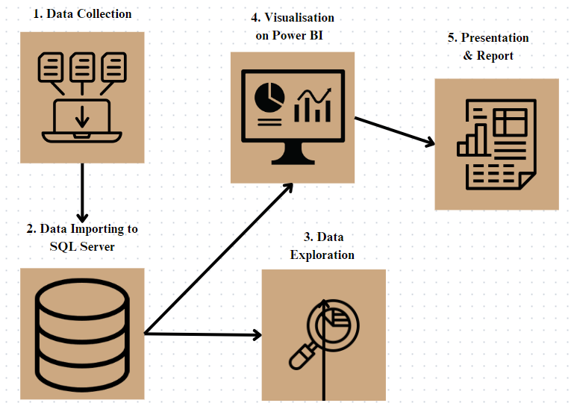
03
Flow Of Work

Slide 5
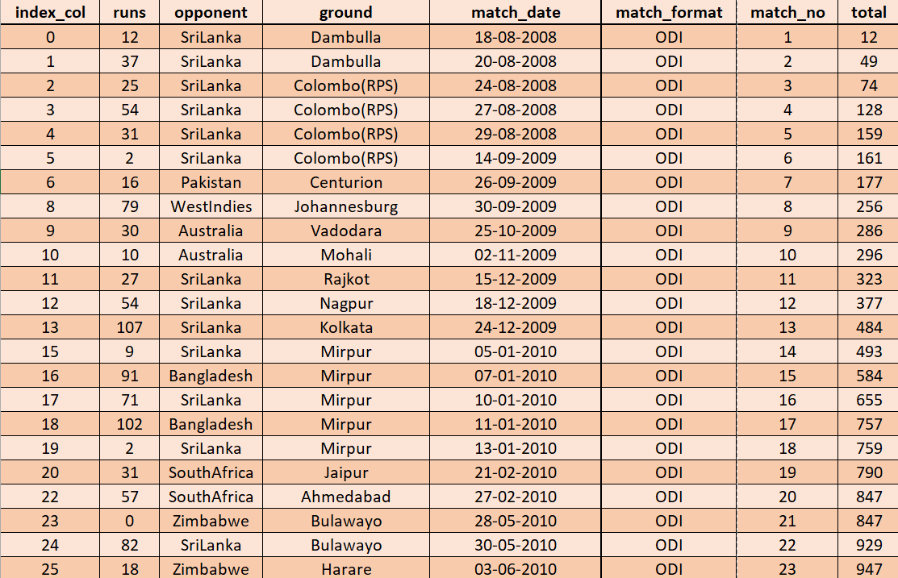
04
Data Information

Slide 6
05
SQL Queries for Insights
Total Runs Against Each Opponent
Total Runs Scored on Each Ground
Total Runs Scored in a Specific Year
Average runs per match format
Matches Played Against a Specific Opponent

Slide 7
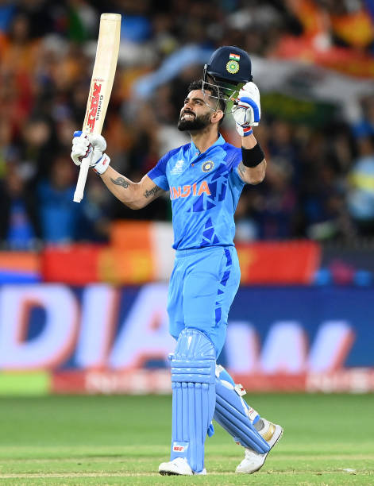
06
Key Performance Indicators
Total Runs
Highest Score
23,709
254
Centuries
Half-Centuries
70
122

Slide 8
07
Insights and Analysis
1
2
3
Total Runs Against Top Opponents
Total Runs in Each Format.
Top Grounds By Maximum Runs
4
5
6
Highest Runs Against Each Opponent
Total Number of Centuries and Half-Centuries
Total Average in Different Formats

Slide 9
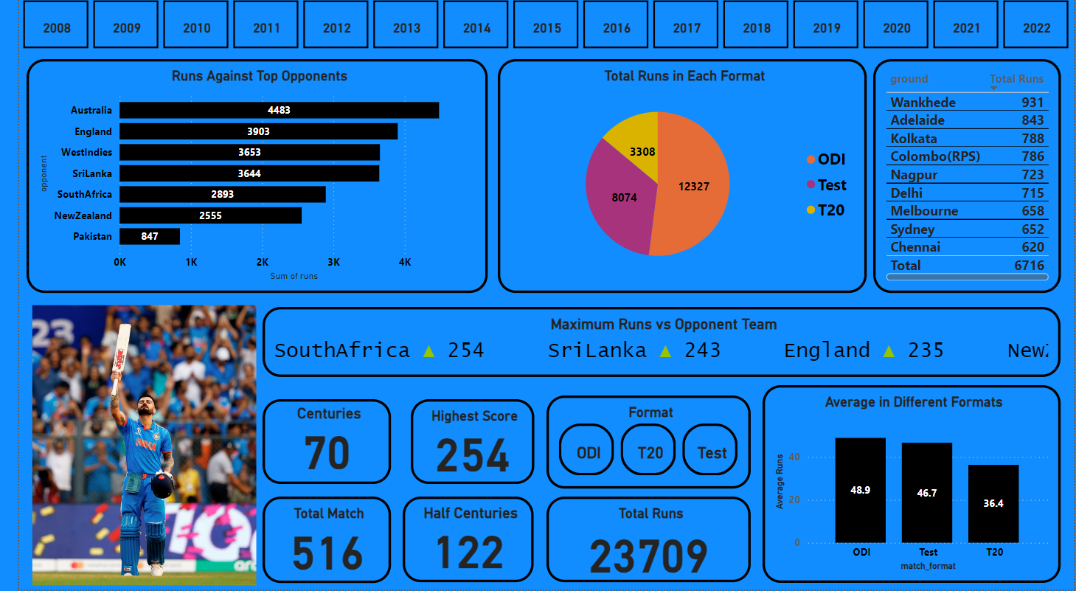
08
Dashboard

Slide 10
09
Conclusion
This Power BI dashboard not only highlights the extraordinary consistency and versatility of Virat Kohli across different formats and venues but also provides valuable insights into his performance trends over time. By analyzing key metrics such as total runs, average runs, and ground-specific achievements, we gain a deeper appreciation of Kohli's strategic approach and adaptability on the field. The visual representation of this data allows us to see patterns that might otherwise be overlooked, reinforcing the importance of data analytics in sports performance analysis. As Virat Kohli continues to build his legacy, this dashboard serves as a testament to his impact on cricket and a tool for predicting future performances based on historical data.

