Slide 1


Credit Card Transaction Analysis
This project delves into analyzing credit card transaction data to extract valuable insights and trends.

Slide 2

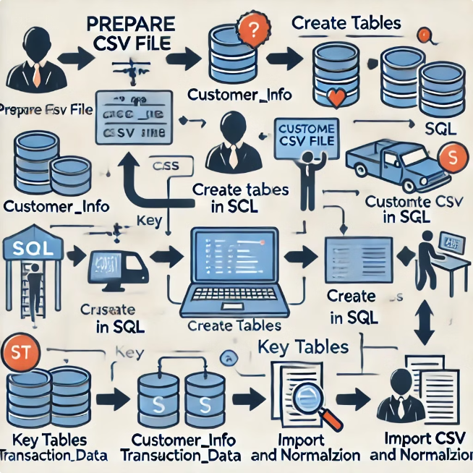
Data Import and Preparation
1
CSV File Preparation
The raw credit card transaction data was initially stored in a CSV format, containing details such as revenue, transaction count, expenditure type, and customer information.
2
SQL Table Creation
A well-defined SQL database schema was designed to store the data in a structured manner. Key tables included cust_detail for customer information and cc_detail for transaction details.
3
CSV Import and Data Cleaning
The CSV file was imported into the SQL tables using the COPY command. Data cleaning and normalization steps were performed to ensure data quality and consistency for analysis.

Slide 3
Project Insights - Week 53 (31st Dec)
wow changes
Revenue increased by 28.8%.
Total Transaction Amt & Count increased by 2.63% & 3.59%.
Customer Count increased by 6.07%.
Overview YTD
overall revenue is 57M.
Total interest is 8M.
Total Transaction Amount is 46M.
Male customers are contributing in revenue with 31M than Female with 26M.
Blue and Silver credit & contributing to 93% of overall transactions.
TX,NY & CA is contributing to 68%.
Overall Activation rate is 57.5%.
Overall Delinquent rate is 6.06%.

Slide 4
Credit Card Transaction Analysis
This presentation has presented key insights from the credit card transaction data.
Thank you for your time.

