Slide 1
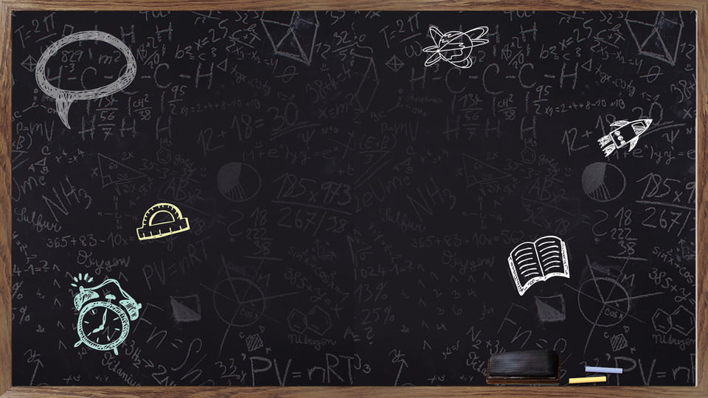
Communication skills
a presentation by Dhun Mehta

Slide 2

What is communication??
The word ‘Communication’ comes from the Latin word communicare which mean ‘to share’.
Communication is nothing but sharing information between two or more individuals or within a group .
Communication
Information
And
Opinions

Slide 3

Types of Communication
Non-Verbal
Communication
Verbal
Communication
Visual
Communication

Slide 4

Verbal communication
Verbal Communication is nothing but sharing of information using words.
Most people use it as a daily method of communication.
In Verbal communication , using the right words is extremely important so that we don't create a sense a confusion which will make it difficult to convey what we want to.

Slide 5
Forms of verbal Communication
Oral or Spoken
This type of verbal communication includes talking , like :
Face to face conversation
Talking on the phone
Classroom teaching
Business discussions and
Public speaking
Written
This type of verbal communication includes written or typed words, like:
Writing letters , notes , E-mails
SMS { Short Message Service }
Books
Magazines
Newspapers

Slide 6


Slide 7
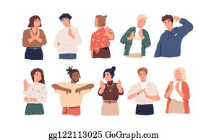
Non-verbal communication
No words are used in this type of communication .
In other words , it is communication without the use of a spoken language.
Non-verbal communication includes gestures, facial expressions, and body language, as well as unspoken understandings and presuppositions, and cultural and environmental conditions that may affect any encounter between people.

Slide 8
Non-verbal communication includes:
Facial Expressions : The facial expressions depict the mood of the person .
Body Posture : Proper body posture should be there . It shows your confidence.
Eye Contact : Proper eye contact depicts self belief which is important.
Voice Intonation / Paralanguage : Your Voice should have a proper speed and pitch , it should not be to fast or slow nor should it be to loud or to low .
Touch: It is advised to not touch anything without permission.
Space : There should be a proper amount of space between you and the person along .

Slide 9
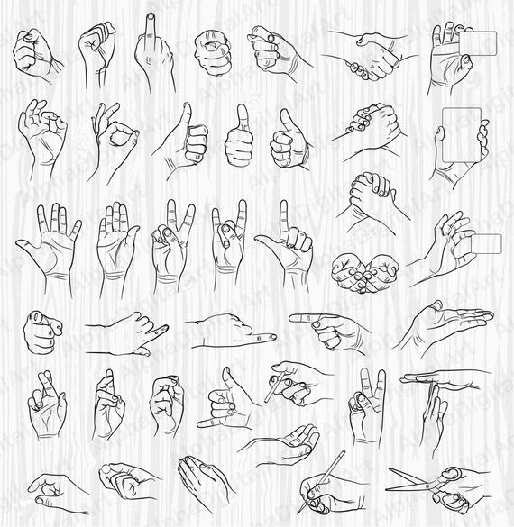

Slide 10

Visual communication
This type of communication can be done using images.
Here, no face to face conversation is required
For example ,
while travelling on the road , we come across various signs such as ‘slow down’ , ‘ speed limit’ etc. These show visual communication where no words or people are involved.

Slide 11
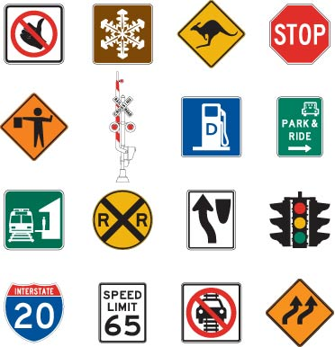

Slide 12
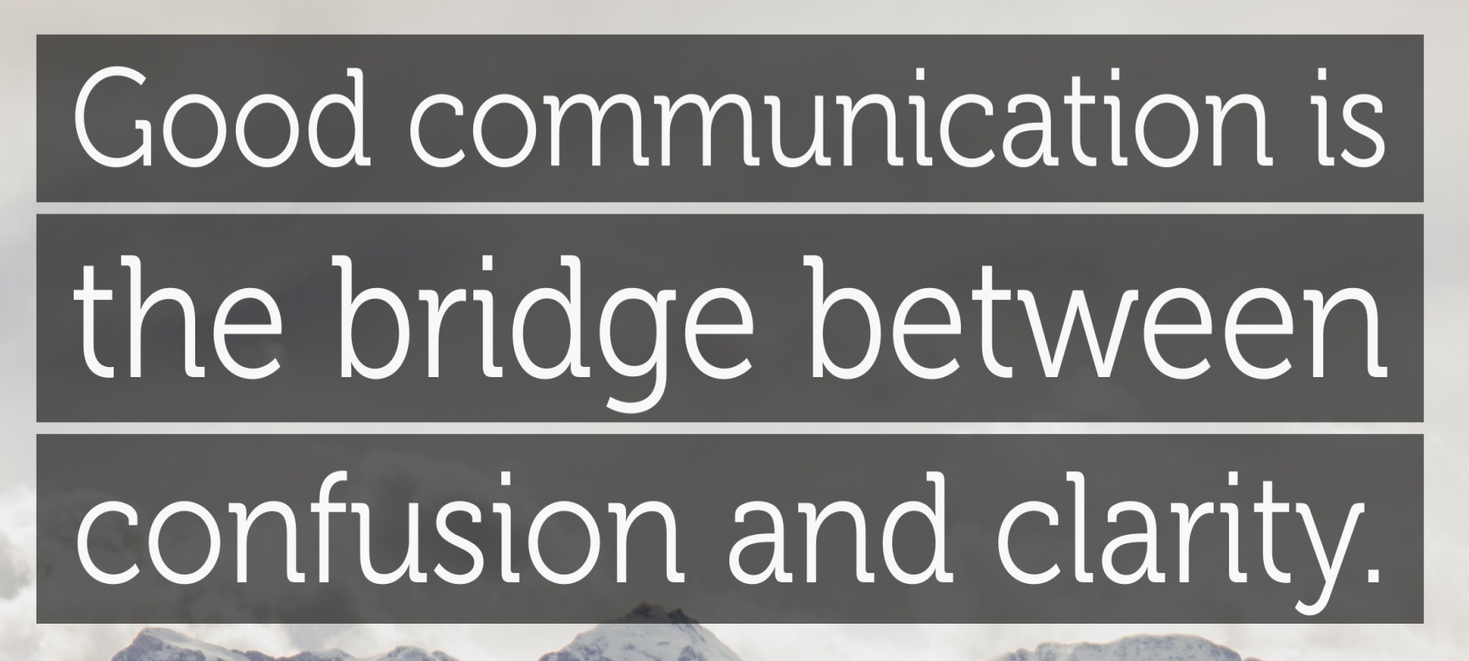

Slide 13
Thank You

