Slide 1
Meal-tech
Your own meal kit

Slide 2
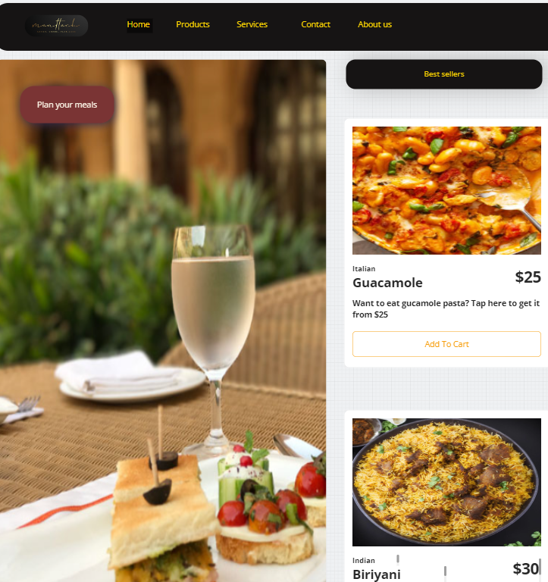
Home page selling different kits

Slide 3
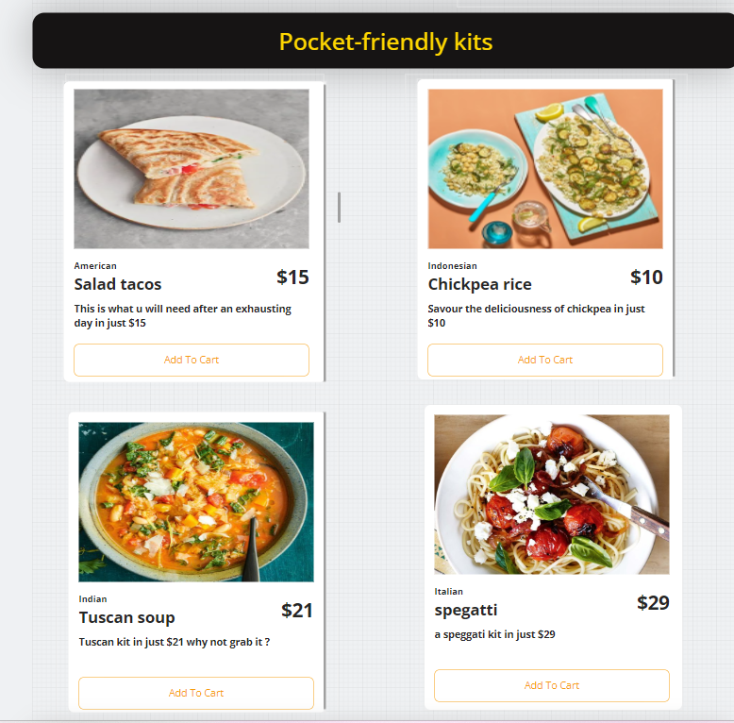
Pocket-friendly meals section

Slide 4
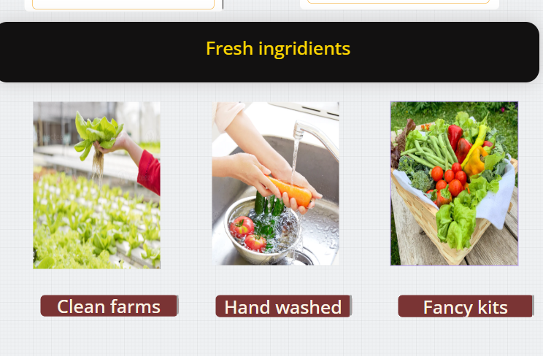
Our vision

Slide 5
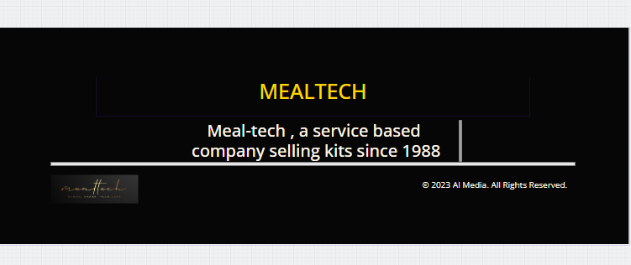
Our footer

Slide 6
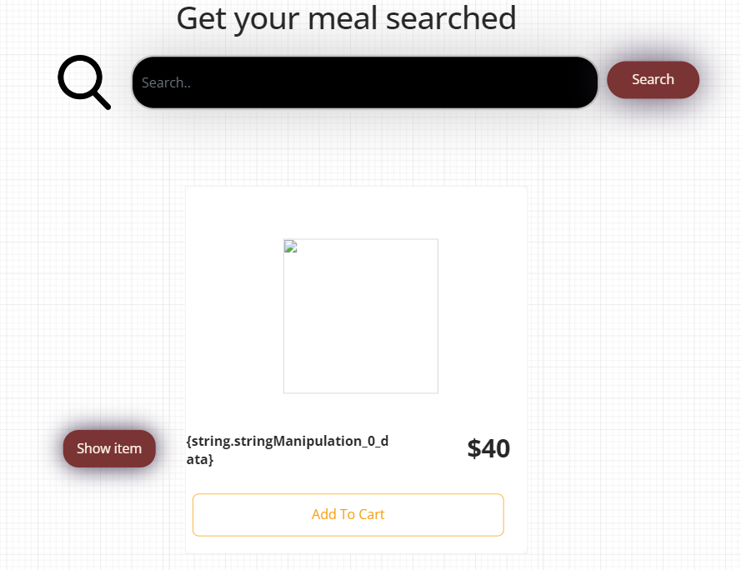
Product page ai generated image of meal and corresponding search request in show item

Slide 7
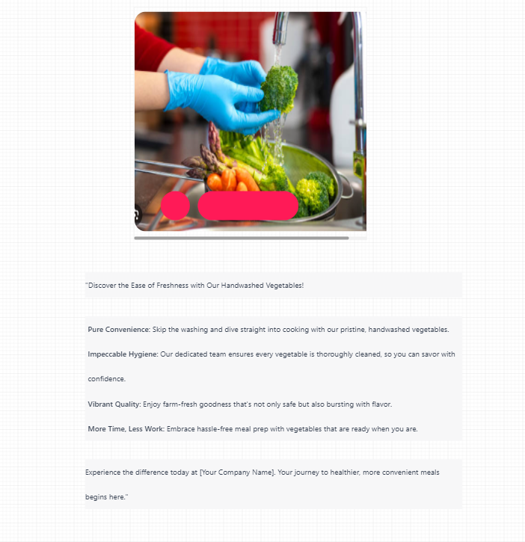
Handwashed section

Slide 8
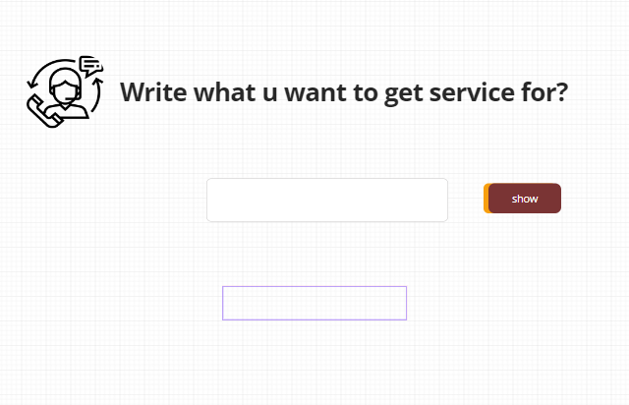
Serive link functionality , text to conent generator for asking any questions

