Slide 1
Customer Shopping
Behavior Analysis
End-to-end data analytics project: Python → MySQL → Power BI
3,900
$233K
10
customers analysed
total revenue
SQL business queries
Riya Cherian | Data Science Graduate | Bengaluru, India

Slide 2
Project Overview
What I set out to do, and how
The problem. A retail company has data on 3,900 customers and wants to know how they behave, so it can decide where to spend marketing money, what to promote, and how to build loyalty.
Questions answered
Who spends most (gender, age)? • Do subscribers spend more? • Which products rate best? • Which depend on discounts? • How loyal are customers? • Does shipping type matter?
1 Clean & explore
2 Analyse
3 Visualise
Python (Pandas), Jupyter
MySQL
Power BI
Checked data, fixed missing values, engineered features, loaded clean data to MySQL
10 queries using aggregations, subqueries, CTEs and window functions
Interactive dashboard with KPI cards, charts and slicers

Slide 3
Dataset & Python Cleaning
Exploratory data analysis in Jupyter
3,900 × 18
Problem found | What I did
37 missing review ratings | Filled with median of the same category
Messy column names | Converted to snake_case for SQL
No age segments | Created age_group (4 quartile bands)
Frequency stored as text | Created purchase_frequency_days
promo_code_used = discount_applied in every row | Dropped the redundant column
Data in a CSV file | Loaded 3,900 × 19 clean table into MySQL
rows and columns; each row is one customer
$59.76
average purchase (range $20–$100)
4 · 25 · 50
categories · items · US states
Result: 0 missing values, 19 clean columns, ready for SQL.

Slide 4
Data Analysis using SQL
10 queries in MySQL answering business questions
Techniques used
GROUP BY and aggregates
Subquery (above-average discounted orders: 839)
CASE WHEN (discount rate by product)
CTE (New / Returning / Loyal segments)
Window function ROW_NUMBER() OVER (PARTITION BY)
Selected results
Male $157,890 vs Female $75,191 revenue
Subscribers $59.49 vs non-subscribers $59.87 avg spend
Express $60.48 vs Standard $58.46

Slide 5
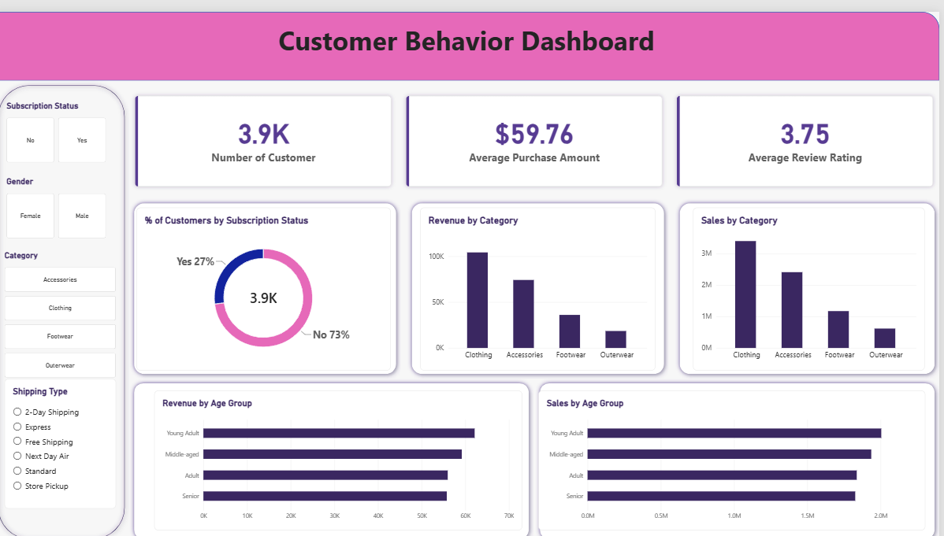
Data Visualization using Power BI
Interactive Customer Behavior Dashboard
What it contains
3 KPI cards: customers, avg purchase, avg rating
Subscription donut: 27% yes, 73% no
Revenue and sales by category
Revenue and sales by age group
4 slicers: subscription, gender, category, shipping type
Click any slicer and every chart updates, so managers can explore segments without writing SQL.

Slide 6
Key Insights
What the data says
68%
No uplift
of revenue is from men, but only because there are more male customers. Spend per customer: $59.54 men vs $60.25 women.
Subscribers spend $59.49 vs $59.87 for non-subscribers. Only 27% of customers subscribe.
80% vs 2%
43%
of customers are Loyal vs New: the base is loyal but not growing.
of purchases used a discount. Hats, Sneakers and Coats are discounted about half the time.
Also: young adults lead revenue (26.7%) but all age groups are close • Express shippers spend 3.5% more • Top-rated: Gloves, Sandals, Boots

Slide 7
Recommendations & Skills
From insight to action
Finding | Recommendation
Subscribers spend no more | Redesign member benefits (early access, free-shipping threshold)
Only 2% new customers | Run acquisition campaigns; use loyal base for referrals
Women: 32% of customers, same spend per person | Target women in best-selling categories
About 50% discounts on Hat, Sneakers, Coat | A/B test smaller or fewer discounts to protect margin
Express shippers spend more | Promote Express at checkout
Skills demonstrated: Python (Pandas, SQLAlchemy) • SQL (CTEs, window functions) • Power BI (DAX, slicers) • Business storytelling

