Slide 1
MLSA PROJECT
Created by: Riya Deshmankar
Section-C
rollno.-2300290100212
Branch CSE

Slide 2
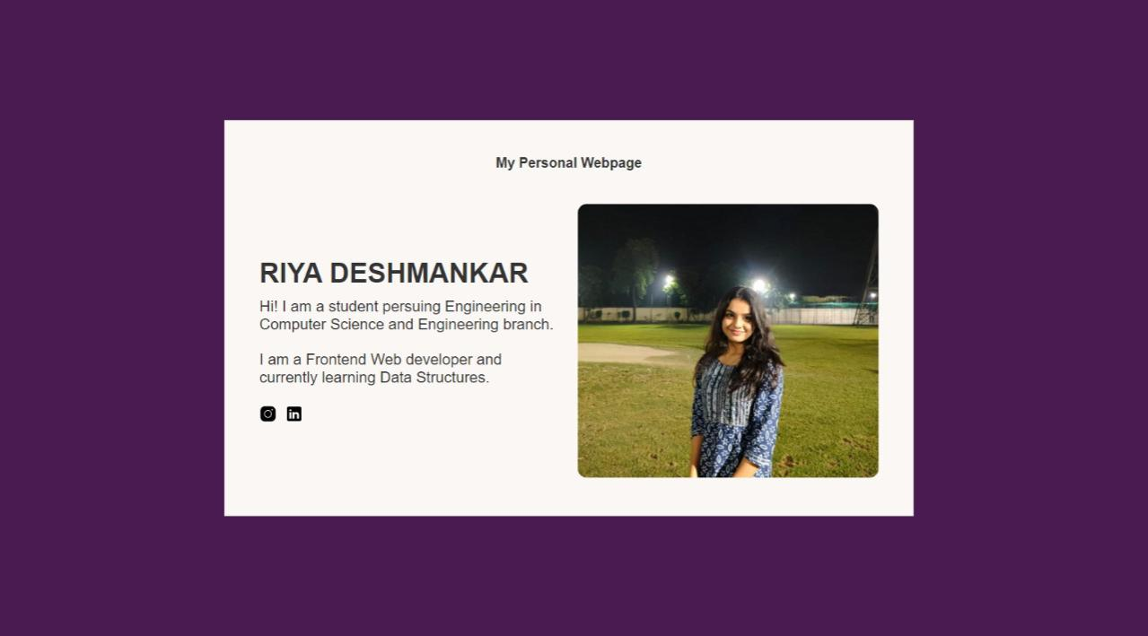
Create a simple personal webpage

Slide 3
This personal webpage is created using basic html and css.
I have used many tags like <img> tag to insert image and
<a> tag to create links.

Slide 4
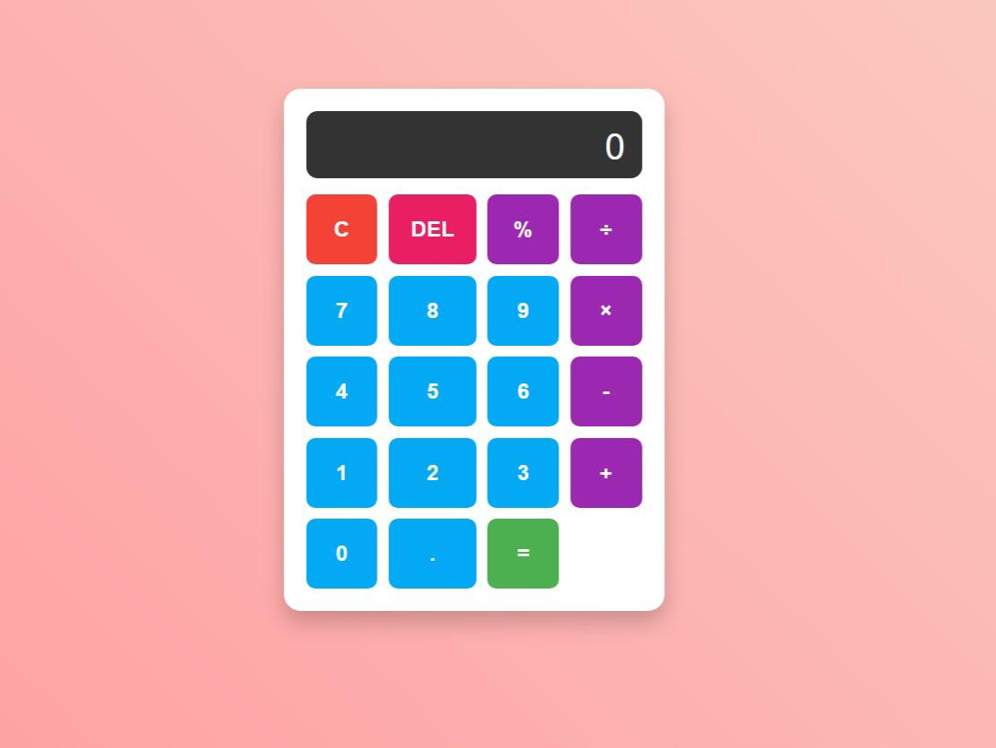
Create a simple calculator

Slide 5
This calculator is made using HTML, CSS and Javascript.
In this I have used Javascript basics to create Functions.
This calculator can perform addition, subtraction, multiplication
and division of simple numbers.

Slide 6
THANKYOU

