Slide 1

Employee Management System
A Comprehensive Solution for Managing Employee Data
Presented by: Riya Garg Employee ID: 206624
Notes:
office

Slide 2

Introduction
1
What is the EMS?
The Employee Management System is a software solution designed to help businesses manage employee data efficiently.
2
Key Objectives
It allows organizations to add, update, delete, and view employee information in a centralized MySQL database, ensuring data accuracy and efficiency.

Slide 3

Key Features
Employee Registration
Employee Login
Employees can register by providing personal details, and the system automatically generates secure passwords.
Employees securely log in using their assigned ID and password, ensuring authorized access to their information.
View Employees
Update/Delete Employees
The system allows viewing all employee records or retrieving specific details based on their ID.
Employee details can be easily modified or removed from the system as needed.

Slide 4
Technologies Used
Backend
User Interface
MySQL: Secure and reliable database for storing employee records.
The system currently utilizes a Command-Line Interface (CLI), providing a text-based interaction for user input and output.
Python: Used for application logic and operations, interacting with the MySQL database using mysql-connector-python library.

Slide 5
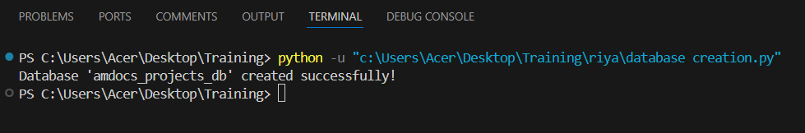
Database Creation
cursorObject.execute("CREATE DATABASE amdocs_projects_db")
The database is created using a SQL query executed through the Python connector. The output message confirms successful database creation.

Slide 6
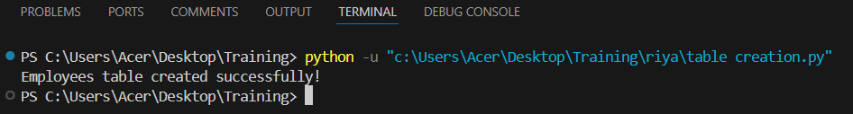
Employee Table Creation
employeeRecord = """CREATE TABLE EMPLOYEES( ID INT AUTO_INCREMENT PRIMARY KEY, FIRST_NAME VARCHAR(45) NOT NULL, LAST_NAME VARCHAR(45) NOT NULL, DATE_OF_BIRTH DATE NOT NULL, ADDRESS VARCHAR(255), CONTACT VARCHAR(15), PASSWORD VARCHAR(20))"""
The EMPLOYEES table is created with columns for employee ID, name, date of birth, address, contact, and password. The table is designed to store essential employee information.

Slide 7
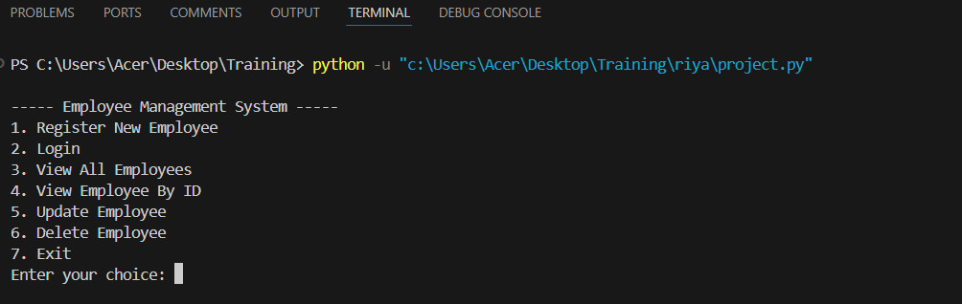
Project Menu

Slide 8


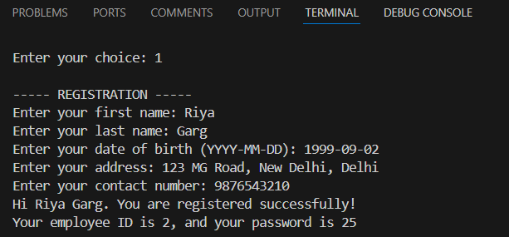
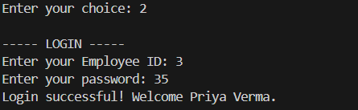
Registration & Login
Registration
Login
New employees provide their personal information during registration. The system automatically generates a unique and secure password.
Registered employees can log in using their unique ID and password, granting them access to their data and system functionalities.

Slide 9
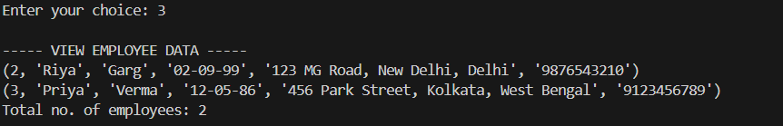
View Employees
View All Employees
Displays a list of all registered employees, including formatted date of birth.

Slide 10
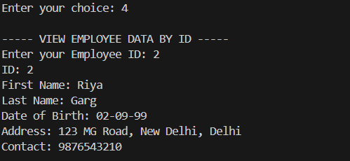
View Employee By ID
View by ID
Retrieves and displays specific employee details based on their unique ID.

Slide 11


Update and Delete Employees
Update Details
Employee information can be modified, such as changing their address or contact details.
Delete Employee
Employees can be removed from the system using their ID, ensuring data integrity and accuracy.

Slide 12
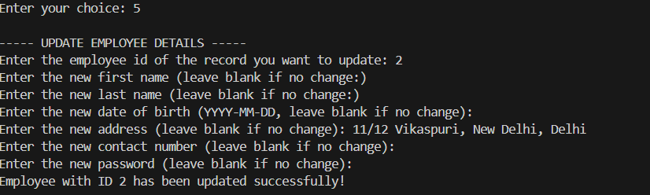
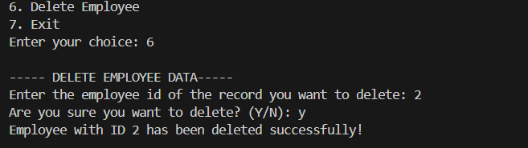
Update and Delete Employees
Update Details
Delete Employee

Slide 13
Thank You!

